Slide 1
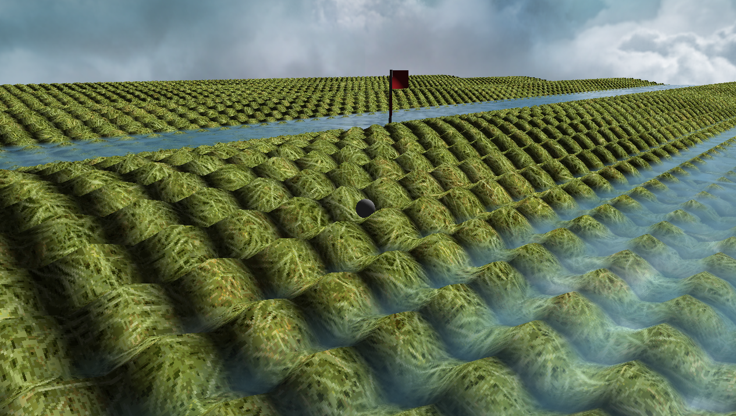
Crazy Putting phase 3
René Steeman
Aaron SchapirA
Ivan Poliakov
Jean Janssen
Matthijs Kusters
Haoran Luan

Slide 2
The challenge
1. Having a random error in the initial position and velocity of the ball, including an analysis of the impact on the bot’s performance.
2. Handling different (unknown) coefficients of friction and making sure the bot can handle them.
3. Allow for balls that can both fly and bounce, as well as improvements to the bot so it can handle these new options.
4. Improve the bot to handle complex terrains like mazes.
5. Implement collision detection.
Notes:
Jean

Slide 3
Table of contents
1. Game Engine
2. Physics and experiments
3. Bots and experiments
4. Collision Detection?
5. Conclusion

Slide 4
Our questions
1. Is it possible to create a realistic putting game that can be played by an AI?
2. What is a good physics solver that can be used in real-time?
3. What kind of AI can be used in order to play the game?
4. What kind of engine is required to show the game, create terrain defined by a height function and allow a human to play?

Slide 5
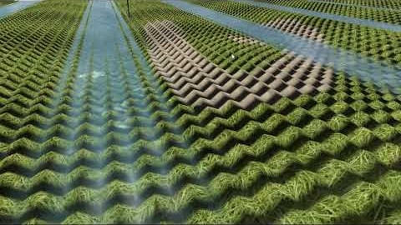
Game Engine
We have made our own openGL-based game engine with support for the following features:
Dynamic terrain generation
Real-time editing
Collision detection
Realistic lighting
Water with special effects (du/dv maps, reflections, depth effect)
3D model support (.obj)
Third person camera

Slide 6
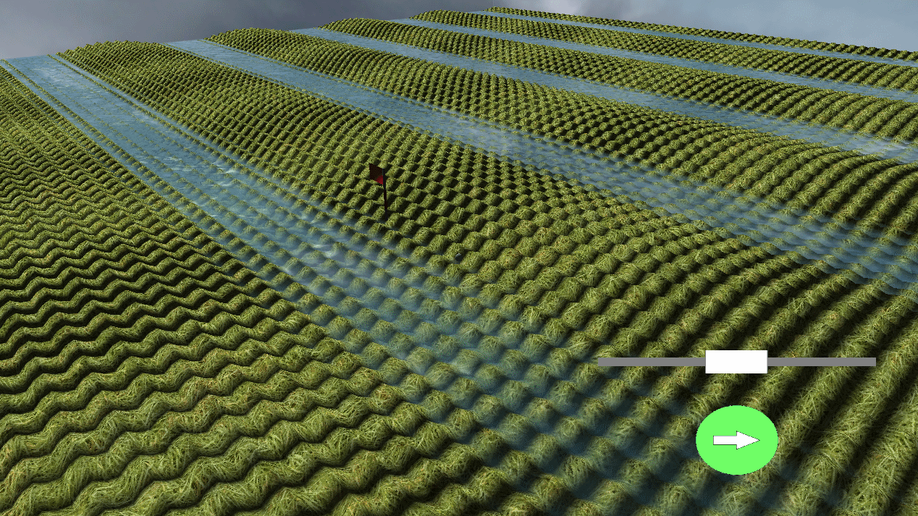
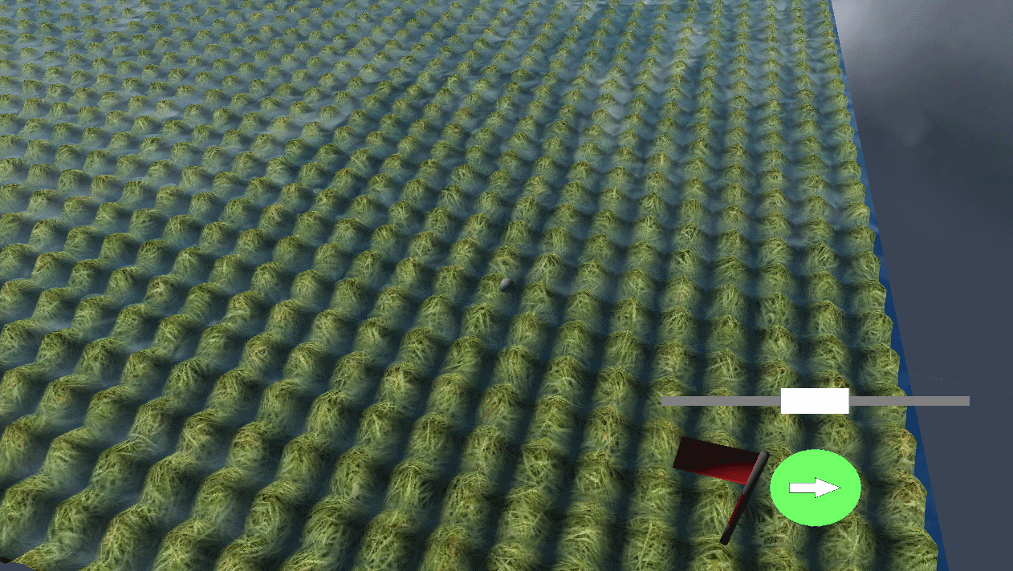
Terrain generation
Given a mathematical function with the variables x and y we can generate a terrain during runtime.

Slide 7
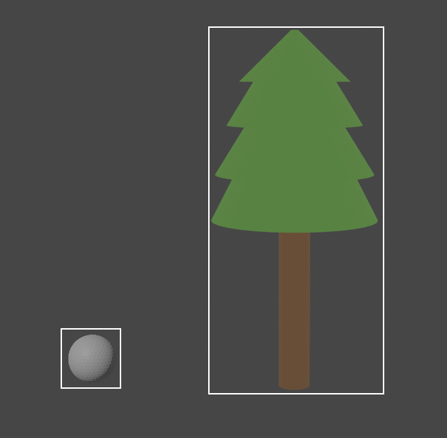
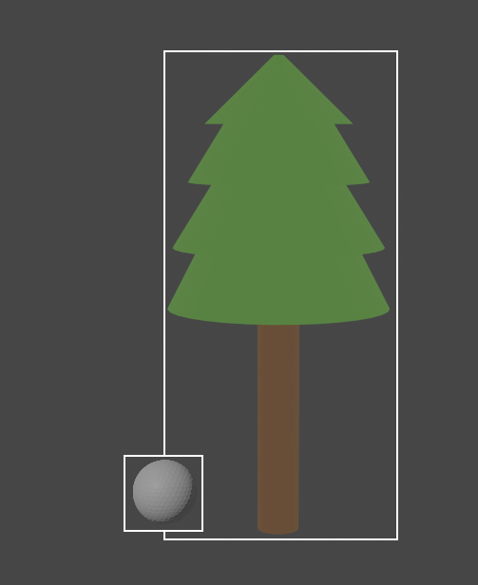
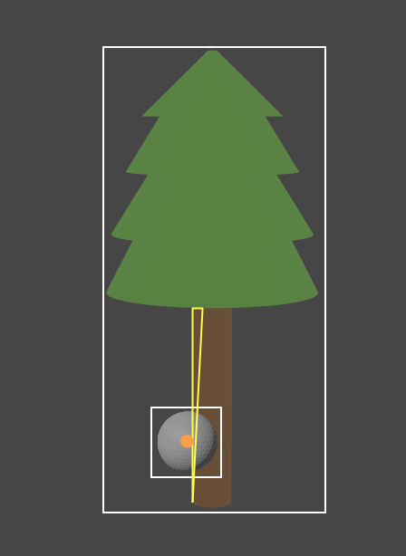
Collision detection
Stages:
1. Check if the smallest possible box around an object, that still contains every point making up the model, overlaps with that of the ball.
2. Check if the actual mesh is colliding with the ball
No collision
Possible collision
Collision

Slide 8
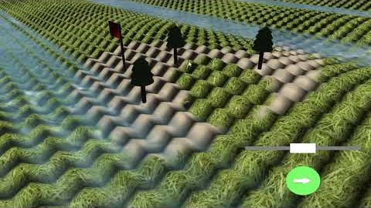
Live saving and loading
Notes:
Should it be there?

Slide 9
Our solvers
We rewrote the entire physics engine to improve the way it interacts with the rest of the game. We also added 3 new solvers to improve the accuracy of our calculations.
Second order Verlet
Second order velocity Verlet
Classical 4th order Runge-Kutta

Slide 10

The formulas 2nd-order Verlet
p$\left(t+∆t\right)=2p\left(t\right)−p\left(t−∆t\right)+a\left(t\right)∆t^{2}+O\left(∆t^{2}\right)$
$a\left(t\right)= \frac{F(p\left(t\right), v\left(t\right))}{m}$
$v\left(t\right)=\frac{p\left(t+∆t\right)−p(t−∆t)}{2∆t}+O(∆t^{2})$
Notes:
First ask the examiners if they would like us to explain the formulas. Possibly skip this slide

Slide 11

The formulas 2nd-order Velocity Verlet
$p\left(t+∆t\right)=p\left(t\right)+v\left(t\right)∆t+\frac{1}{2}a(t)∆t^{2}$
$v\left(t+\frac{1}{2}∆t\right)=v\left(t\right)+\frac{1}{2}a\left(t\right)∆t$
$a\left(t+∆t\right)= \frac{F(p\left(t+∆t\right), v\left(t+∆t\right))}{m}$
$v\left(t+∆t\right)=v\left(t+\frac{1}{2}∆t\right)+\frac{1}{2}a(t+∆t)∆t$
Notes:
First ask the examiners if they would like us to explain the formulas. Possibly skip this slide

Slide 12
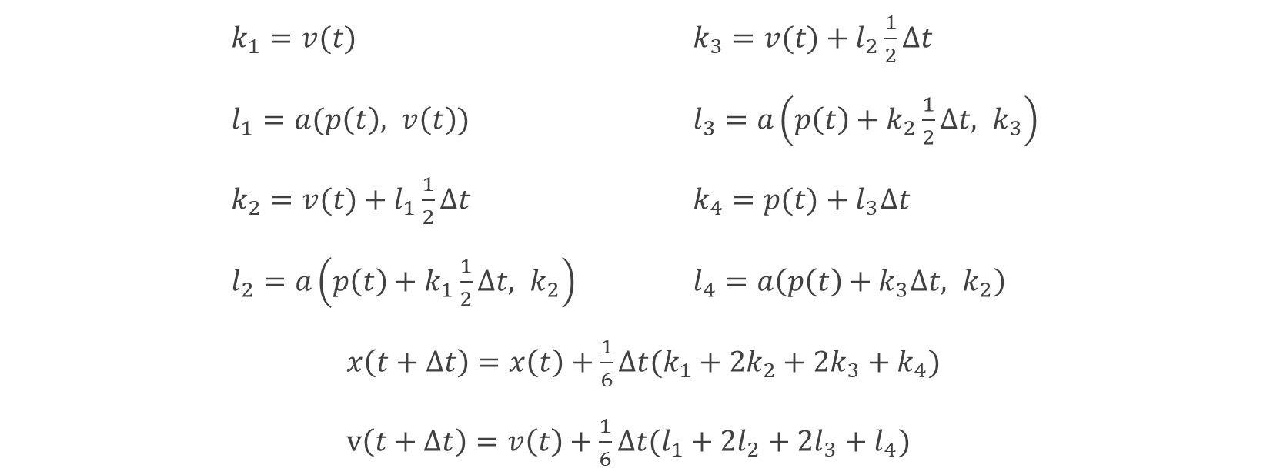
The formulas Classical 4th-order Runge-Kutta
$k_{1}=v(t)$ $k_{3}=v(t)+l_{2}\frac{1}{2}∆t$
$l_{1}=a(p\left(t\right), v\left(t\right))$ $l_{3}=a\left(p\left(t\right)+k_{2}\frac{1}{2}∆t, k_{3}\right)$
$k_{2}=v(t)+l_{1}\frac{1}{2}∆t$ $k_{4}=p(t)+l_{3}∆t$
$l_{2}=a\left(p\left(t\right)+k_{1}\frac{1}{2}∆t, k_{2}\right)$ $l_{4}=a\left(p\left(t\right)+k_{3}∆t, k_{2}\right)$
$x\left(t+∆t\right)=x\left(t\right)+\frac{1}{6}∆t(k_{1}+2k_{2}+2k_{3}+k_{4})$
$v\left(t+∆t\right)=v\left(t\right)+\frac{1}{6}∆t(l_{1}+2l_{2}+2l_{3}+l_{4})$
Notes:
First ask the examiners if they would like us to explain the formulas. Possibly skip this slide

Slide 13
Flying balls
process(double deltaTime, (Vector position, Vector velocity))
FOR time=0 TO time=deltaTime
IF !isFlying(position)
THEN velocity = redirectVelocity(position, velocity)
calculate next position and velocity
update position and velocity
return (position, velocity)

Slide 14
Bouncing balls

Slide 15
Precision experiment

Slide 16
Speed experiment

Slide 17
Bot
- New bot explanation

Slide 18
Experiments
- TODO

Slide 19
Conclusion

Slide 20
Questions

Slide 21
Sources

