Slide 1
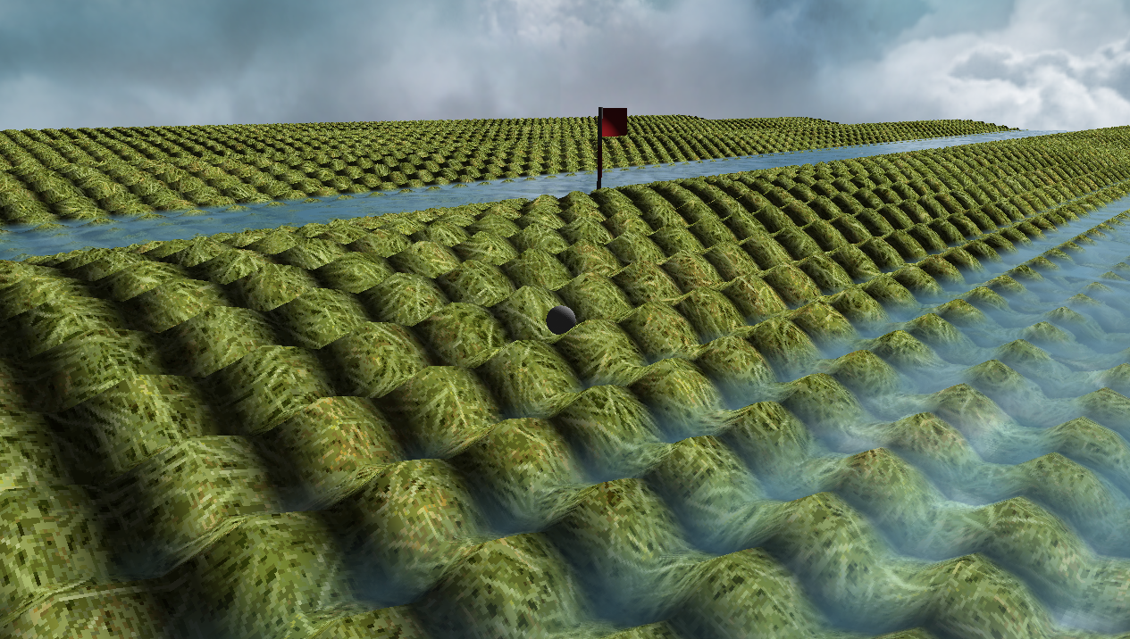
Crazy Putting phase 3
René Steeman
Aaron SchapirA
Ivan Poliakov
Jean Janssen
Matthijs Kusters
Haoran Luan

Slide 2
The challenge
1. Having a random error in the initial position and velocity of the ball, including an analysis of the impact on the bot’s performance.
2. Handling different (unknown) coefficients of friction and making sure the bot can handle them.
3. Allow for balls that can both fly and bounce, as well as improvements to the bot so it can handle these new options.
4. Improve the bot to handle complex terrains like mazes.
5. Implement a collision detection.
Notes:
Jean

Slide 3
Table of contents
1. Game Engine
2. Physics and experiments
3. Bots and experiments
4. UML Diagram?
5. Collision Detection?
6. Saver Loader system?
7. Conclusion

Slide 4
‘Find a name’
1. Is it possible to create a realistic putting game that can be played by an AI?
2. What is a good physics solver that can be used in real-time?
3. What kind of AI can be used in order to play the game?
4. What kind of engine is required to show the game, create terrain defined by a height function and allow a human to play?

Slide 5
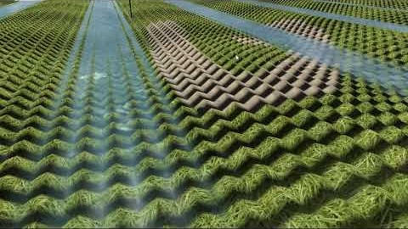
Game Engine

Slide 6
Our game engine
We wrote our own game engine based on OpenGL. This means that we made everything from creating a window, a way to render our 3D world, allowing the use of textures, adding a system for importing 3D models, lighting calculations, a third person camera and so on our selves.
To put next to the video

Slide 7
Physics
- Flying balls explanation by Matthijs the genius

Slide 8
Experiments
- TODO

Slide 9
Bot
- New bot explanation

Slide 10
Experiments
- TODO

Slide 11
UML Diagram
- Should we do it?
Notes:
Is it a good idea to put this in the presentation?

Slide 12
Collision Detection?
- TODO
Notes:
Since it was one of the requirements for this phase I think we should talk about it.
Placement of the slide to check.

Slide 13
Save Loader system?
Notes:
Should it be there?

Slide 14
Conclusion

