Slide 1
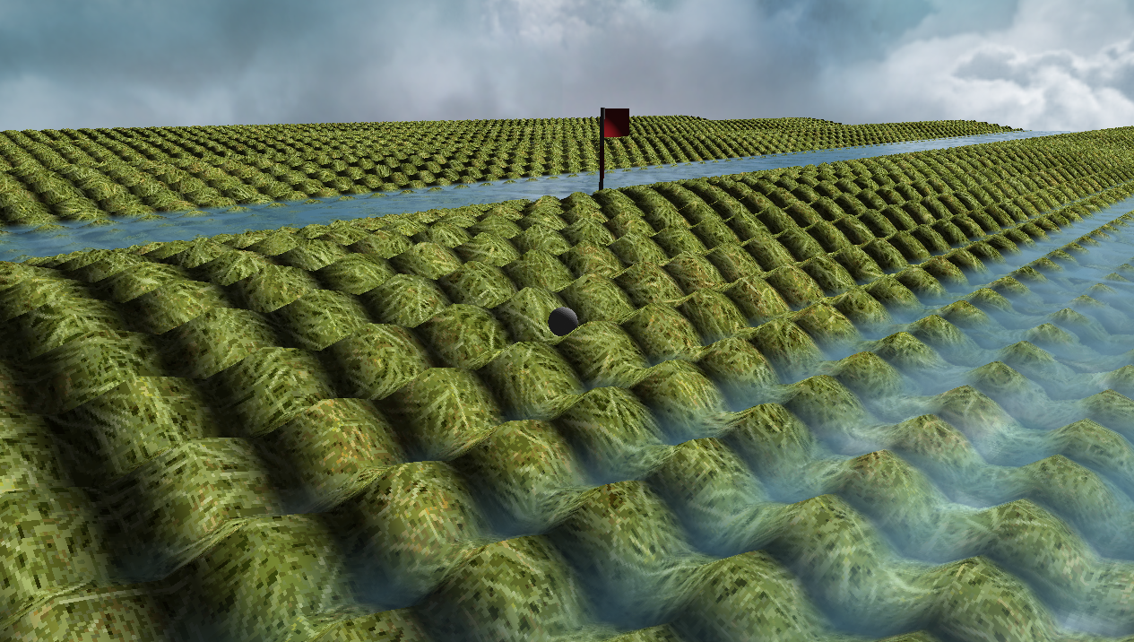
Crazy Putting Phase 3
René Steeman
Aaron SchapirA
Ivan Poliakov
Jean Janssen
Matthijs Kusters
Haoran Luan
Notes:
Haoran

Slide 2
The challenge
Implement collision detection.
Improve the bot to handle complex terrains like mazes.
Having a random error in the initial position and velocity of the ball, including an analysis of the impact on the bot’s performance.
Allow for balls that can both fly and bounce, as well as improvements to the bot so it can handle these new options.
Handling different (unknown) coefficients of friction and making sure the bot can handle them.
Notes:
Jean

Slide 3
Table of contents
1. Game Engine
2. Physics
3. Bots
4. Conclusion
Notes:
Jean

Slide 4
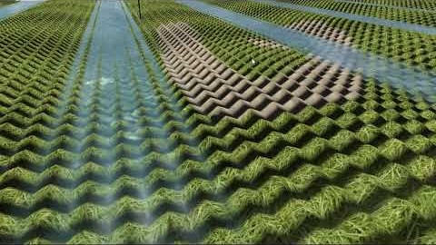
Game Engine
We have made our own openGL-based game engine with support for the following features:
Dynamic terrain generation
Real-time editing
Collision detection
Realistic lighting
Water with special effects (du/dv maps, reflections, depth effect)
3D model support (.obj)
Third person camera

Slide 5
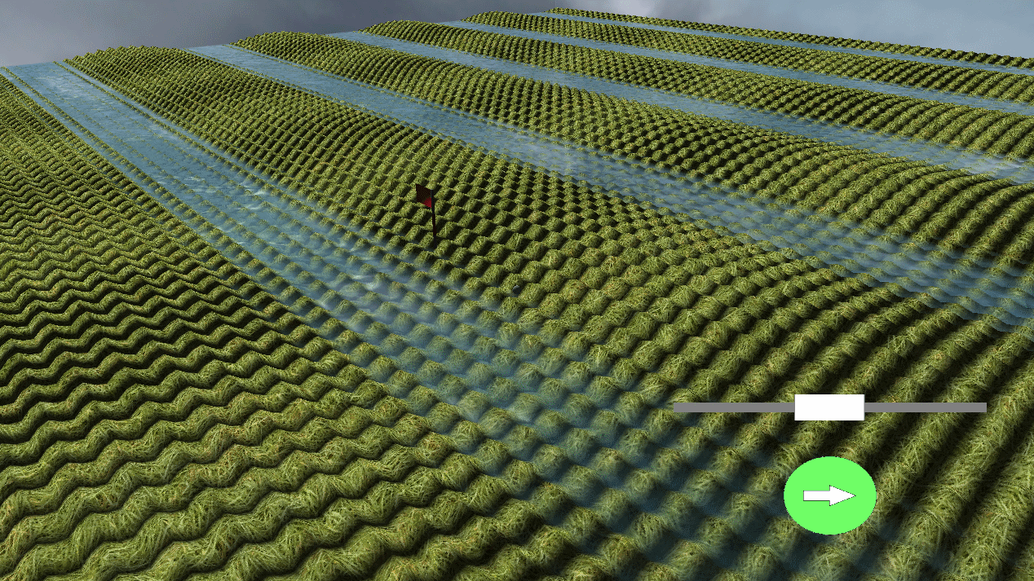
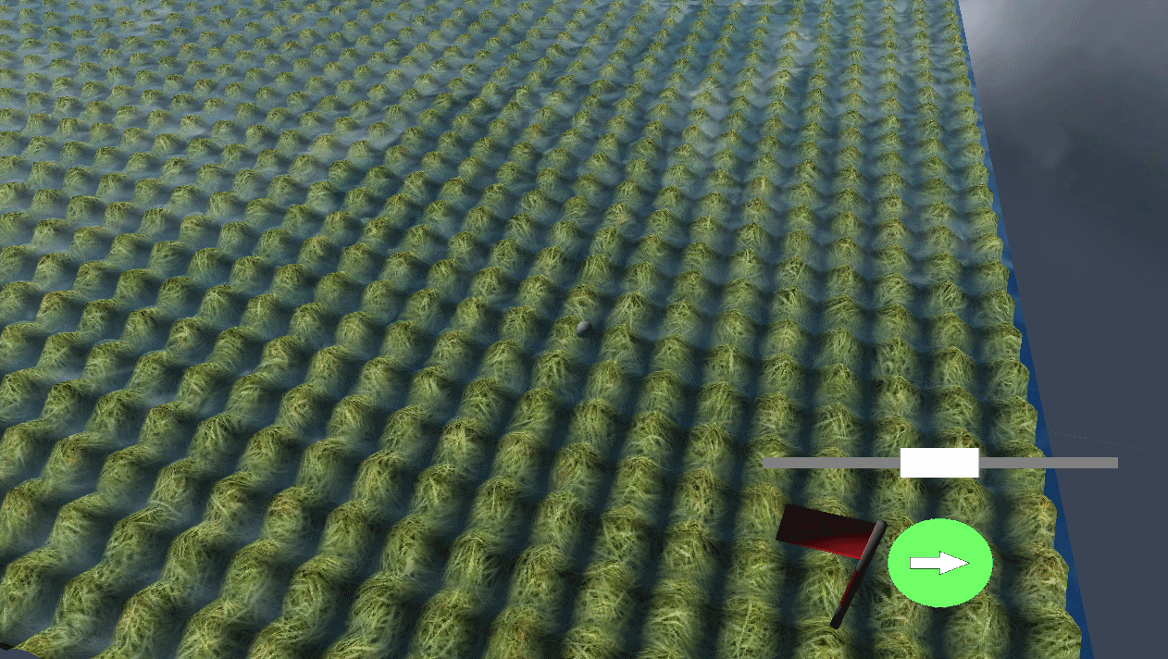
Terrain generation
Given a mathematical function with the variables x and y we can generate a terrain during runtime.

Slide 6
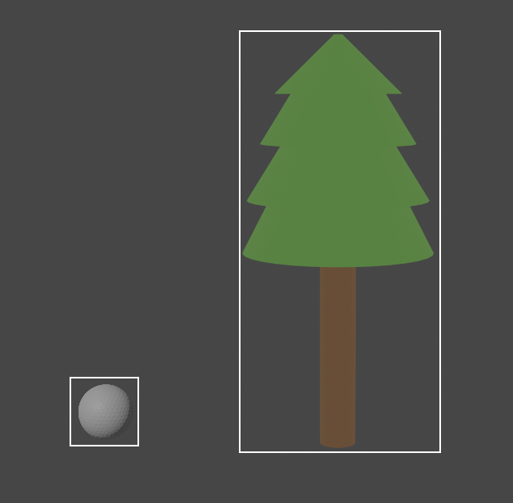
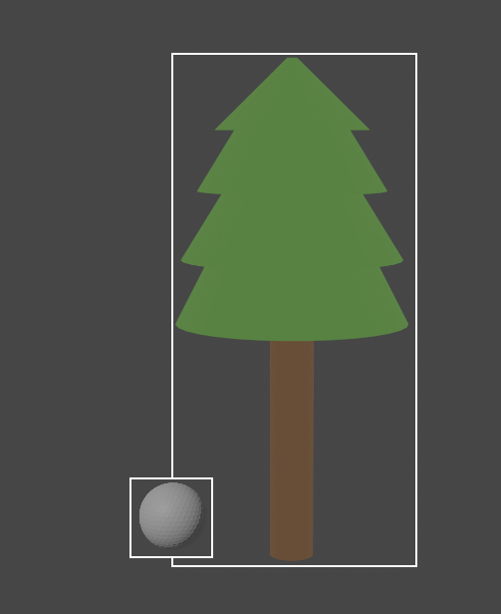
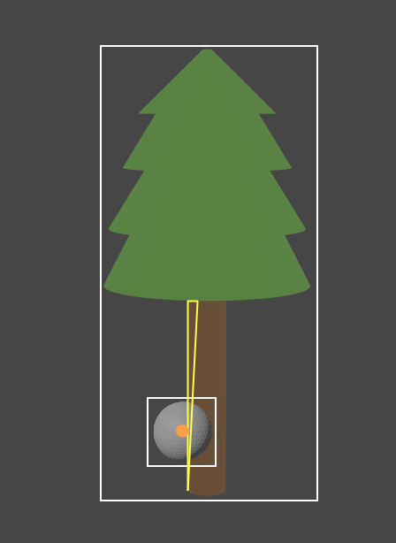
Collision detection
Stages:
1. Check if the smallest possible box around an object, that still contains every point making up the model, overlaps with that of the ball.
2. Check if the actual mesh is colliding with the ball
No collision
Possible collision
Collision
Notes:
Aaron
Third image:
Once we know that the boxes overlap, we check if any of the faces collides.
We do this by projecting the ball onto the face and check if this projection is closer to the centre of the ball than the size of the ball. If this is the case, we have a collision and return the normal vector of the face that the ball collided with.

Slide 7
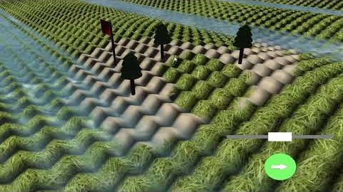
Live saving and loading
Notes:
Should it be there?

Slide 8
Our solvers
Last period we rewrote the entire physics engine to improve the interaction with the game. We also added 1 solver to improve the accuracy of our calculations.
Classical 4th order Runge-Kutta

Slide 9
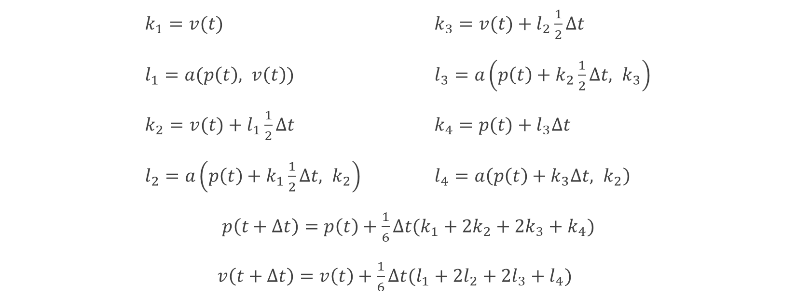
The formulas Classical 4th-order Runge-Kutta
$k_{1}=v(t)$ $k_{3}=v(t)+l_{2}\frac{1}{2}∆t$
$l_{1}=a(p\left(t\right), v\left(t\right))$ $l_{3}=a\left(p\left(t\right)+k_{2}\frac{1}{2}∆t, k_{3}\right)$
$k_{2}=v(t)+l_{1}\frac{1}{2}∆t$ $k_{4}=p(t)+l_{3}∆t$
$l_{2}=a\left(p\left(t\right)+k_{1}\frac{1}{2}∆t, k_{2}\right)$ $l_{4}=a\left(p\left(t\right)+k_{3}∆t, k_{2}\right)$
$p\left(t+∆t\right)=p\left(t\right)+\frac{1}{6}∆t(k_{1}+2k_{2}+2k_{3}+k_{4})$
$v\left(t+∆t\right)=v\left(t\right)+\frac{1}{6}∆t(l_{1}+2l_{2}+2l_{3}+l_{4})$

Slide 10
Flying and bouncing balls
process(double deltaTime, (Vector position, Vector velocity))
FOR time=0 TO time=deltaTime
IF !isFlying(position)
THEN velocity = redirectVelocity(position, velocity)
calculate next position and velocity
update position and velocity
return (position, velocity)

Slide 11
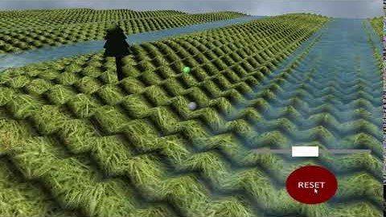
Bouncing ball video

Slide 12

Flying acceleration
In the horizontal directions:
$F_{net}=−F_{D}$ → $ma=−\frac{1}{2}C_{D}ρA{\dot{x}}^{2}$
$a=−\frac{C_{D}ρA{\dot{x}}^{2}}{2m}$
→ $a=−\frac{C_{D}ρA{\dot{y}}^{2}}{2m}$
In the vertical direction:
$F_{net}=−F_{g}−F_{D}$ → $ma=−mg −\frac{1}{2}C_{D}ρA{\dot{z}}^{2}$
$a=−g−\frac{C_{D}ρA{\dot{z}}^{2}}{2m}$

Slide 13
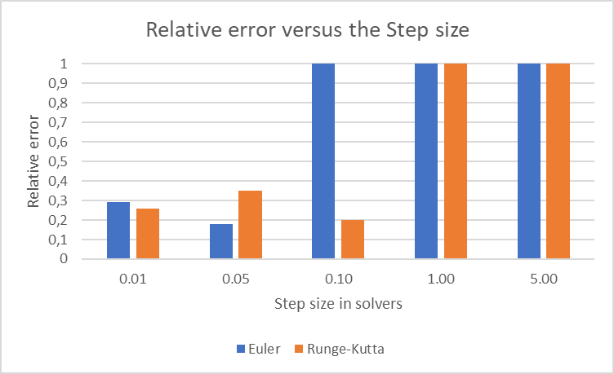
Precision experiment
Notes:
Jean

Slide 14
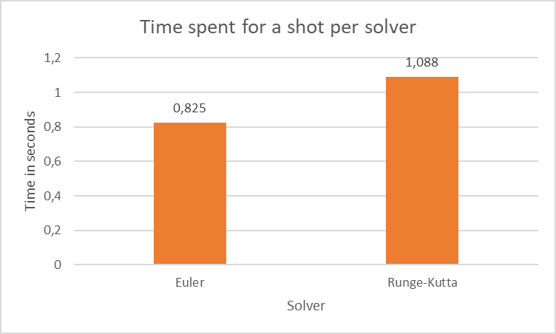
Speed experiment
Notes:
Jean

Slide 15
Bots
Random error
Different coefficients of frictions

Slide 16
Single Shot Bot
Finds the location of the flag
Computes shots in the area of the flag and stores the successful ones
For each successful shot stored, it aims to try the perfect velocity
If there is an obstacle between the ball and the flag, it will shoot the ball with a wider angle
If no hole in one solution is possible, it won’t find a solution.
O(maxVelocity / (degree step * velocity step))

Slide 17
BFS Graph Bot
Olivera Popović. (2020). Breadth-First Search [gif]. Stack Abuse https://stackabuse.com/graphs-in-java-breadth-first-search-bfs/
O(grid * the number of outcoming shots * shot complexity + grid)

Slide 18
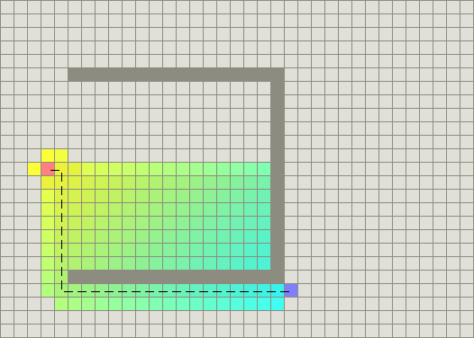
A* Bot
From http://theory.stanford.edu/~amitp/GameProgramming/AStarComparison.html by Stanford, date unknown

Slide 19

Experiments

Slide 20
Conclusion
Graphics engine
Collision detection
Physics solvers
Flying and bouncing balls
AI
Notes:
Aaron

Slide 21

Questions
Notes:
Aaron

Slide 22
Sources
[1] Inc Epic games. Chaos Destruction, accessed 10-06-2020. https://docs.unrealengine.com/en-US/Engine/Chaos/ChaosDestruction/ index.html.
[2] The AlphaStar. AlphaStar: Mastering the RealTime Strategy Game StarCraft II, accessed 10-06-2020. https://deepmind.com/blog/article/alphastar-mastering-real-time-strategy-game-starcraft-ii.
[3] Cass Everitt. Projective Texture Mapping [white paper], 2001. https://www.nvidia.com/en-us/drivers/Projective-Texture-Mapping/.
[4] Rene Truelsen.Real-time Shallow Water Simulation and EnvironmentMapping and Clouds. Universitetsparken 1, DK-2100 Copenhagen, Den-mark.
[5] Department of Data Science and Knowledge Engineer Maastricht University. Crazy Putting, 2019-2020.
[6] R.E.A. Bouwens, P.A.M. de Groot, W. Kranendonk, J.P. van Lune, C.M.Prop-van den Berg, J.A.M.H. van Riswick, and J.J. Westra. BiNaS.Groningen/Houten, The Netherlands, 6 edition, 2013. ISBN 978-90-01-81749-7.
[7] Anastas Ivanov and Juliana Javorova. THREE DIMENSIONAL GOLFBALL FLIGHT, 2017.
[8] Matthias Teschner. Simulation in Computer Graphics Particles. Computer Science Department University of Freiburg.https://cg.informatik.uni-freiburg.de/course_notes/sim_02_particles.pdf.
[9] Vadim Ivshin.Algorithm A* implementation.https://habr.com/en/post/331220/
[10] ITMO University.Algorithm A*.http://neerc.ifmo.ru/wiki/index.php
[11] PATH FINDING: A* OR DIJKSTRA’S?http://www.hindex.org/2014/p520.pdf
[12] Christian Holm. Simulation Methods in Physics 1. Institutefor Computational Physics University of Stuttgart, 2012-2013.https://www2.icp.uni-stuttgart.de/~icp/mediawiki/images/5/54/Skript_sim_methods_I.pdf.
Notes:
Computer

