Slide 1
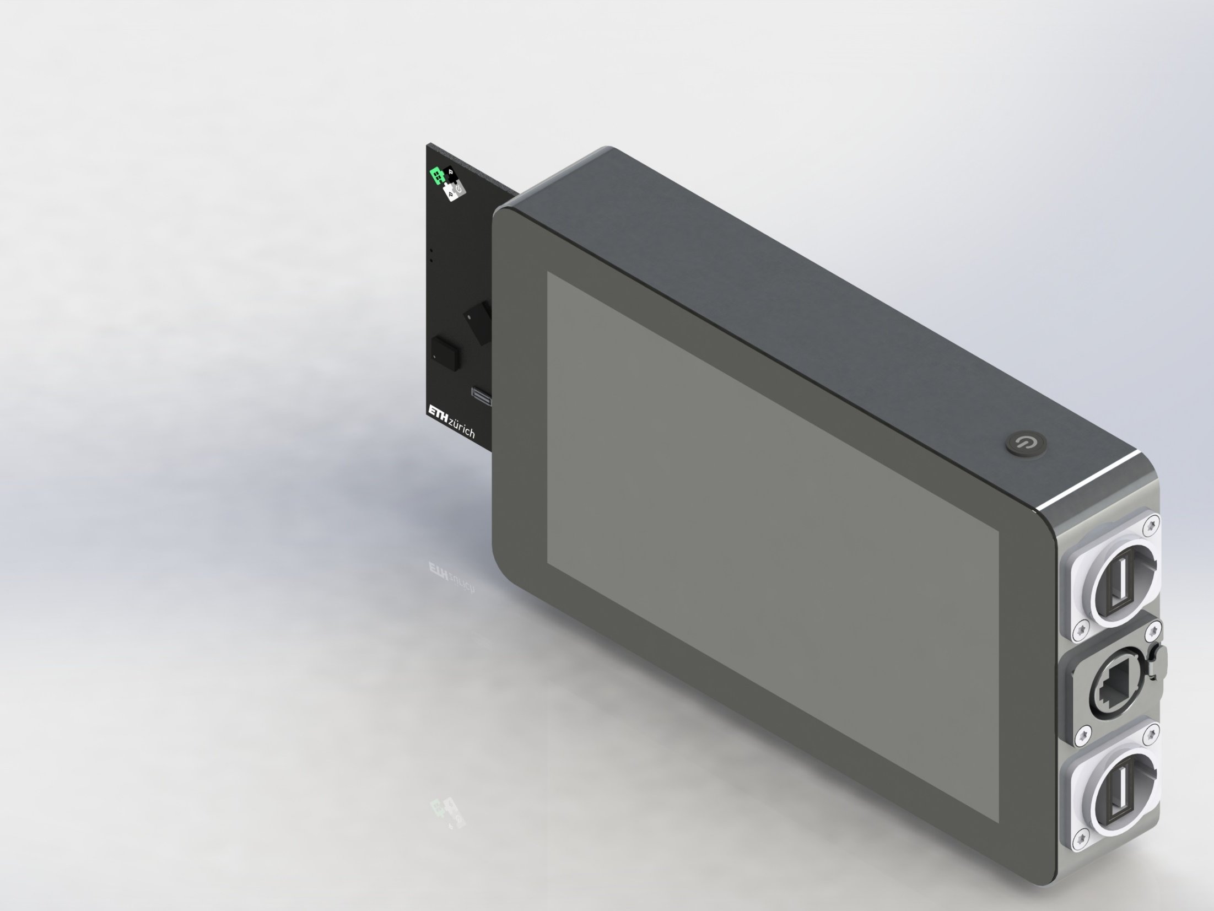
PULP Demonstrator

Slide 2
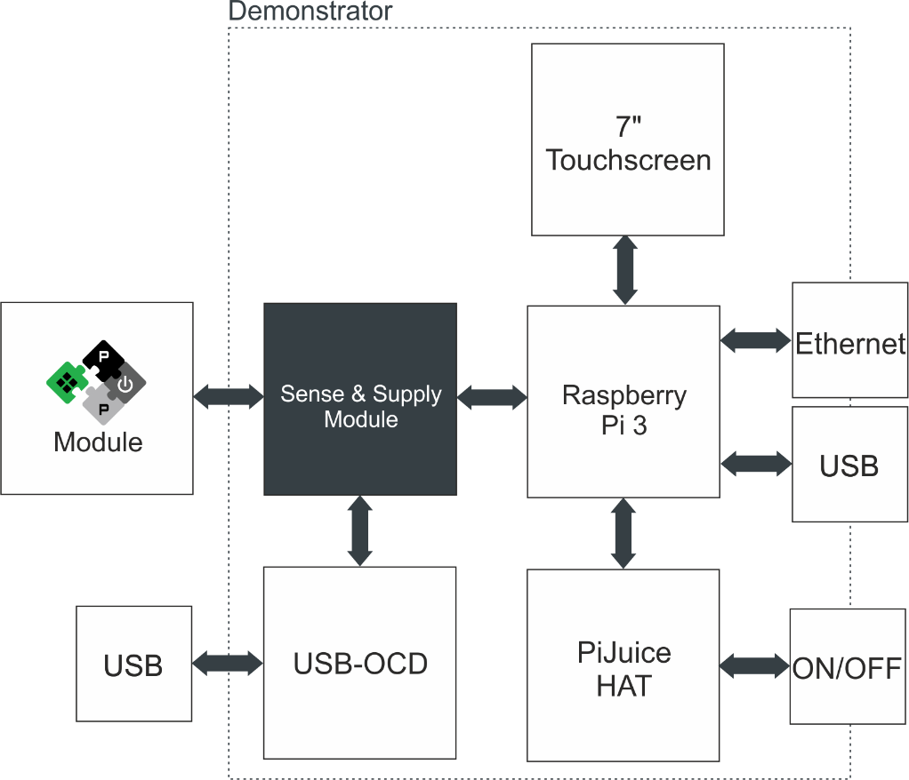
PULP Demonstrator – Block Diagram
Our ICs typically do not have a nonvolatile memory -> you have to supply them, flash your program and keep them supplied. To do so the connector needs the signal for a JTAG interface and in the housing must be space for this programmer + USB connection
https://www.olimex.com/Products/ARM/JTAG/ARM-USB-OCD-H/

Slide 3
PULP Demonstrator – Block Diagram
Somewhere must be a button to turn off the whole thing

Slide 4
PULP Demonstrator – Block Diagram
We need:
USB to supply/charge the demonstrator
A way to transfer easy data to and from the demonstrator (USB + Ethernet)
Nice would be to design the housing in a way that Bluetooth and WiFi is still working

Slide 5
PULP Demonstrator – Block Diagram
Connector selection:
The connection to the daughter board must be mechanical stable
Ideally it’s a common standard
In the pin definition 1.) keep enough GND pins 2.) separate digital from analog 3.) keep unused pins for future usage

Slide 6
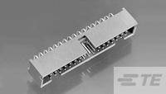
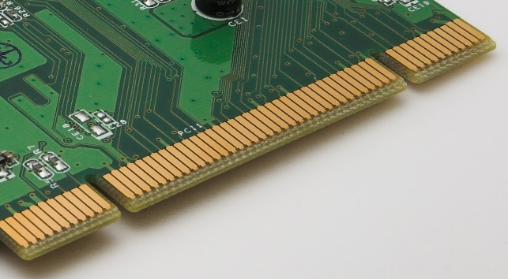
Connector Selection
Ideal would be a widely used box connector with 2.54mm pitch (unfortunately a female solder connector is not easy to find):
https://www.te.com/deu-de/product-1-5103311-0.html
Alternative is something in this direction. Or direct in card format without connector on daughter board side
https://www.te.com/deu-de/product-1734099-6.html
https://www.te.com/deu-de/product-1734098-6.html

Slide 7
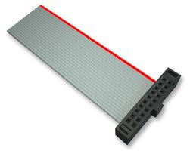
PULP Demonstrator – Block Diagram
This connection must not be rigid. You can use cables to design a thinner device

Slide 8
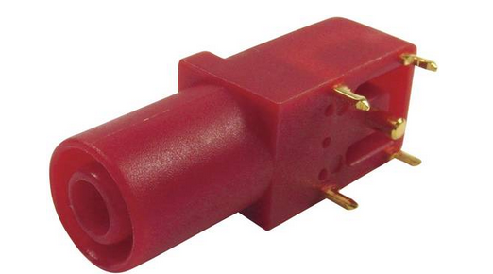
PULP Demonstrator – Block Diagram
Building a PULP daughter board is not necessary part of your thesis. This we decide depending on your progress. However we need a way to test your HW and show the performance -> At least a simple daughter board with this banana/lab connecters should be made

Slide 9
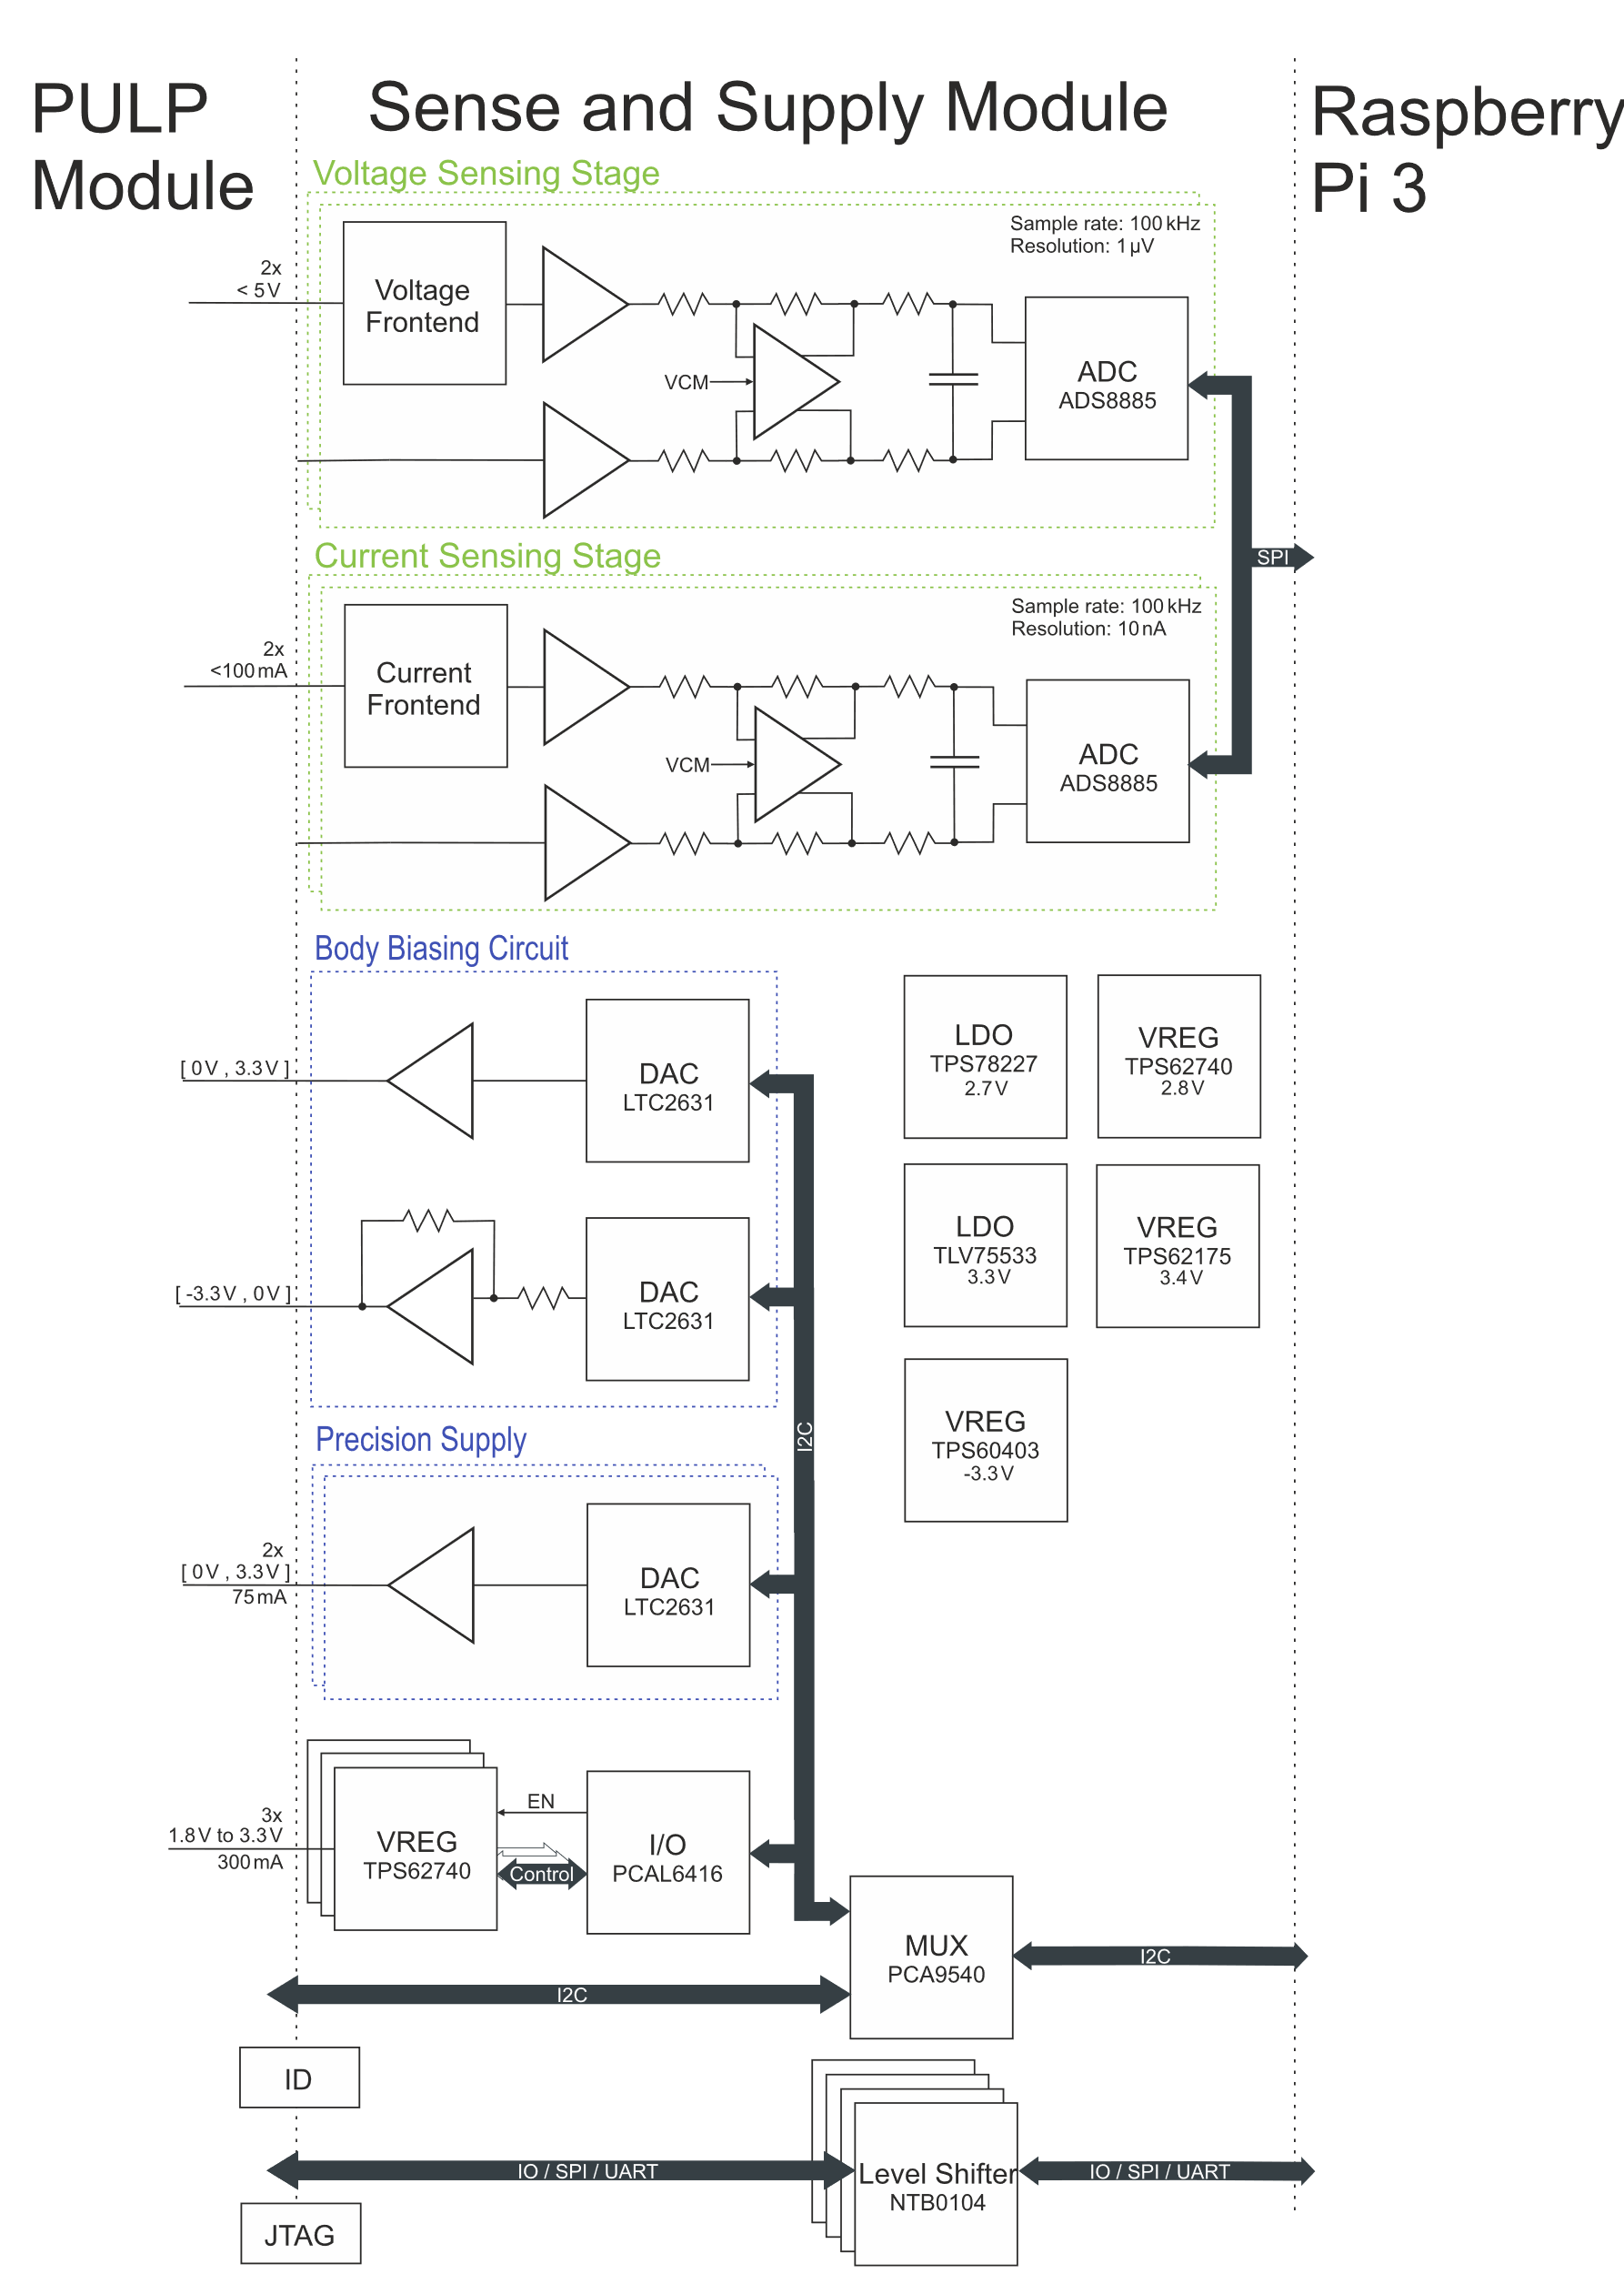
Your PCB
The power supply is not simple as you need multiple voltage levels including a decoupled and stable supply for the analog measurement part.
Common practice is a switching regulator (efficiency) followed by a LDO (stability). If you read the documentation of the TI sample project you will find a good explanation.
There is also a charge pump to get a dual supply for the body biasing circuit

Slide 10
Your PCB
Our ICs have typically a own supply for IOs. Never the less its not always 3.3V of the Rpi
-> all signals need level shifter.
The voltage level for the daughter board must come as input from the board
1.2 –> 3.3V
3.3V
V(VGPIO)

Slide 11
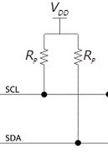
Your PCB
The PCAL6416 has a I2C voltage and a IO voltage.
as the TPS62740 will have 5V input voltage also the control pins should have 5V levels
The same is valid for the I2C signals. Here you will need multiple pull-up resistors to the right voltage level
5V
3.3V
3.3V
V(VGPIO)

Slide 12
Your PCB
I would recommend to take the analog input form this project:
TI Designs:TIDA-01012
Wireless IoT, Bluetooth® LowEnergy,4½ Digit,
100-kHzTrueRMSDigitalMultimeterReferenceDesign
It explains very nice the important parts, including design guide etc…
You will learn a lot by reading and partly replicating it.
(There are also more complex 24Bit examples but i think this will be sufficient)
There are two options:
a.) using a multiplexer to have different channels
b.) just build this part multiple times on your PCB
(The second will bring better results and is easier but will limit the number of channels )

Slide 13
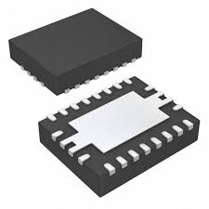
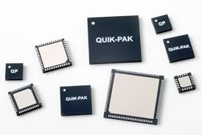
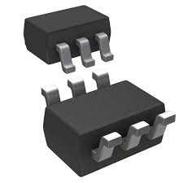
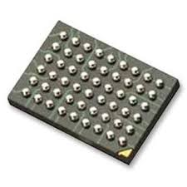
Which Component Packages?
It’s easy to design boards which are almost impossible to solder (especially without practice)
Depending on the availability (you will not get 100uF in a 0402 package) 0603 or 0402 is nice to solder -> we have also most resistors here
For ICs the best compromise between parasitics, soldering and size is QFN
-> I try to avoid packages with legs (however for opamps etc. this is not always possible. Its also a matter of taste.
-> We can solder BGAs, but typically they make the PCB more expensive (more layers lower pitch)

Slide 14
Software design
1.) setup linux
2.) play with kivy (if you don’t find a better alternative)
3.) connect a LTC2631(on a breakout board) and write the I2C driver
3.) if it is possible to the same for the other I2C ICs
4.) write the driver to SPI ADC
5.) make a fully working demo
Find a user-friendly way to configure the voltages
It should be a demonstrator -> the configuration must be somehow password controlled
Find ways to visualize your data
6.) If the basics work perfect think about how to support different daughter boards. How configurations can be stored. How new GUIs can be implemented
7.) The ultimate application for now is to get a video stream via SPI. Would you be able to read this data and show it on the LCD?
SW design should be independent from the HW design process!

Slide 15
Mechanical design
-> be aware that the workshop will need time
1.) think about the best suited way to fit everything inside.
2.) find connectors, buttons etc. How can be everything accessible without big afford.
4.) Define together with HW board size, connector type, and connector position.
5.) Design a case under consideration of all information. Draw all important parts. (for most connectors etc. 3D files will be available. In Altium you can make a quick export without having the layout finished)
6.) During the drawing think about how the machine will manufacture it. Not everything is possible (min radii, machining direction, complexity of your design.. )
7.) Meeting with the workshop -> (adaption?) -> 3D printing
8.) if everything is perfect manufacturing in alu.
Case design should be as much independent as possible from the HW

