Slide 1
Technical Answer For Real World Problems
SWE1901
Faculty: SRINIVASA PERUMAL
TEAM MEMBERS:
HARIGANESH
DINESH KUMAR
KRISHNAA

Slide 2
PROBLEM STATEMENT
Developing an alternate Government processes to ease for issuing for permission, license or registration by Government Departments
Minimizing the processing time and Provide clear,sequential quidance to applicants regarding the necessary documentation for obtaining specific identity cards

Slide 3
Major Problems to Solve
Reduce physical interface required in the current process of grant of a permission, license or registration by government departments
Eliminate the need of submission of information multiple times to Government Departments

Slide 4
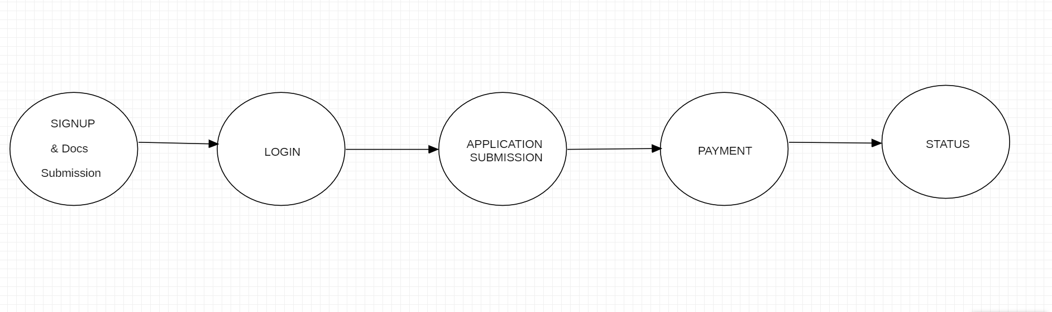
PHASES

Slide 5
