Slide 1
Spark for Beginners

Slide 2
What is Apache Spark?
Apache Spark is an open-source cluster computing framework for real-time processing. It has a thriving open-source community and is the most active Apache project at the moment. Spark provides an interface for programming entire clusters with implicit data parallelism and fault-tolerance.

Slide 3
Why Spark when Hadoop is already there?
The first of the many questions everyone asks when it comes to Spark is, “Why Spark when we have Hadoop already?“.
To answer this, we have to look at the concept of batch and real-time processing. Hadoop is based on the concept of batch processing where the processing happens of blocks of data that have already been stored over a period of time. At the time, Hadoop broke all the expectations with the revolutionary MapReduce framework in 2005. Hadoop MapReduce is the best framework for processing data in batches.
This went on until 2014, till Spark overtook Hadoop. The USP for Spark was that it could process data in real time and was about 100 times faster than Hadoop MapReduce in batch processing large data sets.

Slide 4
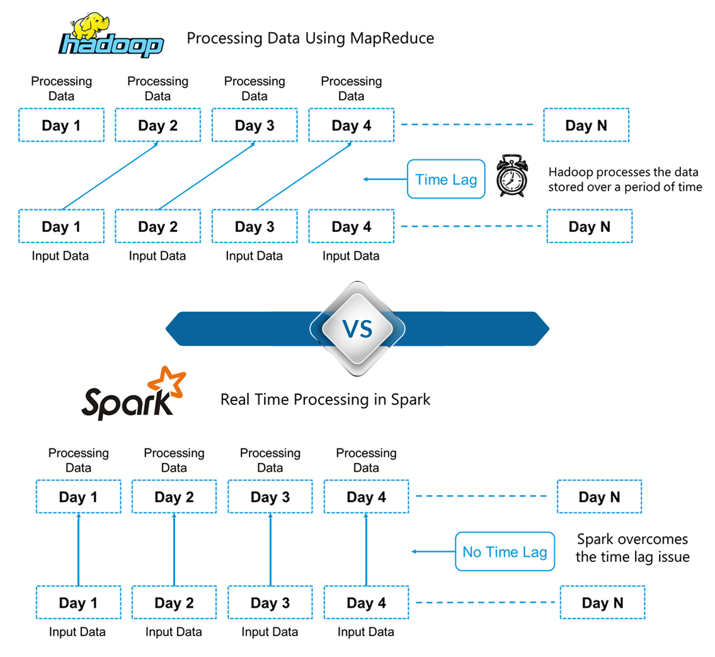

Slide 5
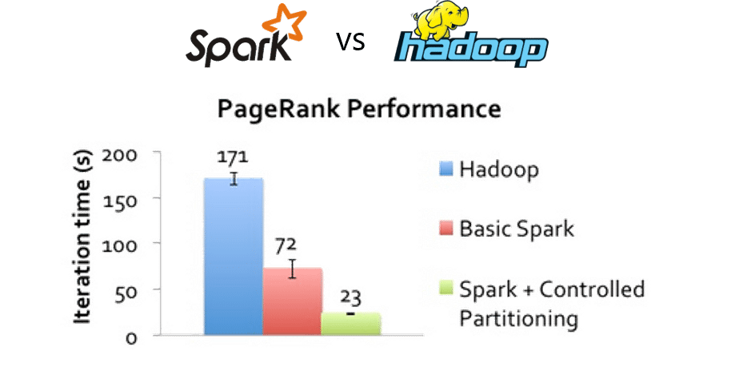
Features of Apache Spark
 | Speed: Spark runs up to 100 times faster than Hadoop MapReduce for large-scale data processing. Spark is able to achieve this speed through controlled partitioning. It manages data using partitions that help parallelize distributed data processing with minimal network traffic.

Slide 6
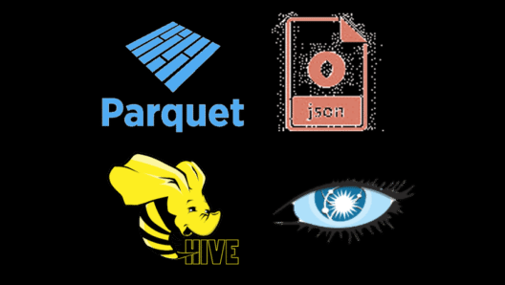

Multiple Formats:
Spark supports multiple data sources such as Parquet, JSON, Hive and Cassandra apart from the usual formats such as text files, CSV and RDBMS tables. The Data Source API provides a pluggable mechanism for accessing structured data though Spark SQL. Data sources can be more than just
simple pipes that convert data and pull it into Spark.
 | Lazy Evaluation: Apache Spark delays its evaluation till it is absolutely necessary. This is one of the key factors contributing to its speed. For transformations, Spark adds them to a DAG (Directed Acyclic Graph) of computation and only when the driver requests some data, does this DAG actually gets executed.

Slide 7
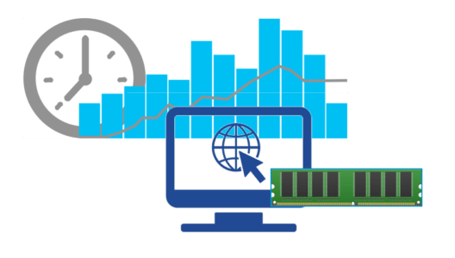
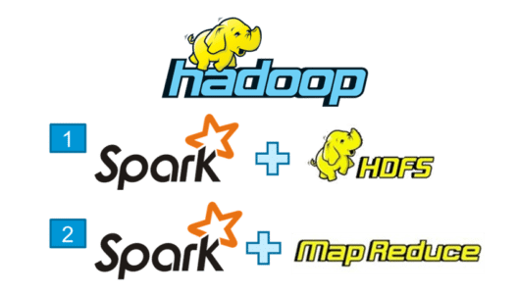
Real Time Computation: Spark’s computation is real-time and has low latency because of its in-memory computation. Spark is designed for massive scalability and the Spark team has documented users of the system running production clusters with thousands of nodes and supports several computational models.
Hadoop integration:
Apache spark provides smooth compatibility with hadoop. This is a boon
for all the Big data engineers who started their careers with hadoop.
Spark is a potential Replacement for the mapreduce functions of
hadoop, while spark has the ability To run on top of an existing hadoop
cluster using YARN for resource scheduling.

Slide 8

Spark Architecture

Slide 9
Components of Spark Run-time Architecture
Apache Spark Driver
The main() method of the program runs in the driver. The driver is the process that runs the user code that creates RDDs, and performs transformation and action, and also creates SparkContext. When the Spark Shell is launched, this signifies that we have created a driver program. On the termination of the driver, the application is finished. The driver program splits the Spark application into the task and schedules them to run on the executor. The task scheduler resides in the driver and distributes task among workers. The two main key roles of drivers are:
Converting user program into the task.
Scheduling task on the executor.
The structure of Spark program at a higher level is: RDDs consist of some input data, derive new RDD from existing using various transformations, and then after it performs an action to compute data. In Spark Program, the DAG (directed acyclic graph) of operations create implicitly. And when the driver runs, it converts that Spark DAG into a physical execution plan.

Slide 10
Apache Spark Cluster Manager
An external service for acquiring resources on the cluster (e.g. standalone manager, Mesos, YARN)
A cluster manager is just a manager of resources, i.e. CPUs and RAM, that SchedulerBackends use to launch tasks. A cluster manager does nothing more to Apache Spark, but offering resources, and once Spark executors launch, they directly communicate with the driver to run tasks.
Apache Spark Executors
The individual task in the given Spark job runs in the Spark executors. Executors launch once in the beginning of Spark Application and then they run for the entire lifetime of an application. Even if the Spark executor fails, the Spark application can continue with ease. There are two main roles of the executors:
Runs the task that makes up the application and returns the result to the driver.
Provide in-memory storage for RDDs that are cached by the user.
How Spark works Internally
Using spark-submit, the user submits an application.
In spark-submit, we invoke the main() method that the user specifies. It also launches the driver program.
The driver program asks for the resources to the cluster manager that we need to launch executors.
The cluster manager launches executors on behalf of the driver program.
The driver process runs with the help of user application. Based on the actions and transformation on RDDs, the driver sends work to executors in the form of tasks.
The executors process the task and the result sends back to the driver through the cluster manager.

Slide 11
Before we move further, let us start up Apache Spark on our systems and get used to the main concepts of Spark like Spark Session, Data Sources, RDDs, DataFrames and other libraries.
Spark Shell:
Spark’s shell provides a simple way to learn the API, as well as a powerful tool to analyze data interactively.
Spark Session:
In earlier versions of Spark, Spark Context was the entry point for Spark. For every other API, we needed to use different contexts. For streaming, we needed StreamingContext, for SQL sqlContext and for hive HiveContext. To solve this issue, SparkSession came into the picture. It is essentially a combination of SQLContext, HiveContext and future StreamingContext.
Data Sources:
The Data Source API provides a pluggable mechanism for accessing structured data though Spark SQL. Data Source API is used to read and store structured and semi-structured data into Spark SQL. Data sources can be more than just simple pipes that convert data and pull it into Spark.
RDD:
Resilient Distributed Dataset (RDD) is a fundamental data structure of Spark. It is an immutable distributed collection of objects. Each dataset in RDD is divided into logical partitions, which may be computed on different nodes of the cluster. RDDs can contain any type of Python, Java, or Scala objects, including user-defined classes.
Dataset:
A Dataset is a distributed collection of data. A Dataset can be constructed from JVM objects and then manipulated using functional transformations (map, flatMap, filter, etc.). The Dataset API is available in Scala and Java.

Slide 12
DataFrames:
A DataFrame is a Dataset organized into named columns. It is conceptually equivalent to a table in a relational database or a data frame in R/Python, but with richer optimizations under the hood. DataFrames can be constructed from a wide array of sources such as: structured data files, tables in Hive, external databases or existing RDDs.
RDD
How to Create RDDs in Apache Spark?
Resilient Distributed Datasets (RDD) is the fundamental data structure of Spark. RDDs are immutable and fault tolerant in nature. These are distributed collections of objects. The datasets are divided into a logical partition, which is further computed on different nodes over the cluster. Thus, RDD is just the way of representing dataset distributed across multiple machines, which can be operated around in parallel. RDDs are called resilient because they have the ability to always re-compute an RDD. Let us revise Spark RDDs in depth here. Now as we have already seen what is RDD in Spark, let us see how to create Spark RDDs. There are three ways to create an RDD in Spark.
Parallelizing already existing collection in driver program.
Referencing a dataset in an external storage system (e.g. HDFS, Hbase, shared file system).
Creating RDD from already existing RDDs.

Slide 13
i. Parallelized collection (parallelizing)
In the initial stage when we learn spark, rdds are generally created by parallelized collection i.E. By taking an existing collection in the program and passing it to sparkcontext’s parallelize() method. This method is used in the initial stage of learning spark since it quickly creates our own rdds in spark shell and performs operations on them. This method is rarely used outside testing and prototyping because this method requires entire dataset on one machine. Consider the following example of sortbykey(). In this, the data to be sorted is taken through
parallelized collection:
Val data=spark.sparkContext.parallelize(Seq(("maths",52),("english",75),("science",82),("computer",65), ("maths",85))) val sorted = data.sortByKey() sorted.foreach(println)

Slide 14
i. External Datasets (Referencing a dataset)
In Spark, the distributed dataset can be formed from any data source supported by Hadoop, including the local file system, HDFS, Cassandra, HBase etc. In this, the data is loaded from the external dataset. To create text file RDD, we can use SparkContext’s textFile method. It takes URL of the file and read it as a collection of line. URL can be a local path on the machine or a hdfs://, s3n://, etc. The point to jot down is that the path of the local file system and worker node should be the same. The file should be present at same destinations both in the local file system and worker node. We can copy the file to the worker nodes or use a network mounted shared file system. Learn: Spark Shell Commands to Interact with Spark-Scala DataFrameReader Interface is used to load a Dataset from external storage systems (e.g. file systems, key-value stores, etc). Use SparkSession.read to access an instance of DataFrameReader.DataFrameReader supports many file formats-
a. csv (String path)
It loads a CSV file and returns the result as a Dataset<Row>. Example:

Slide 15
b. json (String path)
It loads a JSON file (one object per line) and returns the result as a Dataset<Row>
c. textFile (String path)
It loads text files and returns a Dataset of String.
import org.apache.spark.sql.SparkSession def main(args: Array[String]):Unit = { object DataFormat { val spark = SparkSession.builder.appName("AvgAnsTime").master("local").getOrCreate() val dataRDD = spark.read.csv("path/of/csv/file").rdd
val dataRDD = spark.read.json("path/of/json/file").rdd
val dataRDD = spark.read.textFile("path/of/text/file").rdd

Slide 16
iii. Creating RDD from existing RDD
Transformation mutates one RDD into another RDD, thus transformation is the way to create an RDD from already existing RDD. This creates difference between Apache Spark and Hadoop MapReduce. Transformation acts as a function that intakes an RDD and produces one. The input RDD does not get changed, because RDDs are immutable in nature but it produces one or more RDD by applying operations. Some of the operations applied on RDD are: filter, count, distinct, Map, FlatMap etc. Example:
Note – In above code RDD “wordPair” is created from existing RDD “word” using map() transformation which contains word and its starting character together.
val words=spark.sparkContext.parallelize(Seq("the", "quick", "brown", "fox", "jumps", "over", "the", "lazy", "dog")) val wordPair = words.map(w => (w.charAt(0), w)) wordPair.foreach(println)

Slide 17
SPARK SQL

Slide 18
Spark sql architecture
Language API
Datasources
scala
python
java
HiveQL
Spark SQL
Schema RDD
Dataframe
Parquet
Json
Hive
Cassandra

Slide 19
Description:
Language Api : Spark is compatible with different languages and Spark SQL. It is also, supported by these languages- API (python, scala, java, HiveQL).
Schema RDD − Spark Core is designed with special data structure called RDD. Generally, Spark SQL works on schemas, tables, and records. Therefore, we can use the Schema RDD as temporary table. We can call this Schema RDD as Data Frame.
Data Sources − Usually the Data source for spark-core is a text file, Avro file, etc. However, the Data Sources for Spark SQL is different. Those are Parquet file, JSON document, HIVE tables, and Cassandra database.

Slide 20
Spark Sql Dataframes:
A DataFrame is a distributed collection of data, which is organized into named columns. It is equivalent to a relational table in SQL used for storing data into tables.
SQL CONTEXT:
SQLContext is a class and is used for initializing the functionalities of Spark SQL. SparkContext class object (sc) is required for initializing SQLContext class object.
The following command is used for initializing the SparkContext through spark-shell.
$ Spark-shell
Create SQL Context:
val sqlcontext = new org.apache.spark.sql.SQLContext(sc)

Slide 21
Dataframe Example
Let us consider an employee records in json file.use following commands to create the data frame and read the json file.
{“id” : “1001” “name” : “pavan”, “age” : “25”}
{“id” : “1002” “name” : “sai”, “age” : “27”}
{“id” : “1003” “name” : “Hari”, “age” : “26”}
{“id” : “1004” “name” : “prasad”, “age” : “28”}
Read JSON data:
scala> val dfs = sqlcontext.read.json(“directory/employee.json”)

Slide 22
Display the data:
Scala> dfs.show();
age id name
25 1001 Pavan
27 1002 sai
26 1003 Hari
28 1004 prasad

Slide 23
Use select method :
Use following command to fetch only name column.
scala> dfs.select(“name”).show();
Name
Pavan
Sai
Hari
Prasad

Slide 24
Running SQL Quries:
Register the dataframe as a SQL temporary view.
df.createOrReplaceTempView(“Employee”)
val sqlDF = spark.sql(“select * from employee”);
scala> sqlDF.show();
age id name
25 1001 Pavan
27 1002 sai
26 1003 Hari
28 1004 prasad

Slide 25
SPARK STREAMING

Slide 26
Over View :
Spark Streaming is used for processing real-time streaming data. It is a useful addition to the core Spark API. Spark Streaming enables high-throughput and fault-tolerant stream processing of live data streams.
Spark Streaming Features:
Scaling: Spark Streaming can easily scale to hundreds of nodes.
1)Speed: It achieves low latency.
2)Fault Tolerance: Spark has the ability to efficiently recover from failures.
3)Integration: Spark integrates with batch and real-time processing.
4)Business Analysis:
Spark Streaming is used to track the behavior of customers which can be used in business analysis.

Slide 27

Streams in sparkstreaming:
data streams.

Slide 28
Spark Streaming Fundamentals:
Streaming Context
DStream
Caching
Accumulators, Broadcast Variables and Checkpoints
Streaming Context
Streaming Context consumes a stream of data in Spark. It registers an Input DStream to produce a Receiver object. It is the main entry point for Spark functionality. Spark provides a number of default implementations of sources like Twitter, Akka Actor and ZeroMQ that are accessible from the context.
A StreamingContext object can be created from a SparkContext object. A SparkContext represents the connection to a Spark cluster and can be used to create RDDs, accumulators and broadcast variables on that cluster.
import.org.apache.spark._
import.org.apache.spark.streaming._

Slide 29
val conf = new SparkConf().setAppname(appname).setMaster(master)
val ssc = new StreamingContext ( conf,Seconds(1))
Dstream :
Discretized Stream (DStream) is the basic abstraction provided by Spark Streaming. It is a continuous stream of data. It is received from a data source or a processed data stream generated by transforming the input stream.

Slide 30
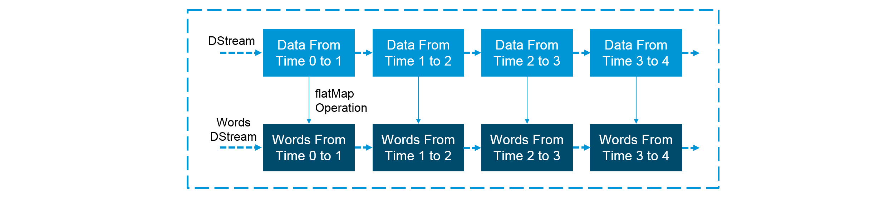
Extracting words from Input Dstream :
orming the input stream.

Slide 31
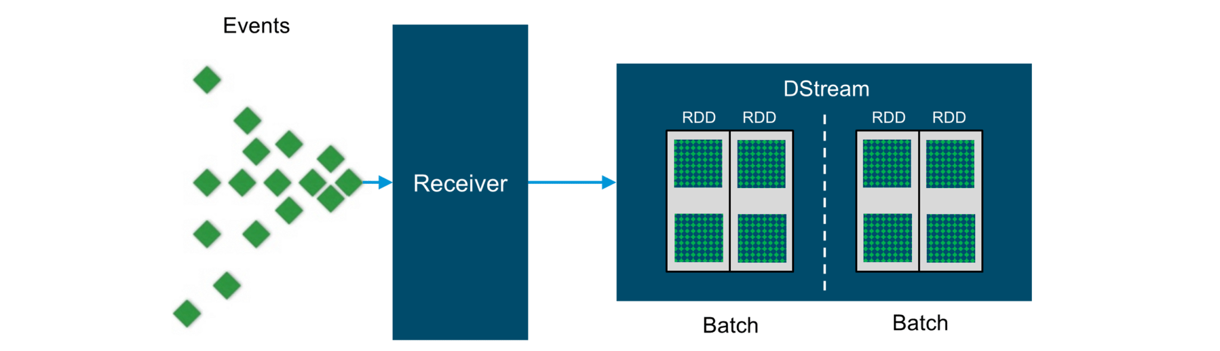
Input Dstreams:
sources.

Slide 32
Input DStreams are DStreams representing the stream of input data received from streaming sources.
Every input DStream is associated with a Receiver object which receives the data from a source and stores it in Spark’s memory for processing.
Transformations on DStreams:
Any operation applied on a DStream translates to operations on the underlying RDDs. Transformations allow the data from the input DStream to be modified similar to RDDs. DStreams support many of the transformations available on normal Spark RDDs.

Slide 33

Dstream Transformations :
Spark RDDs.

Slide 34
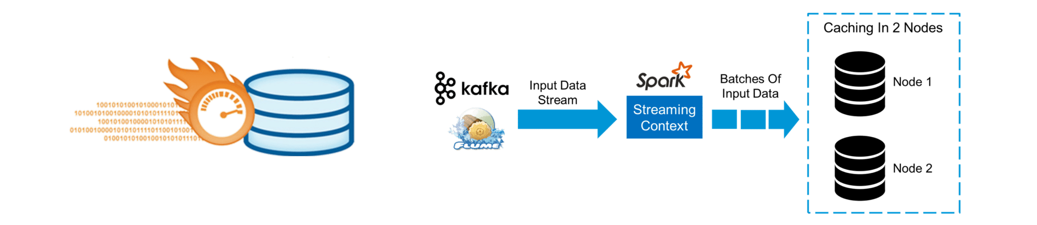
Caching :
Stream.

Slide 35
DStreams allow developers to cache/ persist the stream’s data in memory. This is useful if the data in the DStream will be computed multiple times. This can be done using the persist() method on a DStream. For input streams that receive data over the network (such as Kafka, Flume, Sockets, etc.), the default persistence level is set to replicate the data to two nodes for fault-tolerance.

Slide 36
Accumulators, Broadcast Variables and Checkpoints :
Accumulators: Accumulators are variables that are only added through an associative and commutative operation. They are used to implement counters or sums. Tracking accumulators in the UI can be useful for understanding the progress of running stages. Spark natively supports numeric accumulators. We can create named or unnamed accumulators.
Broadcast Variables: Broadcast variables allow the programmer to keep a read-only variable cached on each machine rather than shipping a copy of it with tasks. They can be used to give every node a copy of a large input dataset in an efficient manner. Spark also attempts to distribute broadcast variables using efficient broadcast algorithms to reduce communication cost.
Checkpoints: Checkpoints are similar to checkpoints in gaming. They make it run 24/7 and make it resilient to failures unrelated to the application logic.

Slide 37
Spark Streaming Transformation Operations :
map() :
Map function in Spark passes each element of the source DStream through a function and returns a new DStream.
Example:
val conf = new SparkConf().setMaster("local[2]") .setAppName("MapOpTest")
val ssc = new StreamingContext(conf , Seconds(1))
val words = ssc.socketTextStream("localhost", 9999)
val ans = words.map { word => ("hello" ,word ) } // map hello with each lineans.print()
ssc.start() // Start the computation
ssc.awaitTermination() // Wait for termination
}

Slide 38
flatMap() :
FlatMap function in Spark is similar to Spark map function, but in flatmap, input item can be mapped to 0 or more output items. This creates difference between map and flatmap operations in spark.
Spark FlatMap Example
val lines = ssc.socketTextStream("localhost", 9999)
val words = lines.flatMap(_.split(" ")) // for each line it split the words by space
val pairs = words.map(word => (word, 1))
val wordCounts = pairs.reduceByKey(_ + _)
wordCounts.print()

Slide 39
filter() :
Filter function in Apache Spark returns selects only those records of the source DStream on which func returns true and returns a new DStream of those records.
Spark Filter function example:
val lines = ssc.socketTextStream("localhost", 9999)
val words = lines.flatMap(_.split(" "))
val output = words.filter { word => word.startsWith("s") } // filter the words starts with letter“s”
output.print()

Slide 40
reduceByKey(func, [numTasks])
When called on a DStream of (K, V) pairs, ReduceByKey function in Spark returns a new DStream of (K, V) pairs where the values for each key are aggregated using the given reduce function.
Spark reduceByKey example :
val lines = ssc.socketTextStream("localhost", 9999)
val words = lines.flatMap(_.split(" "))
val pairs = words.map(word => (word, 1))
val wordCounts = pairs.reduceByKey(_ + _)
wordCounts.print()
e. countByValue() :
CountByValue function in Spark is called on a DStream of elements of type K and it returns a new DStream of (K, Long) pairs where the value of each key is its frequency in each Spark RDD of the source DStream.
Spark CountByValue function example
val line = ssc.socketTextStream("localhost", 9999)
val words = line.flatMap(_.split(" "))
words.countByValue().print()

Slide 41
REFERENCES
https://spark.apache.org/docs/latest/rdd-programming-guide.html
https://spark.apache.org/docs/latest/streaming-programming-guide.html
http://allaboutscala.com/big-data/spark/#dataframe-introduction

