Slide 1
LendingClubCaseStudy
Renganayaki S
Executive PG Diploma in AI/ML

Slide 2
Problem Statement
This company is the largest online loan marketplace, facilitating personal loans, business loans, and financing of medical procedures. Borrowers can easily access lower interest rate loans through a fast online interface.
Like most other lending companies, lending loans to ‘risky’ applicants is the largest source of financial loss (called credit loss). Credit loss is the amount of money lost by the lender when the borrower refuses to pay or runs away with the money owed. In other words, borrowers who default cause the largest amount of loss to the lenders. In this case, the customers labelled as 'charged-off' are the 'defaulters'.
If one is able to identify these risky loan applicants, then such loans can be reduced thereby cutting down the amount of credit loss. Identification of such applicants using EDA is the aim of this case study.
In other words, the company wants to understand the driving factors (or driver variables) behind loan default, i.e. the variables which are strong indicators of default. The company can utilise this knowledge for its portfolio and risk assessment.

Slide 3
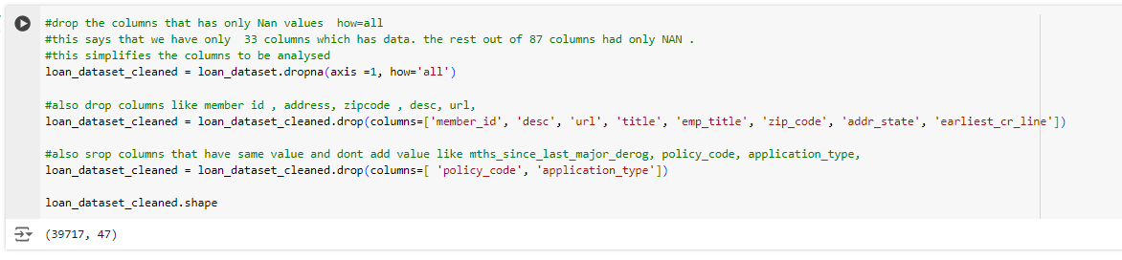
Exploratory Data Analysis
By looking at the dataset , it has (39717, 111) as shape
Since there are too many parameters , look for columns that add value to the problem statement
Clean the data by dropping the columns that has only NaN values
After cleaning some columns the shape is now 47 columns

Slide 4
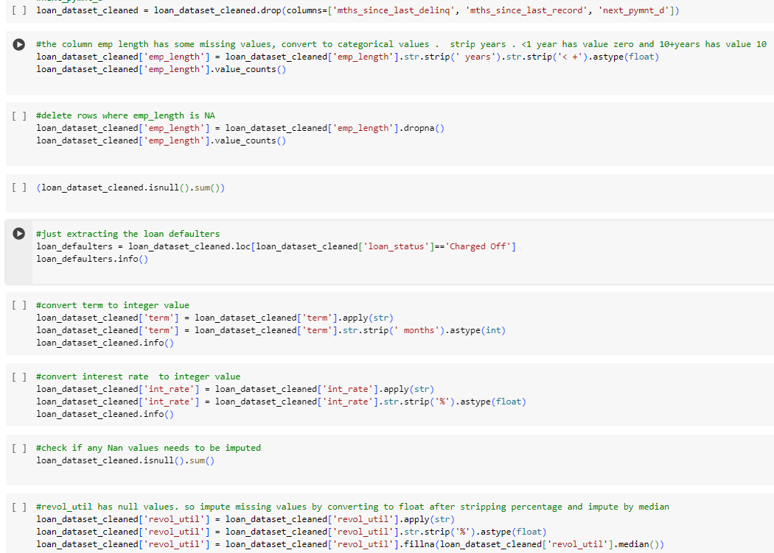
Exploratory Data Analysis
Check for data sanity and datatype checks
Drop the rows with employment length as null. Convert term , interest rate and emp length as int for better analysis . Impute missing values in revol_util

Slide 5
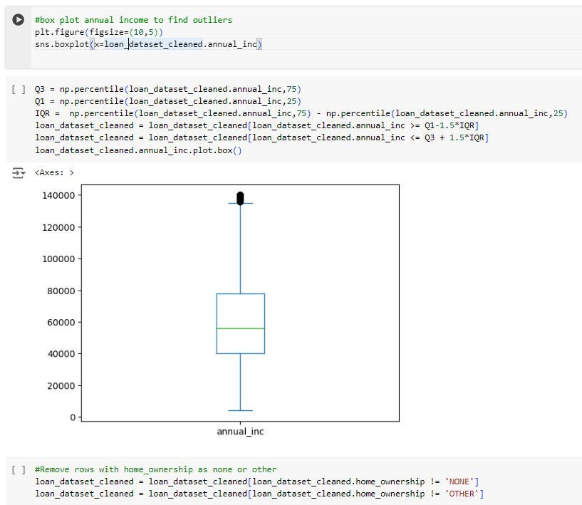
Outlier analysis using box plots
Annual income has outliers . So, clean the data using IQR range and visualize using box plots .
Drop the rows without a proper home_ownership

Slide 6
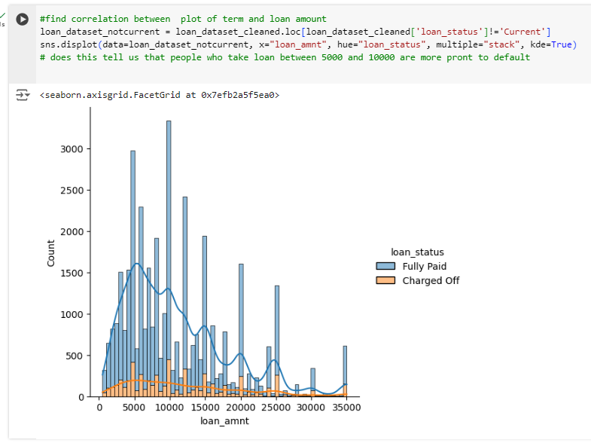
Visualizing data – Check loan amount and the trend

Slide 7
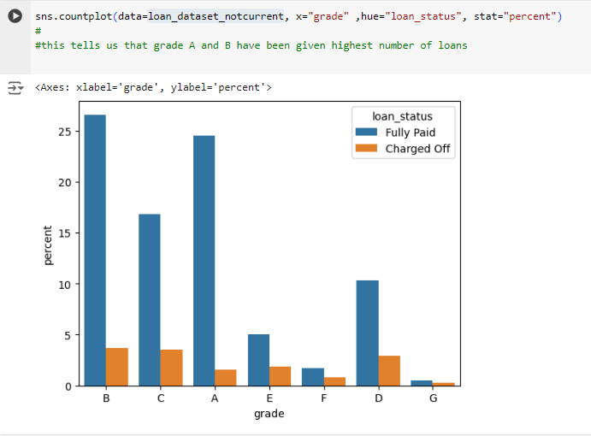
Loans and Grade
Inference : Higher number of loans have been given to Grade A and Grade B

Slide 8
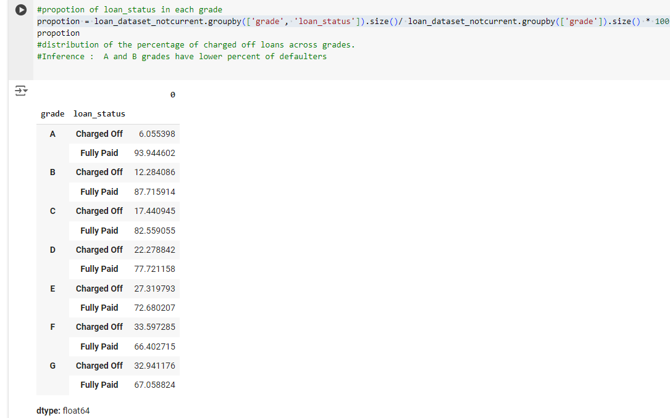
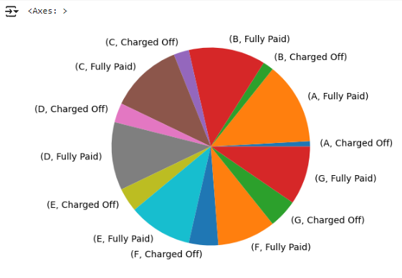
Visualizing data to understand correlation of Grade with defaulters
Inference : The percentage of defaulters increases with grade A to G

Slide 9
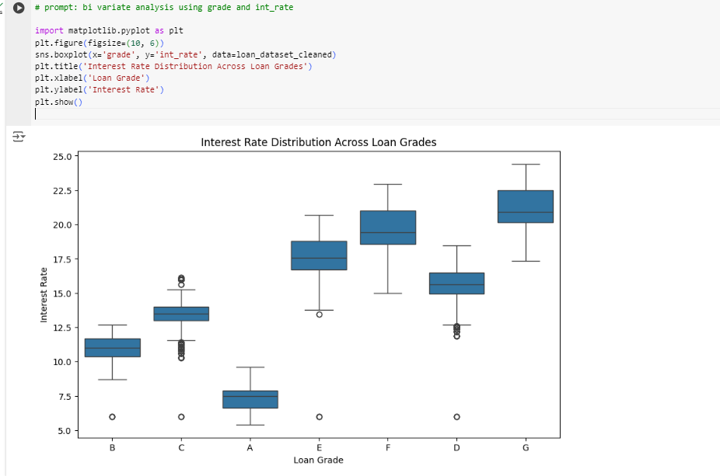
Interest rates and Grade
Grades A and B have lower interest rates comparted to other grades

Slide 10
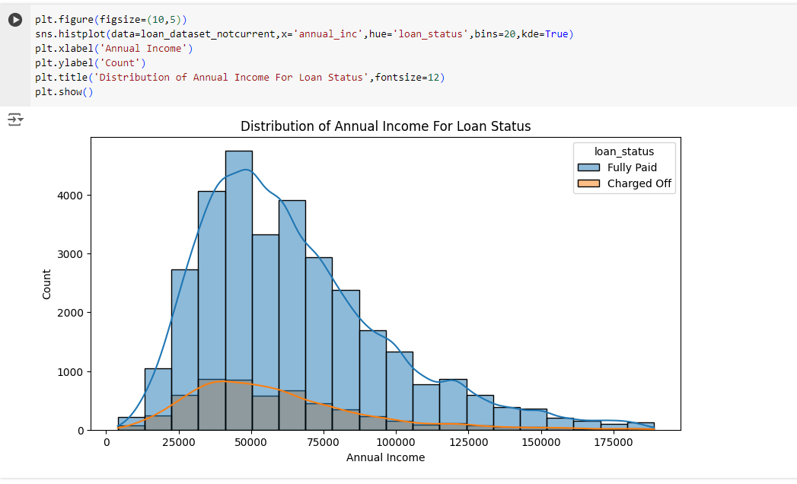
Distribution of annual income

Slide 11
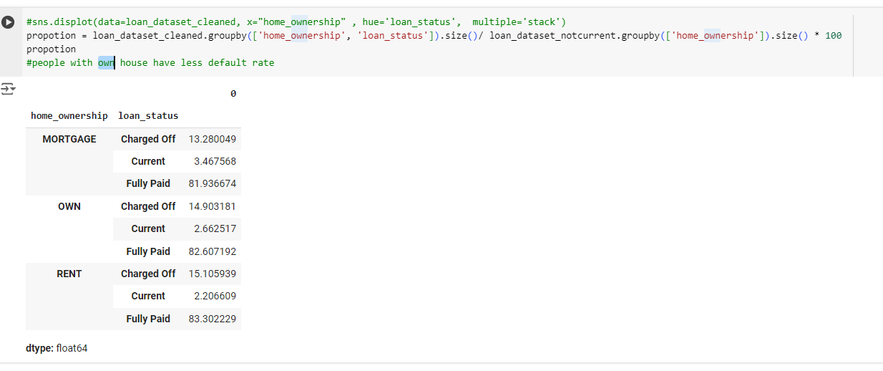

Slide 12
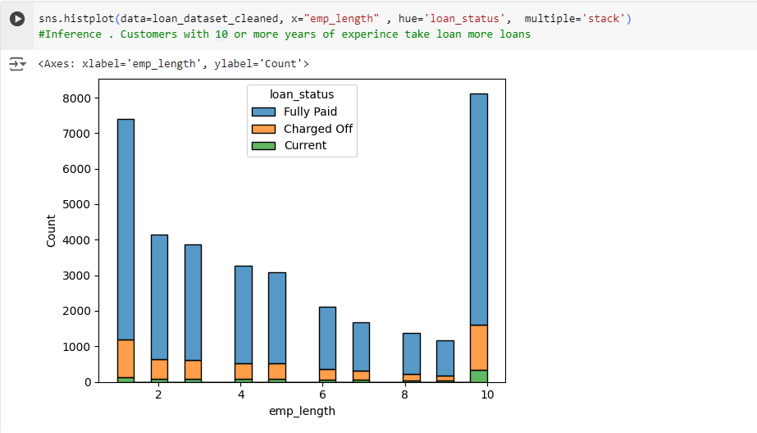

Slide 13
