Slide 1

Lending Club Case Study
Renganayaki S
Balla Mallibabu

Slide 2
Agenda
Problem Statement
Exploratory Data Analysis
Data Loan & Understanding
Data Cleaning
Segmentation
Univariate Analysis
Bivariate Analysis
Inferences

Slide 3

Problem Statement
This Finance company is the largest online loan marketplace, facilitating personal loans, business loans, and financing of medical procedures. Borrowers can easily access lower interest rate loans through a fast online interface.
The finance company aims to minimize losses by identifying risky loan applicants. Approving a risky applicant may lead to defaults and financial loss, while rejecting a reliable applicant results in lost business.
Using Exploratory Data Analysis (EDA), the goal is to analyze past loan data to identify key factors that predict loan defaults, enabling better decision-making to reduce credit risk and improve portfolio management..

Slide 4
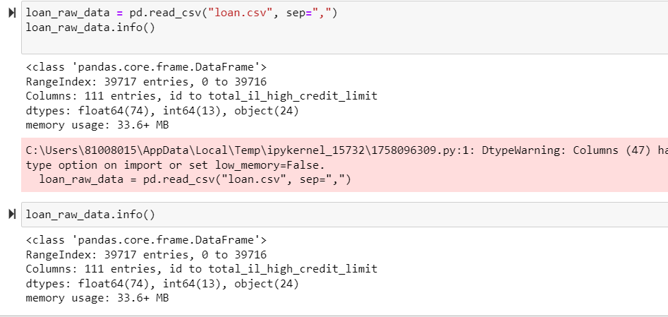
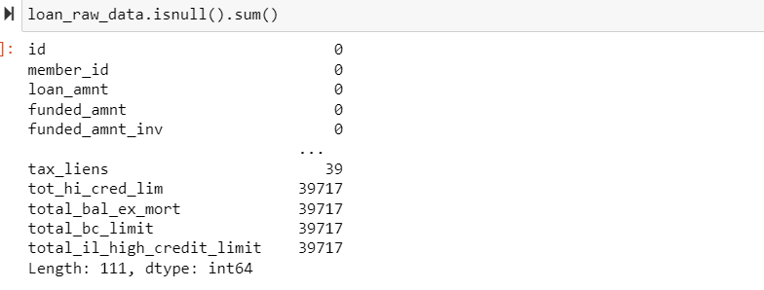
Data Load & Understanding
Data set contains 39717 records and 111 columns
Need to perform data clean as data contains many columns with null values
Also, need to convert data type for few columns and drop the rows which are not required

Slide 5
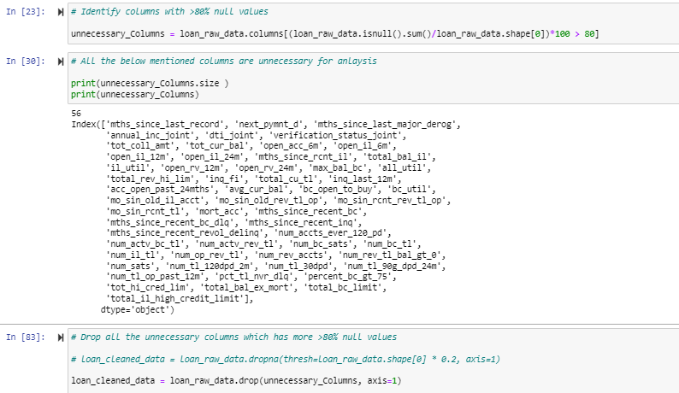
Data Cleaning
Fix Rows:
Loan Raw data not having, Summary Rows (Total, sub total rows), Extra rows (Column number indicator rows, blank rows, section indicator rows)
Fix Columns:
Identified 56 Columns with complete null values

Slide 6
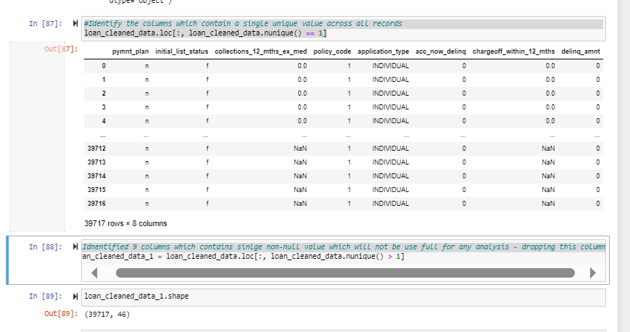
Data Cleaning
Fix Columns:
Data Set share after dropping Null columns (39717 rows, 54 columns)
Identified 9 columns which contains sinlge non-null value which will not be use full for any analysis, dropping this columns. Data Shape (46 columns)

Slide 7
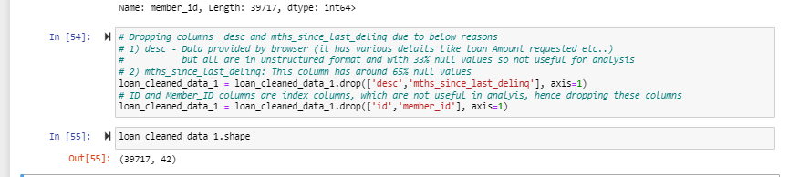
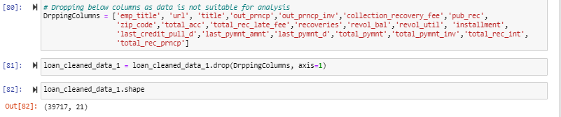
Data Cleaning
Dropping below columns as no helpful to derive insights
1) desc - Data provided by browser (it has various details like loan Amount requested etc..)
but all are in unstructured format and with 33% null values so not useful for analysis
2) mths_since_last_delinq: This column has around 65% null values
loan_cleaned_data_1 = loan_cleaned_data_1.drop(['desc','mths_since_last_delinq'], axis=1)
3) ID and Member_ID columns are index columns, which are not useful in analyis, hence dropping these columns
4) Dropping additional columns which are not derive much insights

Slide 8
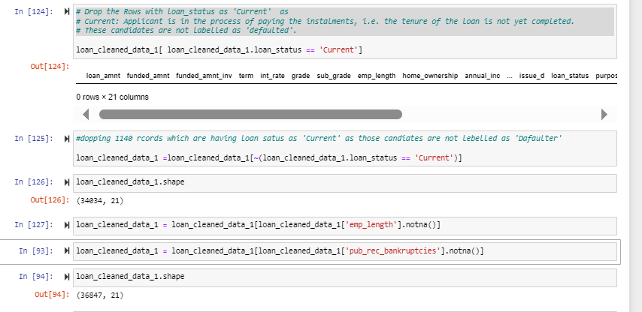
Data Cleaning
No Duplicate rows exist
No Rows present with more than 5 null values
Drop the Rows with loan_status as 'Current' as Current: Applicant is in the process of paying the instalments, i.e. the tenure of the loan is not yet completed. These candidates are not labelled as 'defaulted’.
Removed records with NA values

Slide 9
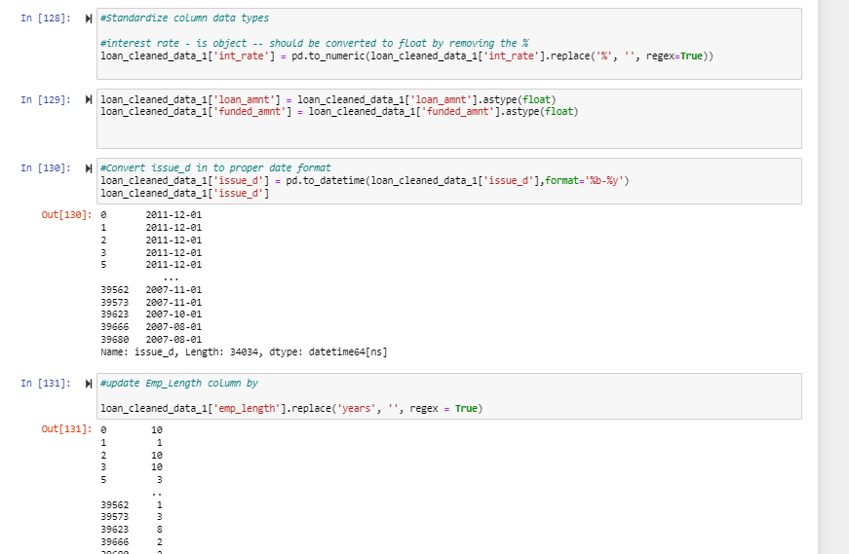
Data Cleaning
Data standardization
Int_Rate, Loan_amnt, funded_amnt, issue_d, emp_length columns data is standardized by changing data type, converting to valid data formats as in below

Slide 10
Data Segmentation
Data variables divided in to 3 sections as below
Categorical Variables
addr_state
earliest_cr_line
emp_length
grade
home_ownership
issue_d
loan_status
purpose
sub_grade
term
verification_status
pub_rec_bankruptcies
Additional Columns (with complete Null Values / singel values / imporper data)
acc_now_delinq | total_rev_hi_lim | dti_joint | member_id | pub_rec
acc_open_past_24mths | mths_since_last_record | emp_title | num_tl_30dpd | all_util
tot_hi_cred_lim | percent_bc_gt_75 | bc_util | inq_fi | pymnt_plan
mths_since_last_delinq | num_tl_op_past_12m | avg_cur_bal | il_util | tax_liens
mths_since_recent_bc | num_tl_120dpd_2m | next_pymnt_d | open_acc_6m | title
mths_since_recent_inq | last_fico_range_low | bc_open_to_buy | open_il_12m | tot_coll_amt
mths_since_recent_revol_delinq | mo_sin_old_il_acct | num_actv_bc_tl | open_il_24m | tot_cur_bal
num_accts_ever_120_pd | mo_sin_old_rev_tl_op | num_actv_rev_tl | open_il_6m | total_bal_il
chargeoff_within_12_mths | mo_sin_rcnt_rev_tl_op | num_bc_sats | open_rv_12m | total_bc_limit
collection_recovery_fee | mo_sin_rcnt_tl | num_bc_tl | open_rv_24m | total_cu_tl
collections_12_mths_ex_med | mort_acc | num_il_tl | out_prncp | desc
num_tl_90g_dpd_24m | annual_inc_joint | num_op_rev_tl | out_prncp_inv | url
total_il_high_credit_limit | total_bal_ex_mort | num_rev_accts | pct_tl_nvr_dlq | installment
mths_since_recent_bc_dlq | mths_since_last_record | application_type | inq_last_12m | id
num_rev_tl_bal_gt_0 | mths_since_rcnt_il | num_sats | policy_code
verification_status_joint | fico_range_high | fico_range_low | max_bal_bc
last_credit_pull_d | last_pymnt_amnt | last_pymnt_d | initial_list_status
mths_since_last_major_derog | last_fico_range_high | zip_code | delinq_amnt
Numerical Variables
annual_inc
delinq_2yrs
dti
funded_amnt
inq_last_6mths
int_rate
loan_amnt
open_acc
funded_amnt_inv
Additional variables includes (Variables with full null values, and columns which contains only single value, index columns, and extra columns which are not helping much in deriving any insights

Slide 11
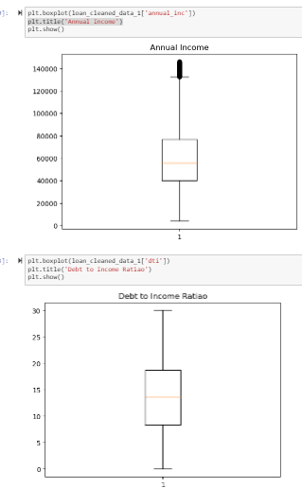
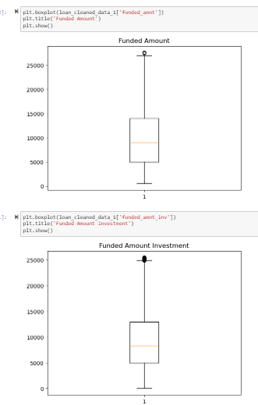
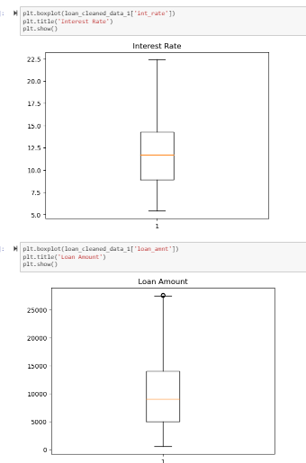
Outlier Analysis using Box Plot
Identified Outlier in below columns
Int_Rate, Loan_amnt, funded_amnt, issue_d, emp_length columns data is standardized by changing data type, converting to valid data formats as in below except DTI.

Slide 12
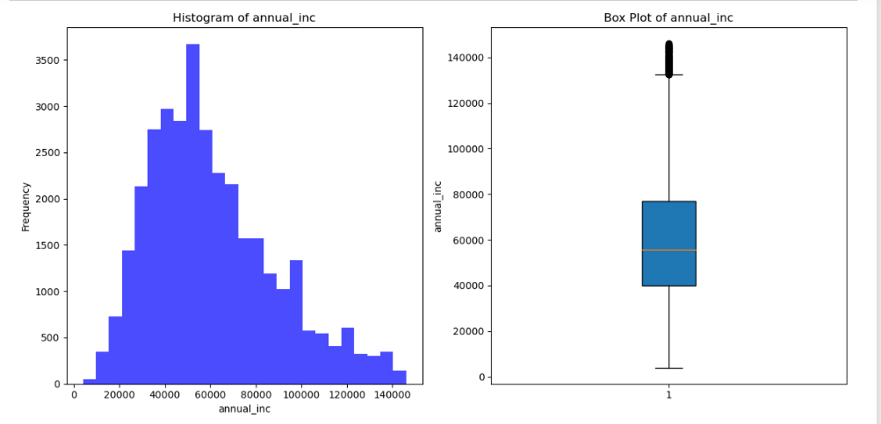
Univariate Analysis
Annual Income Variable observations:
Annual Income of Most applicants is in between 40000-77000 as per IQR
Average Annual Income: 60880

Slide 13
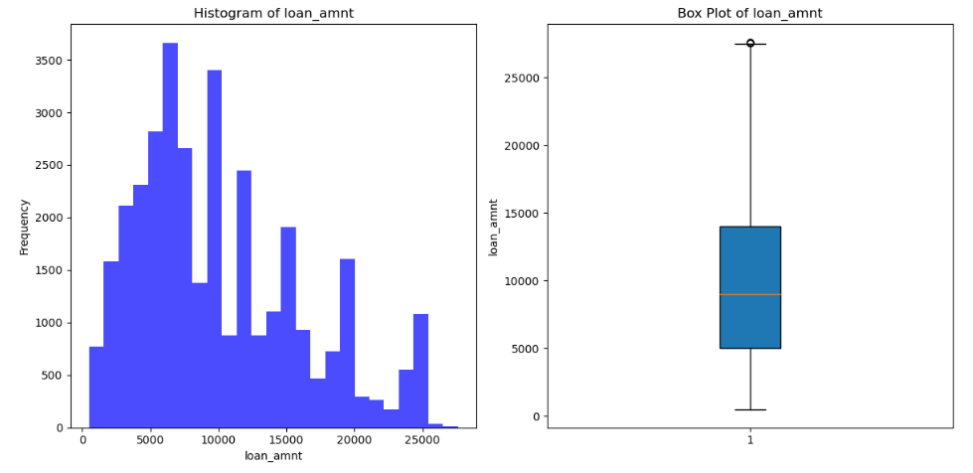
Univariate Analysis
Loan Amount Variable observations:
Loan Amount of Most applicants is in between 5K to 14K as per IQR
Average Loan Amount: ~10K

Slide 14
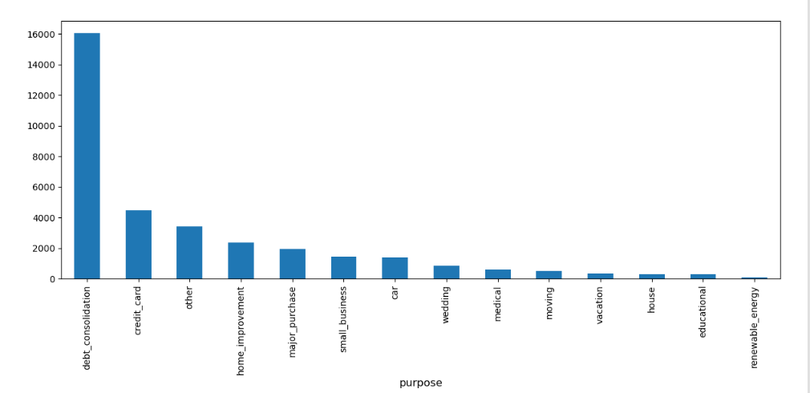
Univariate Analysis (Categorical Variables)
Major portion of the loan applicants are
From mortgage or rental homes under home ownership
From 36 month loan term
Most applicants verification status is not Verified
Most loan applicants are from CALIFORNIA
Major loan applicants purpose is ‘Debt Consolidation’
Most applicants are either below below 1 year or 10+ years employee length
Majority portion is from Grade A and Grade B

Slide 15
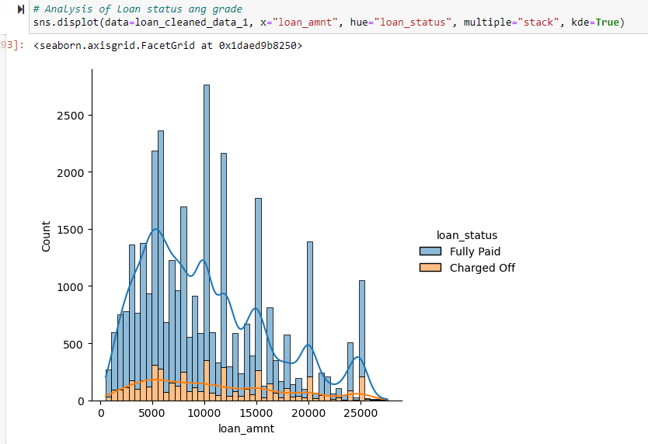
Bivariate Analysis
Loan Amount versus Loan Status analysis:
- people who take loan between 5000 and 10000 are more prone to be default

Slide 16
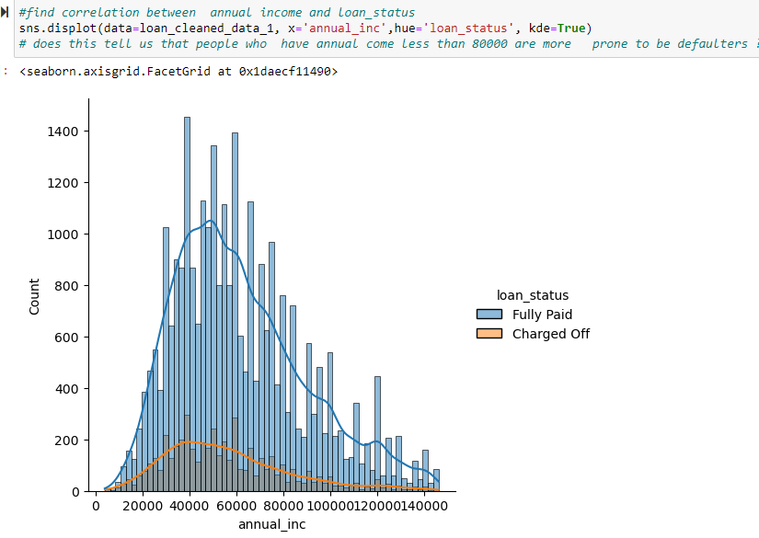
Bivariate Analysis
Annual Income versus Loan Status analysis:
- people who has annual incomes between 30K to 60k are more prone to be defaulters

Slide 17
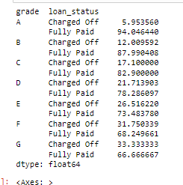
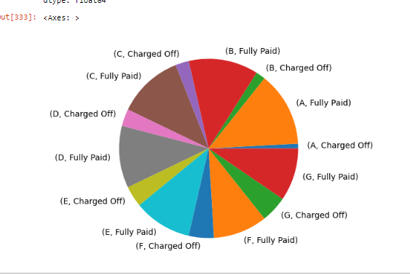
Bivariate Analysis
Visualizing data to understand correlation of Grade with defaulters
Inference : The percentage of defaulters increases with grade A to G

Slide 18
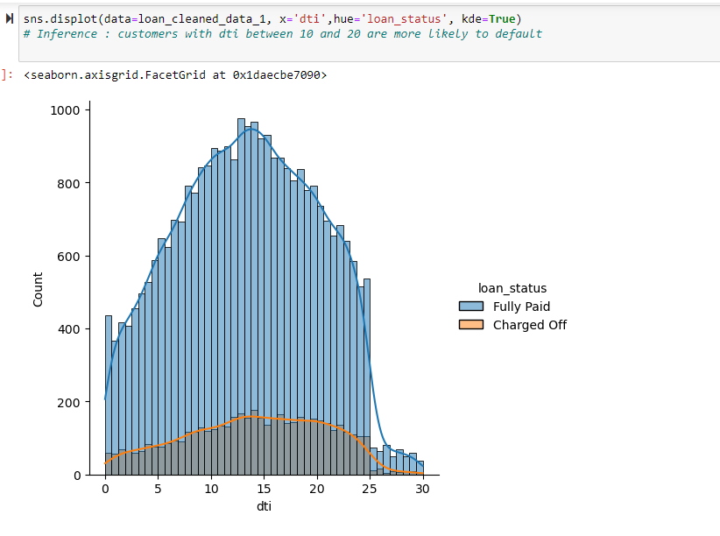
Bivariate Analysis
DTI versus Loan Status analysis:
- people who has DTI between 8 to 20 are more prone to be defaulters

Slide 19
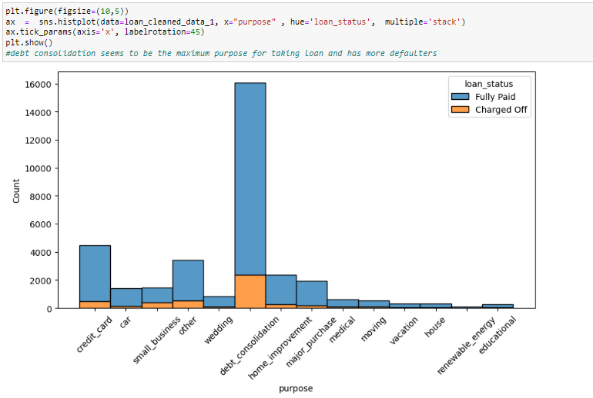
Bivariate Analysis
Loan purpose versus Loan Status analysis:
- people with loan purpose has ‘debt consolidation’ are more prone to be defaulters

Slide 20
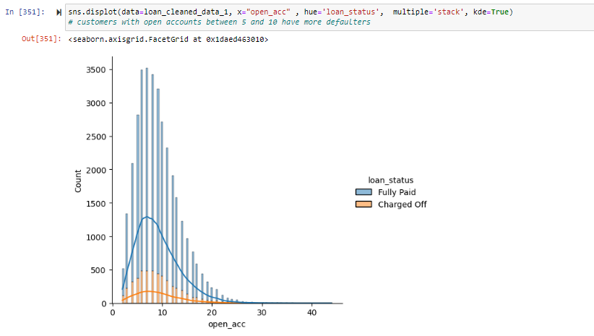
Bivariate Analysis
Open Accounts versus Loan Status analysis:
- Inference: customers with open accounts between 5 and 10 have more defaulters

Slide 21
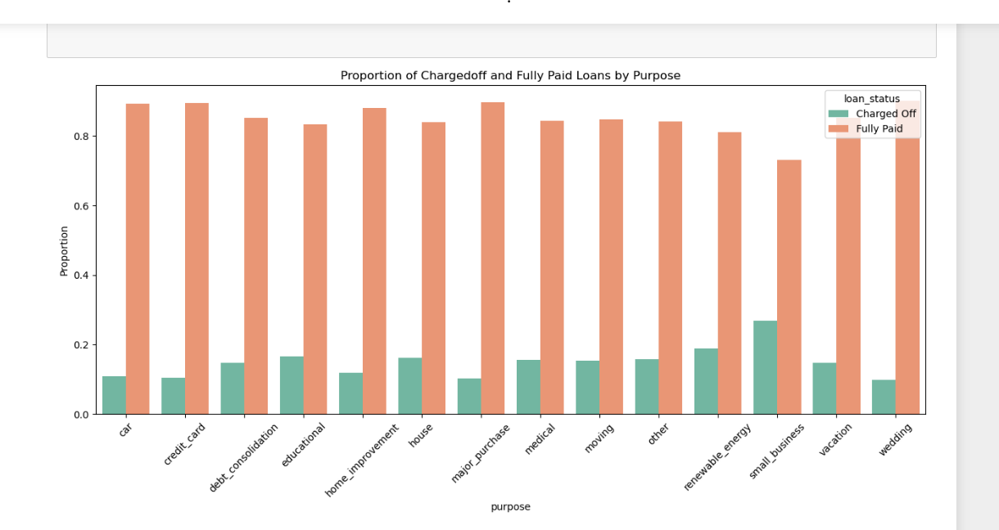
Bivariate Analysis
Loan purpose versus Loan Status analysis:
- Inference: Loans with purpose as ‘Small business’ are more prone to be defaulters

Slide 22
Inferences
Customers with dti between 8 and 20 are more likely to default
Borrowers with annual income between 30k to 65k are more likely to default and higher annual income are less likely to default.
Grade and Interest rates are correlated. Higher number of loans have been given to Grade A and Grade B, and the percentage of defaulters increases with grade A to G. Higher grade will have higher interest rates and the percentage of defaulters increases with grade A to G.
customers with open accounts between 5 and 10 have more defaulters
Loan amounts, Funded amount are highly correlated and people will less than 5k loan amount are less prone to be defaulters
Debt consolidation seems to be the maximum purpose for taking loan and has more defaulters but if we look at proportion, Loans with purpose as ‘Small business’ are more prone to be defaulters

