Slide 1

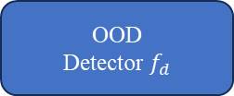


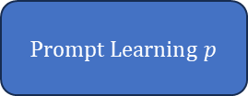

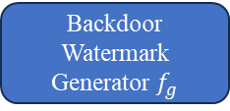
Downstream Datasets G
+
-
Representative Node Selection
Representative Nodes $V_{s}$
OOD
Detector $f_{d}$
Probability $P_{b}$
Adversarial Learning
Watermark$g$
Pre-Train
Model
Backdoor Watermark Generator $f_{g}$
Pair-wise T-test
P$rompt Learning p$
-
+
Probability $P_{w}$
Bi-level Optimization

Slide 2
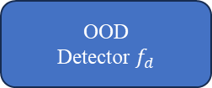


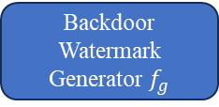
Downstream Datasets G
Representative Node Selection
Representative Nodes $V_{s}$
Data Augmentation model
+
-
OOD
Detector $f_{d}$
Probability $P_{b}$
Adversarial Learning
Watermark$g$
Pre-Train
Model
Pair-wise T-test
P$rompt Learning p$
+
-
Backdoor Watermark Generator $f_{g}$
Probability $P_{w}$
Bi-level Optimization

Slide 3


Pre-Train
Model
G$NN$Embedding
Classifier
Loss
Downstream Datasets G
+
-
P$rompt Learning p$

Slide 4





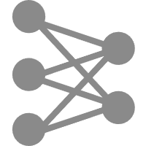

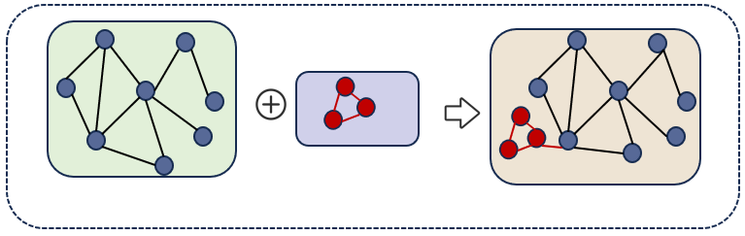





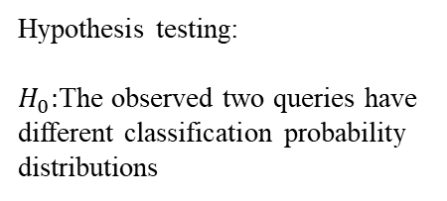




Building Query
Phase2:Watermark Verification
Classifier
GNN
Original P$rompt p$
Query $q_{1}$
Hypothesis testing:
$H_{0}:$The observed two queries have different classification probability distributions
Disturbance Embedding
$$\text{Disturbance} Prompt p^{′}$$
Query $q_{2}$

Slide 5







Phase2:Watermark Verification
Downstream Datasets $G$
Trigger $δ$
Disturbance Datasets $G^{′}$
Building Query
Original P$rompt p$
GNN
Query $q_{1}$
Disturbance Embedding
$$\text{Disturbance} Prompt p^{′}$$
Query $q_{2}$

Slide 6

Phase2:Watermark Verification
Trigger $δ$
Disturbance Datasets $G^{′}$
Building Query
Original P$rompt p$
Downstream Datasets $G$

Slide 7




Optimization for Prompt
Downstream Datasets G
G$NN$Embedding
+
-
Pre-Train
Model
P$rompt Learning p$
Classifier
Loss
Disturbance Datasets G
Dissimilar
P$rompt Learning p^{′}$
+
-
G$NN$Embedding
+
$$l_{cls}$$
$${βl}_{Dissimilarity}$$

Slide 8
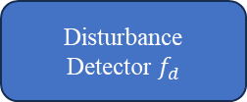

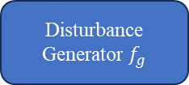



Optimization for Disturbance Graph
Downstream Datasets G
G$NN$Embedding
+
-
Pre-Train
Model
MLP
Disturbance Generator $f_{g}$
P$rompt Learning p$
Disturbance Datasets G
Dissimilar
P$rompt Learning p^{′}$
+
-
G$NN$Embedding
$$δ$$
Optimize the Disturbance
Disturbance
Detector $f_{d}$
MLP
Disturbance Generator $f_{g}$

Slide 9
数据权属者
扰动节点的邻居节点分类结果
置信度水平相对高
0.7 0.2 0.1
1
原始 Prompt p1
0.6 0.2 0.2
1
节点分类器
扰动节点的分类结果
GNN嵌入
置信度水平相对低
下游数据集
图提示学习方法
扰动图/原始图
置信度水平相对低
置信度差异？
2
扰动节点的邻居节点分类结果
扰动Prompt p2
0.7 0.2 0.1
节点分类器
2
GNN嵌入
0.6 0.2 0.2
所提方案
扰动图/原始图
扰动节点的分类结果
置信度水平相对高
满足假设性检验的比例
每个扰动节点本身以及邻居节点符合预期的假设检验的比例
通过结果的概率分布数据权属验证
邻近节点的选择
H-hop
创新点：1、适合扰动的节点/代表节点选择
2、扰动子图生成
3、利用分布一致性提高生成扰动图的隐蔽性（通过扰动前后的分布对齐）扰动子图内部的分布对齐以及整个扰动图的分布对齐
可能由于多个惩罚项的约束导致水印无法被Prompt很好的学习，我们可以在水印节点加入权重项来提高Prompt对水印节点的注意力
扰动比例/成本控制
下游数据集以大图的方式存在 还是 多个子图的方式存在
在每个子图都注入相应扰动/ 部分子图注入扰动

Slide 10
创新点：1、适合扰动的节点/代表节点选择
2、扰动子图生成
3、利用分布一致性提高生成扰动图的隐蔽性（通过扰动前后的分布对齐）扰动子图内部的分布对齐以及整个扰动图的分布对齐
避免选择在特征分布边缘或异常的节点 （属于ID内的具备代表性的节点）
适合扰动的节点/代表节点选择
结合图结构信息和节点特征的优化筛选 (度中心性、介数中心性、特征向量中心性）
扰动子图内部分布一致/整个扰动图的分布一致
扰动子图生成（多个约束条件）
生成的多个子图应该距离较远（在特征空间中分散）？

Slide 11
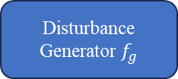



Disturbance Datasets G
Disturbance Generator
G$NN$Embedding
+
-
Pre-Train
Model
KDE核密度估计$k_{kde}$
扰动样本概率密度
Similar
利用SWD计算分布差异
Downstream Datasets G
G$NN$Embedding
干净样本概率密度
+
-
利用SWD计算分布差异
G$NN$Embedding
扰动子图概率密度
$$δ$$
MLP
Disturbance Generator $f_{g}$
A,X

Slide 12

Representative Node Selection
Kmeans
Pre-Train
Model
KDE核密度估计$k_{kde}$
Downstream Datasets G
G$NN$Embedding
选择概率密度较高的节点作为代表节点
+
-

Slide 13












Phase1:Watermark Injection
Optimization for GNN P$rompt$
Downstream Datasets $G$
Watermark Query $q_{1}$
GNN
Original Embedding
Original
P$rompt$
Similar
Original Query $q_{2}$
Disturbance Datasets $G^{′}$
Disturbance Embedding
$$\text{Disturbance}$$
$$Prompt$$
Dissimilar
Disturbance Query $q_{3}$
Optimization for P$rompt$

Slide 14
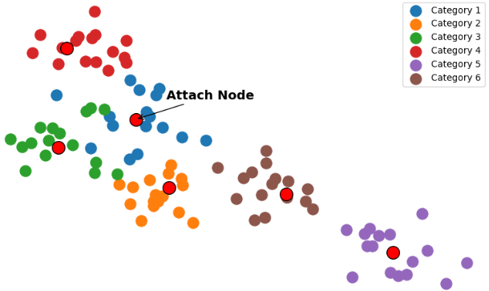
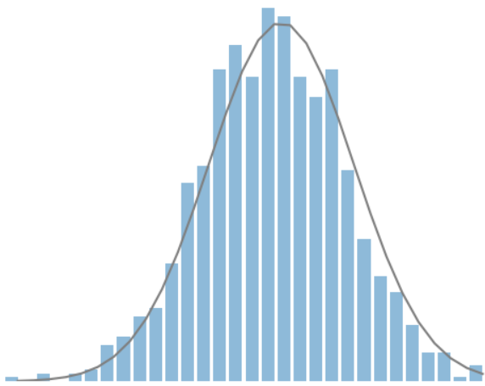



Phase1:Watermark Injection
Selection for Representation Node
Downstream Datasets $G$
GNN
Mean Shift
Graph Embedding
$$K(x)$$
$$h$$

Slide 15



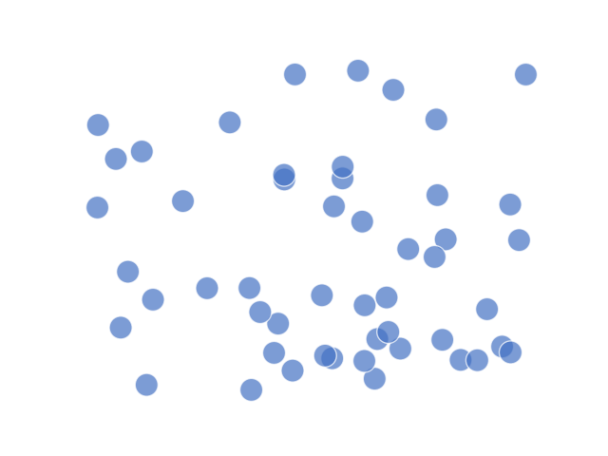
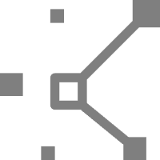
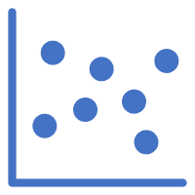
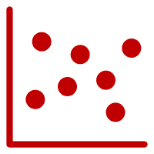
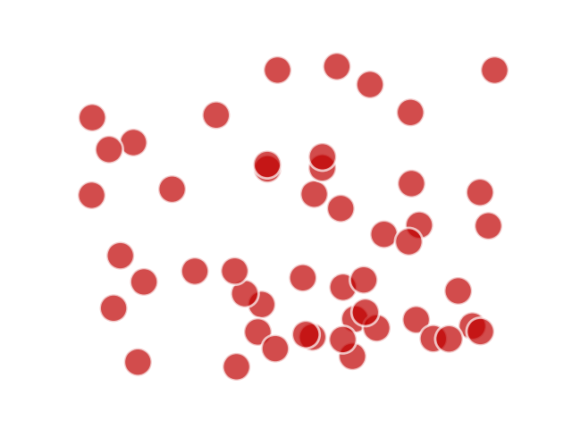
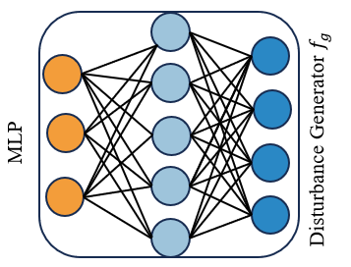






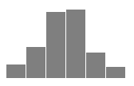
Phase1:Watermark Injection
Optimization for Trigger Watermark Graph
Downstream Datasets $G$
GNN
Original Embedding
Disturbance Data Distribution
Similar
Kernel Density Estimation
Disturbance Datasets $G^{′}$
Wasserstein distance $L_{1}$
Disturbance Embedding
$$K(x)$$
$$h$$
Original Data Distribution
Trigger Embedding
Trigger $δ$
Wasserstein distance $L_{2}$
Similar
Attach Node Embedding
Trigger Data Distribution
Bi-level Optimization $h(A,X)$

Slide 16







Phase1:Watermark Injection
Downstream Datasets $G$
Original Embedding
GNN
Kernel Density Estimation
Original Data Distribution
$$f_{p}$$
Original P$rompt p$
Similar
$$K(x)$$
Wasserstein distance $L_{1}$
Disturbance Datasets $G^{′}$
$$\text{Disturbance} Prompt p^{′}$$
Dissimilar
$$h$$
$$f_{p}$$
Disturbance Data Distribution
Disturbance Embedding
Wasserstein distance $L_{2}$
Trigger $δ$
Trigger Embedding
Trigger Data Distribution
Bi-level Optimization $h(A,X)$

Slide 17
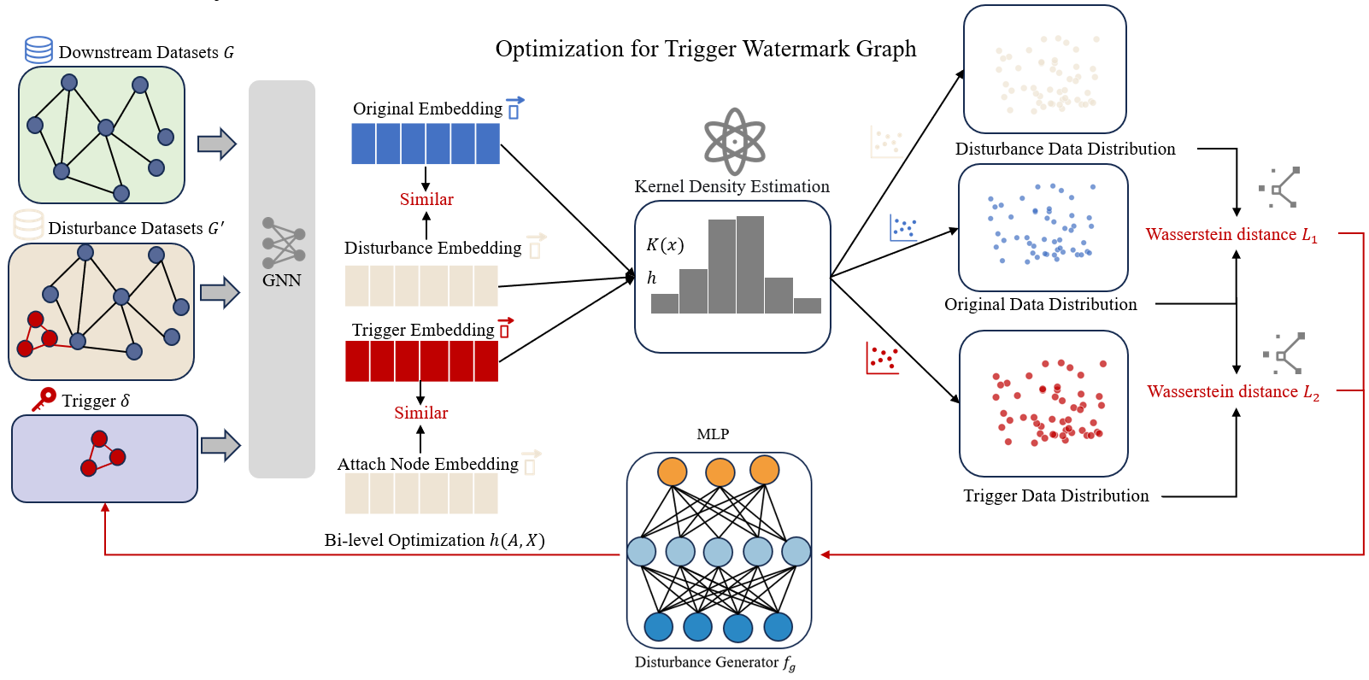
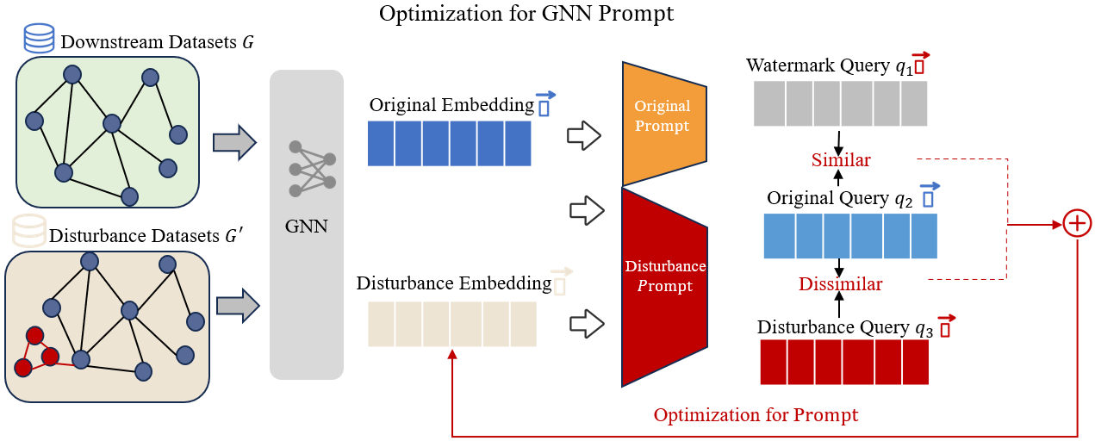
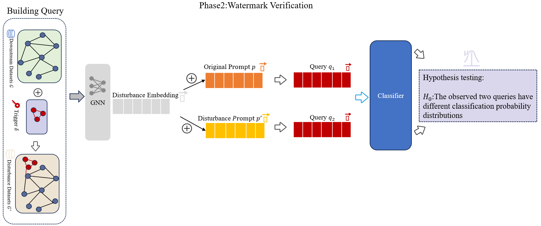
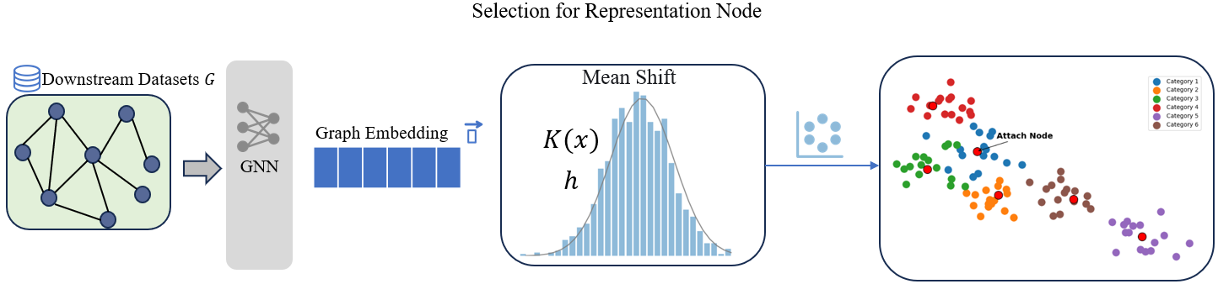
Phase1:Watermark Injection
$l_{ sim1}$+ $l_{ sim2}$+ $l_{cross entropy}$+ $l_{sim3}$+ $l_{sim4}$+ $l_{dis1}+l_{dis2}$

Slide 18
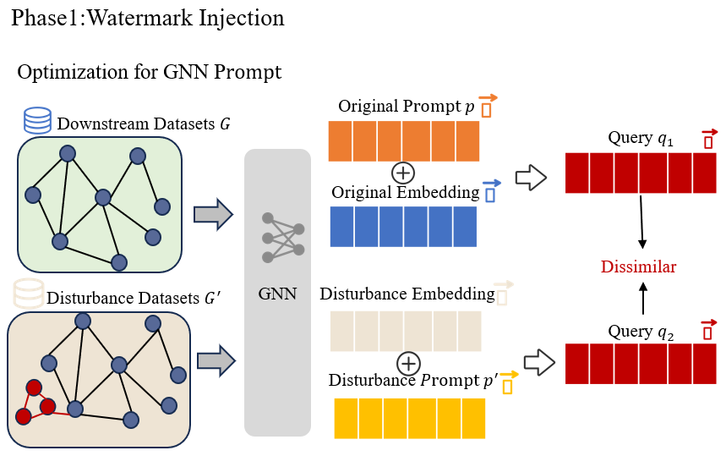

Slide 19




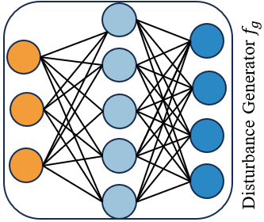














Representative node selection
Optimization for Watermark Trigger
Original Datasets $G$
Representative node
$$h$$
$$x$$
Node Token
Structure Token
模型解释性SHAP
Original
$$n×$$
Mean
Mean
Self Attention
Initialize Trigger adjacent matrix$h$ and feature matrix $x$
Disturbance
Feed-Forward Layer
1
1
1
1
1
1
1
1
1
1
Tigger
Black-box GNNS
0
1
1
1
1
0
1
1
1
1
GMM
Density Estimation
0
0
1
1
0
0
1
1
Optimize
Prompts
1
0
0
1
1
1
0
0
1
1
Attach Node
1
1
0
0
1
1
1
0
0
1
$$h^{′}$$
$$x^{′}$$
扩充提示学习方法
Surrogate
Prompt
Disturbance Prompt
Bi-level Optimization
Wasserstein distance
Representations
Original Query $q_{1}$
Building Query
Hypothesis testing:
$H_{0}:$The observed two queries have different classification probability distributions
Suspected Query $q_{2}$
Suspected Model
Frozen
Tunable
Similar
Dissimilar
比例问题

Slide 20

Representative node selection
Optimization for Watermark Trigger
Original Datasets $G$
Representative node
$$h$$
$$x$$
Node Token
Structure Token
模型解释性SHAP
Original
$$n×$$
Mean
Mean
Self Attention
可以利用上游黑盒GNN
Initialize Trigger adjacent matrix$h$ and feature matrix $x$
Disturbance
Feed-Forward Layer
1
1
1
1
1
1
1
1
1
1
Tigger
Black-box GNNS
描述位置问题
0
1
1
1
1
0
1
1
1
1
GMM
Density Estimation
代理提示生成
0
0
1
1
0
0
1
1
1
0
0
1
1
1
0
0
1
1
Attach Node
Optimize
Prompts
1
1
0
0
1
1
1
0
0
1
$$h^{′}$$
$$x^{′}$$
颜色问题
Surrogate
Prompt
Disturbance Prompt
Bi-level Optimization
Wasserstein distance
Representations
Original Query $q_{1}$
7、特征大小
Building Query
Hypothesis testing:
$H_{0}:$The observed two queries have different classification probability distributions
8、相似性图标
Suspected Model
9、输入数据
信息量问题
Suspected Query $q_{2}$
表示输入问题
对齐问题
Frozen
Tunable
Similar
Dissimilar
1、字体大小 字体类型 3、边框颜色 5、 图比例问题
2、 icon图标颜色 4、边框数量和设计 6、 MLP模型设计

Slide 21


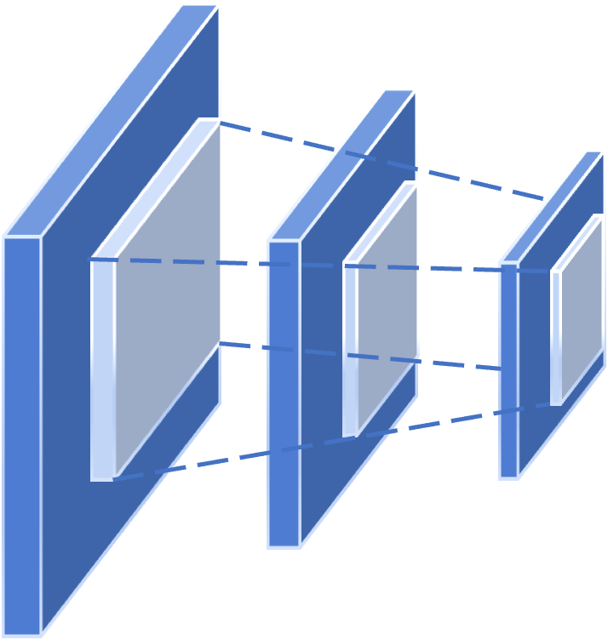








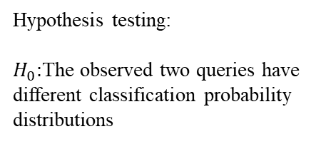








Optimization for Watermark Trigger
Representative node selection
Representative node
SHAP value
$$h$$
$$x$$
Node Token
Structure Token
Original graph
$$n×$$
SHAP
Mean
Mean
Self Attention
sort
Initialize trigger adjacent matrix$h$ and feature matrix $x$
Feed-Forward Layer
Disturbance graph
Black-box GNNS
1
1
1
1
1
1
1
1
1
1
Tigger graph
GMM
Density Estimation
0
1
1
1
1
0
1
1
1
1
Original datasets $G$
0
0
1
1
0
0
1
1
Substitution
prompts generation
1
0
0
1
1
1
0
0
1
1
1
1
0
0
1
1
1
0
0
1
$$h^{′}$$
$$x^{′}$$
Attach node
$$ℒ_{P}$$
$$ℒ_{MLP}$$
$$ℒ_{SIM}$$
Surrogate
Prompt
Disturbance Prompt
Bi-level optimization
Wasserstein distance
MLP Disturbance generator $f_{g}$
Watermark Verification
Representations
1、首字母大写 其他小写
2、边框选择统一
3、SHAP 字体
4、图节点颜色
5、表针颜色
Building query
Original query $q_{1}$
Hypothesis testing:
$H_{0}:$The observed two queries have different classification probability distributions
Suspected query $q_{2}$
Suspected model
Frozen
Tunable
Similar
Dissimilar

Slide 22













Phase1: Isotope node injection
b) Optimize trigger
c) Calculate dataset distribution
a) Select representative node
$$h$$
$$x$$
SHAP value
Mean
Mean
Original embedding
SHAP
Initialize trigger adjacent matrix$h$ and feature matrix $x$
Similar
Normalizing flow
sort
1 0 1 0 1
5 0 3 2 9
Disturbed embedding
Supervised contrastive learning
Black-box GNN
1 1 1 1 0
6 4 5 4 4
Original datasets $G$
Representative node
0 0 1 1
5 0 2 8
Density estimation
1 1 1 0 0
3 7 9 6 3
0 0 1 1 0
1 0 2 1 4
Trigger embedding
$$h_{t}$$
$$x_{t}$$
$z_{flow}$ $GMM\left(μ,σ\right)$
Similar
$$ℒ_{prompt}$$
$$ℒ_{mlp}$$
$$ℒ_{sim}$$
Bi-level optimization
Evaluate difference
Generate surrogate prompt
Attach node embedding
Surrogate
prompt
Disturbed prompt
Representations
Wasserstein distance $l_{w}$
MLP disturbed generator $f_{g}$
Frozen
Tunable
Dissimilar

Slide 23






Topological isotope injection
b) Imperceptible trigger generation
c) Swift distribution difference estimation
a) Representative node selection
1 0 1 0 1
$$h$$
4 0 3 8 1
$$x$$
1 1 1 0 1
5 0 7 0 1
0 0 1 0 1
6 3 1 2 1
SHAP values
1 0 1 0 1
8 6 3 7 1
0 0 1 1 1
9 3 5 7 1
Original embedding
Mean
Mean
SHAP
Initialize trigger adjacent matrix$h$ and feature matrix $x$
Similar
Normalizing flow
sort
1 0 1 0 1
5 0 3 2 9
Disturbed embedding
Supervised contrastive learning
Black-box GNN
1 1 1 1 0
6 4 5 4 4
Original datasets $G$
Representative nodes
0 0 1 1
5 0 2 8
Density estimation
1 1 1 0 0
3 7 9 6 3
0 0 1 1 0
1 0 2 1 4
Trigger embedding
$$h_{t}$$
$$x_{t}$$
$z_{flow}$ $GMM\left(μ,σ\right)$
Similar
Surrogate prompt generation
$$ℒ_{pro}$$
$$ℒ_{mlp}$$
$$ℒ_{sim}$$
Bi-level optimization
Difference calculation
Attach node embedding
Disparate representations
Surrogate
prompts
Dissimilar
Disturbed prompts
Wasserstein distance $l_{w}$
MLP disturbed generator $f_{g}$
Frozen
Tunable

Slide 24










Topological isotope injection
b) Isotope-driven disturbance generation
c) Bipartite perspective embedding discrepancy restriction
a) SHAP-driven representative node selection
1 0 1 0 1
$$h$$
4 0 3 8 1
$$x$$
1 1 1 0 1
5 0 7 0 1
Original embedding
0 0 1 0 1
6 3 1 2 1
SHAP values
1 0 1 0 1
8 6 3 7 1
0 0 1 1 1
9 3 5 7 1
Similar
Mean
Mean
Normalizing flow
SHAP
Initialize isotope adjacent matrix$h$ and feature matrix $x$
Flow model training
Disturbed embedding
sort
Contrastive learning
1 0 1 0 1
5 0 3 2 9
Black-box GNN
1 1 1 1 0
6 4 5 4 4
Isotope embedding
Density estimation
Original datasets $G$
0 0 1 1
5 0 2 8
Representative nodes
1 1 1 0 0
3 7 9 6 3
Similar
0 0 1 1 0
1 0 2 1 4
$z_{flow}$ $GMM\left(μ,σ\right)$
$$h_{i}$$
$$x_{i}$$
Bi-level optimization
Attach node embedding
Difference calculation
Surrogate prompt generation
$$ℒ_{pro}$$
$$ℒ_{mlp}$$
$$ℒ_{sim}$$
Wasserstein distance $l_{w}$
Disparate representations
Surrogate
prompts
Dissimilar
Disturbed prompts
Binary MLP isotope generator $f_{g}$
Frozen
Tunable

Slide 25
Topological isotope injection
b) Isotope-driven disturbance generation
c) Bipartite perspective embedding discrepancy restriction
a) SHAP-driven representative node selection
1 0 1 0 1
$$h$$
4 0 3 8 1
$$x$$
1 1 1 0 1
5 0 7 0 1
Original embedding
0 0 1 0 1
6 3 1 2 1
SHAP values
1 0 1 0 1
8 6 3 7 1
0 0 1 1 1
9 3 5 7 1
Similar
Mean
Mean
Normalizing flow
SHAP
Initialize isotope adjacent matrix$h$ and feature matrix $x$
Flow model training
Disturbed embedding
sort
Contrastive learning
1 0 1 0 1
5 0 3 2 9
Black-box GNN
1 1 1 1 0
6 4 5 4 4
Isotope embedding
Density estimation
Original datasets $G$
0 0 1 1
5 0 2 8
Representative nodes
1 1 1 0 0
3 7 9 6 3
Similar
0 0 1 1 0
1 0 2 1 4
$z_{flow}$ $GMM\left(μ,σ\right)$
$$h_{i}$$
$$x_{i}$$
Bi-level optimization
Attach node embedding
Difference calculation
Surrogate prompt generation
$$ℒ_{pro}$$
$$ℒ_{mlp}$$
$$ℒ_{sim}$$
Wasserstein distance $l_{w}$
Disparate representations
Surrogate
prompts
Dissimilar
Disturbed prompts
Binary MLP isotope generator $f_{g}$
Frozen
Tunable

Slide 26

Topological isotope injection
Frozen
Tunable
a) SHAP-driven representative node selection
b) Isotope-driven disturbance generation
c) Bipartite perspective embedding discrepancy restriction
SHAP values
1 0 1 0 1
4 0 3 8 1
$$x$$
1 1 1 0 1
$$h$$
5 0 7 0 1
Original embedding
0 0 1 0 1
6 3 1 2 1
SHAP
1 0 1 0 1
8 6 3 7 1
0 0 1 1 1
9 3 5 7 1
Similar
Mean
Mean
Normalizing flow
sort
Initialize isotope adjacent matrix$h$ and feature matrix $x$
Flow model training
Black-box GNN
Disturbed embedding
Original datasets $G$
Contrastive learning
Representative nodes
1 0 1 0 1
5 0 3 2 9
1 1 1 1 0
6 4 5 4 4
Isotope embedding
Density estimation
0 0 1 1
5 0 2 8
1 1 1 0 0
3 7 9 6 3
Similar
0 0 1 1 0
1 0 2 1 4
$z_{flow}$ $GMM\left(μ,σ\right)$
Surrogate prompt generation
$$ℒ_{mlp}$$
$$h_{i}$$
$$x_{i}$$
$$ℒ_{pro}$$
$$ℒ_{sim}$$
Difference calculation
Bi-level optimization
Attach node embedding
Disparate representations
Surrogate
prompts
Disturbed prompts
Wasserstein distance $l_{w}$
Dissimilar
Binary MLP isotope generator $f_{g}$
双层优化 分类损失+提示向量相似性损失 MLP损失

Slide 27
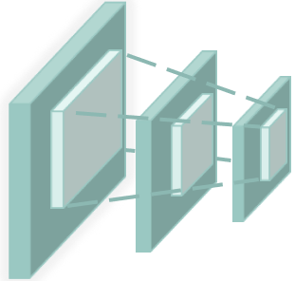








Prompt-driven dataset provenance verification
Building query
Prompt subgraphs
Probability distribution
$$x_{sur}$$
(0.2 0.9 0.4 … 0.1)
Hypothesis testing:
$H_{0}:$The observed two queries have different classification probability distributions
Legal graph model
$p_{sur}$
Original datasets $G$
$$x_{iso}$$
(0.3 0.8 0.2 … 0.2)
$p_{dis}$
$$x_{dis}$$
Suspected graph model

Slide 28





Frozen
Tunable
a) Centrality-guided representative node selection
b) Isotope-driven disturbance generation
c) Bipartite perspective embedding discrepancy restriction
Metric scores
1 0 1 0 1
$$h$$
4 0 3 8 1
$$x$$
1 1 1 0 1
5 0 7 0 1
Original embedding
0 0 1 0 1
6 3 1 2 1
1 0 1 0 1
8 6 3 7 1
0 0 1 1 1
9 3 5 7 1
Similar
K-Means
Mean
Mean
Normalizing flow
Centrality restriction
Initialize isotope adjacent matrix$h$ and feature matrix $x$
Flow model training
TOP-N
selection
Disturbed embedding
Original datasets $G$
Black-box GNN
Contrastive learning
1 0 1 0 1
5 0 3 2 9
1 1 1 1 0
6 4 5 4 4
Isotope embedding
Density estimation
Representative nodes
0 0 1 1
5 0 2 8
1 1 1 0 0
3 7 9 6 3
Similar
0 0 1 1 0
1 0 2 1 4
$z_{flow}$ $GMM\left(μ,σ\right)$
Surrogate prompt generation
$$ℒ_{mlp}$$
$$h_{i}$$
$$x_{i}$$
$$ℒ_{pro}$$
$$ℒ_{sim}$$
Difference calculation
Bi-level optimization
Attach node embedding
Disparate representations
Surrogate
prompts
Disturbed prompts
Wasserstein distance $l_{w}$
Dissimilar
Binary MLP isotope generator $f_{g}$

Slide 29
从特征相似性和分布相似性上约束生成的同位素
Frozen
Tunable
a) Centrality-guided representative node selection
b) Isotope-driven disturbance generation
c) Bipartite perspective embedding discrepancy restriction
Metric scores
1 0 1 0 1
$$h$$
4 0 3 8 1
$$x$$
1 1 1 0 1
5 0 7 0 1
Original embedding
0 0 1 0 1
6 3 1 2 1
1 0 1 0 1
8 6 3 7 1
0 0 1 1 1
9 3 5 7 1
Similar
K-Means
Mean
Mean
Normalizing flow
Centrality restriction
Initialize isotope adjacent matrix$h$ and feature matrix $x$
Flow model training
TOP-N
selection
Disturbed embedding
Original datasets $G$
Black-box GNN
Contrastive learning
1 0 1 0 1
5 0 3 2 9
1 1 1 1 0
6 4 5 4 4
Isotope embedding
Density estimation
Representative nodes
0 0 1 1
5 0 2 8
1 1 1 0 0
3 7 9 6 3
Similar
0 0 1 1 0
1 0 2 1 4
$z_{flow}$ $GMM\left(μ,σ\right)$
Surrogate prompt generation
$$ℒ_{mlp}$$
$$h_{i}$$
$$x_{i}$$
$$ℒ_{pro}$$
$$ℒ_{sim}$$
Difference calculation
Bi-level optimization
Attach node embedding
Disparate representations
Surrogate
prompts
Disturbed prompts
Wasserstein distance $l_{w}$
Dissimilar
Binary MLP isotope generator $f_{g}$
提高扰动后的提示与代理提示的特征差异，平衡下游任务的准确性和溯源效果，提示不同会造成的结果也不同。
但提示不同会导致模型性能变差，因此需要平衡二者
双层优化 一层是固定提示差异性损失和下游任务损失不动 根据二元嵌入差异约束来优化同位素 同位素动
另外一个是优化是固定二元差异损失不动，优化下游分类损失和提示差异性损失 提示动

Slide 30
接近中心性
度数中心性
变量斜体
Frozen
Tunable
a) Centrality-guided representative node selection
b) Isotope-driven disturbance generation
c) Bipartite perspective embedding discrepancy restriction
Metric scores
1 0 1 0 1
$$h$$
4 0 3 8 1
$$x$$
1 1 1 0 1
5 0 7 0 1
Original embedding
0 0 1 0 1
6 3 1 2 1
1 0 1 0 1
8 6 3 7 1
0 0 1 1 1
9 3 5 7 1
Similar
K-Means
Mean
Mean
Normalizing flow
Centrality restriction
Initialize isotope adjacent matrix$h$ and feature matrix $x$
Flow model training
TOP-N
selection
Disturbed embedding
Original datasets $G$
Black-box GNN
Contrastive learning
1 0 1 0 1
5 0 3 2 9
1 1 1 1 0
6 4 5 4 4
Isotope embedding
Density estimation
Representative nodes
0 0 1 1
5 0 2 8
1 1 1 0 0
3 7 9 6 3
Similar
0 0 1 1 0
1 0 2 1 4
$z_{flow}$ $GMM\left(μ,σ\right)$
Surrogate prompt generation
$$ℒ_{mlp}$$
$$h_{i}$$
$$x_{i}$$
$$ℒ_{pro}$$
$$ℒ_{sim}$$
Difference calculation
Bi-level optimization
Attach node embedding
Disparate representations
Surrogate
prompts
Disturbed prompts
Wasserstein distance $l_{w}$
Dissimilar
Binary MLP isotope generator $f_{g}$

Slide 31
















Frozen
Tunable
a) Centrality-guided representative node selection
b) Bipartite embedding discrepancy isotope generation
Metric scores
1 0 1 0 1
$$h$$
4 0 3 8 1
$$x$$
1 1 1 0 1
5 0 7 0 1
0 0 1 0 1
6 3 1 2 1
Original embedding
1 0 1 0 1
8 6 3 7 1
0 0 1 1 1
9 3 5 7 1
Similar
Normalizing flow
K-Means
Mean
Mean
Centrality restriction
Initialize isotope adjacent matrix$h$ and feature matrix $x$
Flow model training
TOP-N
selection
Disturbed embedding
Contrastive learning
Original datasets $G$
Black-box GNN
1 0 1 0 1
5 0 3 2 9
1 1 1 1 0
6 4 5 4 4
Density estimation
0 0 1 1
5 0 2 8
Isotope embedding
Representative nodes
1 1 1 0 0
3 7 9 6 3
Similar
$z_{flow}$ $GMM\left(μ,σ\right)$
0 0 1 1 0
1 0 2 1 4
$$h_{i}$$
$$x_{i}$$
Surrogate prompt generation
$$ℒ_{pro}$$
$$ℒ_{mlp}$$
$$ℒ_{sim}$$
Difference
calculation
Bi-level optimization
Attach node embedding
Disparate representations
Surrogate
prompts
Dissimilar
Disturbed prompts
Wasserstein distance $l_{w}$
Binary MLP isotope generator $f_{g}$
c) Prompt-driven dataset provenance verification
Building query
Prompt subgraphs
Probability distribution
(0.2 0.9 0.4 … 0.1)
Hypothesis testing:
$H_{0}:$The observed two queries have different classification probability distributions
$$x_{sur}$$
Legal graph model
$p_{sur}$
$$x_{iso}$$
(0.3 0.8 0.2 … 0.2)
Original datasets $G$
$p_{dis}$
$$x_{dis}$$
Suspected graph model

Slide 32
Frozen
Tunable
a) Centrality-guided representative node selection
b) Bipartite embedding discrepancy isotope generation
Metric scores
1 0 1 0 1
$$h$$
4 0 3 8 1
$$x$$
1 1 1 0 1
5 0 7 0 1
0 0 1 0 1
6 3 1 2 1
Original embedding
1 0 1 0 1
8 6 3 7 1
0 0 1 1 1
9 3 5 7 1
Similar
Normalizing flow
K-Means
Mean
Mean
Centrality restriction
Initialize isotope adjacent matrix$h$ and feature matrix $x$
Flow model training
TOP-N
selection
Disturbed embedding
Contrastive learning
Original datasets $G$
Black-box GNN
1 0 1 0 1
5 0 3 2 9
1 1 1 1 0
6 4 5 4 4
Density estimation
0 0 1 1
5 0 2 8
Isotope embedding
MM 40天 附录
Representative nodes
1 1 1 0 0
3 7 9 6 3
Similar
$z_{flow}$ $GMM\left(μ,σ\right)$
0 0 1 1 0
1 0 2 1 4
$$h_{i}$$
$$x_{i}$$
Surrogate prompt generation
$$ℒ_{pro}$$
$$ℒ_{mlp}$$
$$ℒ_{sim}$$
Difference
calculation
Bi-level optimization
Attach node embedding
Disparate representations
Surrogate
prompts
Dissimilar
Disturbed prompts
Wasserstein distance $l_{w}$
Binary MLP isotope generator $f_{g}$
c) Prompt-driven dataset provenance verification
验证阶段
模块之间的联系性
Building query
Prompt subgraphs
Probability distribution
(0.2 0.9 0.4 … 0.1)
Hypothesis testing:
$H_{0}:$The observed two queries have different classification probability distributions
$$x_{sur}$$
Legal graph model
$p_{sur}$
$$x_{iso}$$
(0.3 0.8 0.2 … 0.2)
Original datasets $G$
$p_{dis}$
$$x_{dis}$$
Suspected graph model

Slide 33


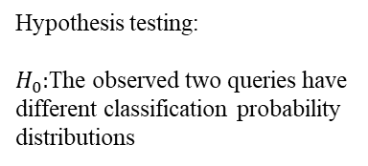






a) Centrality-guided representative node selection
b) Bipartite embedding discrepancy isotope generation
Frozen
Tunable
Metric scores
1 0 1 0 1
$$h$$
4 0 3 8 1
$$x$$
1 1 1 0 1
5 0 7 0 1
0 0 1 0 1
6 3 1 2 1
Original embedding
1 0 1 0 1
8 6 3 7 1
0 0 1 1 1
9 3 5 7 1
Similar
Normalizing flow
Mean
Mean
K-Means
Centrality restriction
Flow model training
Initialize isotope adjacent matrix$h$ and feature matrix $x$
TOP-N
selection
Disturbed embedding
Contrastive learning
Original datasets $G$
Black-box GNN
1 0 1 0 1
5 0 3 2 9
1 1 1 1 0
6 4 5 4 4
Density estimation
0 0 1 1
5 0 2 8
Isotope embedding
Representative nodes
1 1 1 0 0
3 7 9 6 3
Similar
$z_{flow}$ $GMM\left(μ,σ\right)$
0 0 1 1 0
1 0 2 1 4
$$h_{i}$$
$$x_{i}$$
Surrogate prompt generation
Difference
calculation
$$ℒ_{pro}$$
$$ℒ_{mlp}$$
$$ℒ_{sim}$$
Bi-level optimization
Attach node embedding
Disparate representations
Surrogate
prompts
Dissimilar
Disturbed prompts
Wasserstein distance $l_{w}$
Binary MLP isotope generator $f_{g}$
c) Prompt-driven dataset provenance verification
Probability distribution
$$x_{sur}$$
(0.2 0.9 0.4 … 0.1)
Hypothesis testing:
$H_{0}:$The observed two queries have different classification probability distributions
Legal graph model
$p_{sur}$
$$x_{iso}$$
(0.3 0.8 0.2 … 0.2)
Original datasets $G$
$$x_{dis}$$
$p_{dis}$
Prompt subgraphs
Suspected graph model

Slide 34
a) Centrality-guided representative node selection
b) Bipartite embedding discrepancy isotope generation
Frozen
Tunable
Metric scores
1 0 1 0 1
$$h$$
4 0 3 8 1
$$x$$
1 1 1 0 1
5 0 7 0 1
0 0 1 0 1
6 3 1 2 1
Original embedding
1 0 1 0 1
8 6 3 7 1
0 0 1 1 1
9 3 5 7 1
Similar
Normalizing flow
Mean
Mean
K-Means
Centrality restriction
Flow model training
Initialize isotope adjacent matrix$h$ and feature matrix $x$
TOP-N
selection
Disturbed embedding
Contrastive learning
Original datasets $G$
Black-box GNN
1 0 1 0 1
5 0 3 2 9
1 1 1 1 0
6 4 5 4 4
Density estimation
0 0 1 1
5 0 2 8
Isotope embedding
数据集版权保护
Representative nodes
1 1 1 0 0
3 7 9 6 3
Similar
$z_{flow}$ $GMM\left(μ,σ\right)$
0 0 1 1 0
1 0 2 1 4
$$h_{i}$$
$$x_{i}$$
Surrogate prompt generation
Difference
calculation
$$ℒ_{pro}$$
$$ℒ_{mlp}$$
$$ℒ_{sim}$$
Bi-level optimization
Attach node embedding
Disparate representations
Surrogate
prompts
Dissimilar
Disturbed prompts
Wasserstein distance $l_{w}$
Binary MLP isotope generator $f_{g}$
c) Prompt-driven dataset provenance verification
Probability distribution
$$x_{sur}$$
(0.2 0.9 0.4 … 0.1)
Hypothesis testing:
$H_{0}:$The observed two queries have different classification probability distributions
Legal graph model
$p_{sur}$
$$x_{iso}$$
(0.3 0.8 0.2 … 0.2)
Original datasets $G$
$$x_{dis}$$
$p_{dis}$
Prompt subgraphs
Suspected graph model

Slide 35
训练流程
针对原始图数据针对节点分类任务训练一个GCN提取节点的嵌入表示，输入到KMeans方法中进行聚类,聚类的得分由三部分组成欧式距离，度中心性，接近中心性，针对每个类别筛选出一定数量的代表性节点，将选中的代表性节点的索引返回。代表性节点就不再变化了
优化触发器的嵌入表示，余弦相似性差异 和分布差异，触发器由完全连通图组成每个节点都相连，节点数量为3。按照这个修改训练集诱导子图的特征矩阵和连接矩阵，将触发器添加到训练集中，对应的分类类别为与之相连节点的类别，优化触发器损失包括 嵌入表示的余弦相似性损失分布差异损失 溯源损失即使得 概率分布发生变化的损失
优化提示学习，损失包括两部分下游任务的分类损失和扰动提示与代理提示的余弦相似性损失 溯源损失
现存问题 引入了太多的模型 不连贯 训练存在太多的嵌套
损失函数的实现 提示的相似性损失 数据集嵌入向量的相似性损失 分布差异损失
概率分布分类损失 同质性损失
损失名字 描述准确
外循环 二分类损失 同质性损失
内循环 下游任务损失 + 相似性损失

Slide 36
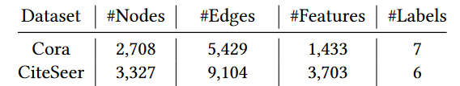
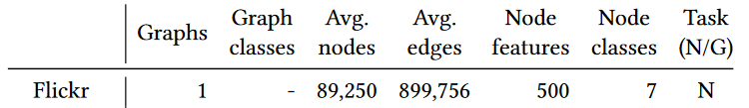
数据集：Cora、 Citeseer 、Pubmed、 Flickr、 Reddit
Cora Citeseer https://www.cs.umd.edu/~sen/lbc-proj/LBC.html
Pubmed https://linqs.org/datasets/#pubmed-diabetes
Flickr https://socialnetworks.mpi-sws.org/data-imc2007.html
Reddit https://snap.stanford.edu/graphsage/
对比方法：
ZeroMark: Towards Dataset Ownership Verification without Disclosing Watermarks（ NeurIPS 2024） Picture DNN
Data Isotopes for Data Provenance in DNNs（PETS 2024)
Domain Watermark: Effective and Harmless Dataset Copyright Protection is Closed at Hand (NeurIPS 2023) Picture DNN
FACE-AUDITOR: Data Auditing in Facial Recognition Systems (USENIX Security)2023
Did You Train on My Dataset? Towards Public Dataset Protection with Clean-Label Backdoor Watermarking(2023 KDD Explorations Newsletter)
Untargeted Backdoor Watermark: Towards Harmless and Stealthy Dataset Copyright Protection（NeurIPS 2022）

Slide 37
数据集：Cora、 Citeseer 、Pubmed、 Flickr
Cora Citeseer https://www.cs.umd.edu/~sen/lbc-proj/LBC.html
Pubmed https://linqs.org/datasets/#pubmed-diabetes
Flickr https://socialnetworks.mpi-sws.org/data-imc2007.html
Reddit https://snap.stanford.edu/graphsage/
对比方法：
GraphGuard: Detecting and Counteracting Training Data Misuse in Graph Neural Networks (NDSS 2024) GNN Graph
ZeroMark: Towards Dataset Ownership Verification without Disclosing Watermarks（ NeurIPS 2024） Picture DNN
Untargeted Backdoor Watermark: Towards Harmless and Stealthy Dataset Copyright Protection（NeurIPS 2022） Graph
Domain Watermark: Effective and Harmless Dataset Copyright Protection is Closed at Hand (NeurIPS 2023) Picture DNN
Did You Train on My Dataset? Towards Public Dataset Protection with Clean-Label Backdoor Watermarking(2023 KDD Explorations Newsletter)文本、图像和音频数据集
Data Isotopes for Data Provenance in DNNs（PETS 2024)
类似的后门 各种GNN 设置场景 -> 有效性 选择一个最新的方案 形成变体 提高说服力 有效性 迁移性 新场景 突出优势
基于最新的后门选择做变体

Slide 38
英文题目：
Imperceptible Graph Dataset Copyright Protection for Graph Prompt Learning
Do You Know Topological Isotope? Towards GPL Dataset Copyright Protection with Distribution Preserving
In-Distribution Topological Isotope For Large Graph Model Dataset Copyright Protection 落脚到数据集
Who used owner graphs? A High Concealment Data Copyright Protection Method for Large Graph Models By Topological Isotope
Graph Prompt Learning Dataset Copyright Protection from Distribution-Preserving Perspective
针对图提示学习的图结构数据权属验证
Who used owner graphs? A High Imperceptible data Copyright Protection scheme for Graph Prompt Learning By Topological Isotope
基于高隐蔽性拓扑同位素的图提示数据集权属验证
An ownership verification scheme for graph-prompted datasets based on imperceptible topological isotope
An ownership Provenance scheme for graph-prompted datasets based on imperceptible topological isotope //题目内容宽泛 内容布局
ownership Provenance 所有权溯源

Slide 39
研究问题： 1、有效性 2、
所提出的OPG-DTIO在提示调优的过程中能否有效完成对数据集的溯源 提示微调
Can the proposed OPG-DTIO effectively proven the dataset during the prompt tuning process?
在非法用户使用剪枝等预处理方法的情况下，我们的方案能否优于其他的数据权属验证方法？在XXX挑战场景
Does our approach outperform other DOV methods under the condition that an unauthorized user uses pruning or other preprocessing methods
所提出的OPG-DTIO如何在各种图提示学习方法下，有效完成数据权属验证的。 描述简单易懂
How does the proposed OPG-DTIO effectively perform data ownership verification under various graph prompt learning methods?
提高拓扑同位素与原始数据的分布相似性对于提高数据集的溯源表现有什么作用
What is the role of increasing the similarity between topological isotopes and the original data distribution in enhancing the dataset's provenance performance?
所提出的方法是否保证了下游提示调优任务的泛化性和健壮性
Whether the proposed OPG-DTIO guarantees strong generalization and robustness in downstream prompt tuning tasks.
An ownership Provenance scheme for graph-prompted datasets based on imperceptible topological isotope
Overleaf 列提纲 （七个子标题、小标题）
改RQ
图美观性

Slide 40
研究问题：
在各种图提示学习系统中，所提出的IDDP-GPL能否有效的完成数据集权属溯源
Can the proposed IDDP-GPL effectively finish dataset ownership provenance in various graph prompt learning systems?
我们的IDDP-GPL方案在图提示调优的条件下是否优于其他的数据集权属溯源方法
Does our IDDP-GPL scheme outperform other dataset ownership provenance methods under the condition of graph prompt learning?
Overleaf 列提纲 （七个子标题、小标题）
改RQ
图美观性

Slide 41

实验设置：1、完全黑盒，不了解对手的提示学习方法
2、灰盒模型 了解对手的提示学习方法
1
1
0
1
0
1
0
1
0
0
1
0
1
1
0
1
$$K(x)$$
$$h$$

Slide 42
PSR
PSR

Slide 43
PSR

Slide 44
现存问题 p 0.05
验证阶段采用的卡方检验，而卡方检验计算P值的过程不可微分，无法直接作为损失项，选择用KL散度替换，不知道说不说的通
选的对比模型性能也很优异，同时也是从分布的角度出发，导致不能突出我们方法的优越性，后面防御机制的设立不知道能不能说得通 DPGBA UGBA 2023 kdd 89 90

Slide 45
现存问题 2025/3/31
在方法论里面新增了Final Objective Function of PGDP 章节 分了三个部分：总体损失介绍，内层优化细节、外层优化细节 (双层优化)
在实验结果章节新增了超参数敏感性分析模块，探究嵌入差异约束α和溯源效果约束γ对所提方案的影响
在自适应对手方面，要不要设置消融实验，也就是多选几个异常检测方法进行对比，说明我们的方法具有很高的隐蔽性，鲁棒性。2-3种
引言最后写 列提纲
逻辑严谨, 提高信息量

Slide 46
GCN-None
GCN-OD
GraphSage-OD
GraphSage-OD
GAT-OD
GAT-OD
GIN-OD
GIN-OD

Slide 47
No defense
OD
β,γ,δ

Slide 48


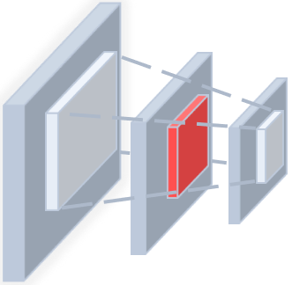


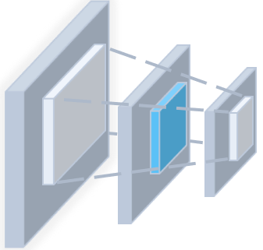







对比图 思路 流程图
(a) Existing backdoor watermark methods
Embed
backdoor
watermarks
Malicious manipulation
Protect
ownership
Fine
tune
leak
traces
Verify
Trigger
Data
owner
Modify
target
class
Trigger
$$y_{s}$$
$$y_{t}$$
Model with backdoor
$$y_{s}$$
$$y_{t}$$
(Unreliable)
Adversary
(b) PDGP scheme
Legal manipulation
Protect
ownership
Embed
isotopes
Fine
tune
Prompt
tune
Verify
leak
traces
Isotope
Isotope
Data
owner
$$p_{s}$$
Modify
probability
distribution
(0.2 0.9 … 0.1)
$$p_{s}$$
$$p_{t}$$
Model without backdoor
Prompt
driven
hypothesis
testing
Adversary
(Reliable)
(0.3 0.8 … 0.2)
$$p_{t}$$
Correctly classified
同位素的介绍 类比成其他的常见名词 指纹 现有的概念

Slide 49

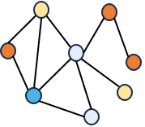



场景
Protected dataset
Legal user
GNN models
authorized
person
Train
Make
Release
Data
owner
Protected dataset
Illegal user
Protected dataset
Cloud platform
unauthorized
person
Train
GNN models

Slide 50





Key pair generation
Public key
Prompt key
Representative
nodes $V_{s}$
Representative node selection
MLP trigger generator
Prompt learning
Original datasets $G$
$$x_{iso}$$
Original datasets $G$
Prompt-driven dataset provenance verification
Probability distribution
(0.2 0.9 0.4 … 0.1)
Hypothesis testing:
$H_{0}:$The observed two queries have different classification probability distributions
Legal graph model
$p_{sur}$
Public key
Prompt key
(0.3 0.8 0.2 … 0.2)
Original datasets $G$
$p_{dis}$
Suspected graph model

Slide 51


(a) Existing backdoor watermark methods
Malicious manipulation
Embed
backdoor
watermarks
Protect
ownership
Leak
traces
Train
Verify
Trigger
Trigger
Data
owner
Modify
target
class
$$y_{s}$$
$$y_{t}$$
Model with backdoor
$$y_{s}$$
$$y_{t}$$
Adversary
(Unreliable)
(b) PDGP scheme
Legal manipulation
逻辑和创新型 不要公钥私钥 有待激活的结构
扰动结构
Generated
key pair
Protect
ownership
Verify
leak
traces
Train
Data
owner
Public key
$$p_{s}$$
$$p_{t}$$
(0.2 0.9 … 0.1)
Adversary
Modify
Probability distribution
Model without backdoor
hypothesis
testing
Prompt key
(Reliable)
(0.3 0.8 … 0.2)
$$p_{t}$$
对比图 思路 流程图 指纹

Slide 52
引言思路
扰动子图结构
代表性节点 有歧义
Signature 签名 指纹 触发器 水印
KL散度
对模型影响较小的节点
Activatable subgraph 可激活的子图
往往存在未经授权的数据收集和滥用。
数据滥用损害了数据所有者的知识产权
后门水印技术被广泛应用到图像数据集上实现数据集的权属保护
现有的后门水印技术存在被攻击者恶意操控后门的风险，会导致训练的模型存在安全隐患，保证不了无害性，现有的后门水印易被检测到，隐蔽性较差
GNN模型快速发展和广泛应用
模型依赖大量的图数据集进行训练实现最佳功能
受图提示学习的启发，我们提出了一个图提示学习驱动，考虑嵌入相似性和分布相似性的高隐蔽性数据集权属保护方法，在验证阶段配合假设检验实现数据集权属验证的同时，避免后门引起的安全隐患
总结方案贡献
对比分析，常见的后门水印技术与我们方案，突出方案的优越性
类似NLP中的提示学习技术近期被广泛应用到GNN领域
分四段或者五段 列小标题

Slide 53
对比图 思路 流程图 指纹
(a) Existing backdoor watermark methods 现有的基于触发/后门的水印方法
Malicious manipulation
Embed
backdoor
watermarks
Protect
ownership
Leak
traces
Train
Verify
Trigger
Trigger
Data
owner
Modify
target
class
$$y_{s}$$
$$y_{t}$$
Model with backdoor
$$y_{s}$$
$$y_{t}$$
Adversary
(Unreliable)
(b) PDGP scheme
Legal manipulation
逻辑和创新型 不要公钥私钥 有待激活的结构
扰动结构
Generated
key pair
Protect
ownership
Verify
leak
traces
Train
Data
owner
Public key
$$p_{s}$$
$$p_{t}$$
(0.2 0.9 … 0.1)
Adversary
Modify
Probability distribution
Model without backdoor
hypothesis
testing
Prompt key
(Reliable)
(0.3 0.8 … 0.2)
$$p_{t}$$
找到固有的子图结构 – 指纹
找到一个局部的子结构 ，使插入的结构对原始数据集的影响尽可能的小 替换在单个节点上插入结构
体现 选中的局部子图结构 以及 插入的子图结构
代理提示和扰动提示的生成过程要有体现

Slide 54
对比图 思路 流程图 指纹
(a) Existing backdoor watermark methods 现有的基于触发/后门的水印方法
Malicious manipulation
Embed
backdoor
watermarks
Protect
ownership
Leak
traces
Train
Verify
Trigger
Trigger
Data
owner
Modify
target
class
$$y_{s}$$
$$y_{t}$$
Model with backdoor
$$y_{s}$$
$$y_{t}$$
Adversary
(Unreliable)
(b) PDGP scheme
Legal manipulation
Generated
key pair
Protect
ownership
Verify
leak
traces
Train
Data
owner
Public key
$$p_{s}$$
$$p_{t}$$
(0.2 0.9 … 0.1)
Adversary
Modify
Probability distribution
Model without backdoor
hypothesis
testing
Prompt key
(Reliable)
(0.3 0.8 … 0.2)
$$p_{t}$$
找到固有的子图结构 – 指纹
找到一个局部的子结构 ，使插入的结构对原始数据集的影响尽可能的小 替换在单个节点上插入结构
体现 选中的局部子图结构 以及 插入的子图结构
代理提示和扰动提示的生成过程要有体现

Slide 55


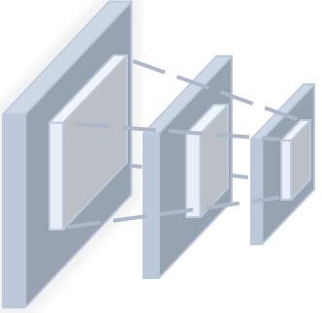

Watermark graph
(a) Existing Backdoor-Based Watermarking Methods
+
-
Labeled
Malicious manipulation
Unlabeled
Embed
backdoor
watermarks
-
Protect
ownership
全局提示
-
+
Verify
+
Leak
traces
局部聚焦提示
+
Train
+
+
+
合法模型
Data
owner
Modify
nodes
labels
+
Watermark node
Watermark
Model with backdoor
Adversary
可疑模型
-
+
+
node is positive
from label to label
(Unreliable)
Release vulnerable datasets
Incorrect classification
(b) PDGP scheme
Legal manipulation
-
Protect
ownership
-
+
+
Assist in classifying hard nodes
Verify
leak
traces
Train
+
?
hard
?
Data
owner
Find inherent hard nodes
hard node
Model without backdoor
Hard-aware
prompt
Adversary
Inactive
subgraph
Assistive
prompt
(Reliable)
?
node is correctly classified
Release trustworthy datasets
Model with high similarity

Slide 56
Trigger
(a) Existing Backdoor-based Watermarking Methods
+
-
Labeled
Malicious manipulation
Unlabeled
Embed
backdoor
watermarks
-
Protect
ownership
-
Leak
traces
+
Train
Verify
+
+
+
+
+
Data
owner
Modify
labels
+
Watermark sample
Trigger
Model with backdoor
Adversary
-
+
+
Node is positive
from label to label
(Unreliable)
Release vulnerable datasets
Incorrect results
(b) PDGP scheme
Legal manipulation
-
Protect
ownership
-
+
+
Assist in classifying hard nodes
Verify
leak
traces
Train
+
?
Hard
?
Data
owner
Find inherent hard nodes
hard node
Model without backdoor
Hard-aware
prompt
Adversary
Inactive
subgraph
Assistive
prompt
(Reliable)
?
node is correctly classified
Release trustworthy datasets
Model with high similarity
子图 绿色
POSITIVE

Slide 57
Trigger
(a) Existing Backdoor-based Watermarking Methods
+
-
Labeled
Malicious manipulation
Unlabeled
Embed
backdoor
watermarks
-
Protect
ownership
-
Leak
traces
+
Train
Verify
+
+
+
+
+
Data
owner
Modify
labels
+
Watermark sample
Trigger
Model with backdoor
Adversary
-
+
+
Node is positive
from label to label
(Unreliable)
错误分类
Release vulnerable datasets
Incorrect results
(b) PDGP scheme
加绿色
Legal manipulation
-
水印
保护
Protect
ownership
-
+
+
Assist in classifying hard nodes
Verify
Leak
traces
Train
+
?
Hard
?
Data
owner
Find inherent hard nodes
Hard node
Model without backdoor
Hard-aware
prompt
Adversary
Cue-sensitive
subgraph
Activated
prompt
(Reliable)
Node is correctly classified
?
Release trustworthy datasets
正确结果
Model with high similarity
潜在的 潜伏的 可激活的
全局权重 局部权重 触发的
子图 绿色
POSITIVE

Slide 58
Trigger
(a) Existing Backdoor-based Watermarking Methods
+
-
Labeled
Malicious manipulation
Unlabeled
Embed
backdoor
watermarks
-
Protect
ownership
-
Leak
traces
+
Train
Verify
+
+
+
+
+
Data
owner
Modify
labels
+
Watermark sample
Trigger
Model with backdoor
Adversary
-
+
+
Node is positive
from label to label
(Vulnerable)
错误分类
Release unreliable datasets
Incorrect results
(b) PDGP scheme
加绿色
Legal manipulation
-
水印
保护
Protect
ownership
-
+
+
Assist in classifying hard nodes
Verify
Leak
traces
Train
+
?
Hard
?
Data
owner
Find inherent hard nodes
Hard node
Model without backdoor
Hard-aware
prompt
Adversary
Cue-sensitive
subgraph
Activated
prompt
(Secure)
Node is correctly classified
?
Release reliable datasets
正确结果
Model with high similarity
潜在的 潜伏的 可激活的
全局权重 局部权重 触发的
子图 绿色
POSITIVE

Slide 59
Trigger
(a) Existing Backdoor-based Watermarking Methods
+
-
Labeled
Malicious manipulation
Unlabeled
Embed
backdoor
watermarks
-
Protect
ownership
-
Leak
traces
+
Train
Verify
+
+
+
+
+
Data
owner
Modify
labels
+
Watermark sample
Trigger
Model with backdoor
Adversary
-
+
+
Node is positive
from label to label
(Vulnerable)
错误分类
水印
保护
有损伤的
Release of compromised datasets
Incorrect results
(b) Our scheme
加绿色
Legal manipulation
-
Protect
ownership
-
+
+
Assist in classifying hard nodes
Verify
Leak
traces
Train
+
?
Hard
?
Data
owner
Find inherent hard nodes
Hard node
Model without backdoor
Hard-aware
prompt
Adversary
Cue-sensitive
subgraph
Activated
prompt
(Secure)
Node is correctly classified
无损伤的
?
Release of harmless datasets
正确结果
Model with high similarity
潜在的 潜伏的 可激活的
全局权重 局部权重 触发的
子图 绿色
POSITIVE

Slide 60
Trigger
(a) Existing Backdoor-based Watermarking Methods
+
-
Labeled
Malicious manipulation
Unlabeled
Embed
backdoor
watermarks
-
Protect
ownership
-
Leak
traces
+
Train
Verify
+
+
+
+
+
Data
owner
Modify
labels
+
Watermark sample
Trigger
Model with backdoor
Adversary
-
+
+
Node is positive
from label to label
(Vulnerable)
错误分类
有损伤的
Release of compromised datasets
Incorrect results
(b) Our scheme
加绿色
Legal manipulation
-
Protect
ownership
-
+
+
Assist in classifying hard nodes
Verify
Leak
traces
Train
+
?
Hard
?
Data
owner
Find inherent hard nodes
Hard node
Model without backdoor
Hard-aware
prompt
Adversary
Cue-sensitive
subgraph
Activated
prompt
(Secure)
Node is correctly classified
无损伤的
?
Release of harmless datasets
正确结果
Model with high similarity

Slide 61

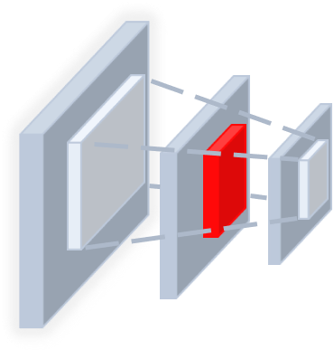
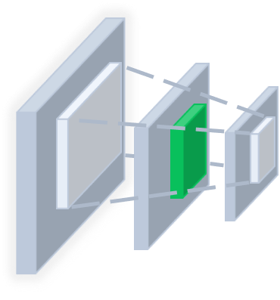


Trigger
(a) Existing Backdoor-based Watermarking Methods
+
Positive
Malicious manipulation
-
Negative
Embed
backdoor
watermarks
-
Unlabeled
Protect
ownership
-
Leak
traces
+
Train
Verify
+
+
+
+
+
Watermark sample
Data
owner
Modify
target
labels
Trigger
+
Adversary
-
Model with backdoor
From label negative
to label positive
(Vulnerable)
Node is positive
Incorrect results
+
+
Release of compromised datasets
(b) Our scheme
Legal manipulation
-
Protect
ownership
-
+
+
Find hard nodes for activation
Verify
Leak
traces
Train
+
-
?
Data
owner
+
Hard
?
Hard node
Adversary
Model without backdoor
Hard-aware
prompt
Cue-sensitive
subgraph
Activated
prompt
(Secure)
Node is correctly classified
Correct results
?
Release of harmless datasets
加绿色
POSITIVE
正确结果
全局权重 局部权重 触发的

Slide 62


Trigger
(a) Existing Backdoor-based Watermarking Methods
+
Positive
Malicious manipulation
-
Negative
Embed
backdoor
watermarks
-
Unlabeled
Protect
ownership
-
Leak
traces
+
Train
Verify
+
+
+
+
+
Watermark sample
Data
owner
Modify
target
labels
Trigger
+
Adversary
-
Model with backdoor
From label negative
to label positive
(Vulnerable)
Node is positive
Incorrect results
+
+
Release of compromised datasets
(b) Our scheme
Legal manipulation
-
Protect
ownership
-
+
Find inherent hard nodes for activation
Leak
traces
+
Verify
Train
+
-
?
Data
owner
+
Hard
?
Learn prompts for verification
Hard node
Adversary
Model without backdoor
Activated
prompt
Cue-sensitive
subgraph
Activated
prompt
(Secure)
Node is correctly classified
Correct results
?
Release of harmless datasets

Slide 63
a) Centrality-guided representative node selection
b) Bipartite embedding discrepancy isotope generation
Frozen
Tunable
Metric scores
1 0 1 0 1
$$h$$
4 0 3 8 1
$$x$$
1 1 1 0 1
5 0 7 0 1
0 0 1 0 1
6 3 1 2 1
Original embedding
1 0 1 0 1
8 6 3 7 1
0 0 1 1 1
9 3 5 7 1
Similar
Normalizing flow
Mean
Mean
K-Means
Centrality restriction
Flow model training
Initialize isotope adjacent matrix$h$ and feature matrix $x$
TOP-N
selection
Disturbed embedding
Contrastive learning
Original datasets $G$
Black-box GNN
1 0 1 0 1
5 0 3 2 9
1 1 1 1 0
6 4 5 4 4
Density estimation
0 0 1 1
5 0 2 8
Isotope embedding
数据集版权保护
Representative nodes
1 1 1 0 0
3 7 9 6 3
Similar
$z_{flow}$ $GMM\left(μ,σ\right)$
0 0 1 1 0
1 0 2 1 4
$$h_{i}$$
$$x_{i}$$
Surrogate prompt generation
Difference
calculation
$$ℒ_{pro}$$
$$ℒ_{mlp}$$
$$ℒ_{sim}$$
Bi-level optimization
Attach node embedding
Disparate representations
Surrogate
prompts
Dissimilar
Disturbed prompts
Wasserstein distance $l_{w}$
Binary MLP isotope generator $f_{g}$
c) Prompt-driven dataset provenance verification
Probability distribution
$$x_{sur}$$
(0.2 0.9 0.4 … 0.1)
Hypothesis testing:
$H_{0}:$The observed two queries have different classification probability distributions
Legal graph model
$p_{sur}$
$$x_{iso}$$
(0.3 0.8 0.2 … 0.2)
Original datasets $G$
$$x_{dis}$$
$p_{dis}$
Prompt subgraphs
Suspected graph model

Slide 64
a) Centrality-guided representative node selection
b) Bipartite embedding discrepancy isotope generation
Frozen
Tunable
Periphery
Node scores
1 0 1 0 1
$$h$$
4 0 3 8 1
$$x$$
Hardness
1 1 1 0 1
5 0 7 0 1
0 0 1 0 1
6 3 1 2 1
Original embedding
Train
1 0 1 0 1
8 6 3 7 1
0 0 1 1 1
9 3 5 7 1
Similar
Normalizing flow
Mean
Mean
-
Periphery
Initialize isotope adjacent matrix$h$ and feature matrix $x$
Flow model training
TOP-N
selection
Disturbed embedding
-
+
Surrogate GNN Model
Contrastive learning
+
?
?
1 0 1 0 1
5 0 3 2 9
Density estimation
-
1 1 1 1 0
6 4 5 4 4
Isotope embedding
Hard nodes
0 0 1 1
5 0 2 8
K-hop
1 1 1 0 0
3 7 9 6 3
Similar
$z_{flow}$ $GMM\left(μ,σ\right)$
Original datasets $G$
?
?
0 0 1 1 0
1 0 2 1 4
$$h_{i}$$
$$x_{i}$$
Difference
calculation
Bi-level optimization
Attach node embedding
Structural Support Region
Surrogate
prompts
Dissimilar
Disturbed prompts
Wasserstein distance $l_{w}$
Binary MLP isotope generator $f_{g}$
c) Prompt-driven dataset provenance verification
Probability distribution
$$x_{sur}$$
(0.2 0.9 0.4 … 0.1)
Hypothesis testing:
$H_{0}:$The observed two queries have different classification probability distributions
Legal graph model
$p_{sur}$
$$x_{iso}$$
(0.3 0.8 0.2 … 0.2)
Original datasets $G$
$$x_{dis}$$
$p_{dis}$
Prompt subgraphs
Suspected graph model

Slide 65

a) Centrality-guided representative node selection
b) Bipartite embedding discrepancy isotope generation
Frozen
Tunable
Periphery
Node scores
1 0 1 0 1
$$h$$
4 0 3 8 1
$$x$$
Hardness
1 1 1 0 1
5 0 7 0 1
0 0 1 0 1
6 3 1 2 1
Original embedding
1 0 1 0 1
8 6 3 7 1
0 0 1 1 1
9 3 5 7 1
Similar
Normalizing flow
Mean
Mean
Periphery
Initialize isotope adjacent matrix$h$ and feature matrix $x$
Flow model training
-
node selection
TOP-N
selection
Disturbed embedding
Surrogate GNN Model
Contrastive learning
-
+
1 0 1 0 1
5 0 3 2 9
?
?
1 1 1 1 0
6 4 5 4 4
Density estimation
-
+
Hard nodes
0 0 1 1
5 0 2 8
Isotope embedding
1 1 1 0 0
3 7 9 6 3
Similar
$z_{flow}$ $GMM\left(μ,σ\right)$
0 0 1 1 0
1 0 2 1 4
Original datasets $G$
Similarity evaluation
$$h_{i}$$
$$x_{i}$$
K-hop
?
?
Difference
calculation
Bi-level optimization
Attach node embedding
Surrogate
prompts
Dissimilar
Disturbed prompts
Structural Support Region
Wasserstein distance $l_{w}$
Binary MLP isotope generator $f_{g}$
c) Prompt-driven dataset provenance verification
Probability distribution
$$x_{sur}$$
(0.2 0.9 0.4 … 0.1)
Hypothesis testing:
$H_{0}:$The observed two queries have different classification probability distributions
Legal graph model
$p_{sur}$
$$x_{iso}$$
(0.3 0.8 0.2 … 0.2)
Original datasets $G$
$$x_{dis}$$
$p_{dis}$
Prompt subgraphs
Suspected graph model

Slide 66
a) Centrality-guided representative node selection
b) Bipartite embedding discrepancy isotope generation
Frozen
Tunable
Periphery
1 0 1 0 1
$$h$$
4 0 3 8 1
$$x$$
1 1 1 0 1
5 0 7 0 1
0 0 1 0 1
6 3 1 2 1
Original embedding
1 0 1 0 1
8 6 3 7 1
Node scores
0 0 1 1 1
9 3 5 7 1
Similar
Normalizing flow
Node scores
Mean
Mean
Hardness
Initialize isotope adjacent matrix$h$ and feature matrix $x$
Flow model training
Periphery
Disturbed embedding
Contrastive learning
-
TOP-N
selection
1 0 1 0 1
5 0 3 2 9
Density estimation
-
+
Surrogate GNN Model
1 1 1 1 0
6 4 5 4 4
Isotope embedding
?
?
0 0 1 1
5 0 2 8
+
1 1 1 0 0
3 7 9 6 3
Similar
$z_{flow}$ $GMM\left(μ,σ\right)$
-
Hard nodes
0 0 1 1 0
1 0 2 1 4
$$h_{i}$$
$$x_{i}$$
Difference
calculation
Original datasets $G$
Bi-level optimization
Attach node embedding
Surrogate
prompts
Dissimilar
Disturbed prompts
Structural Support Region
Wasserstein distance $l_{w}$
Binary MLP isotope generator $f_{g}$
c) Prompt-driven dataset provenance verification
Probability distribution
Hypothesis testing:
$H_{0}:$The observed two queries have different classification probability distributions
$$x_{sur}$$
(0.2 0.9 0.4 … 0.1)
Legal graph model
$p_{sur}$
$$x_{iso}$$
(0.3 0.8 0.2 … 0.2)
Original datasets $G$
$$x_{dis}$$
$p_{dis}$
Prompt subgraphs
Suspected graph model

Slide 67
a) Centrality-guided representative node selection
b) Bipartite embedding discrepancy isotope generation
Frozen
Tunable
1 0 1 0 1
$$h$$
4 0 3 8 1
$$x$$
1 1 1 0 1
5 0 7 0 1
0 0 1 0 1
6 3 1 2 1
Original embedding
Node scores
1 0 1 0 1
8 6 3 7 1
Hardness
0 0 1 1 1
9 3 5 7 1
Similar
Normalizing flow
Mean
Mean
Hard node selection
Initialize isotope adjacent matrix$h$ and feature matrix $x$
Flow model training
Periphery
Disturbed embedding
Contrastive learning
-
TOP-N
selection
Surrogate GNN Model
1 0 1 0 1
5 0 3 2 9
Density estimation
-
+
1 1 1 1 0
6 4 5 4 4
Isotope embedding
?
?
0 0 1 1
5 0 2 8
+
1 1 1 0 0
3 7 9 6 3
Similar
$z_{flow}$ $GMM\left(μ,σ\right)$
-
Hard nodes
0 0 1 1 0
1 0 2 1 4
?
?
$$h_{i}$$
$$x_{i}$$
Difference
calculation
Original datasets $G$
Bi-level optimization
Attach node embedding
Surrogate
prompts
Dissimilar
Disturbed prompts
Structural Support Region
Wasserstein distance $l_{w}$
Binary MLP isotope generator $f_{g}$
c) Prompt-driven dataset provenance verification
Probability distribution
$$x_{sur}$$
(0.2 0.9 0.4 … 0.1)
Hypothesis testing:
$H_{0}:$The observed two queries have different classification probability distributions
Legal graph model
$p_{sur}$
$$x_{iso}$$
(0.3 0.8 0.2 … 0.2)
Original datasets $G$
$$x_{dis}$$
$p_{dis}$
Prompt subgraphs
Suspected graph model

Slide 68
a) Centrality-guided representative node selection
Node scores
Hardness
Periphery
TOP-N
selection
Original datasets $G$
Surrogate GNN Model
Periphery
?
?
-
Hard nodes
-
?
?
-
+
-
+
+
+
?
?
Hard node selection
Hard node selection

Slide 69
a) Centrality-guided representative node selection
b) Bipartite embedding discrepancy isotope generation
Frozen
Tunable
Metric scores
1 0 1 0 1
$$h$$
4 0 3 8 1
$$x$$
1 1 1 0 1
5 0 7 0 1
0 0 1 0 1
6 3 1 2 1
Original embedding
1 0 1 0 1
8 6 3 7 1
0 0 1 1 1
9 3 5 7 1
Similar
Normalizing flow
Mean
Mean
K-Means
Centrality restriction
Flow model training
Initialize isotope adjacent matrix$h$ and feature matrix $x$
TOP-N
selection
Disturbed embedding
Contrastive learning
Original datasets $G$
Black-box GNN
1 0 1 0 1
5 0 3 2 9
Density estimation
1 1 1 1 0
6 4 5 4 4
Isotope embedding
Representative nodes
0 0 1 1
5 0 2 8
1 1 1 0 0
3 7 9 6 3
Similar
$z_{flow}$ $GMM\left(μ,σ\right)$
0 0 1 1 0
1 0 2 1 4
$$h_{i}$$
$$x_{i}$$
Surrogate prompt generation
Difference
calculation
$$ℒ_{pro}$$
$$ℒ_{mlp}$$
$$ℒ_{sim}$$
Bi-level optimization
Attach node embedding
Disparate representations
Surrogate
prompts
Dissimilar
Disturbed prompts
Wasserstein distance $l_{w}$
Binary MLP isotope generator $f_{g}$
c) Prompt-driven dataset provenance verification
Probability distribution
$$x_{sur}$$
(0.2 0.9 0.4 … 0.1)
Hypothesis testing:
$H_{0}:$The observed two queries have different classification probability distributions
Legal graph model
$p_{sur}$
$$x_{iso}$$
(0.3 0.8 0.2 … 0.2)
Original datasets $G$
$$x_{dis}$$
$p_{dis}$
Prompt subgraphs
Suspected graph model

Slide 70
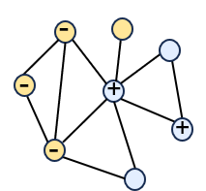
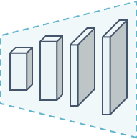
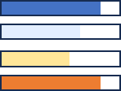
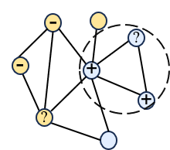
a) Centrality-guided representative node selection
Hard
Hardness
TOP-N
selection
Periphery
Node scores
Original datasets $G$
GNN model
node selection
b) Bipartite embedding discrepancy isotope generation
Original embedding
Similar
Disturbed embedding
Isotope embedding
Similar
Attach node embedding

Slide 71
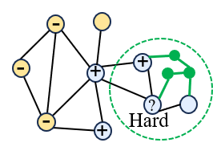



a)
找到固有结构的子图
b) Centrality-guided representative node selection
Hard
Hardness
TOP-N
selection
$$G_{c}$$
Periphery
Global prompt
Node scores
Original datasets $G$
GNN model
Cue-sensitive graph $G_{c}$
Hard-aware prompt
node selection
c)
Activated prompt
单箭头
$$f_{g}$$
Subgraph generator
小标题 a模块的信息量 prompt 展开
Prompt 展开
第一步 发现一个固有的子图结构
第二步 生成一个Cue-sensitive子图 插入到原始图中
配合我们设计的提示 组成验证模块

Slide 72
现有的问题
Ab模块涉及到的公式计算很多，理论的东西用图很不好展现，
实现过程不好展开

Slide 73
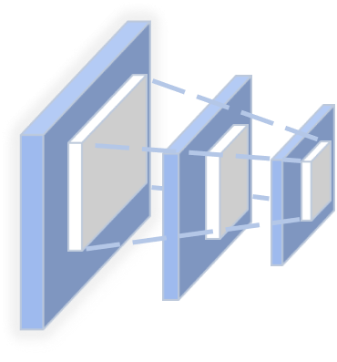

a) Semantic-Topological Consistent Hard Region Selection
Semantic
similarity
Hard
score
Top-N
Semantic
selector
Hard nodes
Original graph $G$
Surrogate
GNN model
Hard
region
Topology consistency
Hard region
extraction
Topology calibrator
b) Semantic-Topological Consistent Hard Region Selection
Semantic similarity alignment
Original graph features
+
GNN
Encoder
Feature
alignment
Subgraph features
CSS generator
Cue-sensitive
subgraph
Hard region features
Distribution similarity alignment
-
-
+
+
-
?
Hard

Slide 74


Trigger
(a) Existing Backdoor-based Watermarking Methods
+
Positive
Malicious manipulation
-
Negative
Embed
backdoor
watermarks
-
Unlabeled
Protect
ownership
-
Leak
traces
+
Train
Verify
+
+
+
+
+
Watermark sample
Data
owner
Modify
target
labels
Trigger
+
Adversary
-
Model with backdoor
From label negative
to label positive
(Vulnerable)
Node is positive
Incorrect results
+
+
Release of compromised datasets
(b) Our scheme
Legal manipulation
-
Protect
ownership
-
+
Find inherent hard nodes for activation
Leak
traces
+
Verify
Train
+
-
?
Data
owner
+
Hard
?
Learn prompts for verification
Hard node
Adversary
Model without backdoor
Activated
prompt
Cue-sensitive
subgraph
Activated
prompt
(Secure)
Node is correctly classified
Correct results
?
Release of harmless datasets

Slide 75
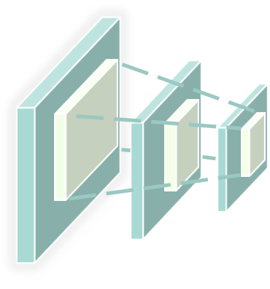
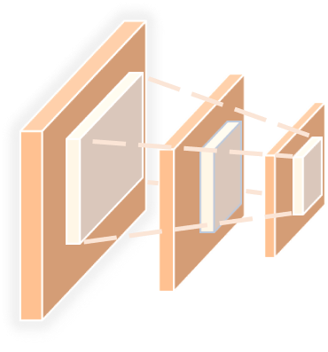















a) Semantic-topological consistent hard region selection
c) Prompt-driven dual dataset ownership verification
Semantic
similarity
1) Behave similarity
Hard
score
Ownership verification
by single-class outputs
Both models make the same predictions on hard nodes.
-
+
+
?
?
?
Semantic
selector
Hard
2) Kernel similarity
形容词
名称相似
关联性
-
Top-N
-
+
+
Hard nodes
Ownership verification
by hypothesis testing
Both models output similar hard-node probabilities
Surrogate
GNN model
-
Original graph $G$
1) Behave similarity
2) Kernel similarity
+
Positive
Topology consistency
Hard region
extraction
-
-
-
Negative
Topology calibrator
Unlabeled
-
+
+
-
+
+
b) Feature-preserving perturbation generation and dual prompt learning
-
?
-
?
Hard
Hard
Distribution similarity alignment
Perturbed graph $G_{p}$
Perturbed graph $G_{p}$
-
+
+
Original graph features
-
Feature
alignment
威胁模型
图标
Original graph $G$
GNN
Encoder
+
Subgraph features
Legal model
Suspected model
Legal model
Suspected model
CSS generator
Cue-sensitive
subgraph
判定
结果
图中表现
表述
Semantic similarity alignment
Hard node features
Global guide
Activated prompt
Activated prompt
-
Predicted
label
$$y_{s}$$
Probability distribution$p_{l}$
Probability distribution$p_{s}$
Global prompt
Predicted
label
$$y_{l}$$
-
+
+
Hard boost
?
$$similar$$
-
$y_{l}=y_{s} :$Infringed
$$p_{l}$$
$${ p}_{s} :$$
Infringed
Hard
1
3
Hard-aware prompt
2
$$dissimilar$$
$y_{l}{≠y}_{s }:$ Unviolated
4
Perturbed graph $G_{p}$
AP generator
$$p_{l}$$
$${ p}_{s} :$$
Unviolated
Activated prompt

Slide 76


a) Semantic-topological consistent hard region selection
c) Prompt-driven dual dataset ownership verification
Semantic
similarity
1) Behave similarity
形容词
名称相似
关联性
Hard
score
Ownership verification
by single-class outputs
Both models make the same predictions on hard nodes.
-
+
+
?
?
?
Semantic
selector
Hard
2) Kernel similarity
-
Top-k
-
+
+
两种情况
Hard nodes
Ownership verification
by hypothesis testing
Both models output similar hard-node probabilities
Original graph
Surrogate
GNN model
-
1) Behave similarity
2) Kernel similarity
特征的
颜色
+
Positive
Topology consistency
Hard region
extraction
-
-
-
Negative
Topology calibrator
-
+
+
-
+
+
威胁模型
图标
b) Feature-preserving perturbation generation and dual prompt learning
-
?
-
?
Hard
Hard
Distribution similarity alignment
Perturbed graph $G_{p}$
Perturbed graph $G_{p}$
周三下午
2点30
图书馆
北门5楼
527会议室
-
+
+
Original graph features
-
Feature
alignment
Original graph
GNN
Encoder
+
Subgraph features
Legal model
Suspected model
Legal model
Suspected model
CSS generator
Cue-sensitive
subgraph
Semantic similarity alignment
Hard node features
模型结果
缺形容词
Global guide
Activated prompt
Activated prompt
-
Predicted
label
$$y_{s}$$
Probability distribution$p_{l}$
Probability distribution$p_{s}$
Global prompt
Predicted
label
$$y_{l}$$
判定
结果
图中表现
表述
-
+
+
Hard boost
?
$$similar$$
-
$y_{l}=y_{s} :$Infringed
$$p_{l}$$
$${ p}_{s} :$$
Infringed
Hard
1
3
Hard-aware prompt
2
$$dissimilar$$
$y_{l}{≠y}_{s }:$ Unviolated
4
Perturbed graph
AP generator
$$p_{l}$$
$${ p}_{s} :$$
Unviolated
Activated prompt

Slide 77
引言思路
扰动子图结构
代表性节点 有歧义
Signature 签名 指纹 触发器 水印
KL散度
对模型影响较小的节点
Activatable subgraph 可激活的子图
往往存在未经授权的数据收集和滥用。
数据滥用损害了数据所有者的知识产权
后门水印技术被广泛应用到图像数据集上实现数据集的权属保护
现有的后门水印技术存在被攻击者恶意操控后门的风险，会导致训练的模型存在安全隐患，保证不了无害性，现有的后门水印易被检测到，隐蔽性较差
GNN模型快速发展和广泛应用
模型依赖大量的图数据集进行训练实现最佳功能
受图提示学习的启发，我们提出了一个图提示学习驱动，考虑嵌入相似性和分布相似性的高隐蔽性数据集权属保护方法，在验证阶段配合假设检验实现数据集权属验证的同时，避免后门引起的安全隐患
总结方案贡献
对比分析，常见的后门水印技术与我们方案，突出方案的优越性
类似NLP中的提示学习技术近期被广泛应用到GNN领域
分四段或者五段 列小标题

Slide 78
















a) Context-aware carrier region generation
c) Prompt-driven trustworthy dataset ownership verification
Semantic
similarity
载体区域的特点
Verification criterion
1) Behavioral agreement check
Score
top-k
Ownership verification via decision agreement
Both models yield identical class predictions
-
+
+
?
?
?
Semantic node selector
Carrier
-
Hard nodes
-
+
?
2) Distributional agreement check
Original graph
Surrogate
GNN model
-
Ownership verification via distributional inference
Both models exhibit similar output probability distributions
Structural consistency
Carrier region
extraction
-
+
Labeled (positive or negative)
Verification mechanism
Unlabeled
Structure-aware edge filter
b) Cue-activated dual prompt generation
-
Distribution similarity alignment
+
Carrier
-
+
Legal model
1)
Dataset
ownership?
-
+
?
?
2)
Original graph features
-
Hard
-
Feature
alignment
GNN
Encoder
Perturbed graph $G_{p}$
Suspected model
Activated prompt
Original graph
+
CSS features
Verification status
$$y_{l}=y_{s}$$
Legal model predicted label $y_{l}$
1
1) Behavioral agreement check
$$y_{l}{≠y}_{s }$$
CSS generator
Cue-sensitive
subgraph
Carrier region features
Suspected model predicted label $y_{s}$
2
$$similar$$
Semantic similarity alignment
$$p_{l}$$
$${ p}_{s}$$
2) Distributional
agreement check
Legal model predicted distribution${ p}_{l}$
3
Task enhancement
Suspected model predicted distribution $p_{s}$
4
$$dissimilar$$
$$p_{l}$$
$${ p}_{s}$$
-
-
+
Verification results
+
Error correction
Regular-aware prompt
1
3
1
4
?
Prediction similarity
between models
No prediction similarity
between models
-
Hard
Hard-aware prompt
2
3
2
4
Confirmable
Unidentifiable
Perturbed graph
AP generator
Activated prompt

Slide 79


a) Context-aware carrier region extraction
c) Prompt-driven trustworthy dataset ownership verification
Semantic
similarity
Verification criterion
载体区域的特点
子图
三种特征概括所有的情况
匹配
名词保持不一样
第三个标题 合成的形容词 + 形容词
按照全部数据/部分数据情况展开
1) Behavioral agreement check
Top-k
score
Ownership verification via decision agreement
Both models yield identical class predictions
-
+
+
?
?
Semantic node selector
Carrier
-
Hard nodes
-
+
?
2) Distributional agreement check
Original graph
Surrogate
GNN model
-
Ownership verification via distributional inference
Both models exhibit similar probability distributions
Structural consistency
Carrier region
extraction
-
+
Labeled (Positive or negative)
Verification mechanism
Unlabeled
Structure-aware edge filter
b) Cue-activated dual prompt generation
-
Distribution similarity alignment
+
Carrier
-
+
Legal model
1)
Dataset
ownership?
-
+
?
?
2)
Original graph features
-
Hard
-
Feature
alignment
GNN
Encoder
Perturbed graph
Suspected model
Activated prompt
Original graph
+
CSS features
Verification status
$$y_{l}=y_{s}$$
Legal model predicted label $y_{l}$
1
1) Behavioral agreement check
$$y_{l}{≠y}_{s }$$
CSS generator
Cue-sensitive
subgraph
Carrier region features
Suspected model predicted label $y_{s}$
2
S$imilar$
Semantic similarity alignment
$$p_{l}$$
$${ p}_{s}$$
2) Distributional
agreement check
Legal model predicted distribution${ p}_{l}$
3
Task enhancement
Suspected model predicted distribution $p_{s}$
4
$$Dissimilar$$
$$p_{l}$$
$${ p}_{s}$$
-
-
+
Verification results
+
Error correction
Regular-aware prompt
1
3
1
4
?
Prediction similarity
between models
No prediction similarity
between models
-
Hard
Hard-aware prompt
2
3
2
4
Perturbed graph
AP generator
Activated prompt

Slide 80
a) Context-aware stealth-anchoring selection
c) Prompt-driven trustworthy dataset ownership verification
Semantic
similarity
Verification criterion
1) Behavioral agreement check
Top-k
score
Ownership verification via decision agreement
Both models yield identical class predictions
-
+
+
?
?
Semantic node sampler
-
Hard nodes
-
+
?
2) Distributional agreement check
Original graph
Surrogate
GNN model
-
Ownership verification via distributional inference
Both models exhibit similar probability distributions
-
Structural consistency
Stealth-anchoring
region selection
+
Labeled (Positive or negative)
Verification mechanism
Unlabeled
Structure-aware edge filter
b) Cue-activated dual prompt generation
-
Distribution similarity alignment
+
-
+
Legal model
1)
Dataset
ownership?
-
+
?
?
2)
Original graph features
-
Hard
-
Feature
alignment
GNN
Encoder
Perturbed graph
Suspected model
Activated prompt
Original graph
+
CSS features
Verification status
$$y_{l}=y_{s}$$
Legal model predicted label $y_{l}$
1
1) Behavioral agreement check
$$y_{l}{≠y}_{s }$$
CSS generator
Cue-sensitive
subgraph
Stealth-anchoring region features
Suspected model predicted label $y_{s}$
2
Semantic similarity alignment
S$imilar$
$$p_{l}$$
$${ p}_{s}$$
2) Distributional
agreement check
Legal model predicted distribution${ p}_{l}$
3
Clear performance align
Suspected model predicted distribution $p_{s}$
4
$$Dissimilar$$
$$p_{l}$$
$${ p}_{s}$$
-
-
+
Verification results
+
Hard prediction flip
Clear-aware prompt
1
3
1
4
?
Prediction similarity
between models
No prediction similarity
between models
-
Hard
Hard-aware prompt
2
3
2
4
Perturbed graph
AP generator
Activated prompt

Slide 81
Trigger
(a) Existing backdoor-based injection methods
+
Positive
Malicious manipulation
-
Negative
Embed
backdoor
watermarks
-
Unlabeled
Protect
ownership
-
Leak
traces
+
Train
Verify
+
+
+
+
+
Watermark sample
Data
owner
Modify
target
labels
Trigger
+
Adversary
From negative labels
to positive labels
Model with backdoor
(Vulnerable)
Soft node is is correctly classified
Incorrect results
Release of compromised datasets
(b) Our scheme
Legal manipulation
-
Protect
ownership
-
+
Find inherent hard nodes for activation
Leak
traces
+
Verify
Train
+
-
?
Data
owner
+
Hard
?
Learn prompts for verification
Hard node
Adversary
Model without backdoor
Activated
prompt
Cue-sensitive
subgraph
Activated
prompt
(Secure)
Hard node is correctly classified
Correct results
Release of harmless datasets

Slide 82








a) Context-aware stealth-anchoring region selection
c) Prompt-gated robust dataset ownership verification
Semantic
similarity
Verification criterion
1) Behavioral consistency check
Top-k
score
Ownership verification via decision consistency
Both models yield identical class predictions
-
+
+
?
?
Semantic node sampler
2) Distributional alignment check
-
Hard nodes
-
+
?
Ownership verification via distribution alignment
Both models exhibit similar probability distributions
Original graph
Surrogate
GNN model
-
Structural consistency
Stealth-anchoring
region selection
Verification mechanism
-
+
Labeled (Positive or negative)
Unlabeled
Structure-aware edge filter
-
Regular-aware
prompt
b) Cue-activated dual prompt generation
-
+
+
Legal model
1)
Dataset
ownership?
Distribution similarity alignment
2)
-
?
Hard-aware
prompt
Hard
-
+
?
Original graph features
Perturbed graph
Suspected model
Activated prompt
-
Feature
alignment
GNN
Encoder
Verification scenarios
Original graph
$$y_{l}=y_{s}$$
+
CSS features
1) Behavioral consistency check
Legal model predicted label $y_{l}$
1
Suspected model predicted label $y_{s}$
$$y_{l}{≠y}_{s }$$
2
S$imilar$
$$p_{l}$$
$${ p}_{s}$$
Cue-sensitive
subgraph
2) Distributional alignment check
Legal model predicted distribution${ p}_{l}$
3
CSS generator
Suspected model predicted distribution $p_{s}$
4
$$Dissimilar$$
Stealth-anchoring region features
$$p_{l}$$
$${ p}_{s}$$
Semantic similarity alignment
Verification results
1
3
Infringed ownerships
1
4
Uncertain ownership
（false positive)
Performance boost
-
2
4
Unviolated ownerships
Uncertain ownership
（false negative)
2
3
+
Ownership verification for fully protected datasets
-
+
Prediction flip
Regular-aware prompt
1
3
1
4
-
?
Hard
Hard-aware prompt
2
4
2
3
Perturbed graph
AP generator
Activated prompt
Ownership verification for partially protected subsets

Slide 83
引言大纲
分四段或者五段 列小标题
1、研究背景与动机
  1.1 数据驱动的机器学习模型在多个领域的广泛应用（如社交网络、生物信息、推荐系统等）
  1.2 图数据集的收集与构建成本高，存在被非法复制、篡改、滥用的风险
  1.3 当前对图数据的权属保护机制仍不成熟，尤其是在黑盒/模型级验证方面
2、现有方法与局限性
2.1 介绍已有的基于后门的数据水印技术
2.2 缺乏对结构隐蔽性的控制，容易被检测/删除；通常只依赖单一验证信号，鲁棒性弱；很少考虑扰动与验证之间的耦合性设计
3、核心问题与研究挑战
3.1 如何设计低干扰、隐蔽性强的扰动结构？
3.2 如何与提示（prompt）机制结合，使扰动在验证时可被“激活”？
3.3 如何实现多角度、高可信度的权属验证？
4、本文贡献
4.1 Hard-aware Carrier Region Construction 承载区的提取
4.2 Coupled Trigger Embedding via Perturbation and Prompt扰动与提示耦合的触发结构嵌入方法
4.3 Dual-Prompt Optimization for Activation and Protection用于激活与保护的双提示联合优化方法
4.4 Dual-View Ownership Verification Mechanism 双视角的数据集权属验证机制
5、结构说明

Slide 84
Trigger
(a) Existing backdoor-based watermarking methods
+
Positive
Malicious manipulation
-
Negative
Backdoor watermark injection
-
Unlabeled
Ownership
protection
-
Leak
traces
+
Train
Verify
+
+
+
+
Target
label
modification
+
Watermark sample
Data
owner
Trigger
+
Adversary
based on adjacent
topological correlations
From negative labels
to positive labels
Model with backdoor
(Vulnerable)
Soft node is incorrectly classified
Incorrect results
Release of compromised datasets
(b) Injection-free transferable dataset ownership verification scheme (Ours)
-
Legal manipulation
Ownership
protection
-
+
+
Inherent hard node selection for activation
Leak
traces
Verify
Train
+
-
?
Data
owner
+
Hard
?
Prompt learning for verification
Hard node
Adversary
Model without backdoor
Activated
prompt
Cue-sensitive
subgraph
Activated
prompt
(Secure)
Hard node is correctly classified
Correct results
Release of harmless datasets
Cue-sensitive
imperceptible subgraph

Slide 85
Trigger
(a) Existing backdoor-based watermarking methods
+
Positive
无损的
自适应的
-
Negative
Malicious manipulation
Unlabeled
Backdoor watermark injection
-
Ownership
protection
-
Leak
traces
+
Train
Verify
+
+
+
+
+
Data
owner
Target
label
modification
+
Watermark sample
Adversary
Trigger
based on adjacent
topological correlations
From negative labels
to positive labels
Model with backdoor
(Vulnerable)
Soft node is incorrectly classified
Incorrect results
Release of compromised datasets
(b) Harmless transferable dataset ownership verification scheme (Ours)
-
Legal manipulation
Ownership
protection
-
+
+
Inherent hard node selection for activation
Verify
Leak
traces
Train
+
-
?
Data
owner
+
Hard
?
Hard node
Adversary
Prompt learning for verification
Model without backdoor
Activated
prompt
Cue-sensitive
imperceptible
subgraph
Activated
prompt
(Secure)
Hard node is correctly classified
Correct results
Release of harmless datasets

Slide 86






a) Context-aware stable region selection
c) Prompt-guided transferable dataset ownership verification
Semantic
similarity
Verification criterions
1) Behavioral consistency inspection
Top-k
score
Ownership verification via decision consistency
Both models yield identical class predictions
-
+
+
?
?
Semantic node sampler
Hard
-
Hard nodes
-
+
?
2) Distributional alignment check
Ownership verification via distribution alignment
Both models exhibit similar probability distributions
Original graph
Surrogate
GNN model
-
Structural consistency
Stable
region selection
Verification workflows
-
+
Labeled (Positive or negative)
Unlabeled
Structure-aware edge filter
b) Cue-activated dual prompt generation
-
Soft-aware prompt
Distribution similarity alignment
-
+
+
Legal model
1)
Success
Hard
?
2)
Fail
-
Hard
Hard-aware
prompt
Verification results
-
+
?
Original graph features
Harmless perturbed graph
Suspected model
Activated prompt
-
Feature
alignment
GNN
models
Verification situations
Original graph
+
CIS features
1) Behavioral
consistency inspection
Legal model predicted label $y_{l}$
1
$$y_{l}=y_{s}$$
Suspected model predicted label $y_{s}$
2
$$y_{l}{≠y}_{s }$$
CIS generator
Cue-sensitive
imperceptible subgraph (CIS)
Stable region features
2) Distributional alignment check
Legal model predicted distribution${ p}_{l}$
3
$$p_{l}$$
Similar
$${ p}_{s}$$
Suspected model predicted distribution $p_{s}$
Dissimilar
Semantic similarity alignment
4
$$p_{l}$$
$${ p}_{s}$$
Performance enhancement
Verification results
-
1
3
Violated ownership
（True positive)
1
4
Uncertain ownership
（False positive)
-
+
+
Soft-aware prompt
Uncertain ownership
（False negative)
2
4
Unviolated ownership
（True negative)
2
3
-
?
Hard
Outcome correction
Hard-aware prompt
Adaptive prompt
generator
Correct results
Incorrect results
Harmless perturbed graph
Activated prompt

Slide 87



a) Context-aware stable region selection
c) Prompt-guided transferable dataset ownership verification
Semantic
similarity
Verification criterions
1) Behavioral consistency inspection
Top-k
score
Ownership verification via decision consistency
Both models yield identical class predictions
-
+
+
?
?
Semantic node sampler
Hard
-
Hard nodes
-
+
?
2) Distributional alignment check
Ownership verification via distribution alignment
Both models exhibit similar probability distributions
Original graph
Surrogate
GNN model
-
Structural consistency
Stable
region selection
Verification workflows
-
+
Labeled (Positive or negative)
Unlabeled
Structure-aware edge filter
b) Cue-activated dual prompt generation
-
Soft-aware prompt
Distribution similarity alignment
-
+
+
Legal model
1)
Success
Hard
?
2)
Fail
-
Hard
Hard-aware
prompt
Verification results
-
+
?
Original graph features
Harmless perturbed graph
Suspected model
Activated prompt
-
Feature
alignment
GNN
models
Verification situations
Original graph
+
CIS features
1) Behavioral
consistency inspection
Legal model predicted label $y_{l}$
1
$$y_{l}=y_{s}$$
Suspected model predicted label $y_{s}$
2
$$y_{l}{≠y}_{s }$$
CIS generator
Cue-sensitive
imperceptible subgraph (CIS)
Stable region features
2) Distributional alignment check
Legal model predicted distribution${ p}_{l}$
3
$$p_{l}$$
Similar
$${ p}_{s}$$
Suspected model predicted distribution $p_{s}$
Dissimilar
Semantic similarity alignment
4
$$p_{l}$$
$${ p}_{s}$$
Performance enhancement
Verification results
-
1
3
Violated ownership
（True positive)
1
4
Uncertain ownership
（False positive)
-
+
+
Soft-aware prompt
Uncertain ownership
（False negative)
2
4
Unviolated ownership
（True negative)
2
3
-
?
Hard
Outcome correction
Hard-aware prompt
Adaptive prompt
generator
Correct results
Incorrect results
Harmless perturbed graph
Activated prompt

Slide 88
引言大纲
课题的重要性-> 发现问题->现有解决方法（缺失）->现存问题->本文的解决思路->解决方案- 衔接问题
1、Background and Motivation
图数据的高价值与高风险并存：数据驱动的机器学习模型在多个领域的广泛应用，图神经网络（GNN）在众多领域的广泛应用（如社交网络、生物医药、金融风控等）依赖高质量的图结构数据集。然而高质量图数据的获取成本高昂，极易被恶意复制或滥用。
  传统方法的局限性：
  后门水印策略在图中隐蔽性和稳定性不足，容易被检测与移除；
  现有验证机制未能同时考虑扰动设计与验证策略之间的耦合；（具体）
  现有数据集权属验证方法（如后门水印、决策边界指纹）多为图像/文本/语音领域设计，在图结构数据中缺乏适配性与迁移性。
  图结构数据上的挑战 结合自己方法的优势 找现有研究的缺陷
  研究动机：急需一种在不损害数据原任务性能的前提下，构建具有泛化能力与验证效力的图数据验证方法。
2、Technical Challenges
C1: 区域选择的稳健性不足：如何从图中选出一组对结构与语义稳定的节点集，支撑后续的扰动注入和验证操作？稳定子图的选择困难Hard node soft node
C2: 验证模式隐蔽性与可迁移性的冲突：如何生成既难以察觉、又能易激活有效验证模式的提示机制？
C3: 验证机制的可信度不足：如何构建一种能在黑盒场景下完成多视角验证（标签+概率分布）的验证流程？ xxx挑战导致可信度不足
3、Core Methodology Overview
阶段一：稳定区域选择基于熵的不确定性分数选出“hard节点”；利用语义相似性（如特征余弦）与结构一致性（如度数分布）构建稳定的图区域；
阶段二：提示优化设计在注入的扰动子图上训练软提示与硬提示，激活扰动信息
阶段三：双重验证机制行为相似性：合法模型与可疑模型在“hard节点”上的标签是否一致；分布相似性：在相同提示下，两个模型对相同节点的分类概率分布是否一致；若均成立，则推定目标模型使用了原始数据集。
4、本文贡献
区域稳健性选择机制：提出一种融合结构一致性与语义相似性的“稳定区域选择”方法；
提示驱动的扰动激活机制：在扰动子图基础上训练迁移性强的软/硬提示，实现有效可迁移的权属验证；
双重验证判据：建立“行为一致性 + 分布一致性”双视角验证体系，增强验证准确性与可信性；
端到端图数据权属验证框架：构建从区域识别、提示学习到验证输出的整体流程，适用于多种数据集、GNN结构和黑盒场景设定。
实验超过了SOTA，量化数值（最好的结果） 摘要量化数值
5、结构说明
6.19 展现核心内容

