Slide 1
Data Science in Infectious Disease Modeling using R
Welcome! We’ll start soon.

Slide 2
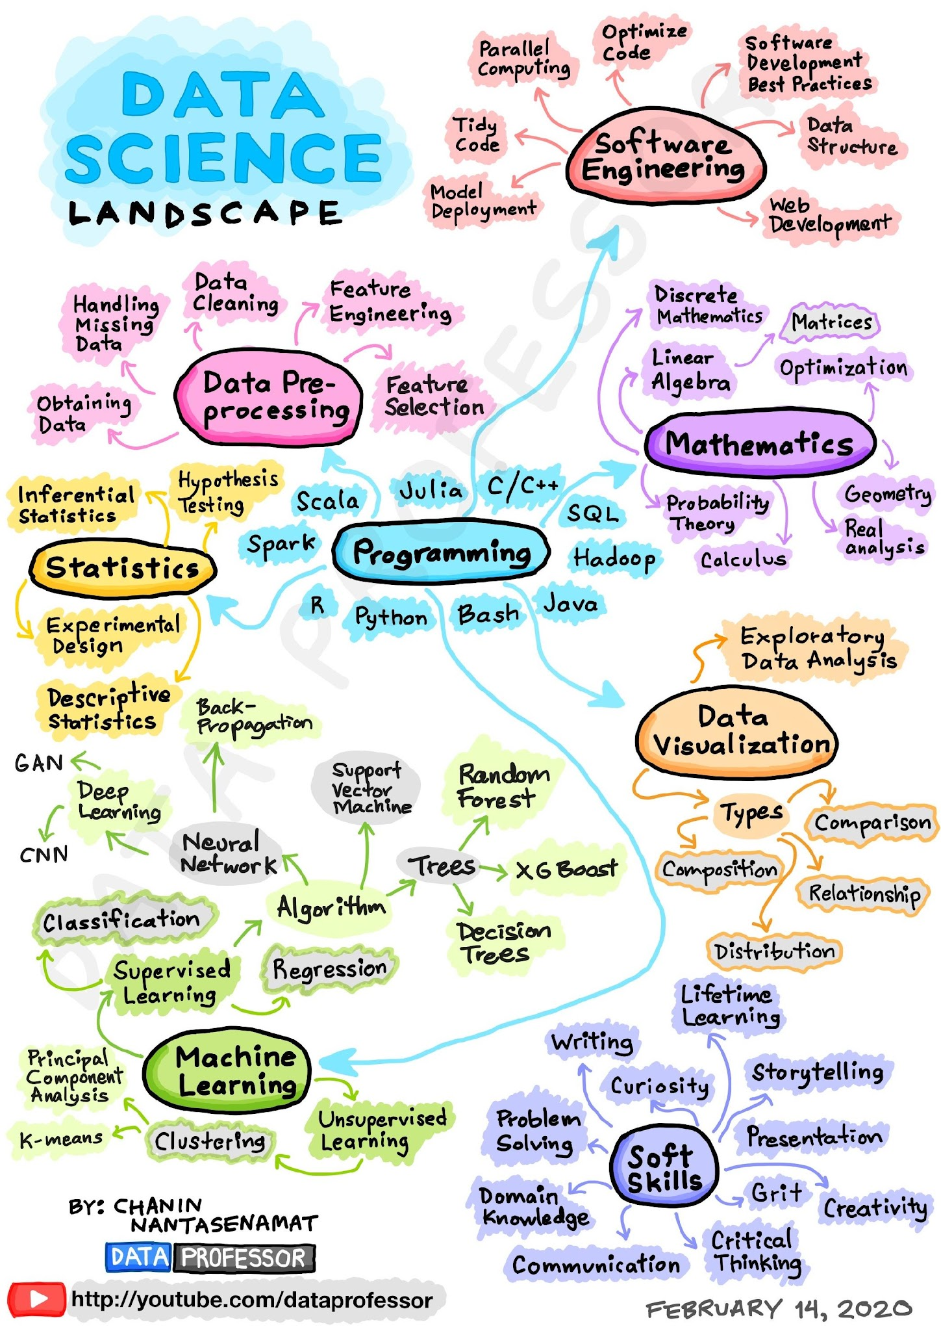
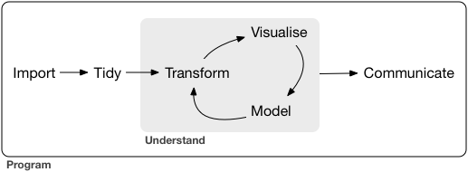
What is data science?
Data Science provides strategies for efficient, transparent and reproducible research
What concept stood out to you? Why? (respond in chat)

Slide 3
What to expect
From Course:
Scenario based activities to apply most concepts covered in asynchronous materials
Active learning through:
zoom reactions and chats
White boards
Breakout rooms
Polls
Padlet
From Us:
Responsive to your needs and interests
Create engaging environment
Organized and enthusiastic
From Yourself:
Ask questions of us and peers
Re-engage when mind wanders
How can I apply this to my work?

Slide 4
Scenario based learning
Today
Tomorrow
Importing Data
Working with survey data
Loading data via API
Building data sets with joins
Wrangling Data
Working with time series data
Data cleaning and manipulation
Visualization with ggplot2
Creating a SitRep
Working with case data
Joining related datasets
Creating visuals and summaries to highlight key trends
Office Hours Q+A
Submit questions ahead of time or ask live

