Slide 1

Team Name: ByteForceX
Team Leader : R. Rudraksh
Team Members:
S.Adarsh, S.Manohar

Slide 2
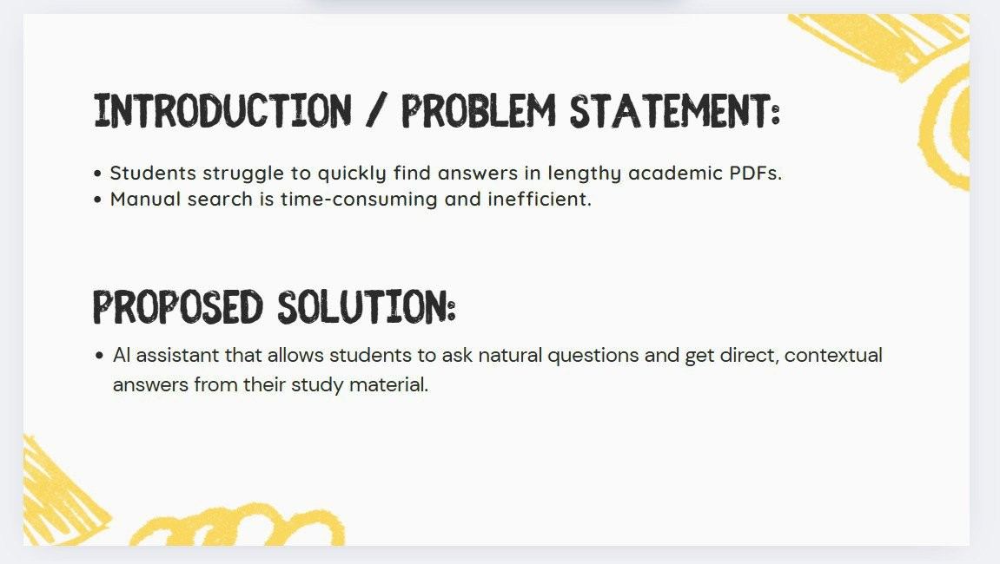

Slide 3
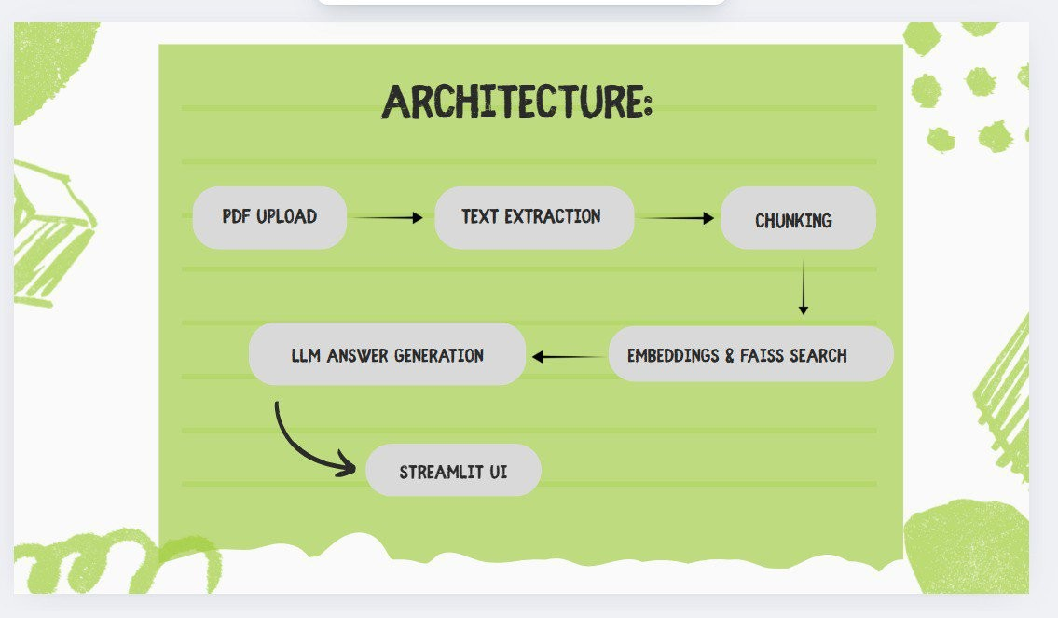

Slide 4
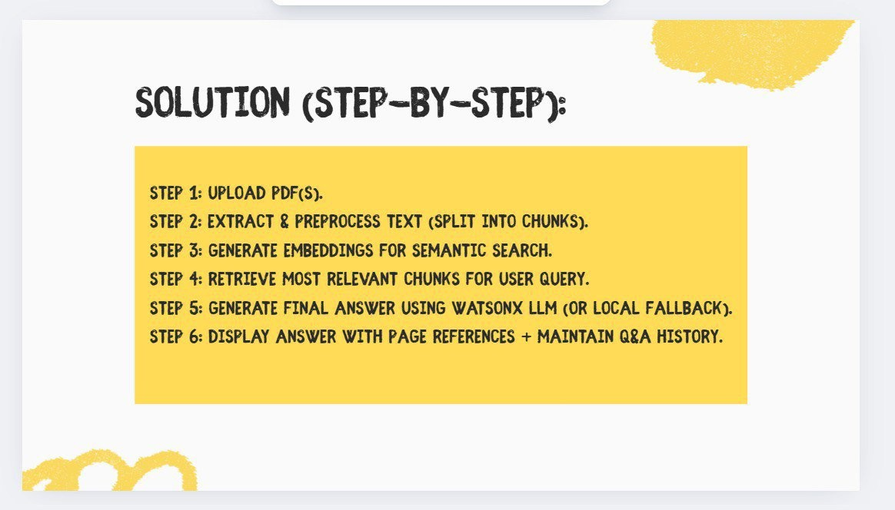

Slide 5
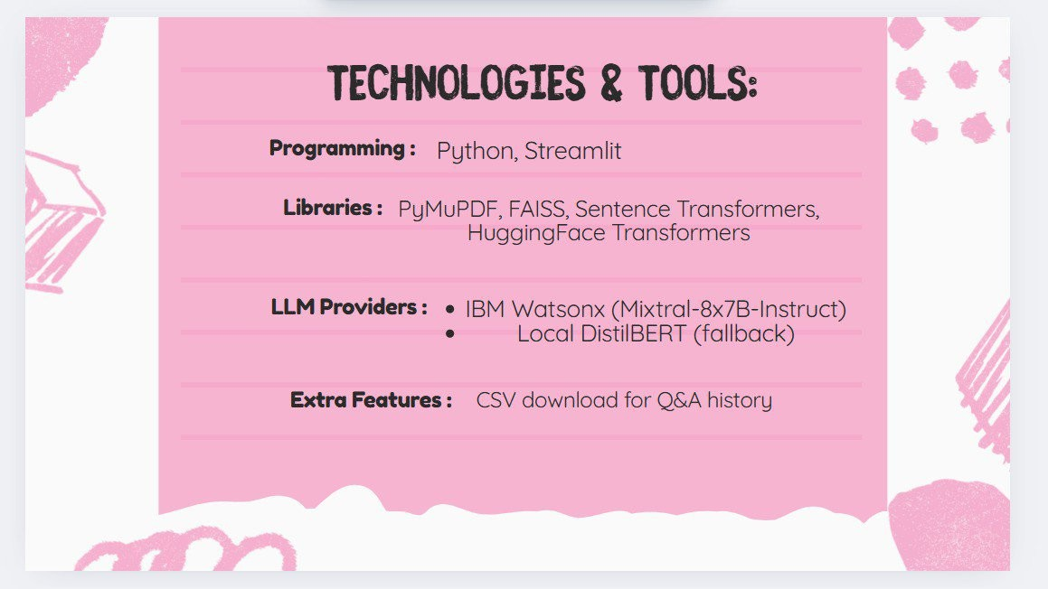

Slide 6


Slide 7


