Slide 1
Nasdaq Data Link Co-Pilot
Contributors: Ruchir Vani, David Ashton, Partha Kuri, Renita Sudirga

Slide 2
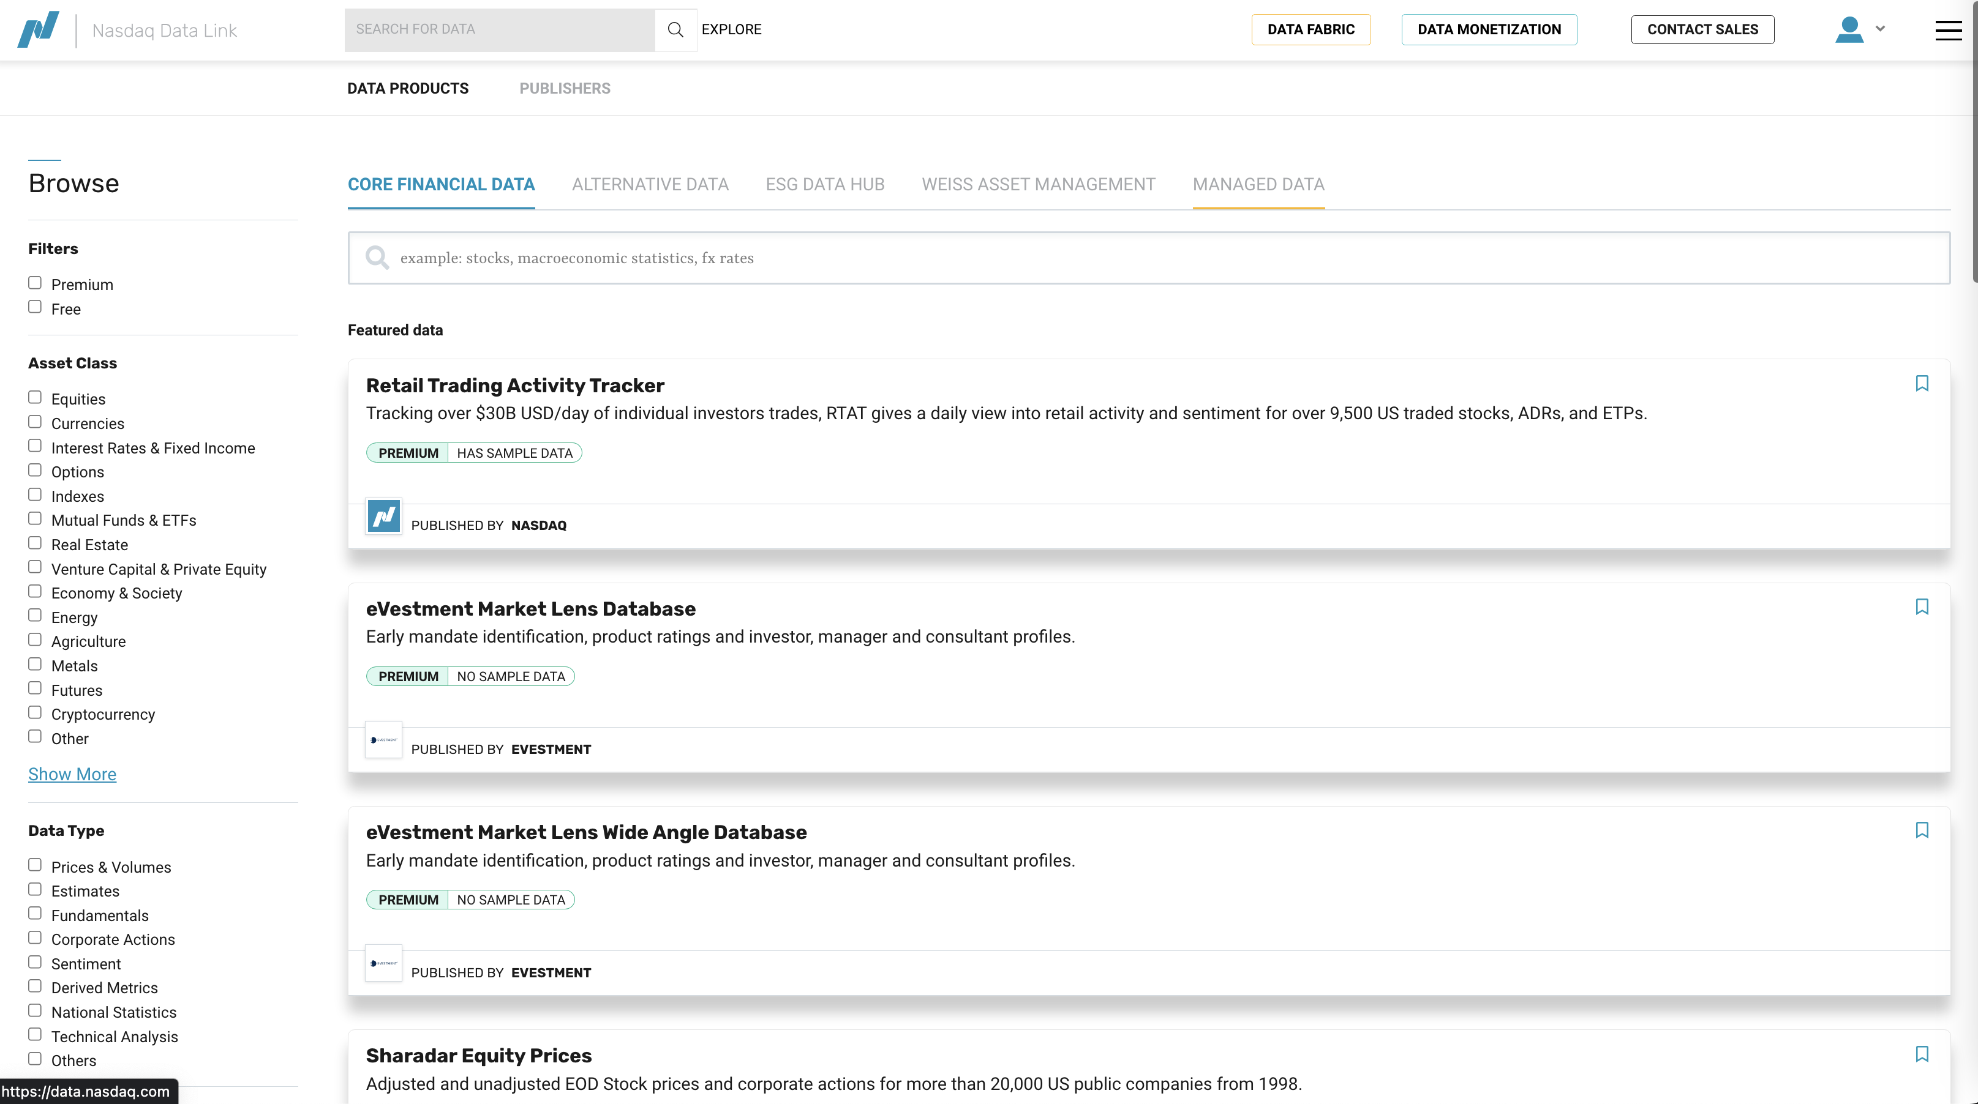
Nasdaq Data Link
Notes:
Nasdaq Data Link is a financial data marketplace offering hundreds of financial datasets. User onboarding becomes increasingly difficult as the number of datasets grows. Our goal is to improve users experience, especially for non-technical users, to be able to interact with NDL using natural language.

Slide 3
Objectives Query catalog Explore datasets Analyze datasets
Facilitate non-technical users’ experience in navigating and exploring Nasdaq Data Link.

Slide 4
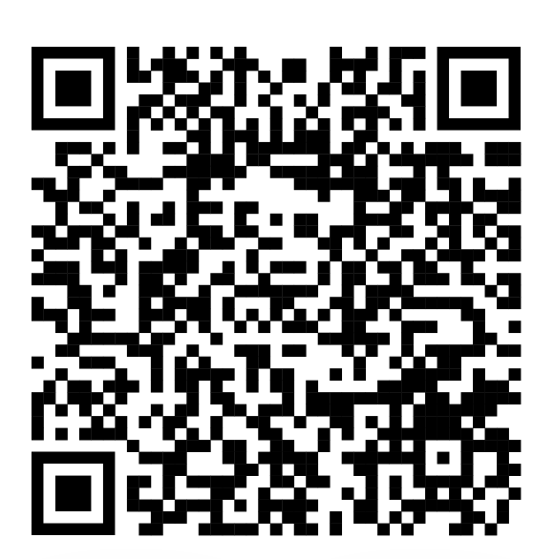
Github Repo

Slide 5
DEMO

