Slide 1


Slide 2
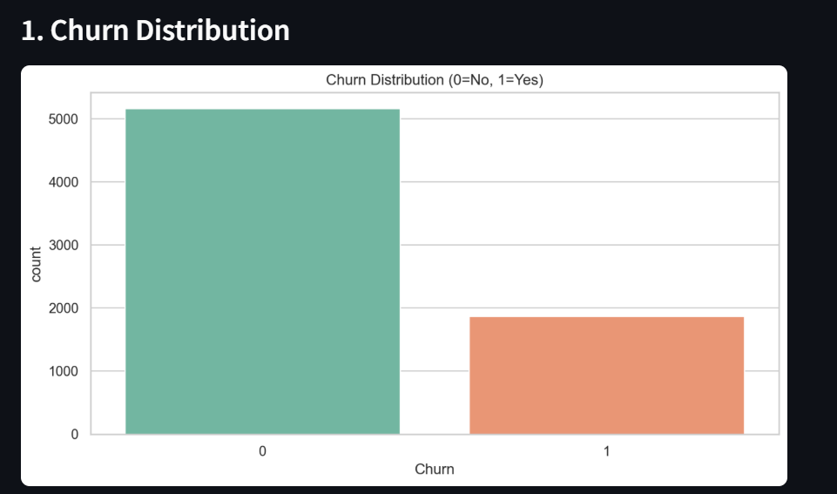
Customer Churn Overview Dashboard

Slide 3
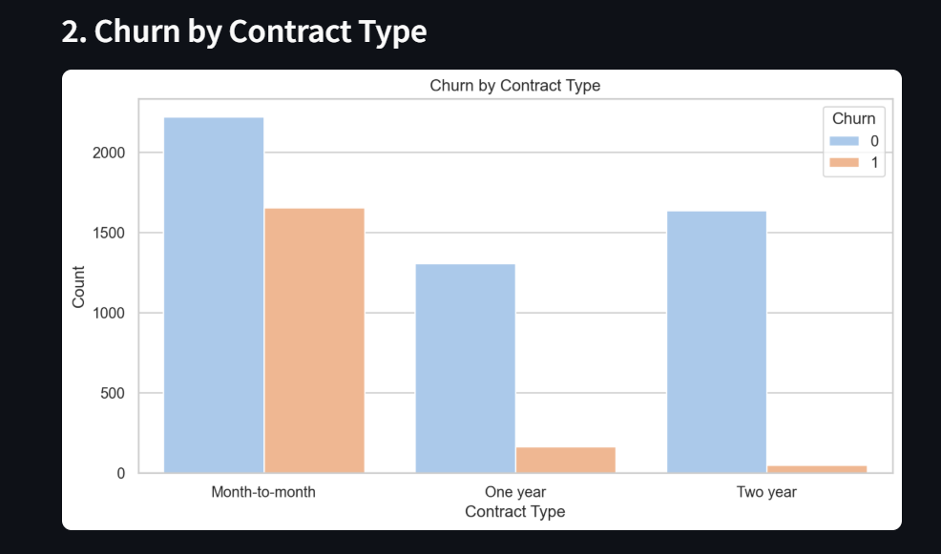
Customer Churn Overview Dashboard

Slide 4
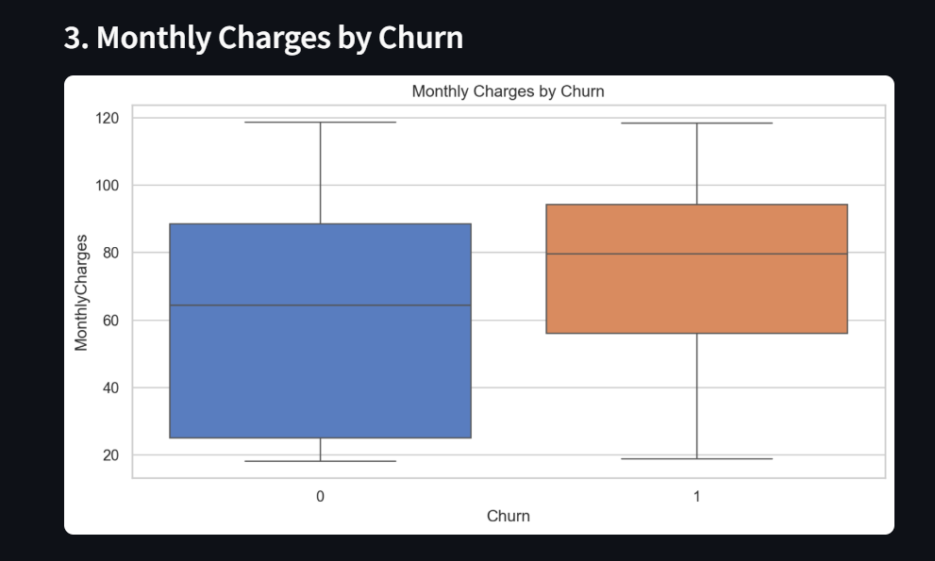
Customer Churn Overview Dashboard

Slide 5
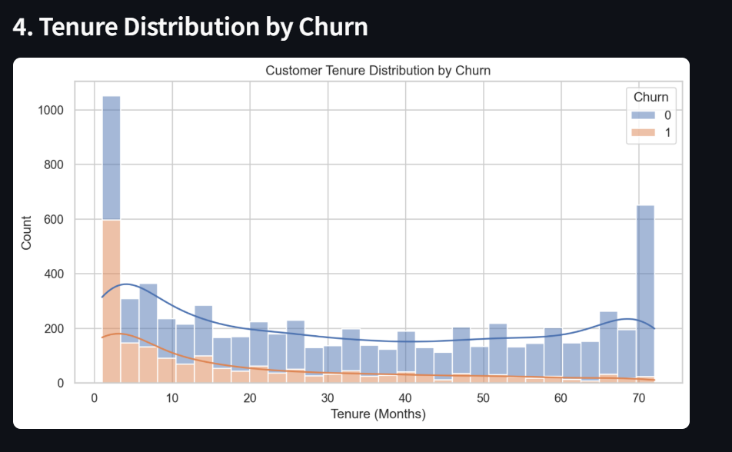
Customer Churn Overview Dashboard

Slide 6
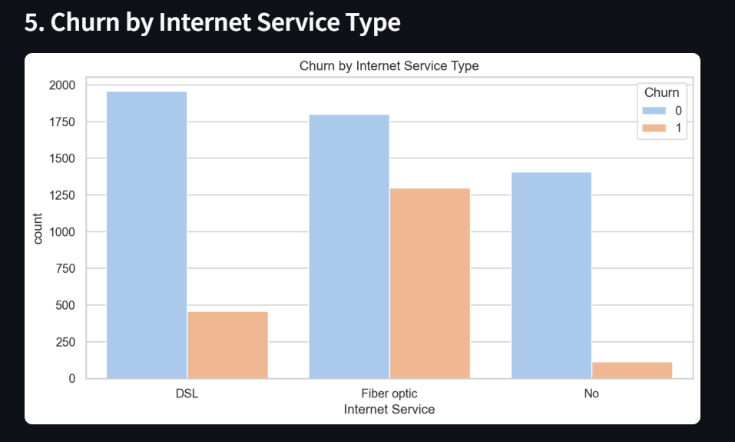
Customer Churn Overview Dashboard

Slide 7
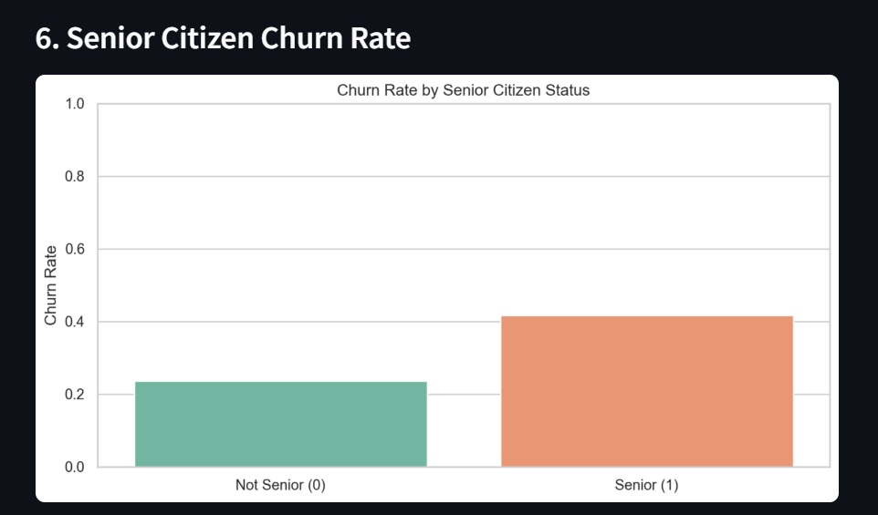
Customer Churn Overview Dashboard

Slide 8
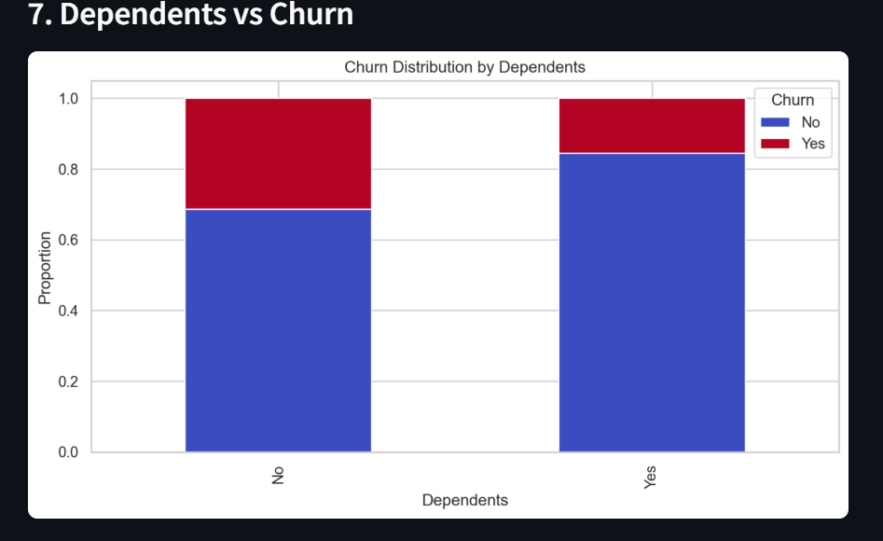
Customer Churn Overview Dashboard

Slide 9
Customer Churn Overview Dashboard
Summary:
Customers with monthly contracts are more likely to churn, than customers with yearly contracts
One cause could be monthly charges.
The customers who have opted for Fiber Optic are likely to churn more maybe due to the service/prices.
The churn rate for Senior Citizens is higher maybe due to less use of services or no knowledge on technological advancements.
The customers with no dependents are likely to churn than the customers with dependents.

Slide 10
Customer Churn Overview Dashboard
Retention Measures:
Offer more discount on prices for Yearly contracts or 6 months contracts, so that customers buy it.
Check competitor’s prices for Services and maybe offer some discount coupons on monthly charges or provide a combination of services.
Check customer complaints for Fiber Optic type of Internet Service. Check the data for downtime and whether customer queries were resolved. Also check the pricing of the DSL services.
Onboard Senior Citizens with comprehensive videos on how they can leverage the services. Train support to solve Senior Citizen queries in a very simple way. Have user manuals in place with images.

Slide 11
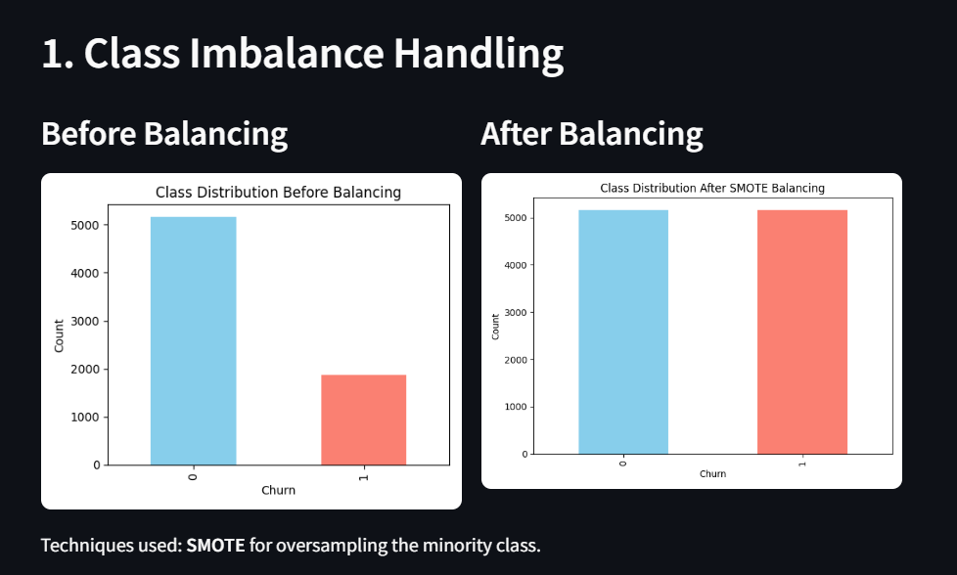
Model Insights & Class Imbalance Handling

Slide 12
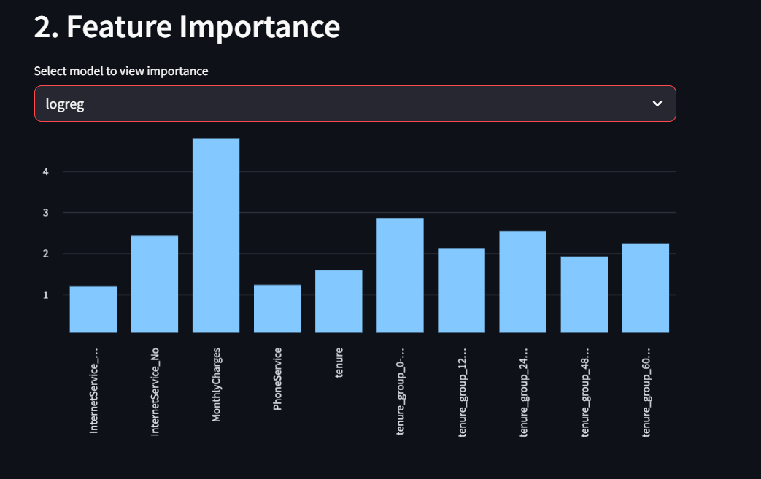
Model Insights & Class Imbalance Handling

Slide 13
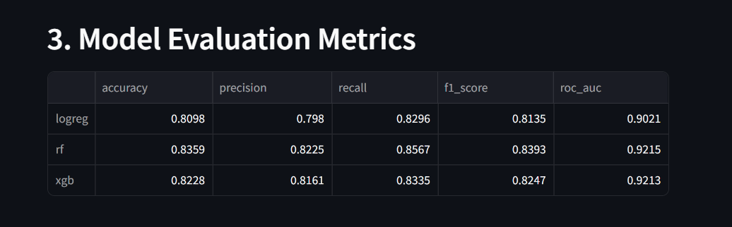
Model Insights & Class Imbalance Handling

Slide 14
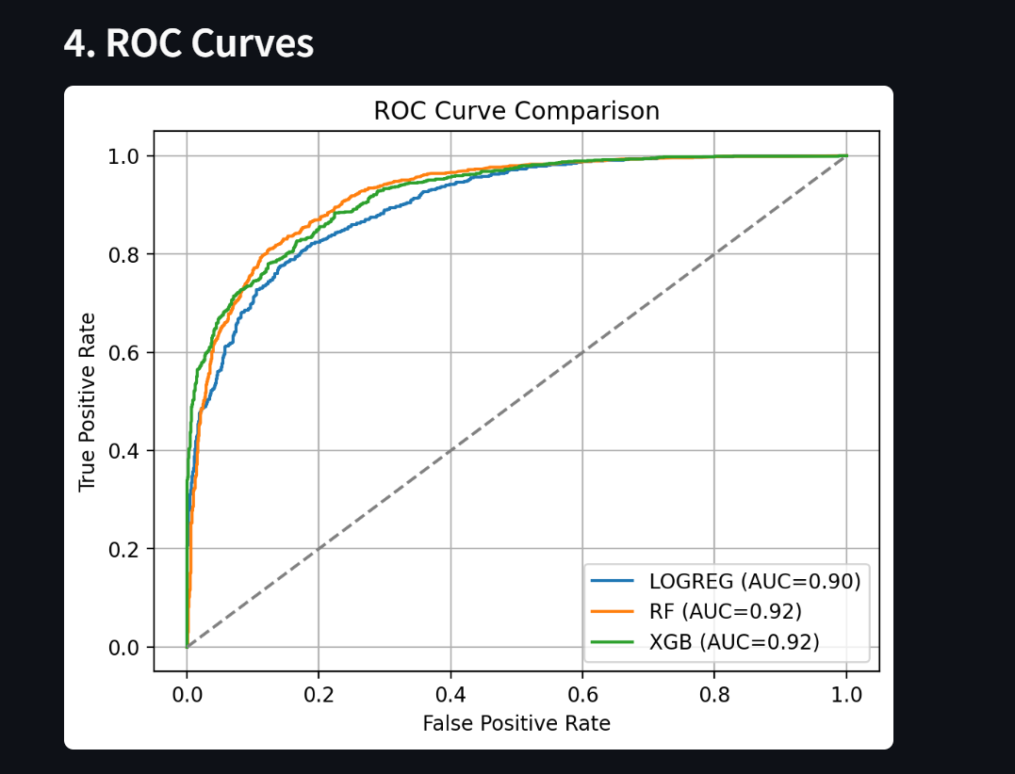
Model Insights & Class Imbalance Handling

Slide 15
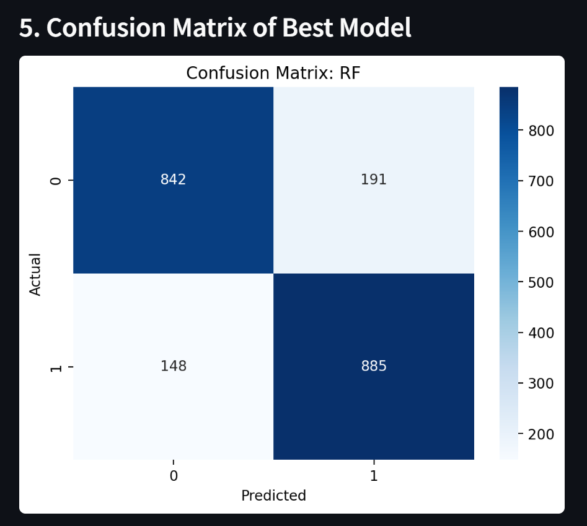
Model Insights & Class Imbalance Handling

Slide 16
Model Insights & Class Imbalance Handling
Final Insights:
SMOTE effectively addressed class imbalance.
Random Forest or XGBoost often outperform logistic regression in ROC-AUC.
ROC Curves show trade-offs in false positive/negative rates.
Feature importance provides explainability—top drivers of churn are clear.
Best model balances precision/recall with tuning improving generalization.

Slide 17

Thank You

