Slide 1
Master thesis review 0 I-glove
Renitto Jose E
S3,M.Tech CSSE
R#:14
GECI

Slide 2
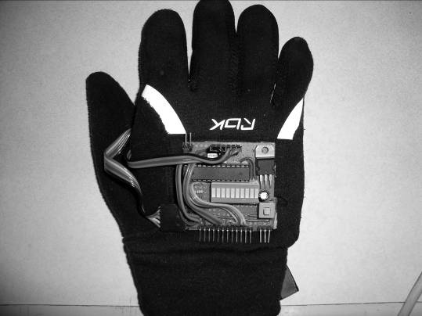
A SIMPLE WEARABLE HAND GESTURE RECOGNITION DEVICE USING I-MEMS

Slide 3
Why Hand Gestures ?

Slide 4
Natural Communication patterns / Non- verbal Interaction.
Avoids injuries like Carpal Tunnel Syndrome , Rheumatoid Arthritis due to continuous use of the keyboard and the mouse.
Intuitive control & Complete Mobility.
3D Graphics interaction.
An Effective Alternative to traditional Gaming gadgets.
Helpful for physically challenged people.

Slide 5
WHAT IS IT ?
This is a Simple Hand Gesture technology device , Which is a Hand glove consist of some components and it interact with systems such as Computer , Robots , Electronic Home appliances using iMEMS technology

Slide 6
Some activities by the device
Navigate through various Microsoft Windows menus
Drag a window to a different location on the screen
Move the cursor on screen
Interact with on-screen elements.
Maximize and minimize windows
Perform Video editing
Interact with 3-D objects/images on screen
Gaming
Control of external hardware such as robots

Slide 7
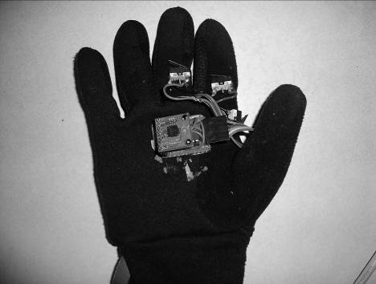
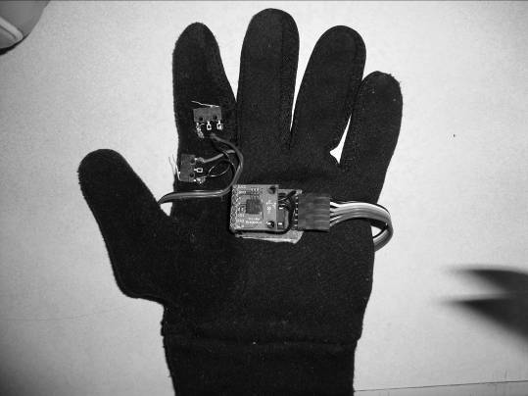
BASE DESIGN
Switch
3-Axis Accelerometer(MMA7260Q)
The Right Glove
The Left Glove

Slide 8
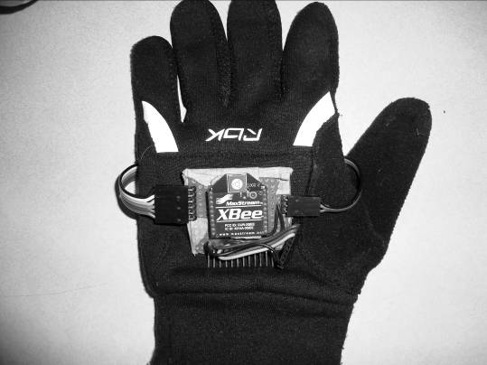
Right Glove, Main Circuit
Circuit:Zigbee(XBee) and Peripherals
Circuit:Atmega8(L) and Peripherals

Slide 9
COMPONENT SECTION
The Human-End
Accelerometer
Microcontroller
XBEE and UART Data Flow
Micro switches

Slide 10
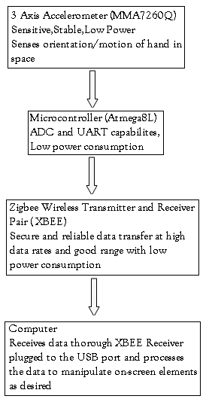
General Data Flow in the Device

Slide 11
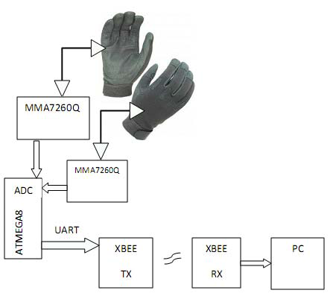
General Data Flow of the Circuit

Slide 12
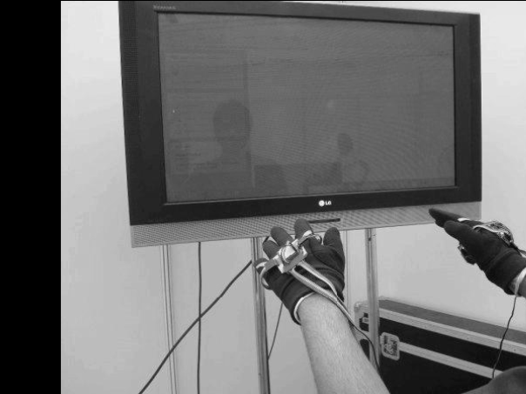
Use of Device

Slide 13
Interfacing issues and solutions
Minimizing power consumption & weight
Data communication between Atmega8L and the computer
Selecting the right data type for carrying information
Security and reliability of communication
Obtaining optimum sensitivity
Avoid picking up stray natural motions/vibrations of the hand
Totally replace the mouse or not

Slide 14
ALGORITHM FOR DATA INTERPRETATION AND EXECUTION.
The following steps are done
Initialization
Reusing of some Essential functions
The overall code function can be summarized in
he following
Getting data from the Serial port
Calibrating
Error Detection
Mapping Dynamic Data onto Positional Parameters
Processing Gestures

Slide 15
CONCLUSIONS AND APPLICATIONS
Replace the mouse as a more convenient and natural interaction peripheral.
Interacting with 3D objects on computer screen
Easy control of Robots, Robotic Arms and Human Controlled Automation
Easy Home Automation

Slide 16
Effective Teaching / Animation / Design Aid
Control of Machines for High-Precision Jobs
Easy accessibility tool for people with disabilities
Dedicated algorithms, when coupled with this technology, can be used to replace the keyboard as well.

Slide 17
When used with other inertial sensors (eg. gyros) the glove can be used to manipulate objects in 3 dimensions
Control over distant actuators connected via a PC interface.
It can be used extensively in the gaming industry for remote location manipulation.

Slide 18
FUTURE WORK.
rich interactive features which would enable the users to interact and take portability to the next level
Use of smaller packages of the integrated circuits will scale down the size of the device
user customizable hand gestures devices.
Controlling advanced robots , holographic devices etc

Slide 19
Another gesture based existing systems :
Sixth sense technology
Vision based systems
Facial emotions based sytems

Slide 20
Thank you

