Slide 1


Hand Age recognition
By: Tos,Eric, and Dat

Slide 2
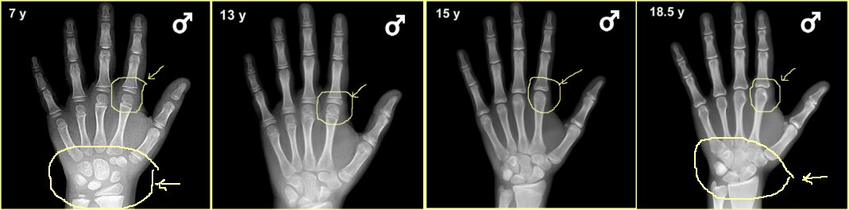
Problem
Inconsistent doctor’s opinion on bone-age
This is an issue in International age-group athletic events

Slide 3
Benefit
Saves time and effort
More consistent and accurate results
Decreases medical cost

Slide 4
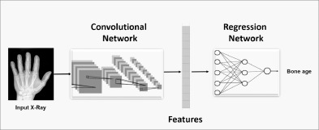

Improvements
Use IBM Watson’s full version.
Create a custom neural network to incorporate more data
gender
race
Use regression model instead.

