Slide 1
Experiment With Slashburn
Jiakai Xiao
waitingxjk@126.com

Slide 2
Contents
Slashburn2011^{[1]}
LoadAdjacentMat.m
Slashburn-1.0.zip
Slashburn2014^{[2]}
Recode.exe
SlashBurn.exe
SlashBurn (source file)
Input Demo
Oregon1.txt
[1] Kang U, Faloutsos C. Beyond'caveman communities': Hubs and spokes for graph compression and mining[C]//Data Mining (ICDM), 2011 IEEE 11th International Conference on. IEEE, 2011: 300-309.
[2] Lim, Y. and Kang, U. and Faloutsos, C., SlashBurn: Graph Compression and Mining beyond Caveman Communities, Knowledge and Data Engineering, IEEE Transactions on, 2014

Slide 3
Slashburn 2011
How it works
Input
Input
LoadAdjacentMat.m
Slashburn.m
Raw data example:
Edge list file
Step 1
Step 2

Slide 4

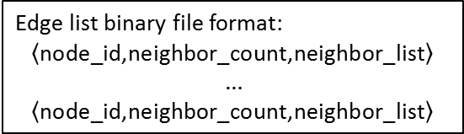
Slashburn 2014(1)
How it works
Recode.exe Parameters:
Lines to skip: E.g. skip 4 lines in oregon1.txt
Output file: the edge list binary file
Working temporary folder: the degree vector binary file will be created under the folder
Vertex count per partition: Recode.exe works in a partition-merge way. It first partition the input file into partitions(in case the file is too large to fit into memory). Recode each partition and merge the partition.
Edge list binary file format:
$$\left\langle \text{node}\text{_}\text{id}\text{,}\text{neighbor}\text{_}\text{count}\text{,}\text{neighbor}\text{_}\text{list}\right\rangle$$
$$…$$
$$\left\langle \text{node}\text{_}\text{id}\text{,}\text{neighbor}\text{_}\text{count}\text{,}\text{neighbor}\text{_}\text{list}\right\rangle$$
Input
Recode.exe
Raw data example:
Edge list file
Step 1
Degree vector binary file format:
$$\left\langle \text{node}\text{_}\text{count}\text{,}d_{1}\text{,}\text{...,}d_{i},…\right\rangle$$
SlashBurn.exe
Step 2

Slide 5
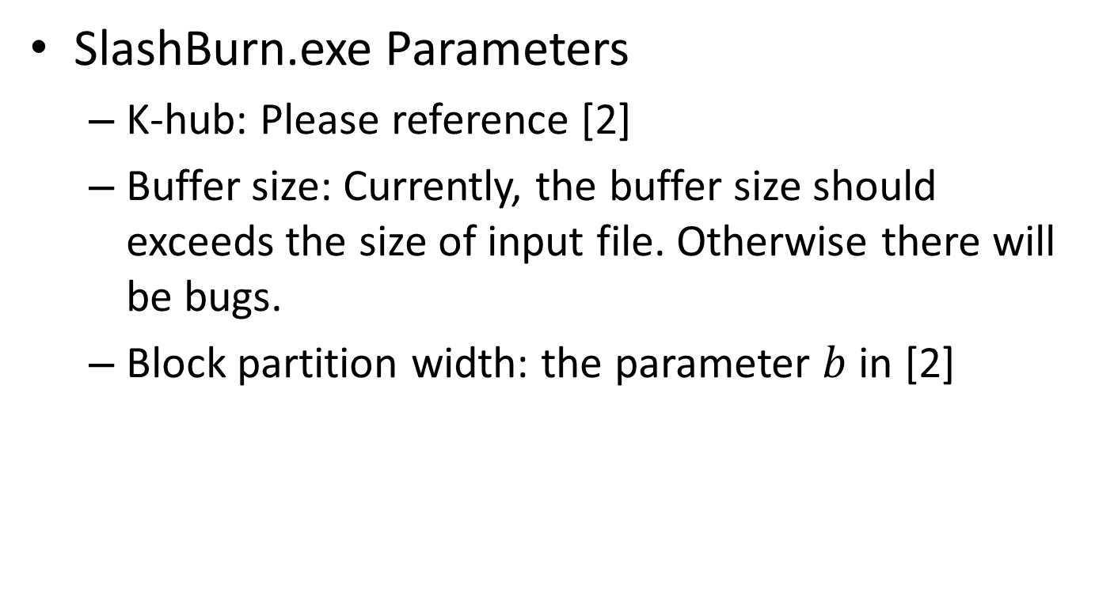
Slashburn 2014(2)
SlashBurn.exe Parameters
K-hub: Please reference [2]
Buffer size: Currently, the buffer size should exceeds the size of input file. Otherwise there will be bugs.
Block partition width: the parameter $b$ in [2]

