Slide 1

Google Merchandise Store Analytics Revenue Prediction
By Sijia Du, Janice Gong, Renjie Liu, Jiekai Ma

Slide 2
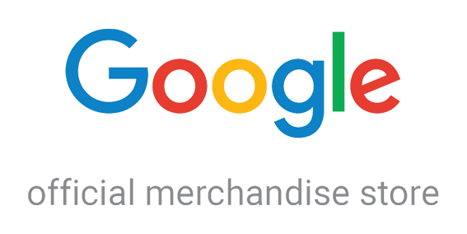
Problem Statement
In order for marketing teams to better targeting customers and generate useful promotional strategies, it is essential to understand the business impact through data analysis. In this project, we would be working in the field of retail and analyzing the customer dataset of Google Merchandise Store to predict revenue per customer.

Slide 3
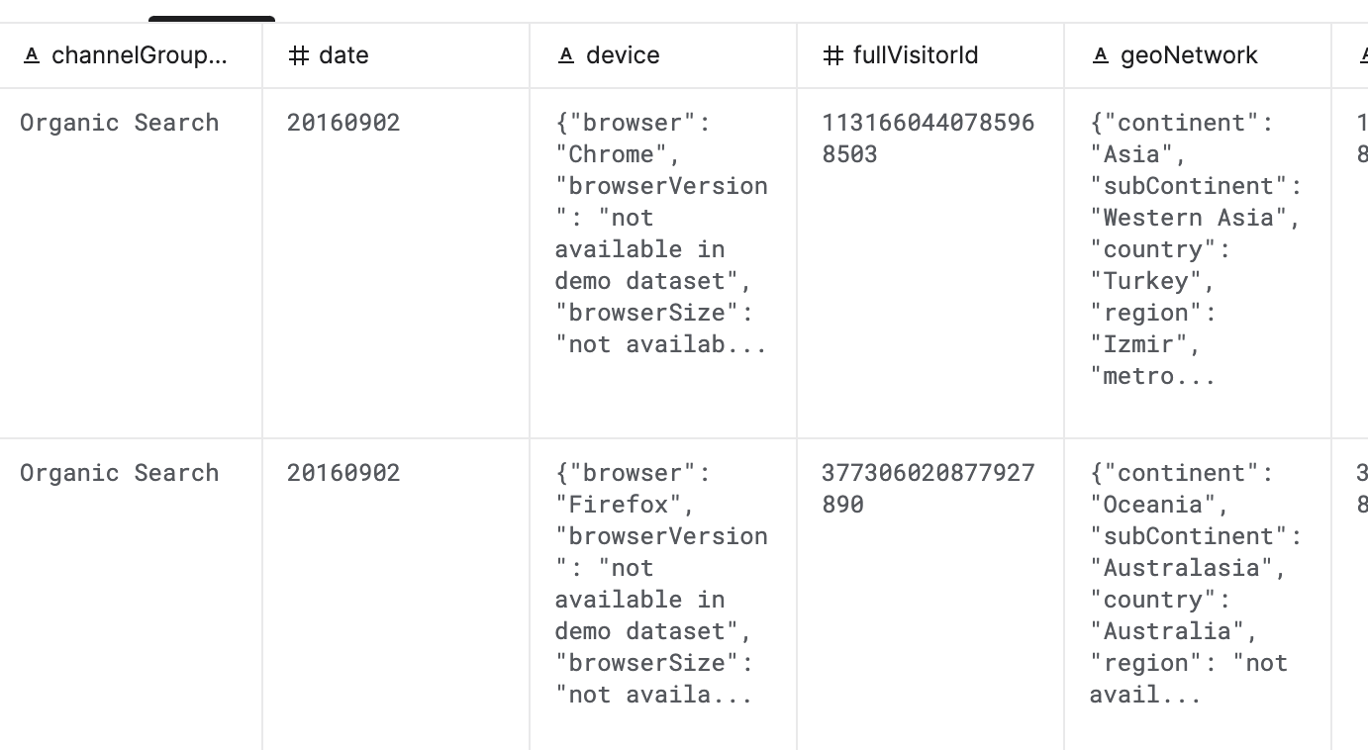
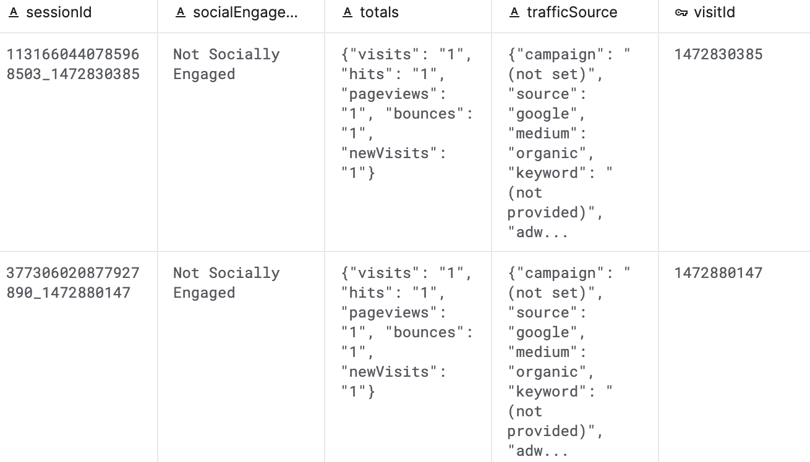
Dataset Introduction
Data Source: Kaggle
Number of Rows (Train): 903654
Number of Columns: 13
Data Size: Train Data ~ 1.4 GB Test Data ~ 1.25 GB

Slide 4
Columns Description
fullVisitorId- A unique identifier for each user of the Google Merchandise Store.
channelGrouping - The channel via which the user came to the Store.
date - The date on which the user visited the Store.
device - The specifications for the device used to access the Store.
geoNetwork - This section contains information about the geography of the user.
socialEngagementType - Engagement type, either "Socially Engaged" or "Not Socially Engaged".
totals - This set of columns mostly includes high-level aggregate data.
trafficSource - This section contains information about the Traffic Source from which the session originated.
visitId - An identifier for this session. This is part of the value usually stored as the _utmb cookie. This is only unique to the user. For a completely unique ID, you should use a combination of fullVisitorId and visitId.
visitNumber - The session number for this user. If this is the first session, then this is set to 1.
visitStartTime - The timestamp
customDimensions - This section contains any user-level or session-level custom dimensions that are set for a session. This is a repeated field and has an entry for each dimension that is set.

