Slide 1
HTML BASIC
My first webpage and Web basic (L1-1)

Slide 2
Your Website
Content:
Text, Media
+ HTML: Structure + Semantics
+ CSS: Presentation + Design
+ JS: Interactivity
= Your Website

Slide 3
Why we learn HTML and CSS?
What is HTML?
Hyper Text Markup Language
markup language
What is looks like?
a language <> < tags > "start tag” "end tag”
How does it work?
file naming and running: myfirstwebpage.html

Slide 4
My first web page
Edit
Go to rowser
Run html file
hello world

Slide 5
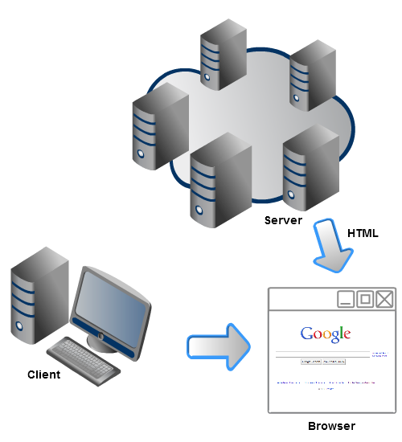
Web
Clients
Servers
Browsers
HTML

Slide 6
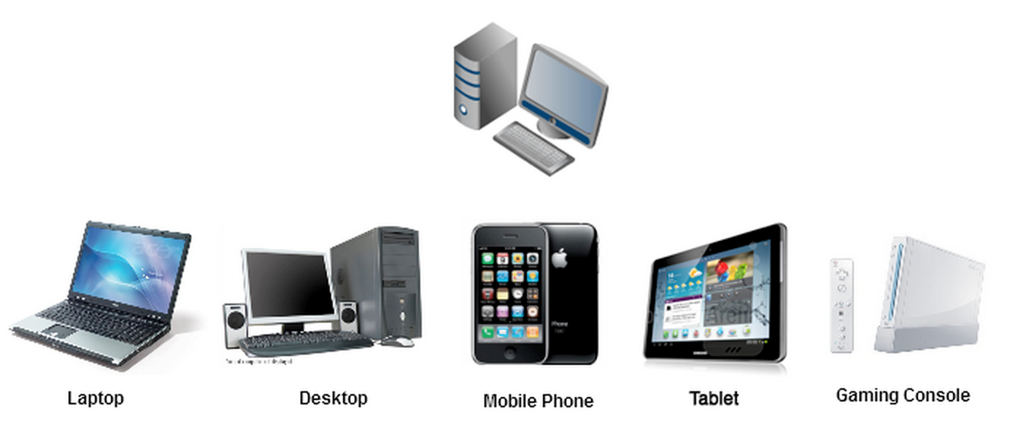
Clients are computers that access the web in any way.
What's different across these devices?

Slide 7
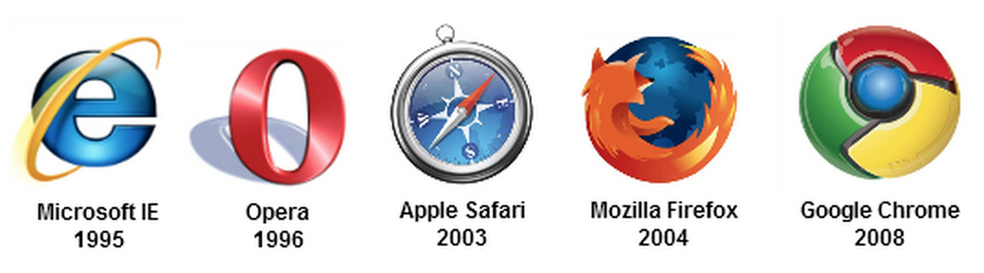
Browsers are programs that render content on the web most often HTML pages and related resources.
Various companies and organizations provide browsers, and each browser varies in how it displays webpages.

Slide 8
Browsers are supported by HTML
HTML is a "markup language" that describes a webpage. When you're on a webpage, you can "view source" to see the HTML that the browser is rendering.

Slide 9
Servers are just programs running on a computer that serve up content
Sometimes they serve up static files, and are exposed like a file system.
Sometimes they can be scripted using "server-side" programming languages (PHP, Python, Perl, Java, etc.) to serve more dynamic pages.

Slide 10
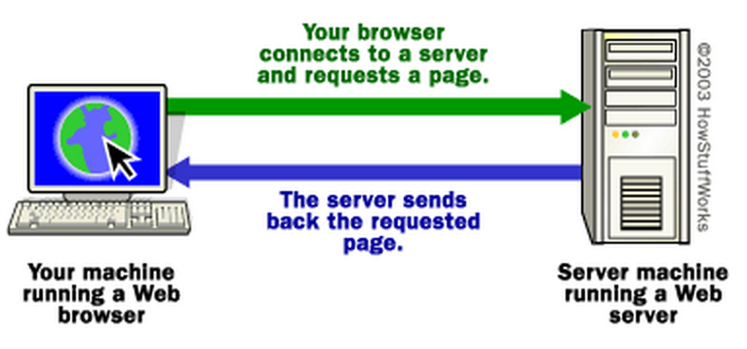
How Web Servers Work
How Web servers bring pages into your home, school or office.

Slide 11
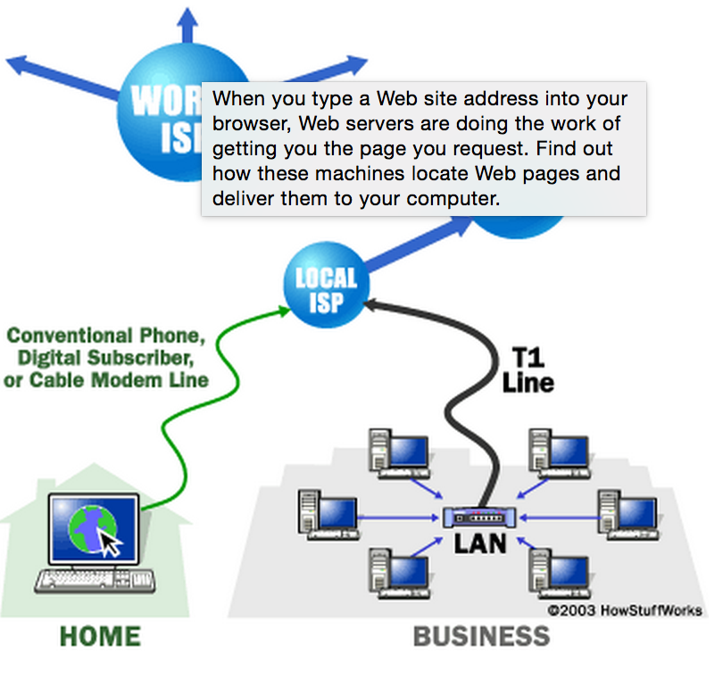
Internet
Structure
IP address unique
Domain name
Name servers (DNS)
Ports
Protocols
HTTP

Slide 12
Internet terms
IP address unique
Domain name
Name servers (DNS)
Ports
Protocols
HTTP
Hyper Text Transport Protocal
URL
Together works – awesome
You know about internet!

