Slide 1
A system applying three scheduling methods for the restaurant waiting line arrangement
Jingyi Ren
Computer Science Department
Western University

Slide 2
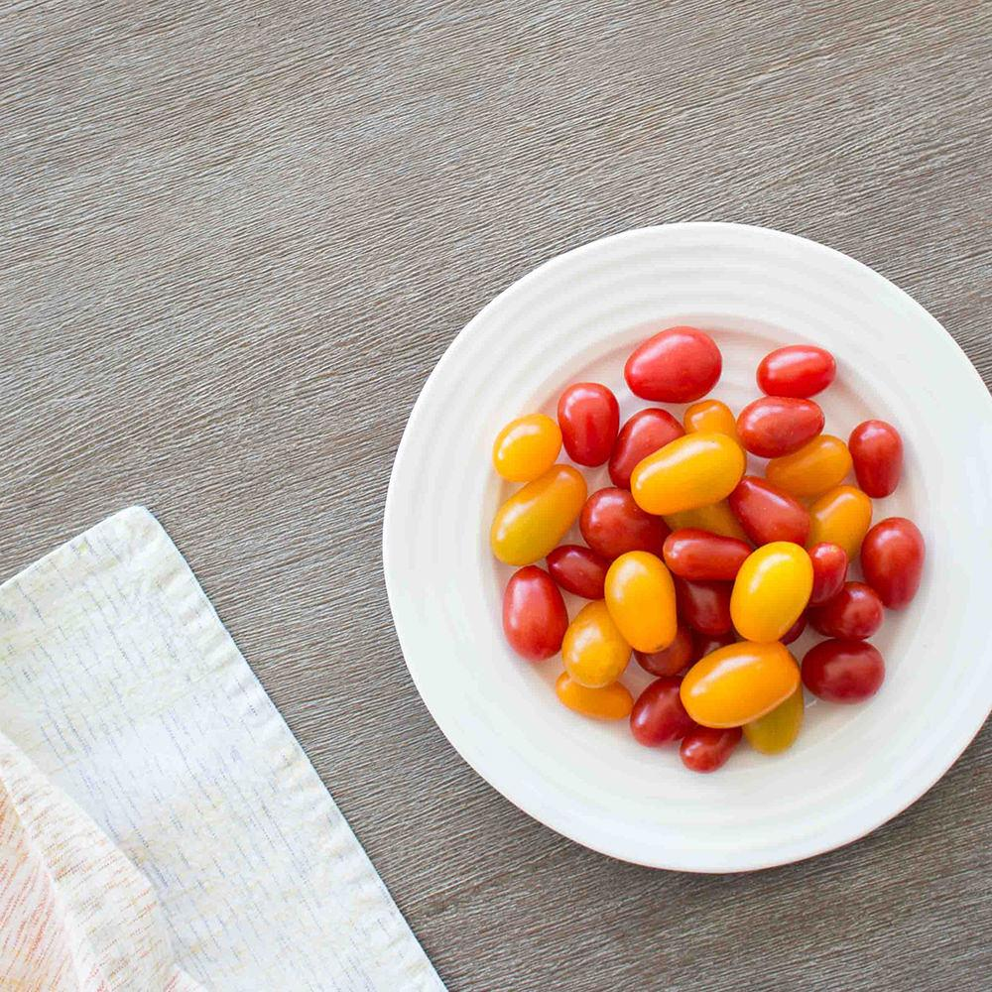
Content
Problem Description
Mathematical Model
System Design
Method One
Method Two
Method Three
Experiments and Results
Conclusion

Slide 3
1.
Problem Description
A long waiting line for a busy restaurant

Slide 4
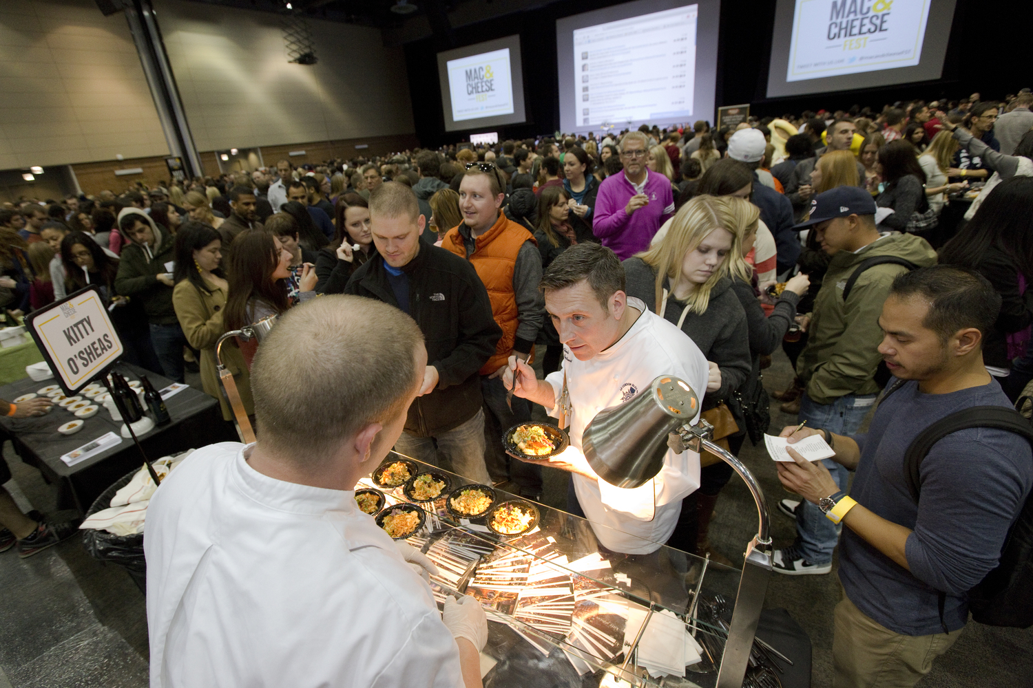
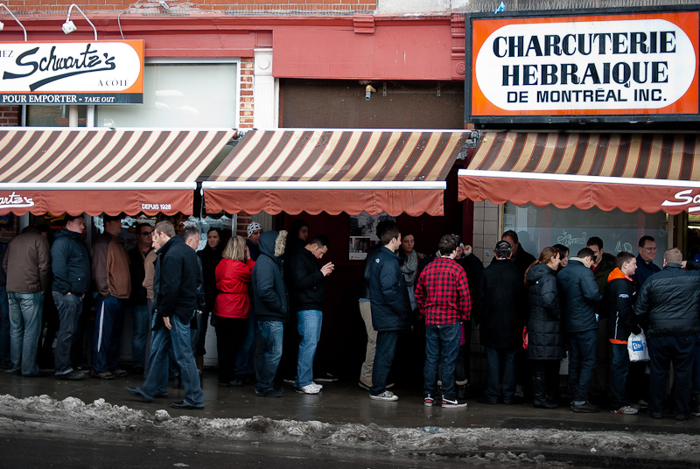
Any Solution?
Win-Win

Slide 5
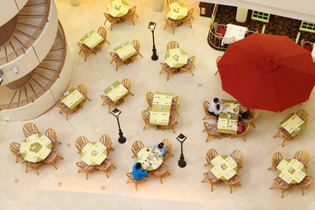
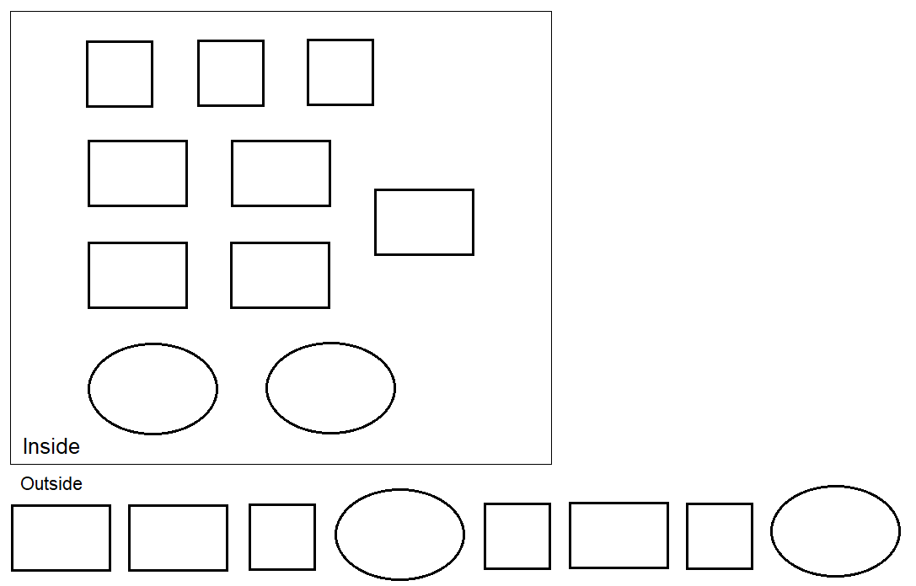

Slide 6
2.
Model Construction
Build up a mathematic model for a real-world problem

Slide 7
Inside the restaurant
Given a set of tables of different types inside a restaurant
t₁, t₂, t₃, ……, t_{k}
where
t₁, t₂, t₃, ……, t_{s} are small tables that seat 1 – N_{s}
t_{s+1}, t_{s+2}, t_{s+3}, ……, t_{m} are middle tables that seat N_{s}+1 – N_{m}
t_{m+1}, t_{m+2}, t_{m+3}, ……., t_{l} are large tables that seat N_{m}+1 – N_{l}
Every group’s meal time
m₁, m₂, m₃, ……, m_{k}

Slide 8
Outside the restaurant
Given a set of groups of customers
g₁, g₂, g₃, ……, g_{n}
known the number of customers in each group
gn₁, gn₂, gn₃, ……, gn_{n}
Split into three lists due to the different group sizes
g₁, g₂, g₃, ……, g_{s} are small groups with 1 – N_{s} people
g_{s+1}, g_{s+2}, g_{s+3}, ……, g_{m} are middle groups with N_{s}+1 – N_{m} people
g_{m+1}, g_{m+2}, g_{m+3}, ……, g_{l} are large groups with N_{m}+1 – N_{l} people
Corresponding the number of customers
gn₁, gn₂, gn₃, ……, gn_{s}
gn_{s+1}, gn_{s+2}, gn_{s+3}, ……, gn_{m}
gn_{m+1}, gn_{m+2}, gn_{m+3}, ……, gn_{l}

Slide 9
3.
System Design
Design a system that implements three scheduling methods

Slide 10
System Design Architecture
Scheduling
Methods
Implementation
Output:
System Suggestion
Text File
Input:
Text File
Random Data
Generation
Performance
Evaluation

Slide 11
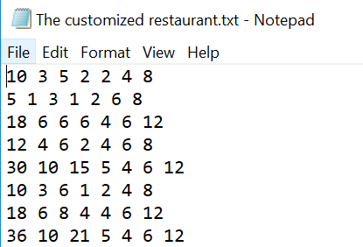
System Input
Text File
The information about the customized restaurants
Each line represents one restaurant
“the total tables,
the number of small tables, middle tables, large tables,
the size of small table, middle table and large table”

Slide 12





Random Data Generation
Random-generated Outside Groups Sizes
Random-generated Groups’ real Meal Time
Random-generated Groups’ Expense
Random-generated Outside Groups’ Arrival Time
Random-generated Groups’ fake Meal Time

Slide 13
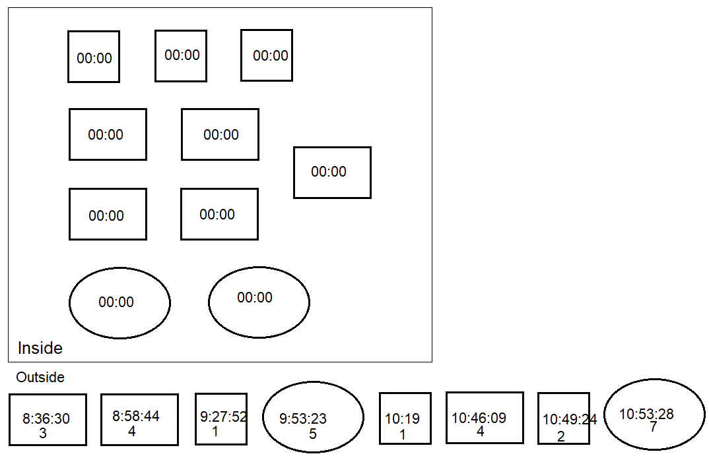
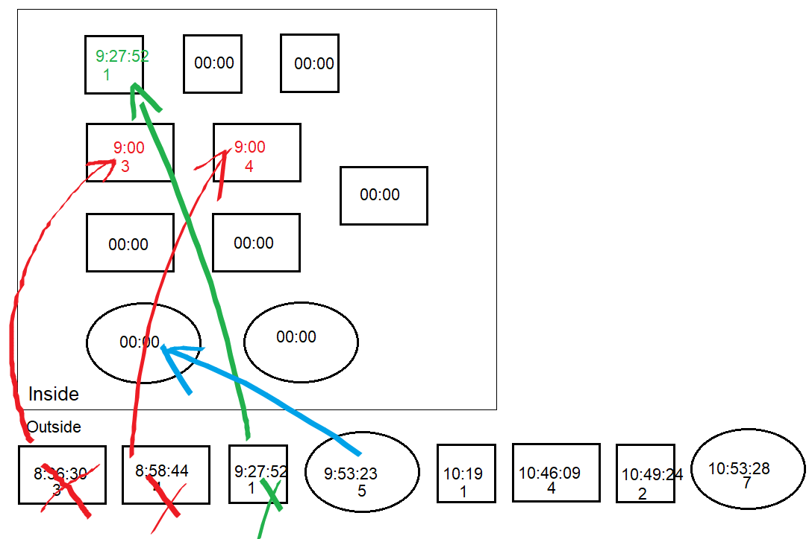
Scheduling Methods Implementation
First Come First Serve
Waiting time = time.between(group time, 9:00) = 23 mins

Slide 14
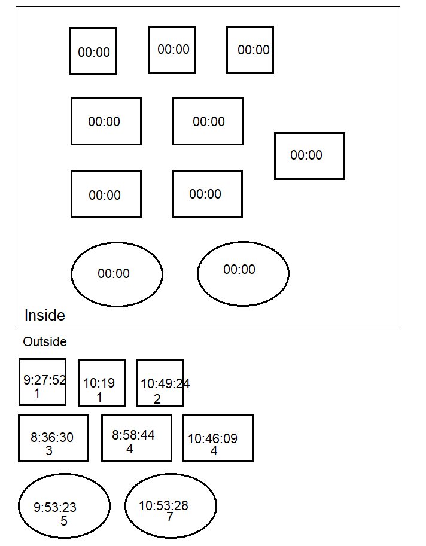
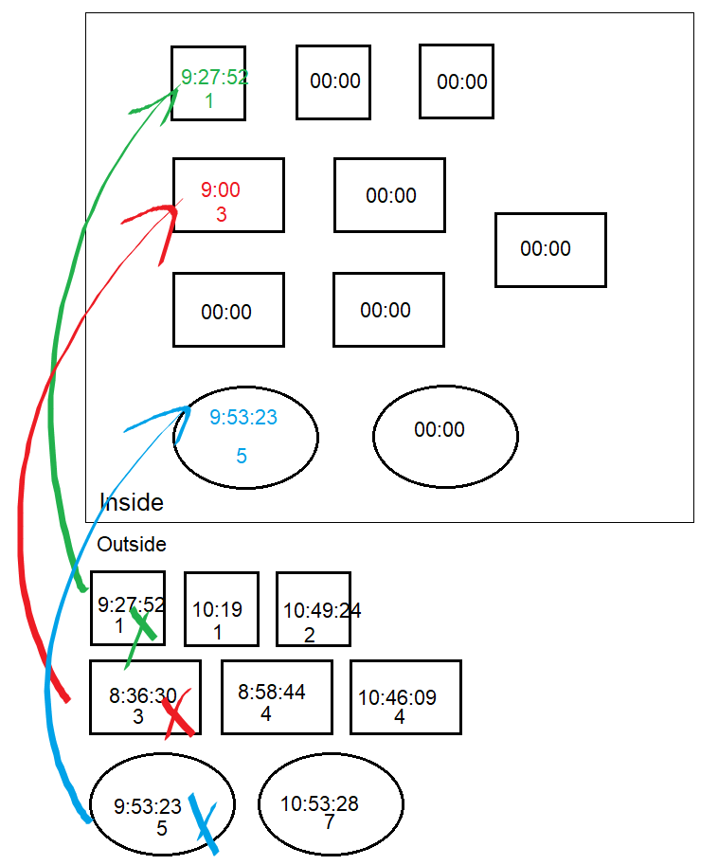


Scheduling Methods Implementation
Size Matching
Split the groups
Apply FCFS to each list

Slide 15


Scheduling Methods Implementation
Group Priority Serving
Compute the priority to each group
41.1457 115.4156 99.4345
0.7213 0.6213 65.9174
30.2663 54.9571
3 2
1 3
2
Sort

Slide 16




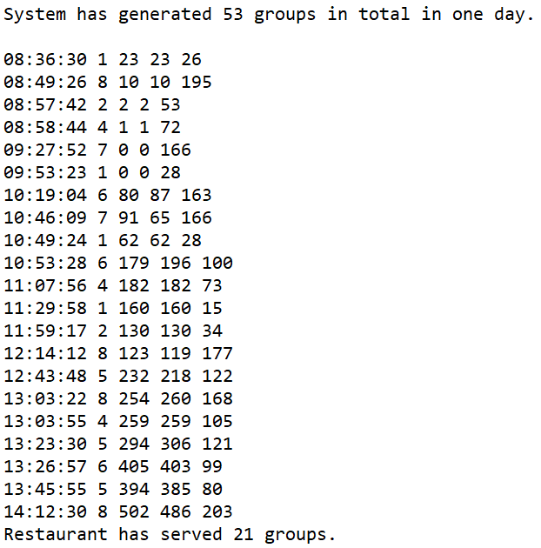
Performance Evaluation
Measurements
Evaluate the total money earned
Evaluate the method recommendation probability
Evaluate the total waiting time
Evaluate the performance of the method
Evaluate the total number of served groups

Slide 17
System Output
System Final Suggestion
After batches of tests, the system will give a final result according to three methods recommendation probabilities distribution.
Text File
where stores all the middle results for the users’ convenience to look up
three result tables for three applied methods
three figures for the total number of served groups for three methods
three figures for the total income earned by restaurant for three methods
three figures for the total customers’ waiting time for three methods
three scores for the three methods
a suggestion for this restaurant instance

Slide 18
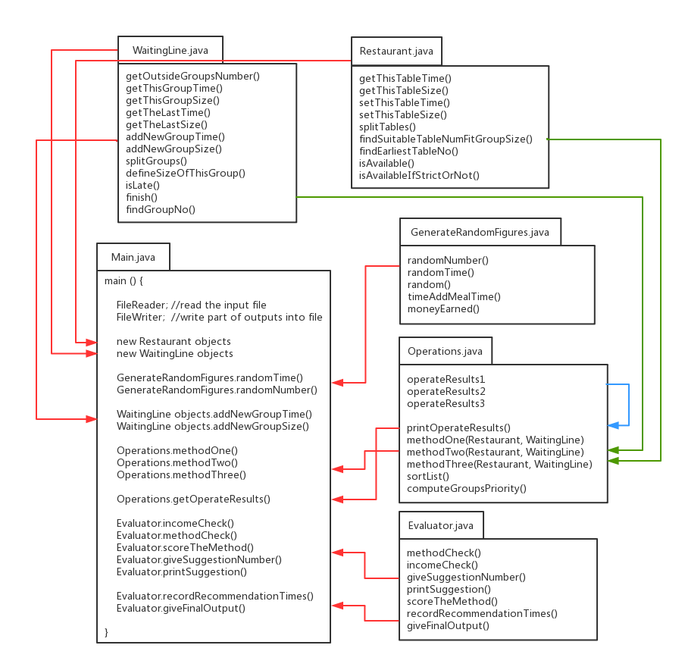

Slide 19
4.
Experiments and Results
A single case and mass data experiments respectively

Slide 20
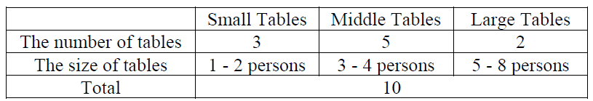
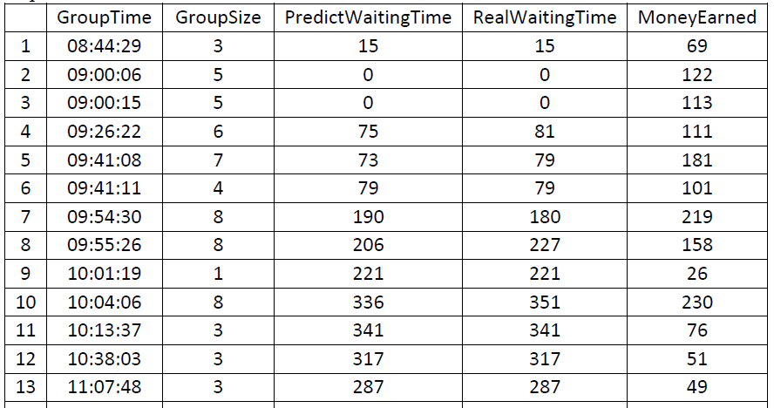
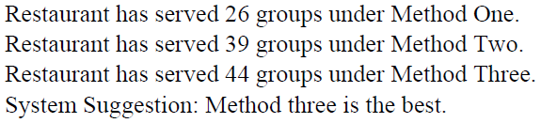
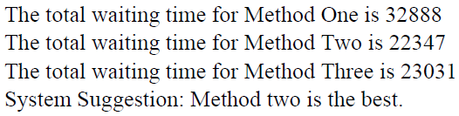

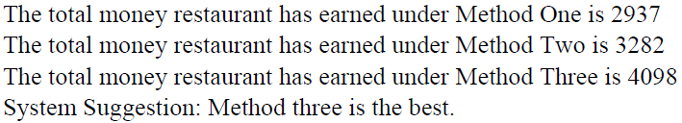

Single Case Illustration
INPUT:
Three figures for the total customers’ waiting time for three methods
Three result tables for three methods
Three figures for the total number of served groups for three methods
A suggestion for this restaurant instance
Three scores for the three methods
OUTPUT:
Three figures for the total income earned by restaurant for three methods

Slide 21
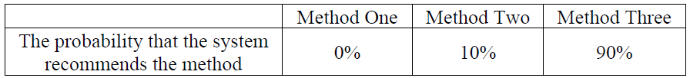
Mass Data Statistics
INPUT:
40 times
OUTPUT:
A text file including all the information for each instance
A statistics table shown the probability distribution
The final system suggestion after the statistics

Slide 22
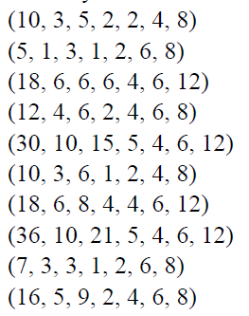
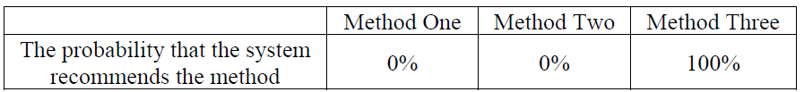
Mass Data Statistics
INPUT:
OUTPUT:
A text file including all the information for each instance
A statistics table shown the probability distribution
The final system suggestion after the statistics

Slide 23
5.
Conclusion

Slide 24
System Conclusion
Method Three show the best performance while Method Two is not bad as well
Directed Study Conclusion
- Skill to build up a mathematical model for a real-world problem
- Idea to produce a system from 0, Top-down
- Coding skill has improved a lot

Slide 25
Thanks!
Any questions?
You can find me at jren85@uwo.ca

