Slide 1

The Emerging JBIG2 Standard
UWO CS9628
Image Compression
Paper Presentation
By Yifang Liu
https://ieeexplore.ieee.org/stamp/stamp.jsp?tp=&arnumber=735380
Notes:
https://ieeexplore.ieee.org/stamp/stamp.jsp?tp=&arnumber=735380

Slide 2

Outline
Introduction
Technical Description
Experimental Results
Conclusion

Slide 3
Introduction

Slide 4

Introduction
What
ISO/IEC International standard for lossy and lossless bi-level image compression
Who
Joint Bi-Level Image Experts Group (JBIG)
Notes:
Is the first international standard for lossy compression for bi-level standard, all exising ones are strictly lossless.
Bi-level: images consisting of a single rectangular bit plane, with each pixel taking on one of just two possible colors.

Slide 5
Introduction
Why
Higher compression ratios but no degradation of quality
Application
Document storage and archiving, images on the World Wide Web, wireless data transmission, print spooling

Slide 6
Technical Description

Slide 7
Main Techniques
A. Control Structure
B. Pattern Matching
C. Refinement of Lossy Image
Notes:
Control Structure: allow the efficient encoding of multipage documents sequential mode, random-access mode or embedded mode
Pattern Matching: to allow the good compression of text and halftone images
Refinement of Lossy Image: to allow to the less lossy images or lossless images

Slide 8
Control Structure
Two modes (sequential, random-access)
Multiple-page processing
Represent multiple pages in single page
Notes:
the decoder will interpret all pages in order, -- interpret the pages you desire
While decoding a page, it can get the information from other pages
A character appears on the first page is likely appear on other pages, although there are some incremental cost, but it increase a compression a lot

Slide 9
Pattern Matching
Pattern Matching and Substitution (PM&S)
Soft Pattern Matching (SPM)

Slide 10
a. Pattern Matching and Substitution
Segmentation
Dictionary Search (Pre-screen, Match Scores)
Coding of Numerical Data
Coding of Bitmap
Notes:
Dictionary search: pre-screen the potential match,

Slide 11
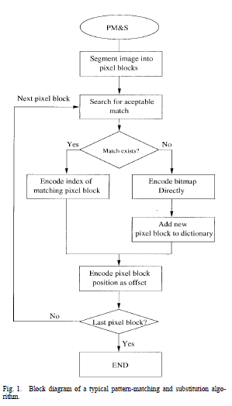

Slide 12
Emphasize
Pointer to the Dictionary & Position Information

Slide 13
Attention
High Lossy Compression Levels
Unacceptable Errors
Extra Coded Bits and Extra Time to Improve

Slide 14
b. Soft Pattern Matching
Segmentation
Dictionary Search
Coding of Numerical Data
Coding of Bitmap
……

Slide 15
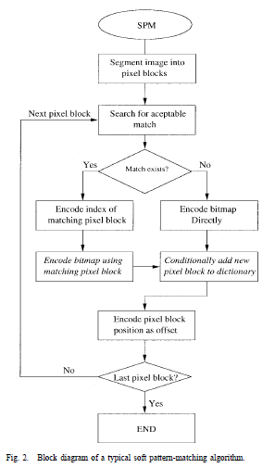

Slide 16
Emphasize
Refinement Data included to recreate the character on the page, yield lossless image
Notes:
consists of the pixels of the current
desired character, coded making use of pixels from both the
current character and the matching character

Slide 17
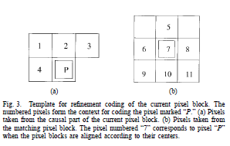

Slide 18
Comparison
1. The numerical data is coded using arithmetic algorithm
2. Direct substitution of the matched character is replaced by lossless encoding

Slide 20
Experimental Results

Slide 21
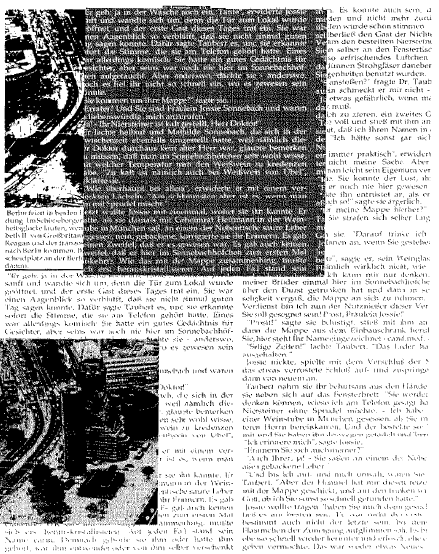

Slide 22
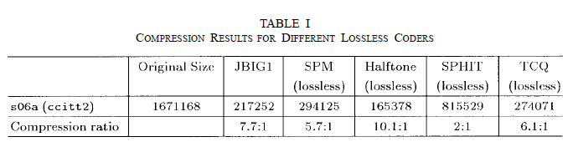

Slide 23
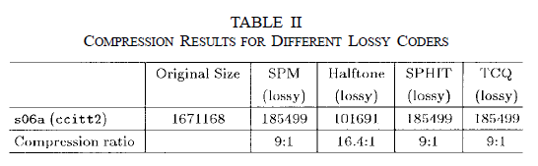

Slide 24
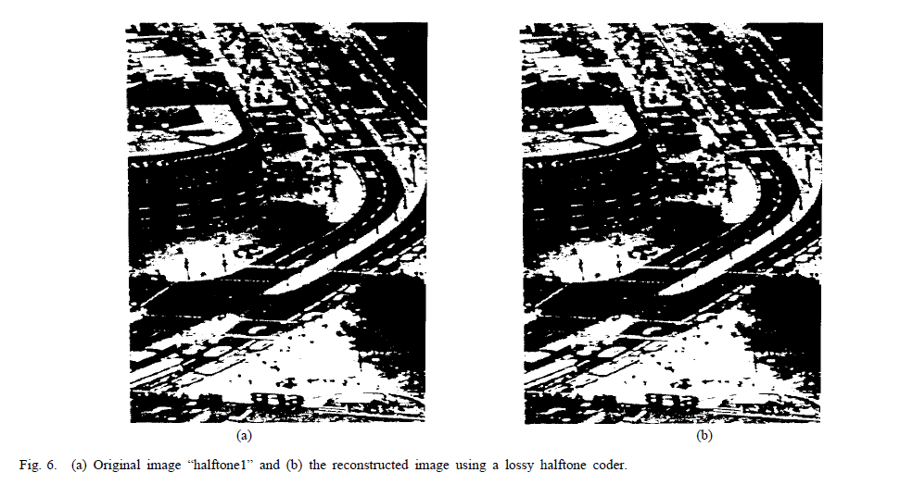

Slide 25
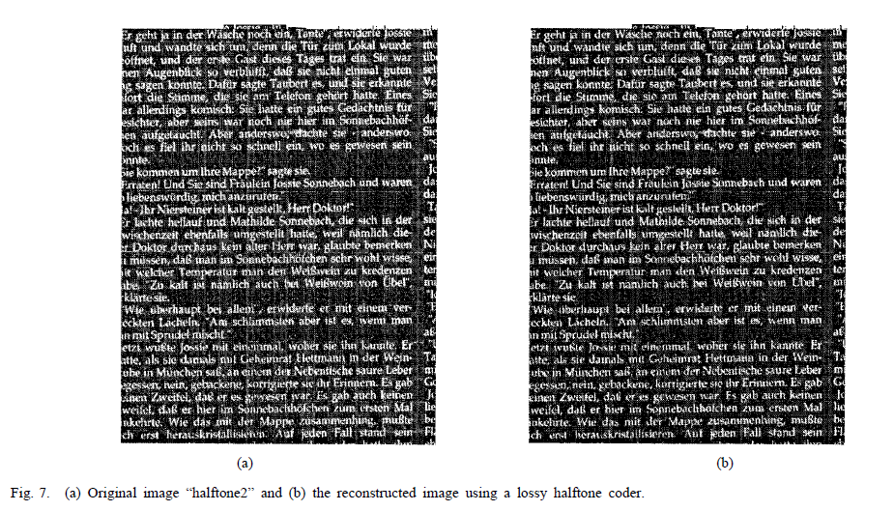

Slide 26
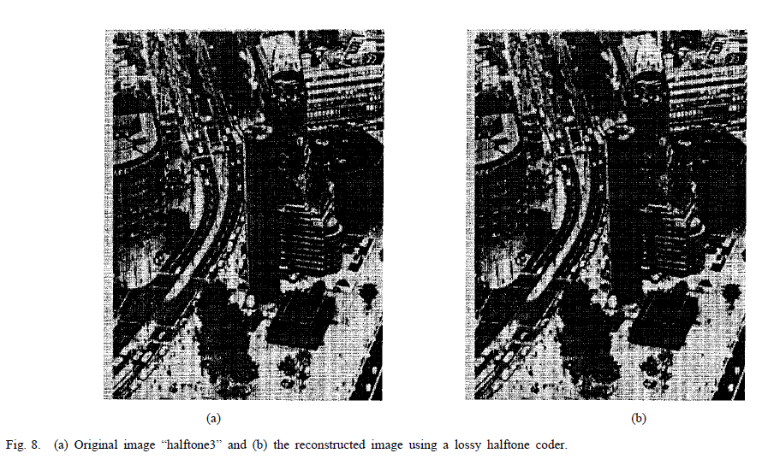

Slide 27
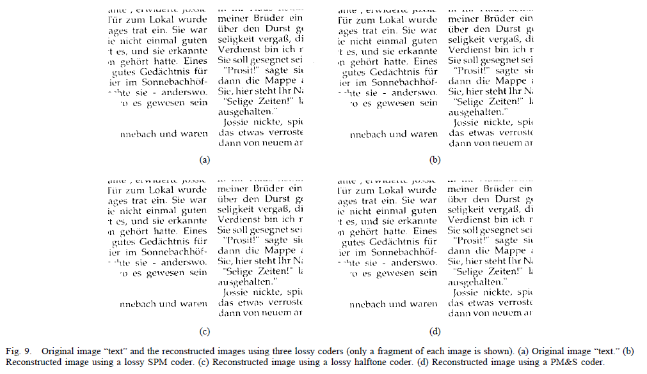

Slide 28
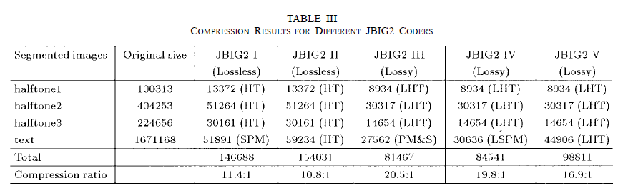

Slide 29
Conclusion
The quality of the reconstructed text image is very good
The compression efficiency is high
If PM&S or SPM is used

Slide 30

Thank you!

