Slide 1
MDS535 Programming Language Environments
David A. Ostrowski

Slide 2
Overview
Intro
Hadoop / Big Data
Amazon web services (install)
Unix basics
Hadoop Hello World
Data sets

Slide 3
Three major first steps
1.) account creation
2.) instance generation and access
3.) download / installation of all software and data to be used.

Slide 4
disclaimer
To sign up for amazon – you will need a credit card
If you follow the instructions appropriately –you will not be charged for anything in this tutorial
If you do not follow the instructions appropriately – you WILL be charged an amount!
Be careful – monitor you account and it will not cost you anything.

Slide 5
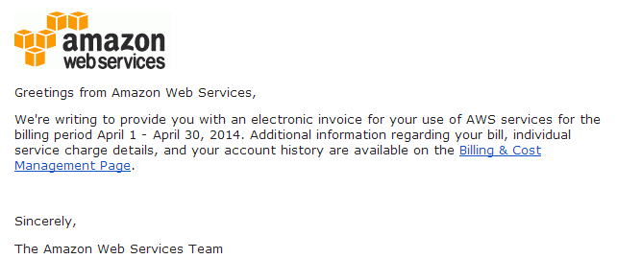
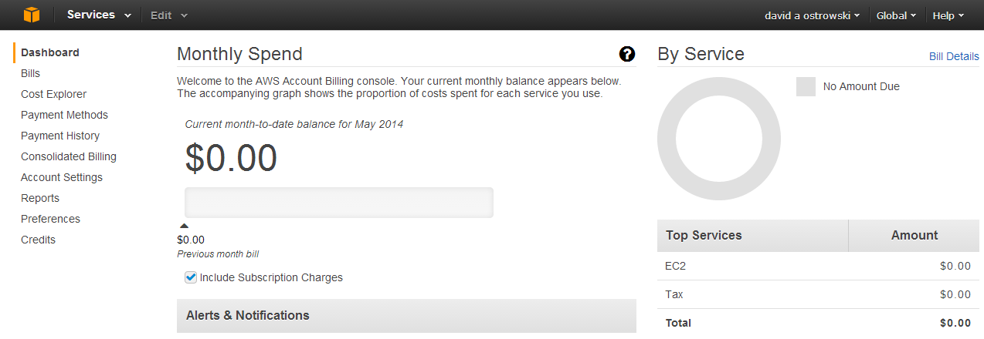
Your goal:

Slide 6
Getting started
First initiate the amazon account
Instantiate your “free” tier EC2
Begin download with provided script
As this occurs I will give more background on the technologies to be covered.

Slide 7
Initial Amazon Signup (overview) Initial signup , key generation and logon.
Step 1) Familiarize yourself with amazon ec2
http://aws.amazon.com/documentation/ec2/
step 2)Sign up for account (look for ‘signup’ at the top of the ec2 link above or go directly to…)
https://portal.aws.amazon.com/gp/aws/developer/registration/index.html
Step 3.) Fill out login credentials, address, credit card,
(It will call you and you will enter a number to verify)
Step 4) once you are signed up go to the EC2 page http://aws.amazon.com/ec2/

Slide 8
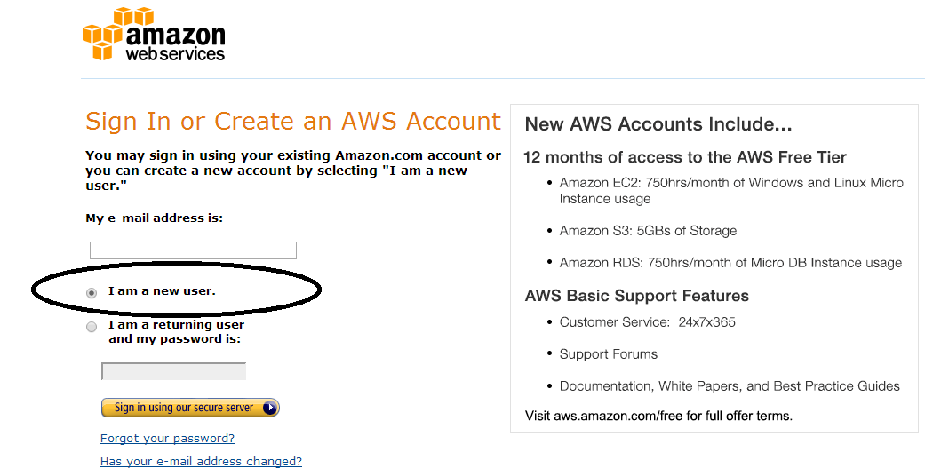
AWS account creation

Slide 9
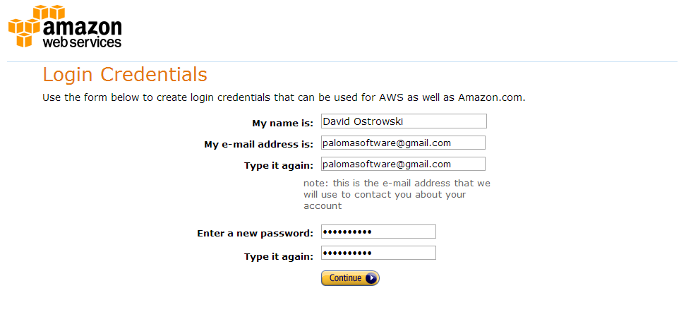
AWS account creation – login credentials screen

Slide 10
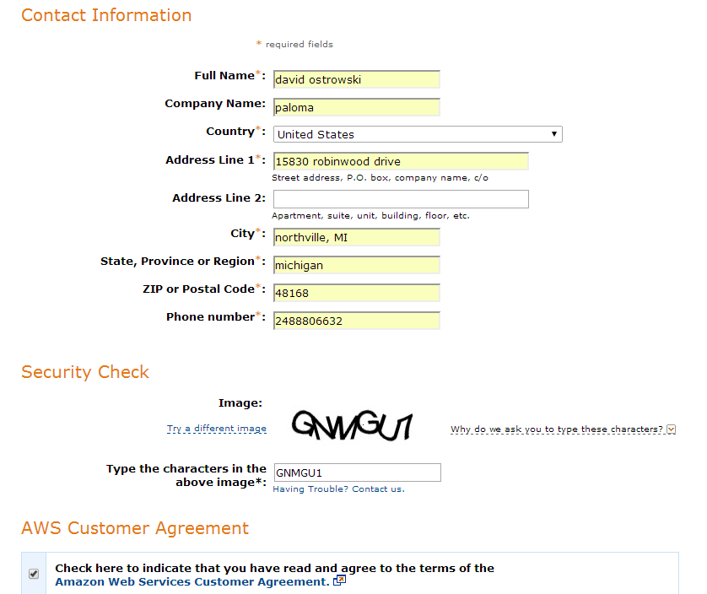
AWS account creation cont.

Slide 11
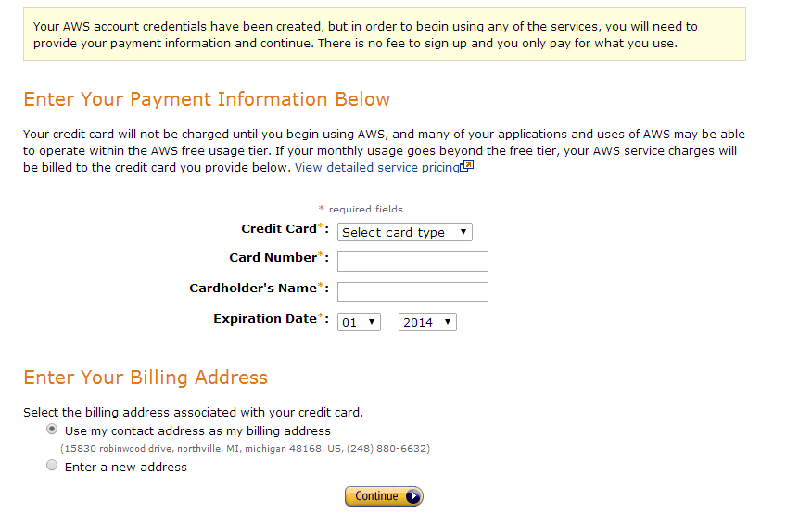
AWS account creation cont.

Slide 12
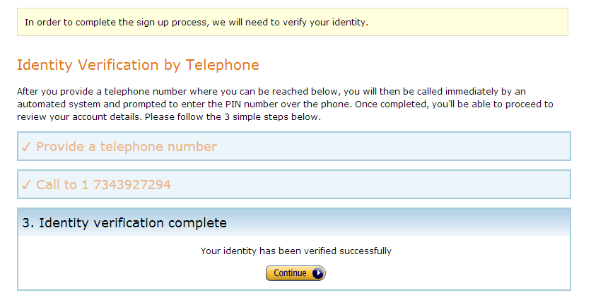
AWS account creation cont.

Slide 13
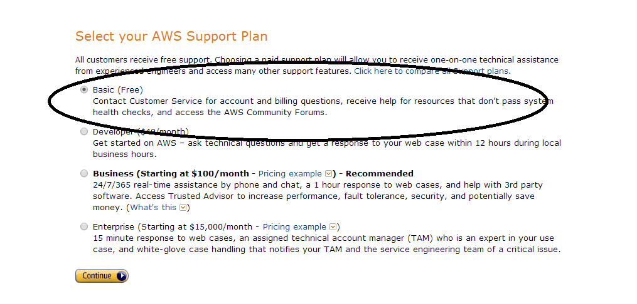
AWS account creation cont.

Slide 14
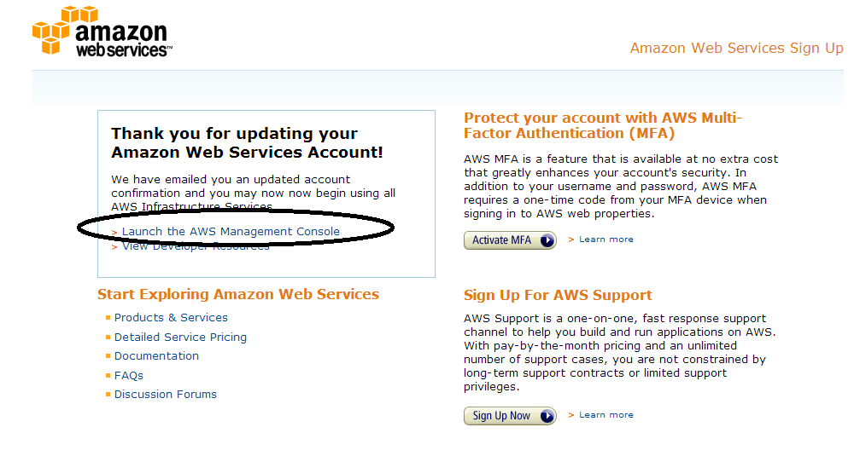
AWS account creation cont.

Slide 15
AWS EC2 instantiation (overview)
Step 1.) Create a “key” value necessary to ‘log in’ to your instance
Create a .pem key - > download to your machine
Generate a .ppk key from your .pem
Use your .ppk everytime you want to connect
Step 2.) Instantiate 32-bit ubuntu instance
Step 3.)Done.

Slide 16
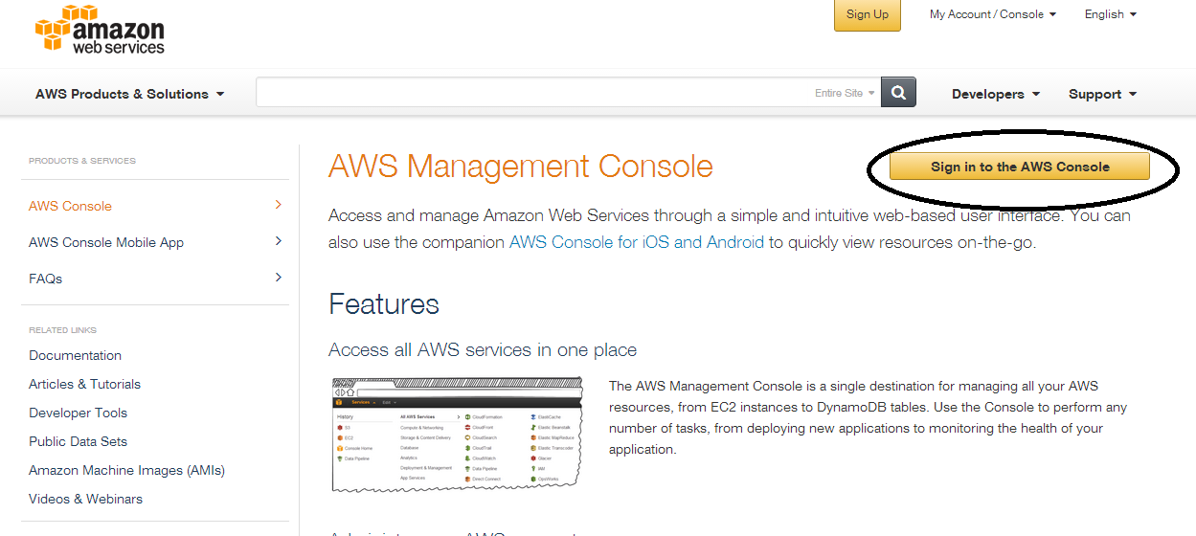
Instantiating the EC2 instance

Slide 17
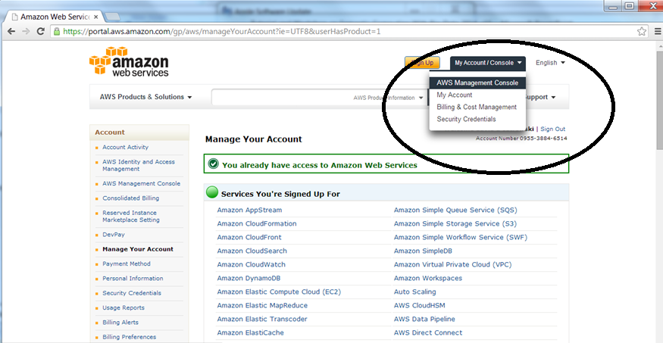
Or if you are logging back in just go to the managemetn console

Slide 18
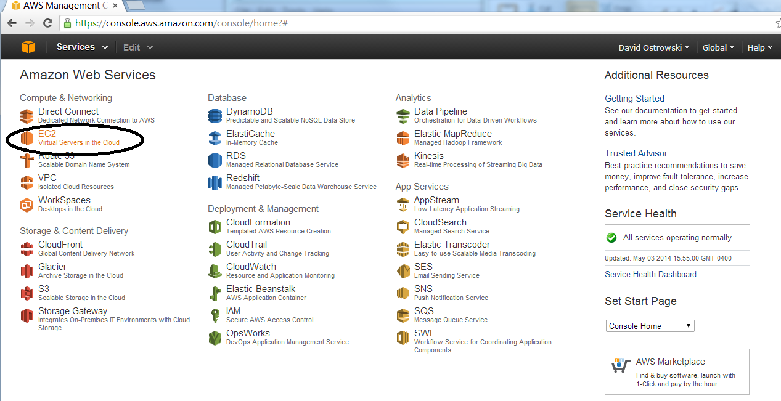
Instantiating EC2 instance

Slide 19
Secure key overview
Create a key from the AWS console
Download a *.pem file to your machine (do not lose ever!)
Convert your *.pem to a *.ppk (via a program called puttygen.exe
Upload your *.ppk with your client anytime your log on
(also – later….) you will use *.ppk to install hdfs

Slide 20
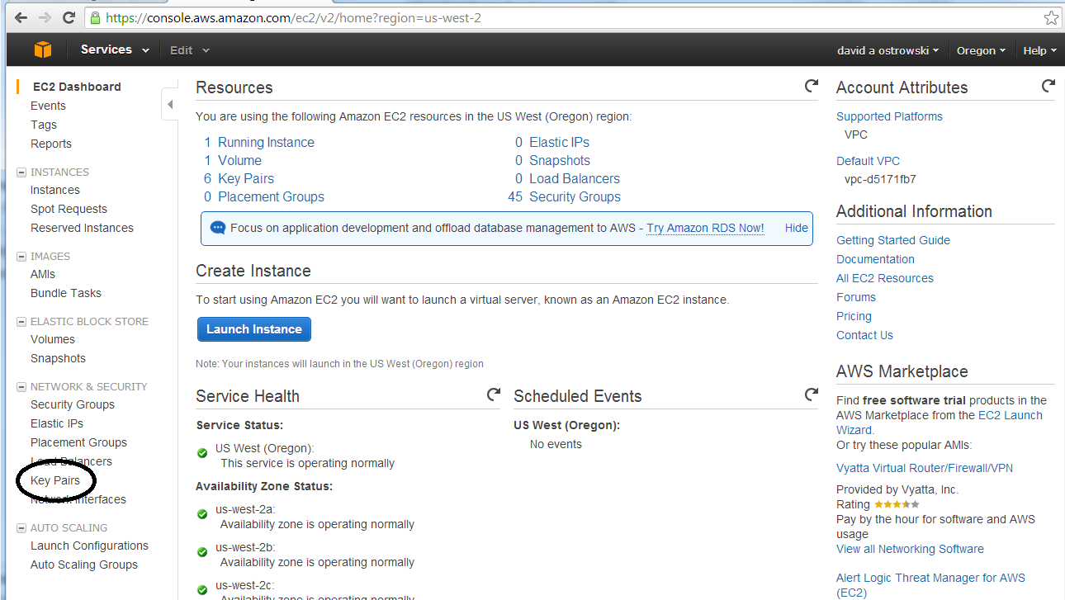
Instantiating EC2 instance (creating a key value)

Slide 21
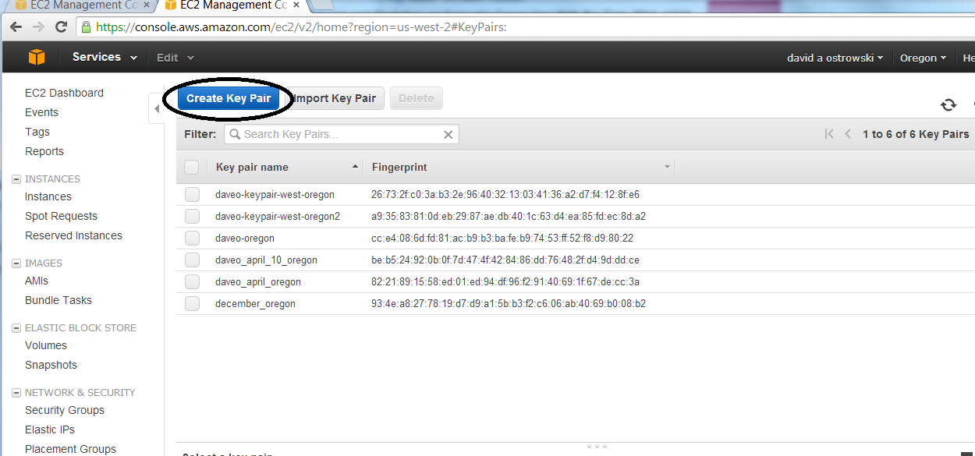
Generate key value

Slide 22
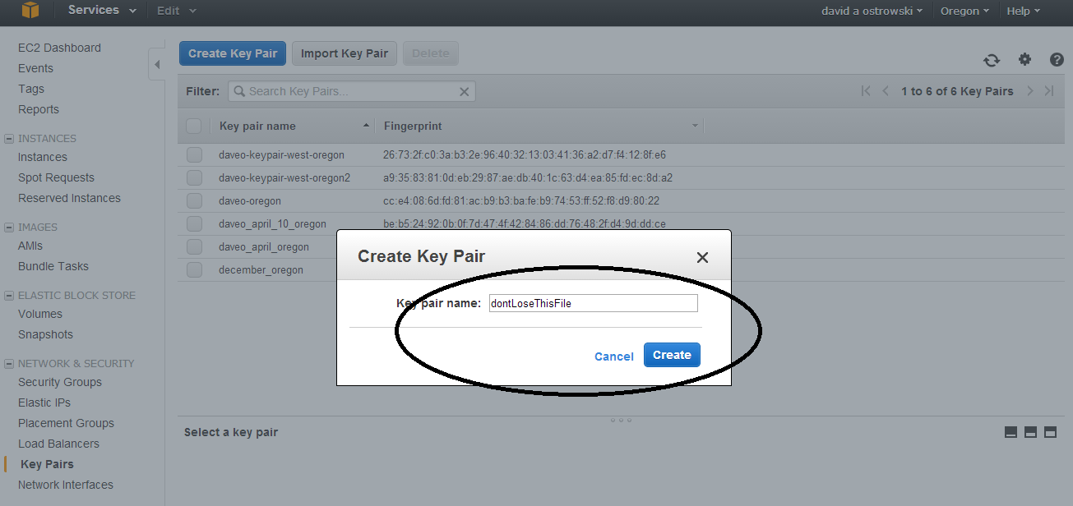

Slide 23
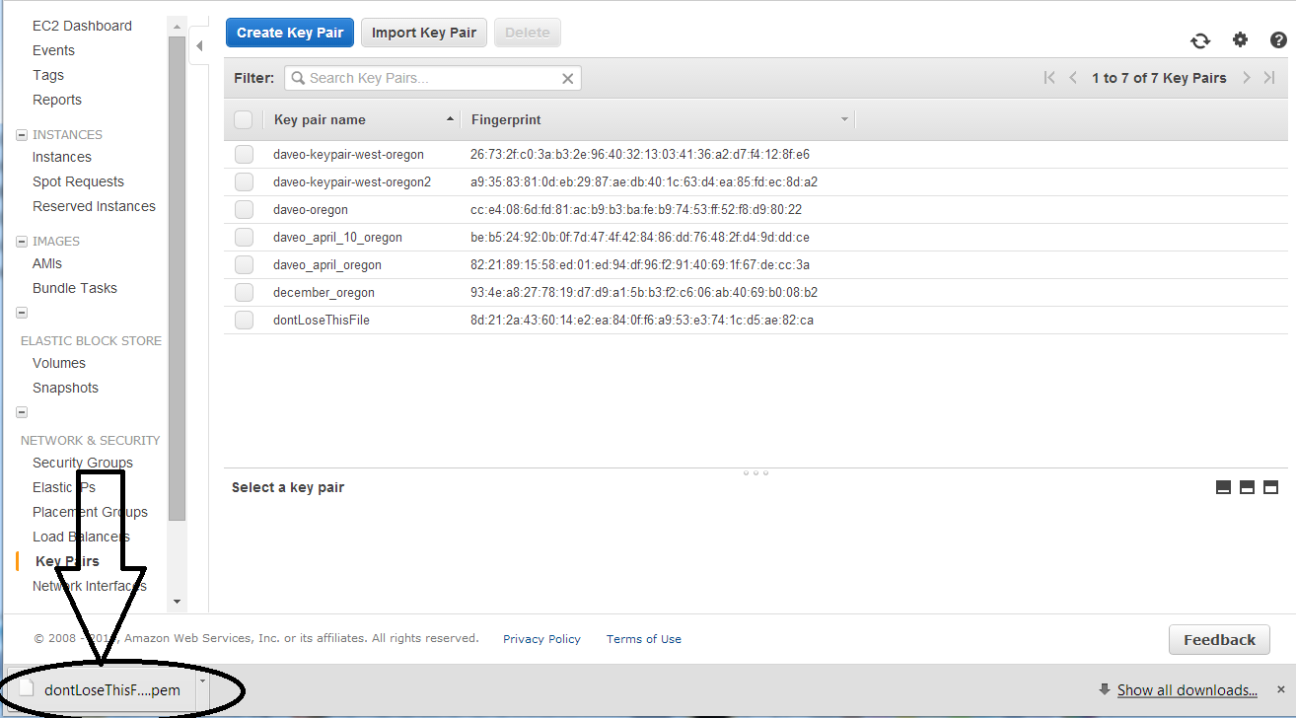

Slide 24
Secure key is necessary to connect your client - putty and puttygen are two programs to convert your key and use for every connection
Now download a copy of puttygen.exe and putty.exe
http://www.chiark.greenend.org.uk/~sgtatham/putty/download.html
putty is also available at …
http://www.putty.org/

Slide 25
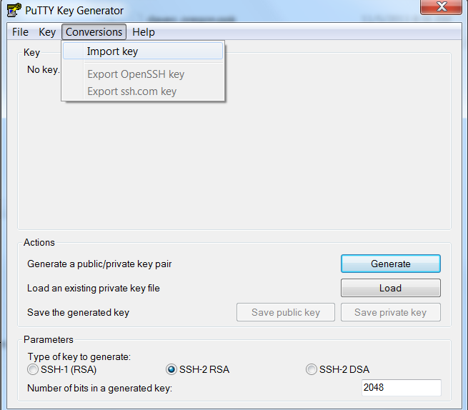

Slide 26
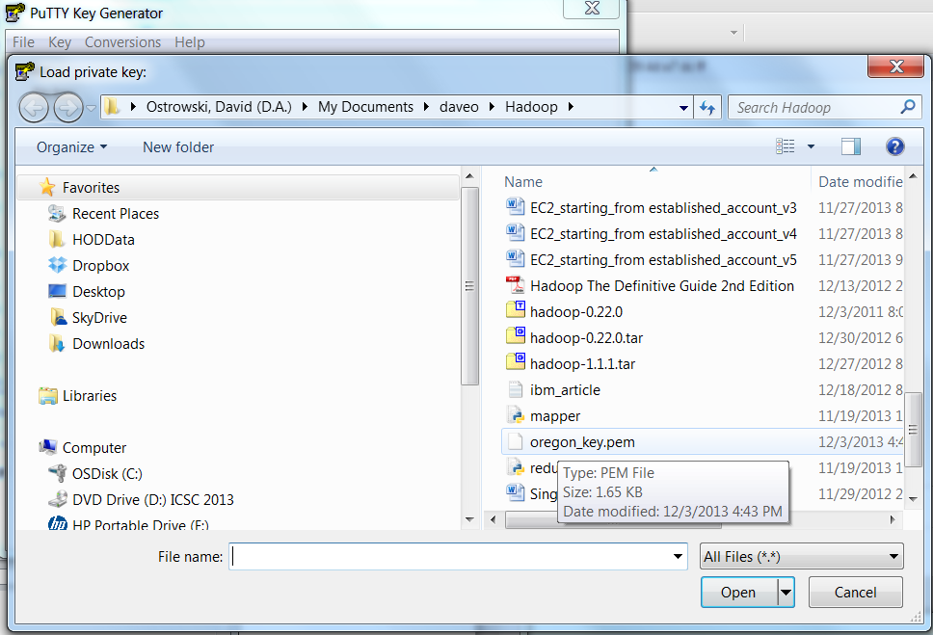
Load in the .pem file and then go to save private key – do not hit “generate” Save as a “private key” .ppk file and you are complete.

Slide 27
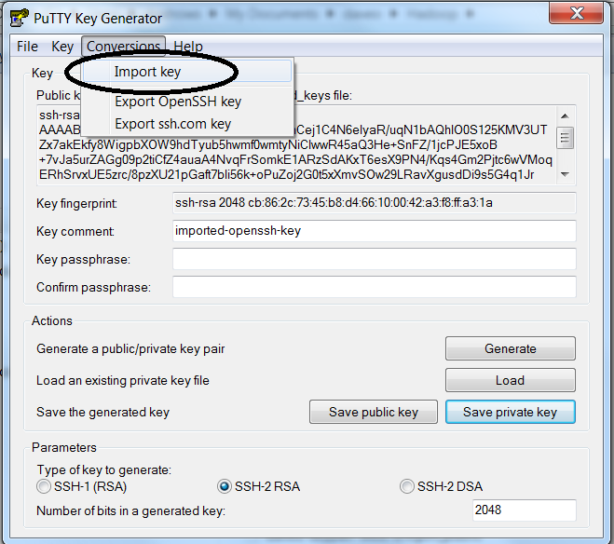
1. Import key option

Slide 28
You will be prompted for your .pem file

Slide 29
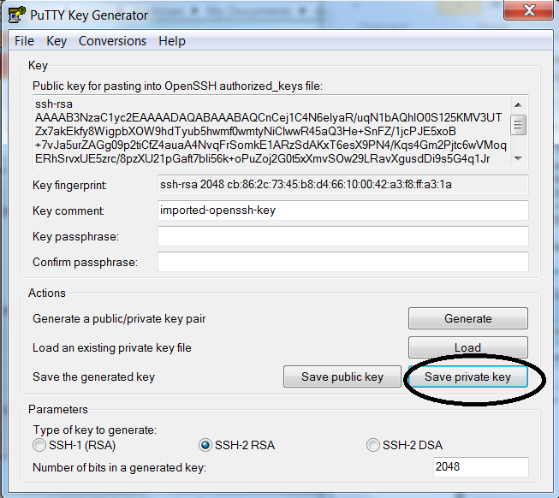
Save your .pem as a .ppk

Slide 30
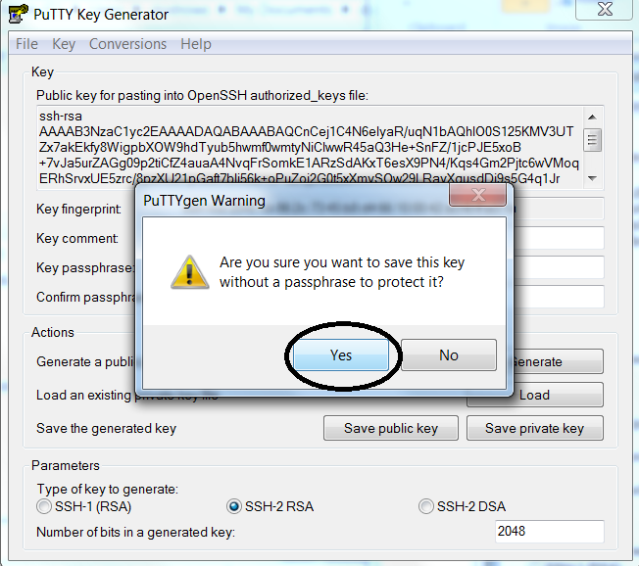
You do not need a password to save.

Slide 31
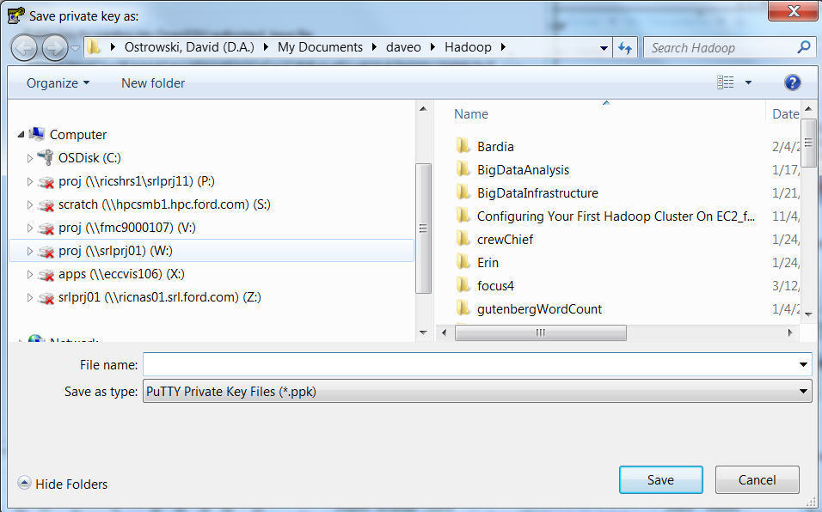
Enter the same name as your .pem and allow it to be saved with a .ppk extension

Slide 32
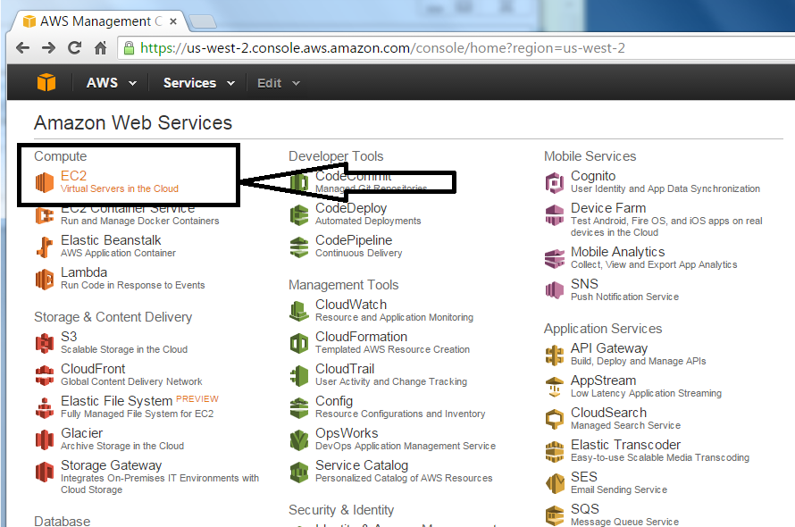
Launch an instance
Select the EC2 option (when logging on typically you will end up on the AWS main screen below)

Slide 33
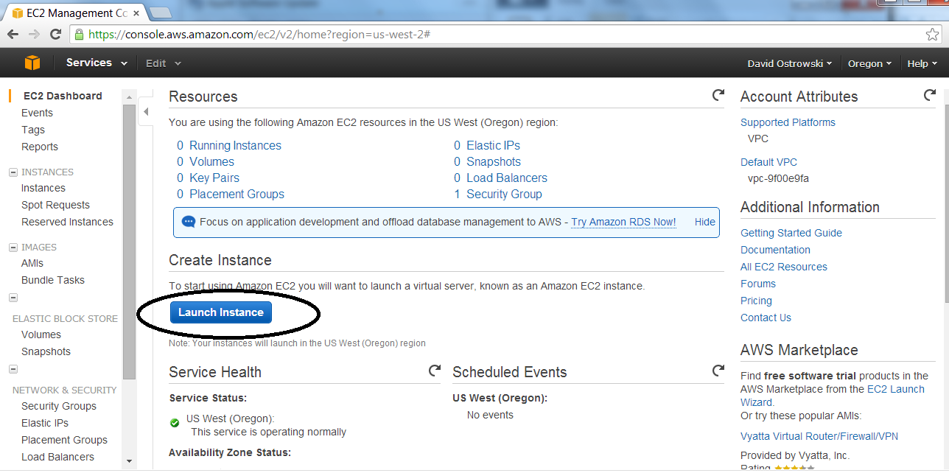
Now start instance! Management console

Slide 34
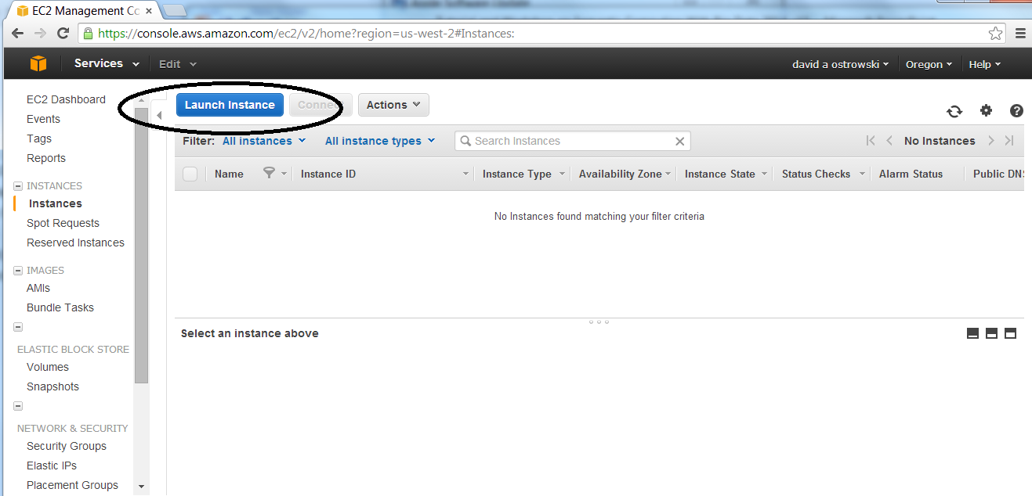

Slide 35
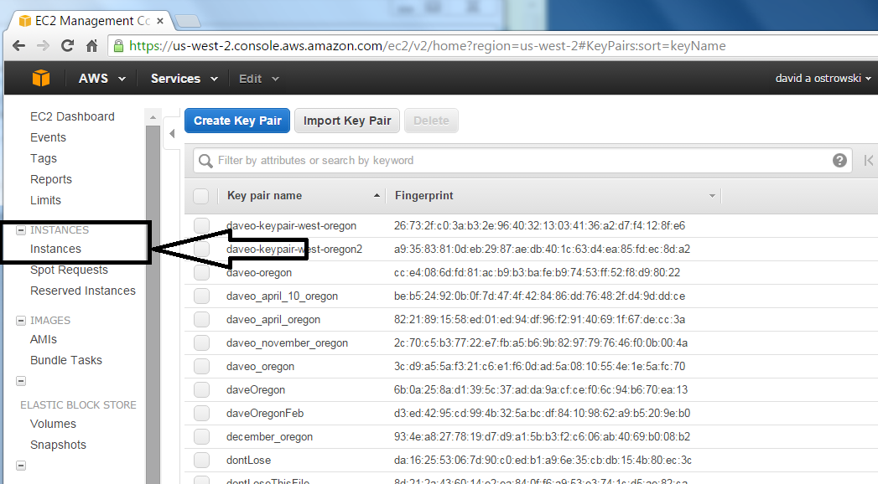
Troubleshooting – how to reach the point of launching the instance if you lose the navigation
Select “instances” on the left hand side of the monitor
This will bring you to the (earlier) screen that has the “launch instance” button

Slide 36
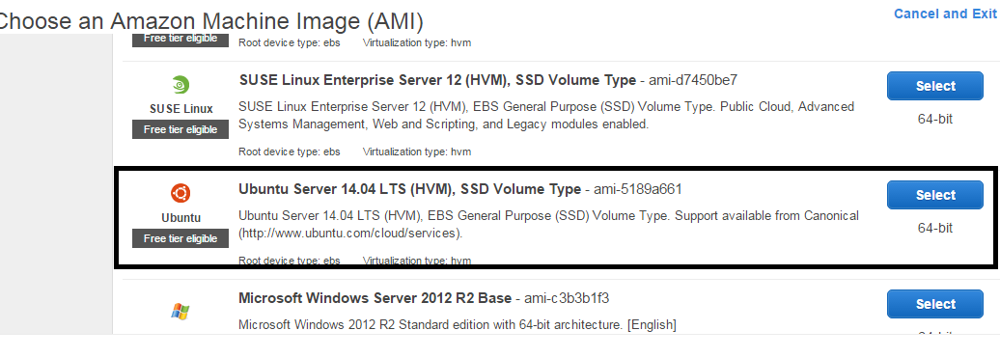
Scroll to ubuntu server 14.04

Slide 37
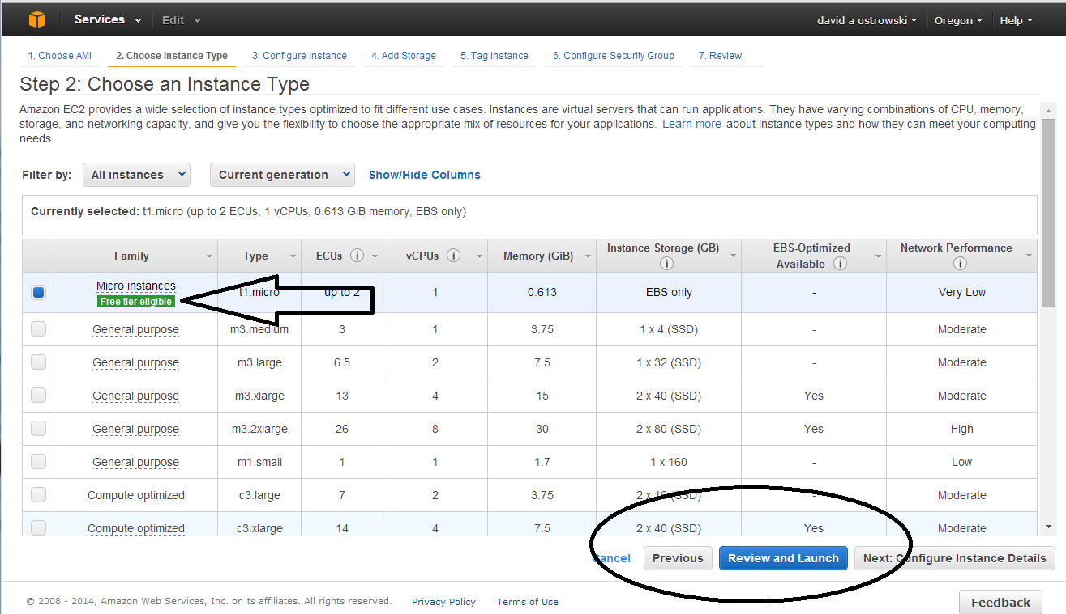

Slide 38
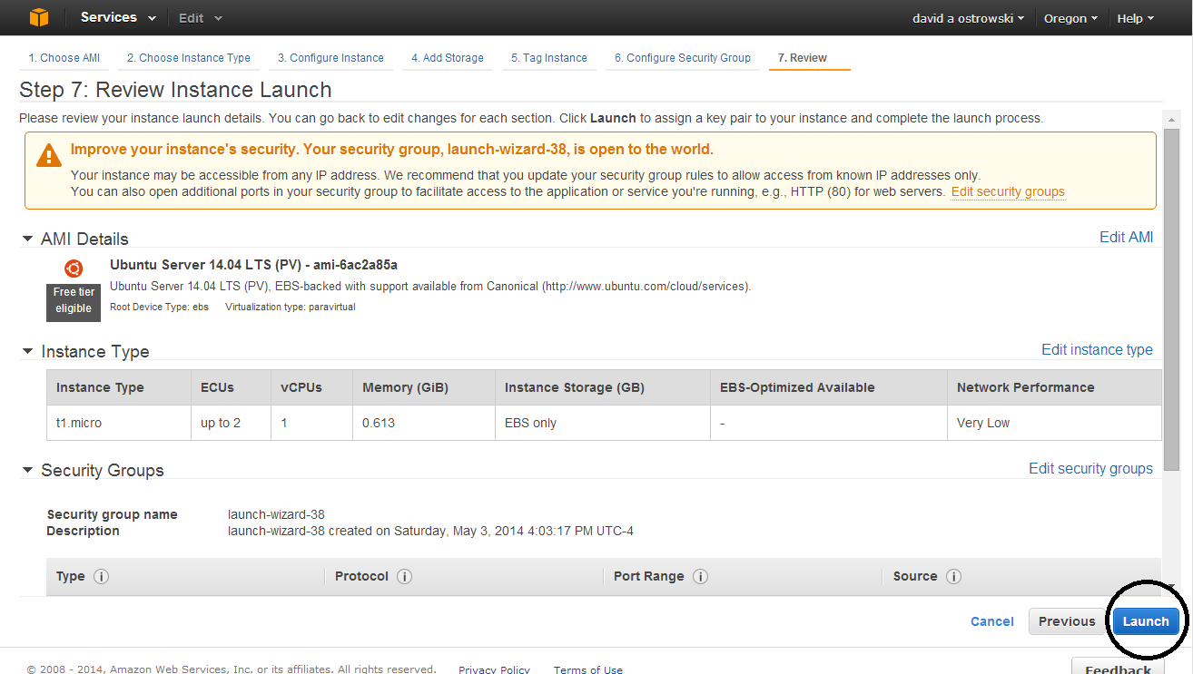

Slide 39
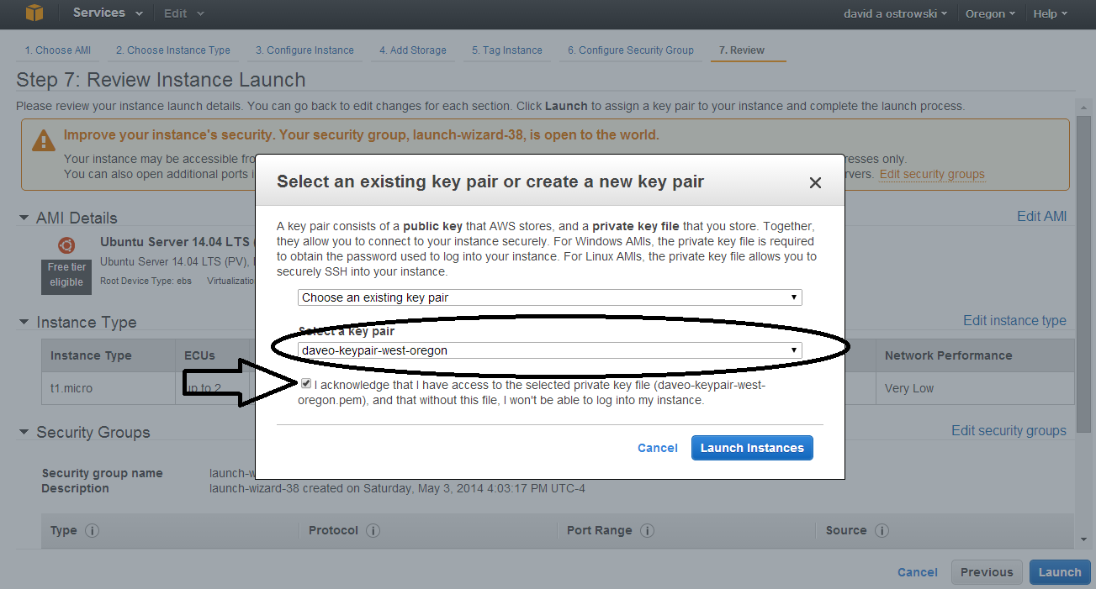

Slide 40
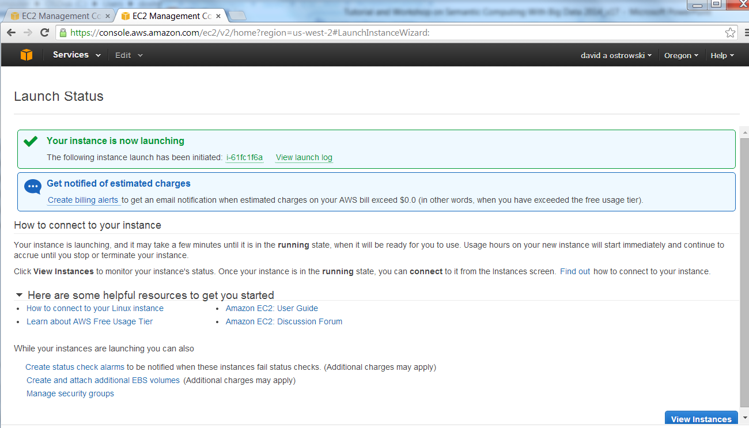

Slide 41
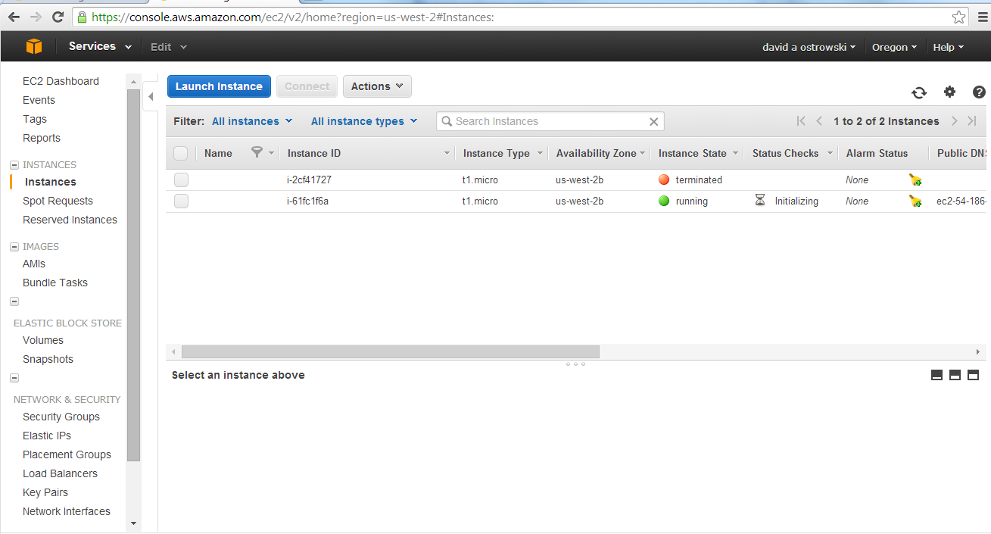

Slide 42
If running is showing on your console – you can now connect to your machine via an independent client (I suggest putty for a console and winscp to upload files)
Another alternative is filezilla for uploading files

Slide 43
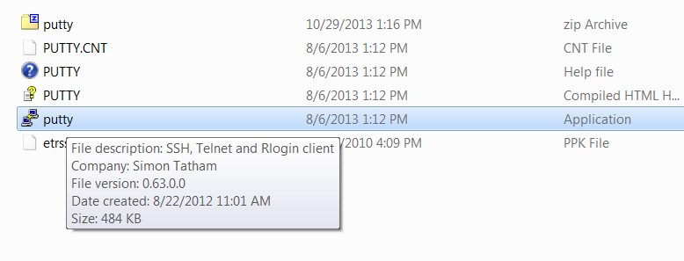
Logging in to an established account
1.) bring up the putty.exe program

Slide 44
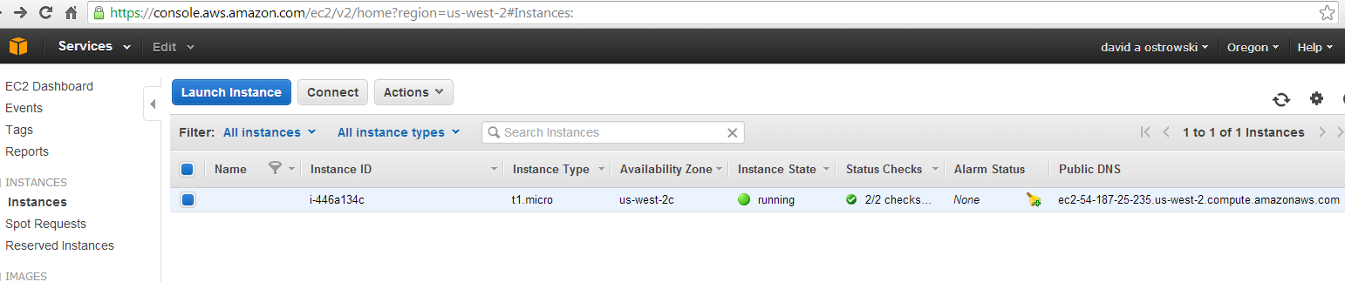
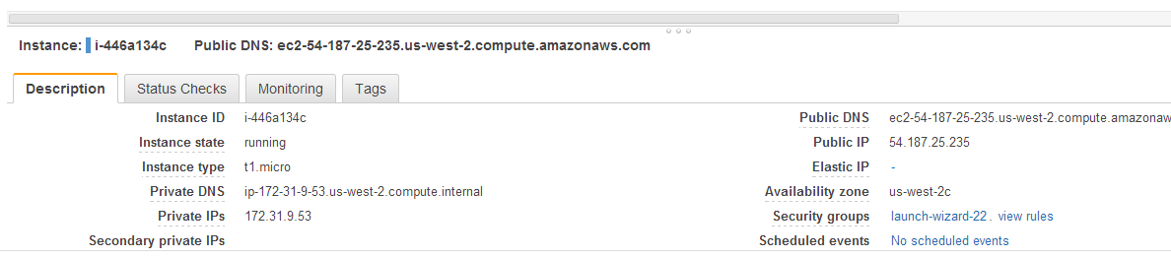
2a.) verify which .ppk to load in .
2b.) load in the generated ppk file (you need to save this )
Scroll down
To verify your
keyname

Slide 45
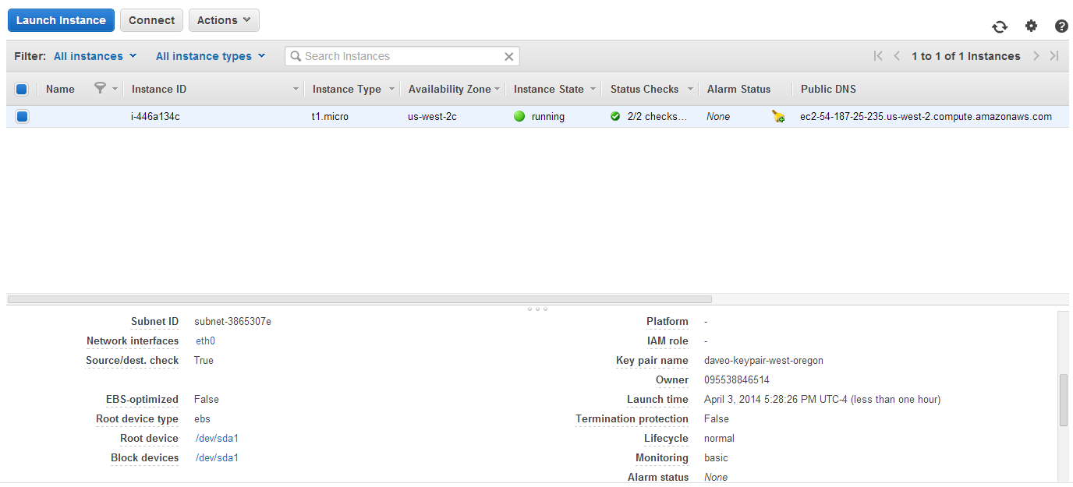
Verify the keyname

Slide 46
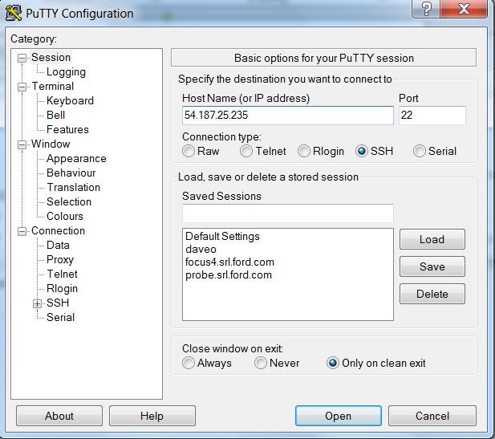
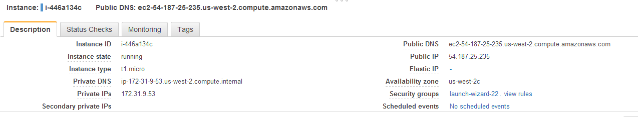
Identify the IP address and input into the putty interface.

Slide 47
The following slide will show you how to set up putty to connect to your client.

Slide 48
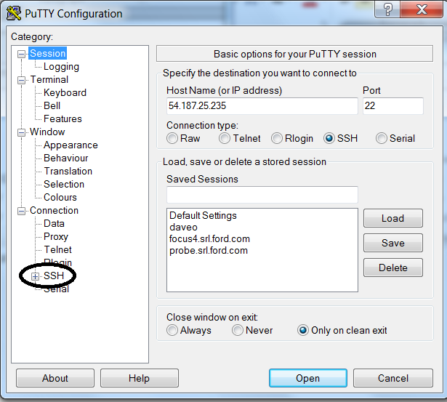
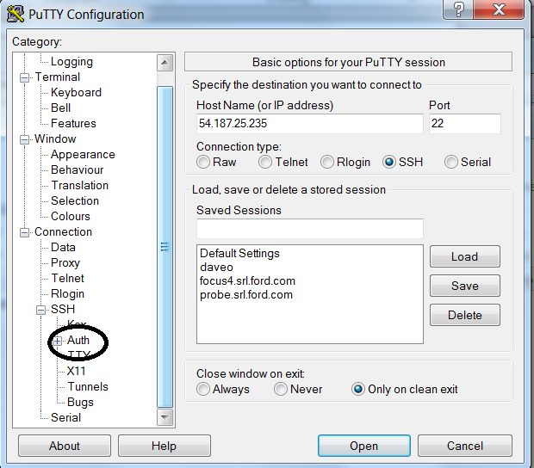
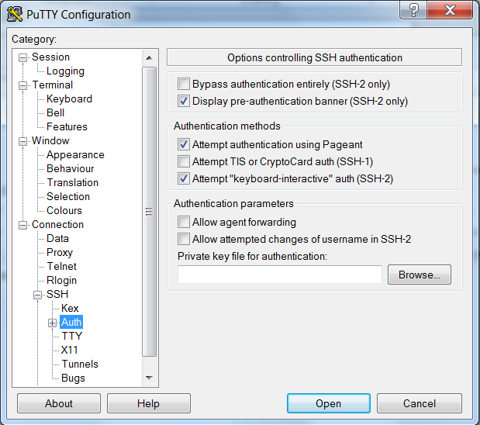
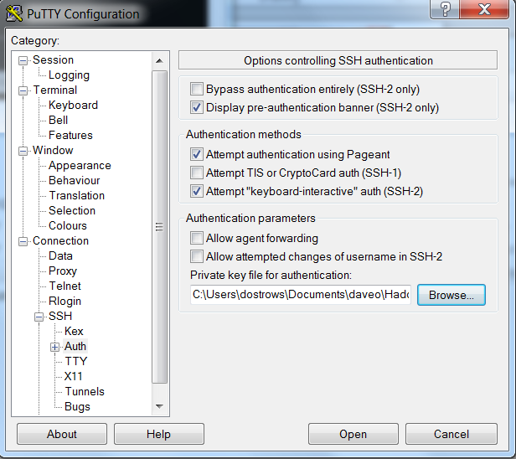
Click Auth
Click SSH
Screen pops up
Load in *.ppk via the browse

Slide 49
Now set up a file transfer….

Slide 50
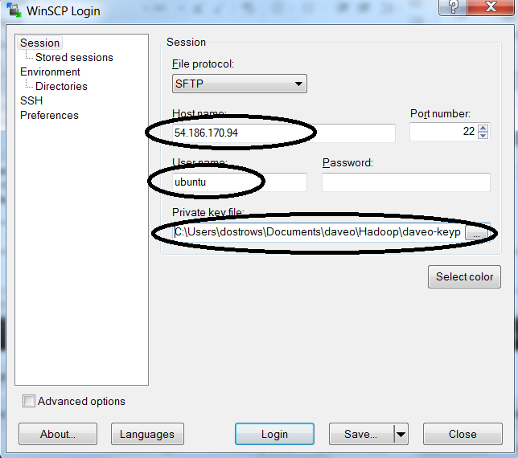
Winscp is configured similarly

Slide 51
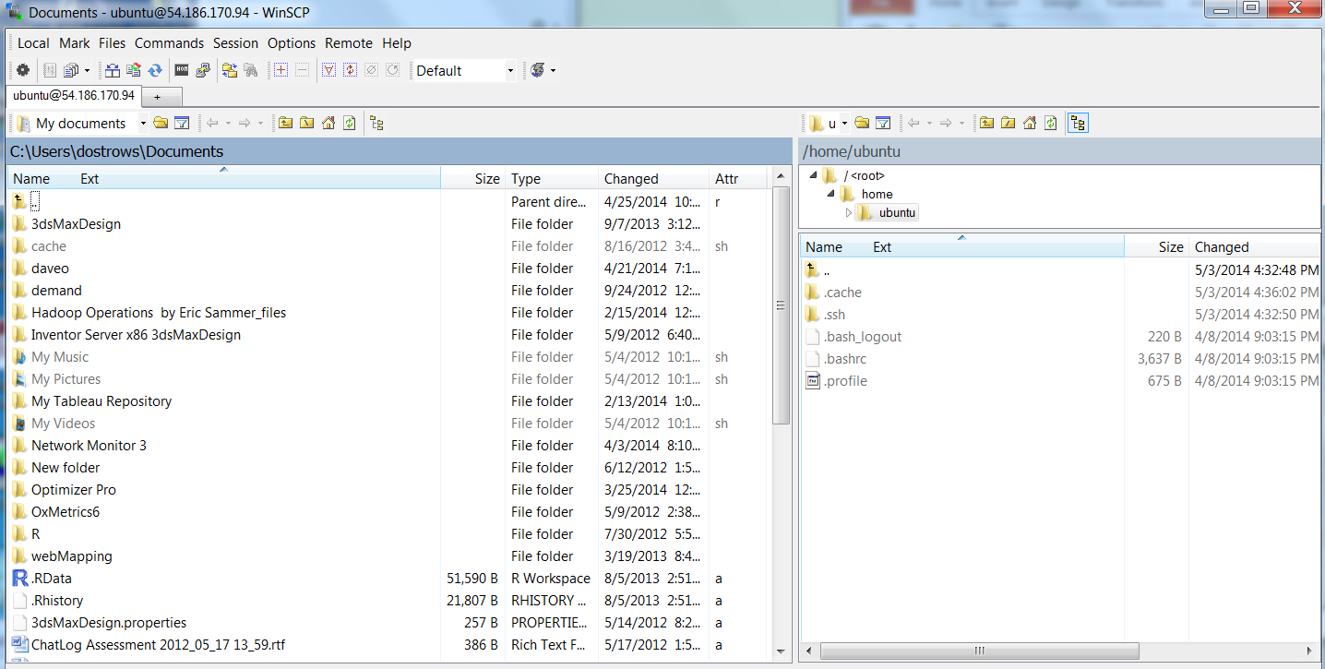
After the connect with winscp you will see the following window:

Slide 52
Logging on with putty (unix client)
I am suggesting to load the bash shell script (bashshell24.sh) and environment script (env.sh) to the “home” directory and start the entire process from that point.
NOTE: your “home” is directory /home/ubuntu
This will load all necessary software for the course and set it up appropriately
Remember every time you log back in , you need to run the env.sh file (this is by using the “source” command as shown in the following commands

Slide 53
Some preliminary information before proceeding

Slide 54
Crash course in Unix shell programming
Unix shell
ls
Equivalent to a “dir” in windows programming
rm
Equivalent to “delete” in windows programming
Cp
Equivalent to “copy in windows programming
mkdir
Same as windows
rmdir
Removes a directory as in windows
cat
Equivalent to “type” in windows programming

Slide 55
overview
You will next:
Install the dos2unix utility (to format your files for the unix environment)
Upload your startup script and environment file
Run dos2unix to both files
Set permissions on both files
Load your startup script and environment file (this will download and install your software and set your paths accordingly)
Start to work in the Big Data environment

Slide 56
Environment set up and software example file download overview
//copy in bashscript24.sh and env.sh
//Install dos2unix
sudo apt-get install dos2unix
chmod 777 bashscript24.sh (take the latest copy provided)
Start up …(enter ‘y’ for any prompts through your script) => do this by entering ./bashscript24.sh
source env.sh

Slide 57
Other issues…
After completion you can ‘test’ the environment by typing java then hadoop at the command line
Remember if you stop / restart an EC2 instance you have to run the “source env.sh” to set your environment variables again.

Slide 58
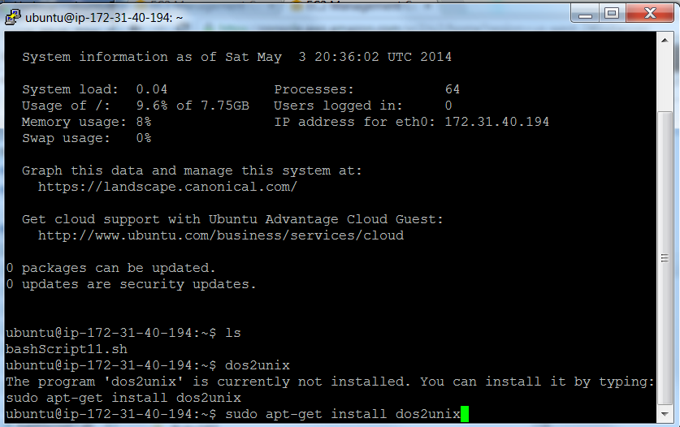

Slide 59
Remember: dos2unix, chmod, directory paths

Slide 60
Environment set up and software example file download overview
copy in bashscript24.sh
dos2unix bashscript24.sh
chmod 777 bashscript24.sh
copy in env.sh
dos2unix env.sh
chmod 777 env.sh
Start up …(enter ‘y’ for any prompts through your script) => do this by entering ./bashscript24.sh
Then run the environment variables =>
source env.sh

Slide 61
After completion you can ‘test’ by typing java then hadoop at the command line

Slide 62
Troubleshooting (why doesn’t it work?)
Set the file to unix format (using dos2unix)
Set permissions on file (using chmod)
Set environment (stop/start EC2 ….and ‘source’ the env.sh )
If you have virtual memory errors: (stop/start EC2 and source the env.sh)
NOTE: in case of shark having java errors – see me , here you must lower memory requirements in the config file (this may happen intermittently)
I have not provided you will an environment on ‘logon’ so every time you shut down you must rerun the environment
A cause of error is improper exit from any of the shells – use <ctrl> d or type “exit”

Slide 63
troubleshooting
What do I log in as ? “ubuntu” is the username and NO password

Slide 64
Trouble shooting for macs
Mac does not need putty or winscp – it has internal utilities that will allow the use of connecting to another unix machine.
Mac is a variant of unix - as such connection should not be troublesome
A GUI utility that allows for file transfer is filezilla for mac.
See next slide for more ref.

Slide 65
If you have a mac, you are running a variant of unix – connecting should not be a problem (see references below)
http://www.rackspace.com/knowledge_center/article/connecting-to-linux-from-mac-os-x-by-using-terminal
http://faculty.smu.edu/reynolds/unixtut/osx.html
https://www.udel.edu/it/help/connecting/ssh/terminal.html

Slide 66
vi editor
NOTE: most of the editing is performed for you
I am relying on ‘vi’ editor to perform some of the tasks (slight modifications)
If you are not familiar , there are some easy references as below
I am including a short summary on the next page
http://www.lagmonster.org/docs/vi.html

Slide 67
vi editor
vi <filename>
Two modes: (insert, edit)
<escape> “i” will take you to “insert”
<escape> will take you to edit
DD will delete a line
x will delete a character
Arrow keys will move you around
ZZ will save your file – take you out of insert mode

Slide 68
Books covered
Hadoop General
Turkington, Garry. Hadoop Beginner's Guide. Packt Publishing Ltd, 2013.
White, Tom. Hadoop: The Definitive Guide: The Definitive Guide. O'Reilly Media, 2009.
Programming PIG
Gates, Alan. Programming Pig. " O'Reilly Media, Inc.", 2011.
Programming HIVE
Capriolo, Edward, Dean Wampler, and Jason Rutherglen. Programming hive. O'Reilly Media, Inc., 2012.
mahout

