Slide 1
Hdfs (in six steps)
Step 1: configure ssh keypair
Step 2: open firewall ports
Step 3: set JAVA_HOME in your hadoop-env.sh
Step 4: configure hdfs xml files: core-site.xml,hdfs-site.xml, mapred-site.xml
Step 5: format namenode
Step 6: start dfs
Ready to use hdfs file system..

Slide 2
Configure SSH Keypairs
Hadoop needs to SSH from master to slave serves to start and stop processes
All amazon servers will have our generated public key installed on them in their ~ubuntu/.ssh/authorized_keys file automatically by Amazon. However we also need to place the corresponding private key in the .ssh directory
This is accomplished by using PuttyGen again , selecting your .pem file and do: (Conversions -> export Open SSH Key)
Using winscp , copy to the host , name your file as “id_rsa” and place alongside authorized_keys in .ssh folder (~ubuntu/.ssh)
This is necessary even with single node as your services for hdfs need them. ….
Also, it is extremely important to set a password on your private key as well as set permissions in the .ssh directory:
cd ~/.ssh
chmod 400 id_rsh

Slide 3
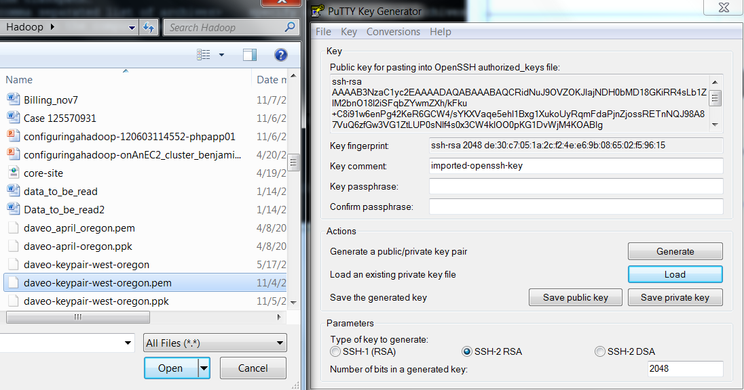
HDFS: Configure ssh keypairs

Slide 4
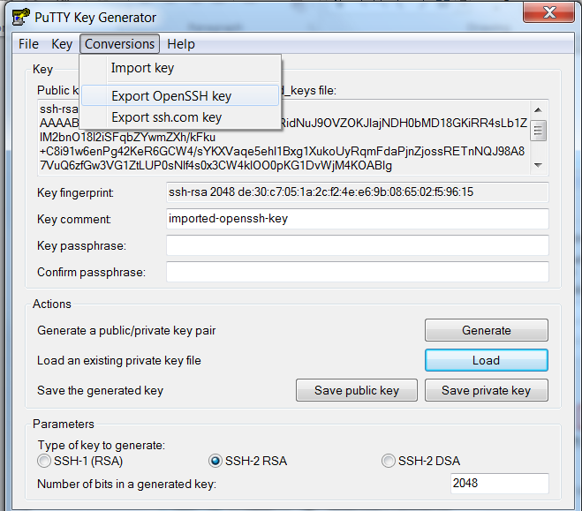
HDFS: Configure ssh keypairs

Slide 5
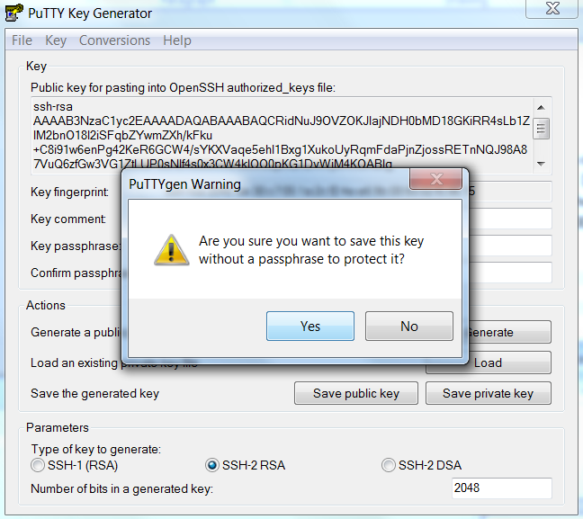

Slide 6
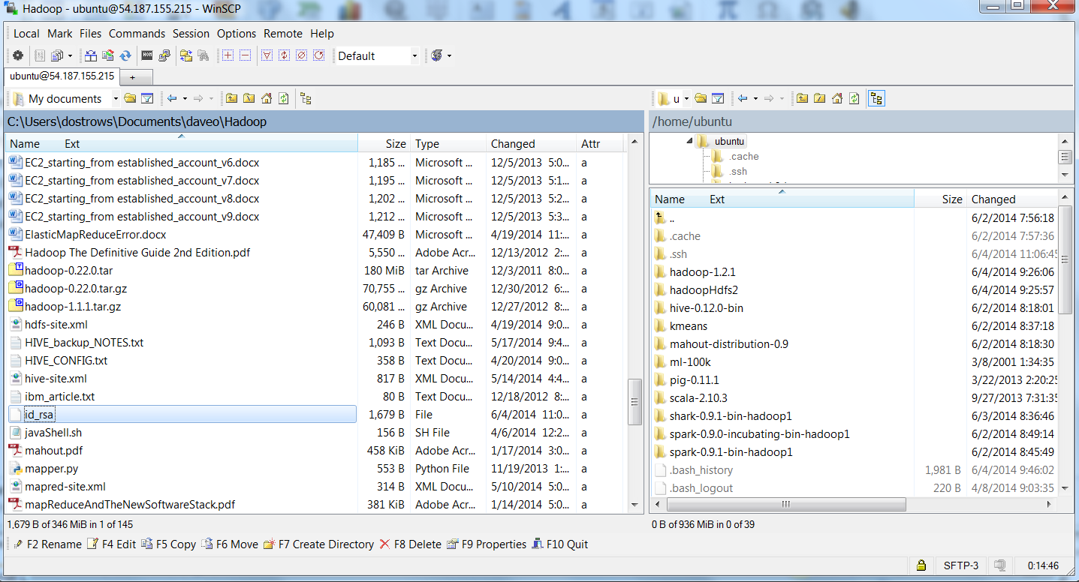
HDFS: Configure ssh keypairs

Slide 7
Open firewall ports
Also, we need to open a number of ports to allow the Hadoop cluster to communicate and expose various web interfaces to us. Do this by adding inbound rules to the default security group on the AWS ECS management console. Open port 9000, 9001, and 50000-50100.

Slide 8
Config/ environment file modification
update ./conf/hadoop-env.sh to include JAVA_HOME=/usr/

Slide 9
configure hdfs xml files: core-site.xml,hdfs-site.xml, mapred-site.xml
HDFS is the distributed file system that sits behind Hadoop instances, syncing data so that it’s close to the processing and providing redundancy. We should therefore set this up first;
We need to specify some mandatory parameters to get HDFS up and running in various XML configuration files;
Still on the master server, the first thing we need to do is to set the name of the default file system so that it always points back at master, again using your own fully qualified hostname:
/home/ubuntu/hadoop-1.0.3/conf/core-site.xml
<configuration>
<property>
<name>fs.default.name</name>
<value>hdfs://ec2-107-20-118-109.compute-1.amazonaws.com:9000</value>
</property>
</configuration>

Slide 10
configure hdfs xml files: core-site.xml,hdfs-site.xml, mapred-site.xml
Still on the master server, we also need to set the dfs.replication parameter, which says how many nodes data should be replicated to for failover and redundancy purposes:
/home/ubuntu/hadoop-1.0.3/conf/hdfs-site.xml
<configuration>
<property>
<name>dfs.replication</name>
<value>1</value>
</property>
</configuration>

Slide 11
configure hdfs xml files: core-site.xml,hdfs-site.xml, mapred-site.xml
As well as the underlying HDFS file system, we have to set one mandatory parameter that will be used by the Hadoop MapReduce framework;
Still on the master server, we need to set the job tracker location, which Hadoop will use. As discussed earlier, we will put the job tracker on master in this instance, again being careful to substitute in your own master server host name:
/home/ubuntu/hadoop-1.0.3/conf/mapred-site.xml
<configuration>
<property>
<name>mapred.job.tracker</name>
<value>ec2-107-22-78-136.compute-1.amazonaws.com:54311</value>
</property>
</configuration>

Slide 12
configure hdfs xml files: core-site.xml,hdfs-site.xml, mapred-site.xml
As well as the underlying HDFS file system, we have to set one mandatory parameter that will be used by the Hadoop MapReduce framework;
Still on the master server, we need to set the job tracker location, which Hadoop will use. As discussed earlier, we will put the job tracker on master in this instance, again being careful to substitute in your own master server host name:
/home/ubuntu/hadoop-1.0.3/conf/mapred-site.xml
<configuration>
<property>
<name>mapred.job.tracker</name>
<value>ec2-107-22-78-136.compute-1.amazonaws.com:54311</value>
</property>
</configuration>

Slide 13
format namenode
$hadoop namenode –format
$start-dfs.sh
$jps
Ready for commands – successful completion of the first two commands follow:

Slide 14
format namenode
ubuntu@ip-172-31-36-170:~$ start-dfs.sh
starting namenode, logging to /home/ubuntu/hadoop-1.2.1/libexec/../logs/hadoop-ubuntu-namenode-ip-172-31-36-170.out
localhost: starting datanode, logging to /home/ubuntu/hadoop-1.2.1/libexec/../logs/hadoop-ubuntu-datanode-ip-172-31-36-170.out
localhost: starting secondarynamenode, logging to /home/ubuntu/hadoop-1.2.1/libexec/../logs/hadoop-ubuntu-secondarynamenode-ip-172-31-36-170.out
ubuntu@ip-172-31-36-170:~$ jps
1699 Jps
1635 SecondaryNameNode
1470 DataNode
1318 NameNode

Slide 15
output
hadoop namenode -format
14/06/04 15:10:19 INFO namenode.NameNode: STARTUP_MSG:
/************************************************************
STARTUP_MSG: Starting NameNode
STARTUP_MSG: host = ip-172-31-36-170/172.31.36.170
STARTUP_MSG: args = [-format]
STARTUP_MSG: version = 1.2.1
STARTUP_MSG: build = https://svn.apache.org/repos/asf/hadoop/common/branches/branch-1.2 -r 1503152; compiled by 'mattf' on Mon Jul 22 15:23:09 PDT 2013
STARTUP_MSG: java = 1.7.0_55
************************************************************/
Re-format filesystem in /home/ubuntu/hadoopHdfs2/dfs/name ? (Y or N) Y
14/06/04 15:10:22 INFO util.GSet: Computing capacity for map BlocksMap
14/06/04 15:10:22 INFO util.GSet: VM type = 32-bit
14/06/04 15:10:22 INFO util.GSet: 2.0% max memory = 1013645312
14/06/04 15:10:22 INFO util.GSet: capacity = 2^22 = 4194304 entries
14/06/04 15:10:22 INFO util.GSet: recommended=4194304, actual=4194304
14/06/04 15:10:23 INFO namenode.FSNamesystem: fsOwner=ubuntu
14/06/04 15:10:23 INFO namenode.FSNamesystem: supergroup=supergroup
14/06/04 15:10:23 INFO namenode.FSNamesystem: isPermissionEnabled=true
14/06/04 15:10:23 INFO namenode.FSNamesystem: dfs.block.invalidate.limit=100
14/06/04 15:10:23 INFO namenode.FSNamesystem: isAccessTokenEnabled=false accessKeyUpdateInterval=0 min(s), accessTokenLifetime=0 min(s)
14/06/04 15:10:23 INFO namenode.FSEditLog: dfs.namenode.edits.toleration.length = 0
14/06/04 15:10:23 INFO namenode.NameNode: Caching file names occuring more than 10 times
14/06/04 15:10:23 INFO common.Storage: Image file /home/ubuntu/hadoopHdfs2/dfs/name/current/fsimage of size 112 bytes saved in 0 seconds.
14/06/04 15:10:23 INFO namenode.FSEditLog: closing edit log: position=4, editlog=/home/ubuntu/hadoopHdfs2/dfs/name/current/edits
14/06/04 15:10:23 INFO namenode.FSEditLog: close success: truncate to 4, editlog=/home/ubuntu/hadoopHdfs2/dfs/name/current/edits
14/06/04 15:10:23 INFO common.Storage: Storage directory /home/ubuntu/hadoopHdfs2/dfs/name has been successfully formatted.
14/06/04 15:10:23 INFO namenode.NameNode: SHUTDOWN_MSG:
/************************************************************
SHUTDOWN_MSG: Shutting down NameNode at ip-172-31-36-170/172.31.36.170
************************************************************/

Slide 16
Start hdfs and test out
ubuntu@ip-172-31-36-170:~$ hadoop fs -copyFromLocal junk.txt junk.txt
ubuntu@ip-172-31-36-170:~$ ls -l junk.txt
-rw-rw-r-- 1 ubuntu ubuntu 19 Jun 4 15:10 junk.txt

Slide 17
Now you see it , now you don’t , now you see it on hdfs.
ubuntu@ip-172-31-36-170:~$ hadoop fs -ls
Found 1 items
-rw-r--r-- 1 ubuntu supergroup 19 2014-06-04 15:11 /user/ubuntu/junk.txt
ubuntu@ip-172-31-36-170:~$ rm junk.txt
ubuntu@ip-172-31-36-170:~$ hadoop fs -ls
Found 1 items
-rw-r--r-- 1 ubuntu supergroup 19 2014-06-04 15:11 /user/ubuntu/junk.txt

Slide 18
finished
You can follow with hdfs and use with any/ all of the earlier technologies
One issue – you need to reset the IP if you plan on shutting down the EC2

