Slide 1

Python Streaming I/O map reduce
Hadoop Infrastructure is completely written in Java
Our “Hello World” code relied on the Hadoop Java API
Really , you can use any language to write for Hadoop if you rely on the Java Streaming I/O library
Streaming I/O allows you to use a programming language standard I/O constructs to manage your data stream (in this case sys.stdin, sys.stdout for Python)

Slide 2
Python Streaming I/O map reduce
Leverage system I/O so you do not have to program the I/O into your application
Easier to test – an I/O streaming job can be executed both inside the hadoop architecture as well as outside (on smaller data sets)
Faster prototyping !
Note: we are using python but you can use any programming language (ruby, perl, C++) that can handle I/O streaming.

Slide 3
Python Streaming I/O map reduce
Download python files
Convert to unix format:
dos2unix <filename>
Set permissions
chmod 777 *.py

Slide 4
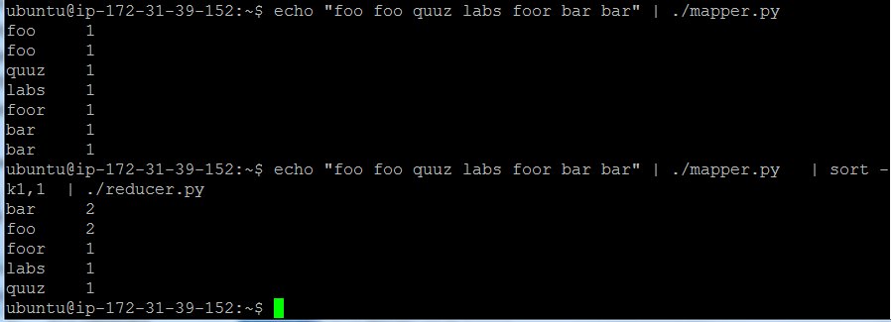
Testing streaming I/O Here, “echo” is used to send data to the mapper.py

Slide 5
Testing streaming I/O
Here a unix ‘sort’ command shell command is used
The parameters k1,1 are to sort on column one (ending at column one)
Don’t ask why ‘k’ and not ‘c’ for column as unix developers are weird like that.

Slide 6
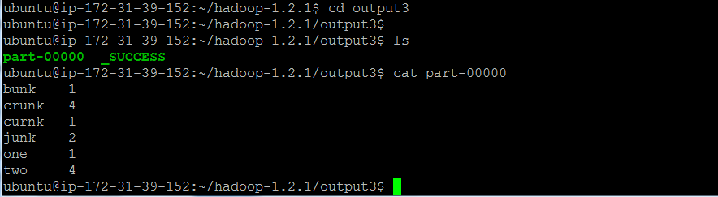
Streaming I/O

Slide 7
Python streaming I/O word count
hadoop jar /home/ubuntu/hadoop-1.2.1/contrib/streaming/hadoop-*streaming*.jar -file /home/ubuntu/m.py -mapper /home/ubuntu/m.py -file /home/ubuntu/r.py -reducer /home/ubuntu/r.py -input /home/ubuntu/input.txt -output output

Slide 8
MapReduce pseudocode (wordcount)
def mapper(line):
foreach word in line.split():
output(word,1)
def reducer(key, values):
output(key,sum(values))
One two two three three three
“one” => 1
“Two” => 1
“Two” => 1
“Three” => 1
“Three”=> 1
“Three”=> 1
One =>1
Two => 2
Three=> 3

Slide 9
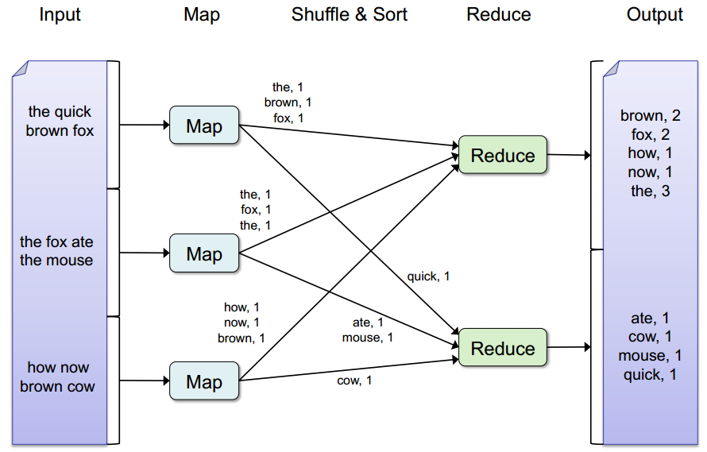
MapReduce breakdown (wordcount)

Slide 10
m.py : code streaming I/O code for the mapper
#!/usr/bin/env python
import sys
for line in sys.stdin:
line = line.strip()
words = line.split()
for word in words:
print '%s\t%s' % (word, 1)

Slide 11
r.py breakdown streaming I/O code for reducer
#!/usr/bin/env python
from operator import itemgetter
import sys
current_word = None
current_count = 0
word = None
for line in sys.stdin:
line = line.strip()
word, count = line.split('\t', 1)
try:
count = int(count)
except ValueError:
continue
if current_word == word:
current_count += count
else:
if current_word:
# write result to STDOUT
print '%s\t%s' % (current_word, current_count)
current_count = count
current_word = word
if current_word == word:
print '%s\t%s' % (current_word, current_count)

Slide 12
Python Streaming I/O Example 2: Distributed grep
#!/usr/bin/env python
import sys
for line in sys.stdin:
line = line.strip()
words = line.split()
if line.find("hi") > 0:
print '%s' % (line)

Slide 13
Python Streaming I/O Example 3: Log file processing
#!/usr/bin/env python
import sys
for line in sys.stdin:
line = line.strip()
words = line.split()
for word in words:
if word.find(".com") > 0:
print '%s\t%s' % (word, 1)

