Slide 1
Supplemental
python

Slide 2
Python crash course
Object oriented – not as much as squeak but a lot more than your average script language
Dynamic allocation (no declaration)
Can run in interpreted mode (from the interpreted prompt)
Can load

Slide 3
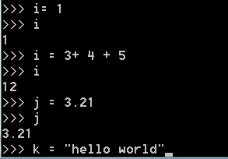
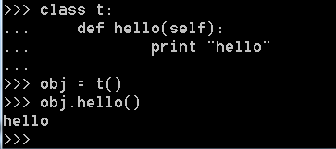
Everything is an object
ints, floats, strings, (classic objects

Slide 4
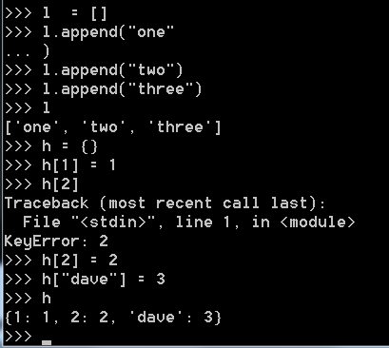
Python crash course
Lists and hashs prevail

Slide 5
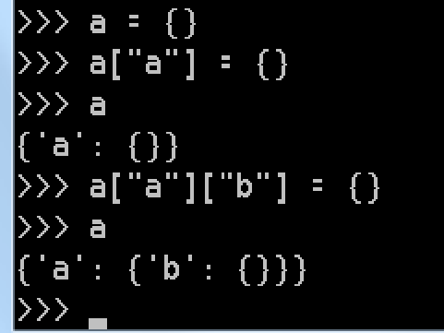
Python crash course
n-dimension associated arrays

Slide 6
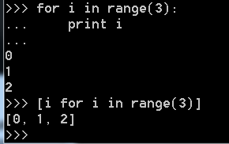
Toby segaran (lists)

Slide 7
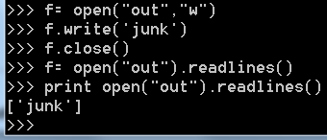
Python file I/O

Slide 8
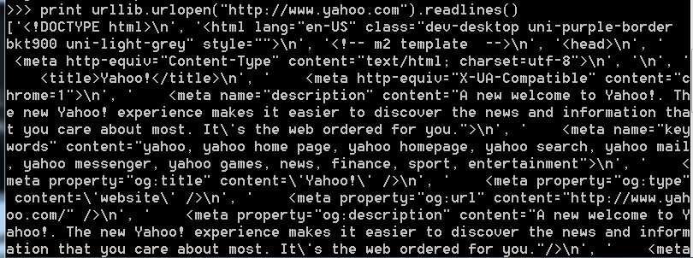
A url opens and reads exactly the same as a file.

Slide 9
Add in the python streaming

Slide 10

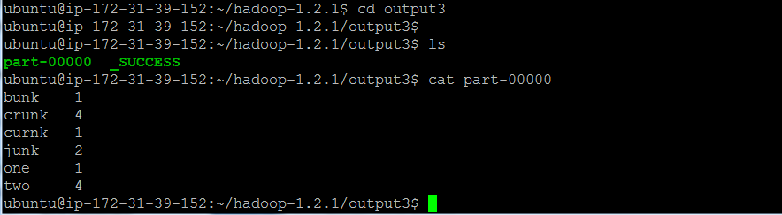
Streaming I/O

Slide 11
Python streaming I/O word count
hadoop jar /home/ubuntu/hadoop-1.2.1/contrib/streaming/hadoop-*streaming*.jar -file /home/ubuntu/m.py -mapper /home/ubuntu/m.py -file /home/ubuntu/r.py -reducer /home/ubuntu/r.py -input /home/ubuntu/input.txt -output output

Slide 12
Stepping into map reduce
echo "foo foo foo goo goo bar junk junk bunk bunk bunk bunk" | ./m.py
echo "foo foo foo goo goo bar junk junk bunk bunk bunk bunk" | ./m.py | sort -k1,1 | ./r.py
hadoop jar /home/ubuntu/hadoop-1.2.1/contrib/streaming/hadoop-*streaming*.jar -file /home/ubuntu/m.py -mapper /home/ubuntu/m.py -file /home/ubuntu/r.py -reducer /home/ubuntu/r.py -input /home/ubuntu/input.txt -output output
hadoop jar /home/ubuntu/hadoop-1.2.1/contrib/streaming/hadoop-*streaming*.jar -file /home/ubuntu/dgrep.py -mapper /home/ubuntu/dgrep.py -input /home/ubuntu/random.txt -output output2
hadoop jar /home/ubuntu/hadoop-1.2.1/contrib/streaming/hadoop-*streaming*.jar -file /home/ubuntu/logMapper.py -mapper /home/ubuntu/logMapper.py -file /home/ubuntu/logReducer.py -reducer /home/ubuntu/logReducer.py -input /home/ubuntu/input2.txt -output outp999

Slide 13
Using Streaming Scripts outside of Hadoop (pp 106) Turkington, Garry. Hadoop Beginner's Guide. Packt Publishing Ltd, 2013.pp106
Python program:
fout = open(“out.dat”,”w”)
for line in sys.stdin:
#postprocess
fout.write(line.split(“,”)[0]) # dump out the first piece of data

Slide 14
How to execute.
cat <hdfs file> | test.py

