Slide 1

Mahout
Machine Learning Suite of programs for Hadoop
Resides on top the Hadoop architecture
Allows for ease of running your machine learning job on a parallel environment as a map-reduce
Can be run from Java environment, command line or integrated with a Java application (all source code is available)
For non-java people – again, knowledge of Java is not necessary.

Slide 2
Two examples
Recommender engine
K-means clustering
References:
Chimpler Blog http://chimpler.wordpress.com/2013/02/20/playing-with-the-mahout-recommendation-engine-on-a-hadoop-cluster/
Piero Giacomelli, Apache Mahout Cookbook, Packt Publishing

Slide 3
Recommendation engine
Recommendation engines operate on the premise that associations are drawn between feature sets
From that, a ‘recommendation’ can be derived by correlations between known features where associations are made between vectors ( individuals ) that are ‘most’ similar in known categories
Given that information a ‘recommendation’ can be made to an individual as to what they may be interested in - given what is known about a peer category.

Slide 4
Recommendations:
Here we have data with movie reviews
Taking review information - individuals who are most similar (accounting for variance in grading ranges (( grade inflation )) ) a recommendation can be made for an individual

Slide 5
Recommendations the data set contains 943 users, 1682 movies and 100,000 ratings
u.data: contains several tuples(user_id, movie_id, rating, timestamp)
u.user: contains several tuples(user_id, age, gender, occupation, zip_code)
u.item: contains several tuples(movie_id, title, release_date, video_release_data, imdb_url, cat_unknown, cat_action, cat_adventure, cat_animation, cat_children, cat_comedy, cat_crime, cat_documentary, cat_drama, cat_fantasy, cat_film_noir, cat_horror, cat_musical, cat_mystery, cat_romance, cat_sci_fi, cat_thriller, cat_war, cat_western)

Slide 6
Example 1 : Recommendation Engine
Loosely following the directions specified:
http://chimpler.wordpress.com/2013/02/20/playing-with-the-mahout-recommendation-engine-on-a-hadoop-cluster/
Get on AWS
Ubuntu 1.3.1
Install hadoop – see other instructions (I used 1.2.1)
Install java (set export) (I used java 7)
Download mahout – I used mahout-distribution=0.8.tar.gz
Download (wget) movie set http://www.grouplens.org/system/files/ml-100k.zip
Download mahout-distribution /mahout-distribution-0.8/mahout-core-0.8-job.jar
Copy u.data to current directory // skip hdfs file system
//make sure you do not have a ‘temp’ from prior runs

Slide 7
Recommendation engine
U.data is the only file read by mahout
The remaining files allow for detail to support a report
This is using only a one line call to mahout – in this example used from the command line , though you can invoke the functions in a java program as well

Slide 8
RUN IT
hadoop jar /home/ubuntu/mahout-distribution-0.9/mahout-core-0.9-job.jar org.apache.mahout.cf.taste.hadoop.item.RecommenderJob -s SIMILARITY_COOCCURRENCE --input u.data --output output

Slide 9
Recommendation engine
Check the output
cd to “output” directory“
cat” the part-r-00000
The following command will present output in a meaningful fashion
Here , we present the recommendations for a user 4
python show_recommendations2.py 4 u.data u.item /home/ubuntu/ml-100k/output/part-r-00000

Slide 10
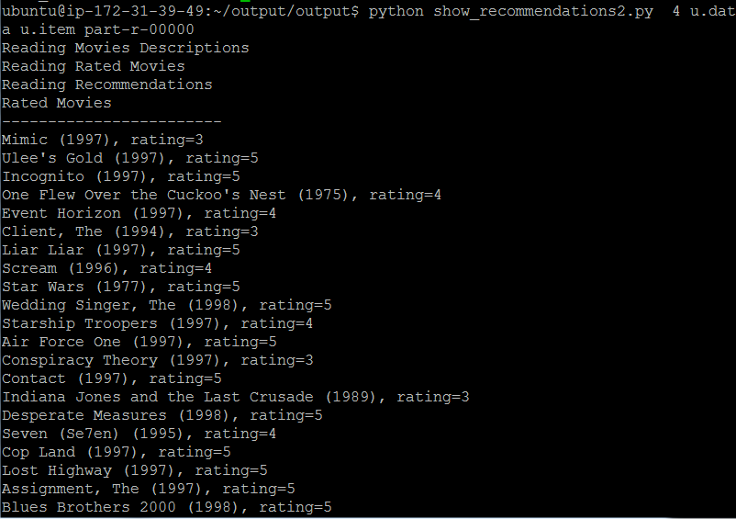
Recommender engine: Use the python script to show the output

Slide 11
Example two - kmeans
Kmeans clustering is a means of classification
Here, vectors are compared to see who is the closest in an n-dimensional space
Best approximated by how we would see points associated on an x,y axis
From here we can make associations between individual data sets and compare information between those that are most similar

Slide 12
Example two (from packt publishers Mahout cookbook): kmeans
steps involved
1.) get the dataset
2.) convert the input into sequence file format
3.) calculate the vectors data points converting text occurrence to number
4.) run the k-means algorithm

Slide 13
kmeans : Config Environment
export WORK_DIR= /home/ubuntu/kmeans
mkdir WORK_DIR/reuters-out-seqdir
mkdir $WORK_DIR/reuters-out
cd $WORK_DIR
wgethttp://kdd.ics.uci.edu/databases/reuters21578/reuters21578.tar.gz
tar -xvf reuters21578.tar.gz -C $WORK_DIR/reuters-sgm
mkdir /home/ubuntu/kmeans/reuters-kmeans/clusteredPoints

Slide 14
Example depending on if the path is set – you may have to modify ./mahout to simply mahout do not copy dircectly from powerpoint as you may insert an innappropriate end of line character
1) Extract files
./mahout org.apache.lucene.benchmark.utils.ExtractReuters $WORK_DIR/reuters-sgm $WORK_DIR/reuters-out
2)Create sequence files
./mahout seqdirectory -i $WORK_DIR/reuters-out -o $WORK_DIR/reuters-out-seqdir2 -c UTF-8 -chunk 5
3.)create vectors
./mahout seq2sparse -i $WORK_DIR/reuters-out-seqdir2 -o $WORK_DIR/reuters-out-seqdir-sparse-kmeans --maxDFPercent 85 --namedVector

Slide 15
example
4.)conduct analysis using kmeans
./mahout kmeans -i $WORK_DIR/reuters-out-seqdir-sparse-kmeans/tfidf-vectors/ -c $WORK_DIR/reuters-kmeans-clusters -o $WORK_DIR/reuters-kmeans -dm org.apache.mahout.common.distance.CosineDistanceMeasure -x 10 -k 20 -ow
5.)present the file result
./mahout clusterdump -i $WORK_DIR/reuters-kmeans/clusters-*-final -o $WORK_DIR/reuters-kmeans/clusterdump -d $WORK_DIR/reuters-out-seqdir-sparse-kmeans/dictionary.file-0 -dt sequencefile -b 100 -n 20 --evaluate -dm org.apache.mahout.common.distance.CosineDistanceMeasure -sp 0 --pointsDir $WORK_DIR/reuters-kmeans/clusters-0

Slide 16
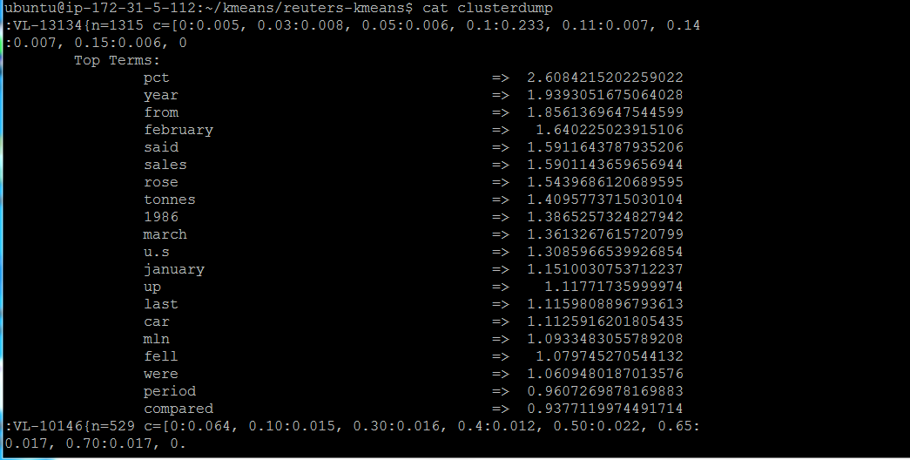
Output is in clusterdump home/ubuntu/kmeans/reuters-kmeans

