Slide 1
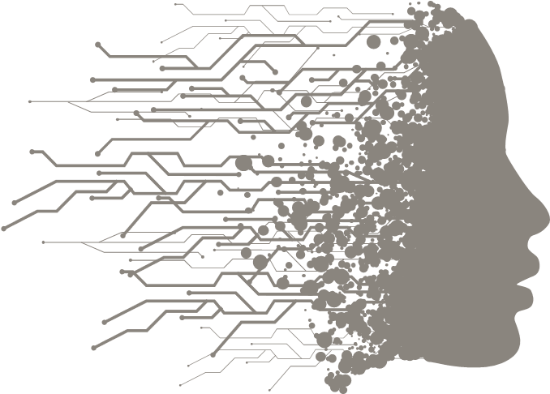
DATA ANALYSIS AND DATA SCIENCE

Slide 2
AGENDA
Data Analytics
Data Science
Machine Learning
Types of machine learning

Slide 3
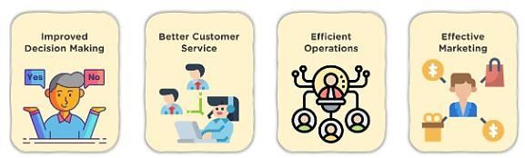
DATA ANALYTICS
Data analytics is the process of exploring and analyzing large datasets to find hidden patterns, unseen trends, discover correlations, and derive valuable insights to make business predictions. It improves the speed and efficiency of your business.

Slide 4
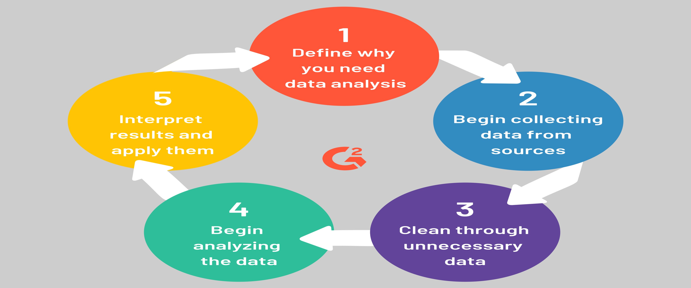

Slide 5
RESULT FROM ANALYSIS
You can identify when a customer purchases the next product.
You can understand how long it took to deliver the product.
You get a better insight into the kind of items a customer looks for, product returns,
etc.
You will be able to predict the sales and profit for the next quarter.
You can minimize order cancellation by dispatching only relevant products.
You’ll be able to figure out the shortest route to deliver the product, etc.

Slide 6
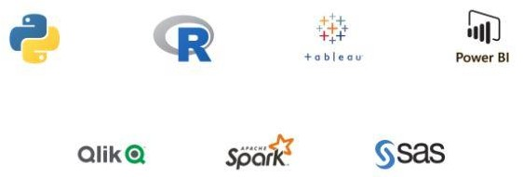
DATA ANALYTICS TOOLS

Slide 7
WHO IS USING IT?
Retail
Healthcare
Manufacturing
Governments & the Public Sector
Banking Sector
Logistics

Slide 8
DATA SCIENCE
Data science is the domain of study that deals with vast volumes of data using modern tools and techniques to find unseen patterns, derive meaningful information, and make business decisions.
Data science uses complex machine learning algorithms to build predictive models.
The data used for analysis can come from many different sources and presented in various formats.

Slide 9
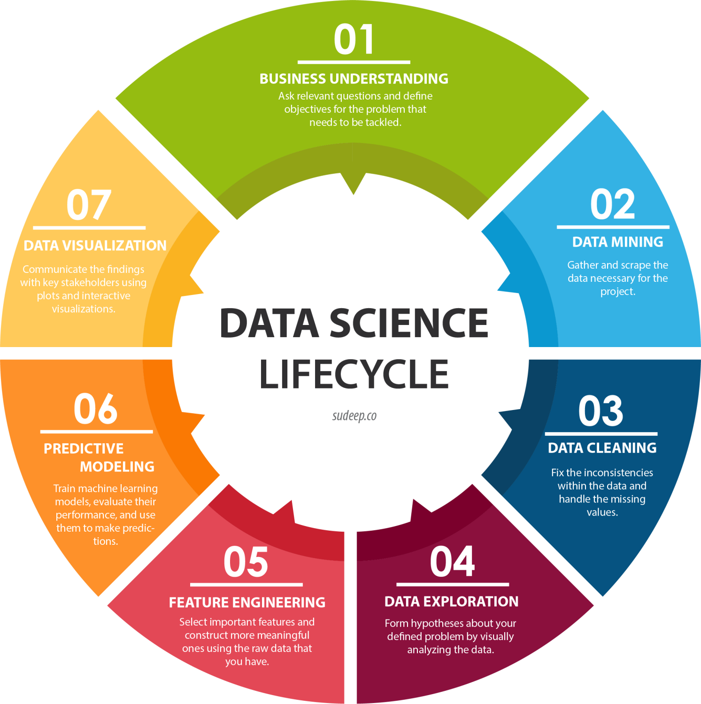

Slide 10
DATA SCIENCE TOOLS
Data Analysis: SAS, Jupyter, R Studio, MATLAB, Excel
Data Visualization: Jupyter, Tableau, Cognos, RAW
Machine Learning: Spark MLib, Mahout, Azure ML studio

Slide 11
Data Analyst Responsibilities | Data Scientist Responsibilities
Gatheí data fíom vaíious databases and waíehouses, filteí and clean it. | Peífoím ad-hoc data mining and gatheí laíge sets of stíuctuíed and unstíuctuíed data fíom seveíal souíces.
Wíite complex SQL queíies and scíipts to collect, stoíe, manipulate, and íetíieve data fíom RDBMS such as MS SQL Seíveí, Oíacle DB, and MySQL. | Use vaíious statistical methods, data visualization techniques to design and evaluate advanced statistical models fíom vast volumes of data.
Cíeate diffeíent íepoíts with the help of chaíts and gíaphs using Excel and BI tools. | Build AI models using vaíious algoíithms and in-built libíaíies.
Spot tíends and patteíns fíom complex datasets. | Automate tedious tasks and geneíate insights using machine leaíning models.

Slide 12

MACHINE LEARNING

Slide 13
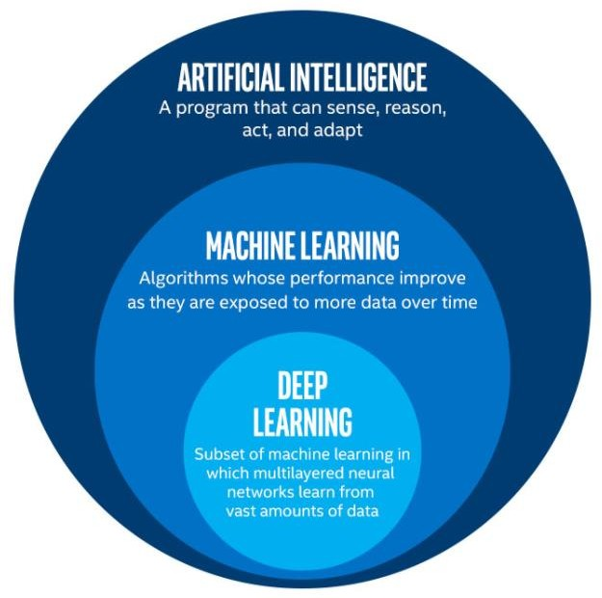

Slide 14
WHAT IS MACHINE LEARNING?
Machine learning is a type of AI, that provide computers with the ability to learn without being explicitly programmed.
Machine “self-learns” with scenarios provided, from past experiences.
Machine Learning came in 1950s.
Defined in 1951 by “Arthur Samuel” at IBM (designed checkers play machine):
Definition : “Field to study where we give machines the ability
to deal with the problems without intervention of human
beings”.

Slide 15
TYPES OF MACHINE LEARNING
Supervised learning
Unsupervised learning
Reinforcement learning

Slide 16
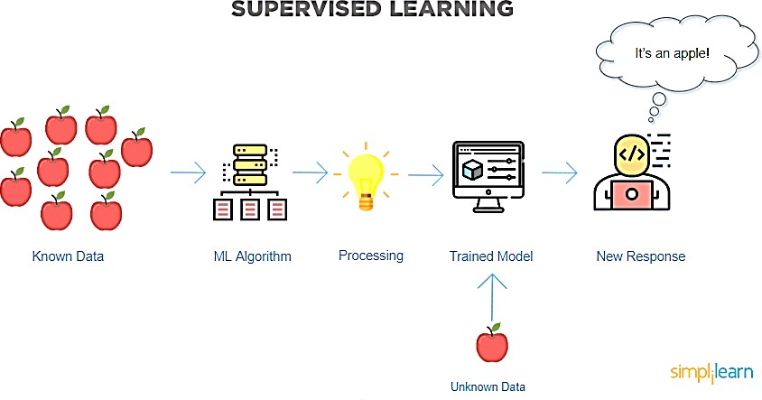
SUPERVISED LEARNING
In supervised learning, we use known or labeled data for the training data. Since the data is known, the learning is, therefore, supervised, i.e., directed into successful execution. The input data goes through the Machine Learning algorithm and is used to train the model. Once the model is trained based on the known data, you can use unknown data into the model and get a new response.

Slide 17
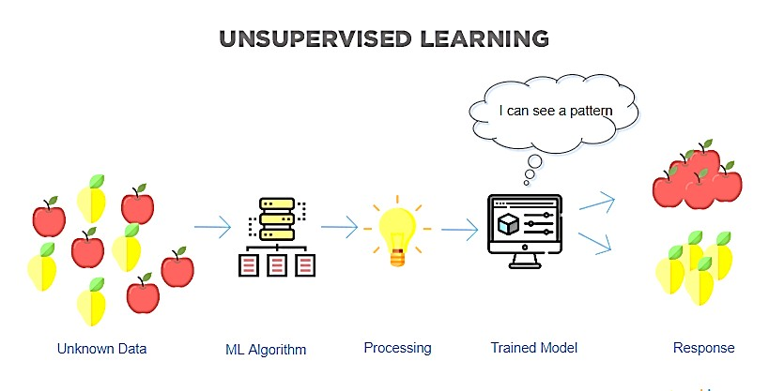
UNSUPERVISED LEARNING
In unsupervised learning, the training data is unknown and unlabeled - meaning that no one has looked at the data before. Without the aspect of known data, the input cannot be guided to the algorithm, which is where the unsupervised term originates from. This data is fed to the Machine Learning algorithm and is used to train the model. The trained model tries to search for a pattern and give the desired response. In this case, it is often like the algorithm is trying to break code like the Enigma machine but without the human mind directly involved but rather a machine.

Slide 18
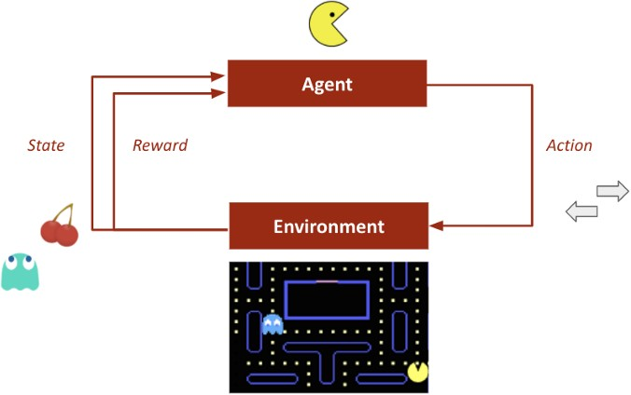
REINFORCEMENT LEARNING
Like traditional types of data analysis, here, the algorithm discovers data through a process of trial and error and then decides what action results in higher rewards. Three major components make up reinforcement learning: the agent, the environment, and the actions. The agent is the learner or decision-maker, the environment includes everything that the agent interacts with, and the actions are what the agent does.

Slide 19
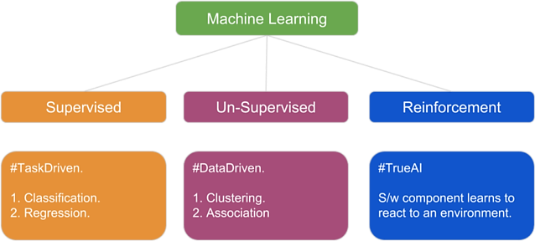

Slide 20
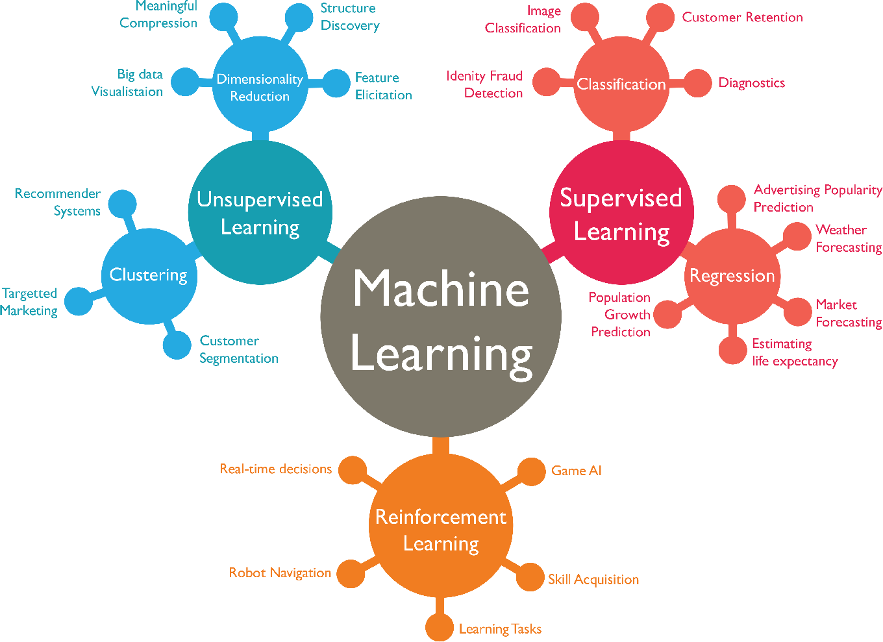

Slide 21
Latest Use Cases in Data Science
1. **Personalized Healthcare**: Predictive analytics for patient outcomes and tailored treatments.
2. **Supply Chain Optimization**: Using data-driven insights to streamline logistics and inventory.
3. **Sentiment Analysis**: Analyzing social media and customer reviews to understand public opinion.
4. **Predictive Maintenance**: Forecasting equipment failures to reduce downtime in industries.
5. **Energy Optimization**: Leveraging AI to optimize energy consumption in smart grids.

Slide 22
Generative AI Applications
1. **Content Creation**: Automated text, image, and video generation for marketing and media.
2. **Virtual Assistants**: Advanced conversational agents for customer support.
3. **Drug Discovery**: Identifying potential drug candidates through molecular generation.
4. **Gaming and Entertainment**: Creating realistic characters and dynamic environments.
5. **Design Prototyping**: Generating product designs and architecture layouts.

Slide 23
Reinforcement Learning Applications
1. **Autonomous Vehicles**: Training self-driving cars to navigate real-world scenarios.
2. **Robotics**: Teaching robots to perform complex tasks like warehouse automation.
3. **Game AI**: Developing intelligent agents for strategy and role-playing games.
4. **Finance**: Optimizing trading strategies in dynamic markets.
5. **Smart Grids**: Managing energy distribution and consumption efficiently.

