Slide 1
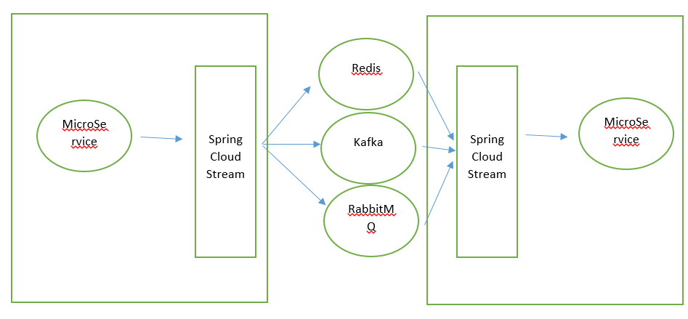
Spring Cloud Stream is a framework for building message-driven microservice applications. Spring Cloud Stream builds upon Spring Boot to create standalone, production-grade Spring applications, and uses Spring Integration to provide connectivity to message brokers.
The application communicates with the outside world through input and output channels injected into it by Spring Cloud Stream. Channels are connected to external brokers through middleware-specific Binder implementations.
Spring Cloud Stream provides an abstraction over the messaging infrastructure. The underlying messaging implementation can be RabbitMQ, Redis, or Kafka. Spring Cloud Stream provides a declarative approach for sending and receiving messages:

Slide 2
AXON is a CQRS framework for Java”
CQRS is a way of building software systems that stresses separating the part of your application that changes the state of the application and the part that queries the state of the application.
How it works
The domain is literally split into a command-side microservice application and a query-side microservice application.
Communication between the two microservices is event-driven and uses RabbitMQ messaging as a means of passing the events between processes (VM’s).
The command-side processes commands. Commands are actions which change state in some way. The execution of these commands results in Events being generated which are persisted by Axon and propagated out to other VM’s (as many VM’s as you like) via RabbitMQ messaging.
The query-side is an event-listener and processor. It listens for the Events and processes them in whatever way makes the most sense.
Axon will always first store the events in the event store, and publish them to the bus afterwards.If you attach a transaction manager to the unit of work, everything is dealt with transactionally as well.

Slide 3
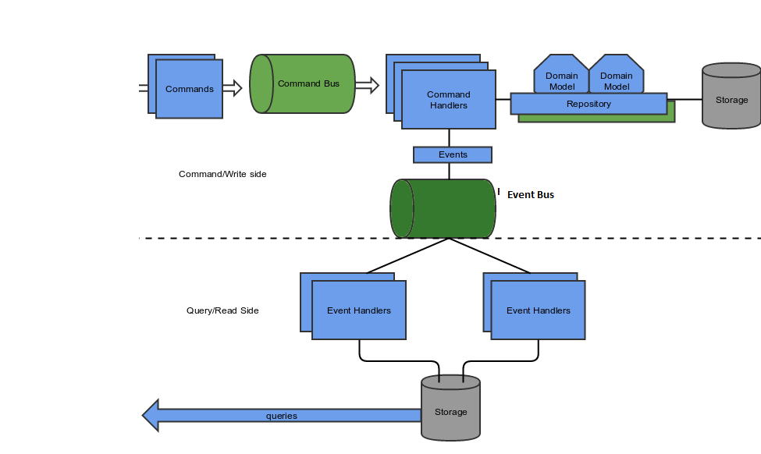
Microservice REST Controller receive the command from the
client. The command is dispatched to command bus of the AXON framework. The command handler configured in your application will handle the command .It store the domain model in the repository and generate an event in event bus in transactional way. The event bus makes sure the necessary Event handlers are notified. Event handlers then updates the representation of the state of the application.

Slide 4
QBit
The Java microservice lib. QBit is a reactive programming lib for building microservices - JSON, HTTP, WebSocket, and REST.
EventBus
EventBus is a way to send a lot of messages to services that may be loosely coupled. QBit has a high-speed event bus modeled loosely on Vertx style event bus
Very fast.
In-proc but can be integrated with others
QBit now has the ability to send events over a remote connection.
EventManager talks to an EventBus which talks to a series of Channels. Channels are like topics and they manage a collection of listeners. There are adapters that can move an event from a Channel to a ServiceQueue.
To support integration with other event busses and remote event busses ,it added the concept of an EventConnector. The EventBus sends all events to its EventConnector. The default EventConnector is a no-op EventConnector. You can plug in additional event connection with the EventConnector.

