Slide 1
Rising Tide
Interaction & Visual design
iOS (Phone)

Slide 2
Features explored
Global Navigation
Scouting
Soil Sampling
Mapping
Calendar
Recommendation Writing including Work Orders

Slide 3
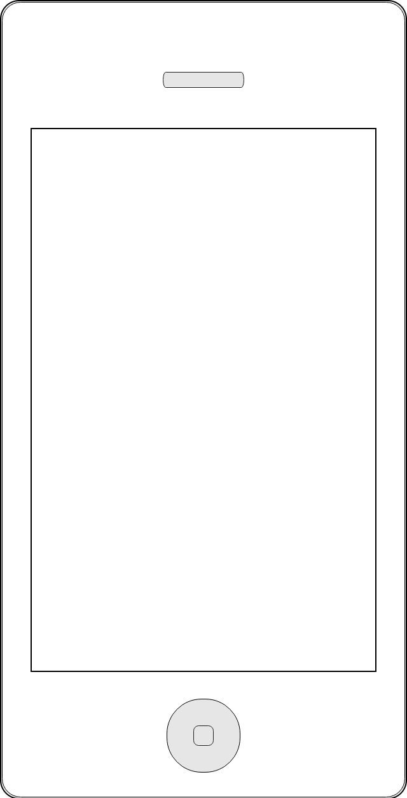
Global Navigation
Since a majority of users are on the iPhone 4S form factor, vertical real estate is a premium.
To increase the amount of usable real estate, the global navigation has been designed to be accessible on-demand versus being ubiquitous.
It can be accessed at all times via a single tap that brings the common actions into view.
Tapping the pull out icon again or tapping anywhere else will collapse the tab bar out of view.
The common actions we are exploring are:
Calendar
Growers
Tasks
Weather
Calendar
Growers
Tasks
Weather
TBD

Slide 4

Navigating Growers – List View
Upon login, users will be presented the nearest growers based on the users location.
Each row will contain information about the grower, farm, field, block and sub-block. The level of detail depends on how much is available for that grower.
Users are also able to navigate through the hierarchy using the ‘All’ option. Additional view options can possibly provided by allowing users to swipe through the views bar.
Users can also jump between the map view and list view.
Note: This screen can be accessed at all times using the global navigation to allow users to quickly jump through growers.
+
+
GROWERS
GROWERS
NEAR ME
RECENT
ALL
NEAR ME
RECENT
ALL
Grower Name
Associated farm, field & Grower Information.
Activity performed with date-time stamp.
Grower Name
Associated farm, field & Grower Information.
Activity performed with date-time stamp.
0.1
miles
Grower Name
Associated farm, field & Grower Information.
Activity performed with date-time stamp.
Grower Name
Associated farm, field & Grower Information.
Activity performed with date-time stamp.
1.2
miles
Grower Name
Associated farm, field & Grower Information.
Activity performed with date-time stamp.
Grower Name
Associated farm, field & Grower Information.
Activity performed with date-time stamp.
2.1
miles
Grower Name
Associated farm, field & Grower Information.
Activity performed with date-time stamp.
Grower Name
Associated farm, field & Grower Information.
Activity performed with date-time stamp.
3.7
miles
Grower Name
Associated farm, field & Grower Information.
Activity performed with date-time stamp.
Grower Name
Associated farm, field & Grower Information.
Activity performed with date-time stamp.
3.8
miles

Slide 5

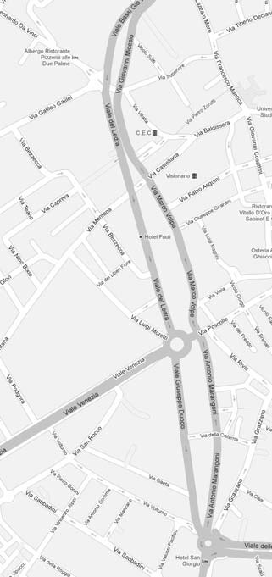


Navigating Growers – Map View
Users can pick a field/grower using the map view as well. Tapping on a pin will pull up a details card for the selected field/grower.
Maps can be zoomed, panned using standard phone gestures like pinch, push and two finger tap to zoom out.
Tapping on the card again will take the user to the task screen.
Users can get back to their current location using the my location icon at the bottom right.
To switch back to the list view, users can tap on the list view icon on the top right.
+
+
GROWERS
GROWERS
NEAR ME
RECENT
ALL
NEAR ME
RECENT
ALL
Grower Name
Associated farm, field & Grower Information.
Activity performed with date-time stamp.
0.1
miles
Grower Name
Associated farm, field & Grower Information.
Activity performed with date-time stamp.
1.2
miles
Grower Name
Associated farm, field & Grower Information.
Activity performed with date-time stamp.
2.1
miles
Sub Block Name
Associated Grower Information
Last Activity Performed with date-time stamp
Grower Name
Associated farm, field & Grower Information.
Activity performed with date-time stamp.
3.7
miles
Grower Name
Associated farm, field & Grower Information.
Activity performed with date-time stamp.
3.8
miles

Slide 6









Tasks and Actions
Once an grower is selected, the user is presented with a task screen.
The intention here is to allow for the tasks to be laid out clearly with clear touch areas for quick access.
Users should be able to customize the task placement based on their personal preferences.
Users will also be able to get in touch with the associated contact with just a simple tap.
+
GROWERS
GROWER NAME
Sub-Block Name
NEAR ME
RECENT
ALL
John Smith
Related Crop: Corn
Scouting Events
Grower Name
Associated farm, field & Grower Information.
Activity performed with date-time stamp.
Scouting
Photos
Notes
0.1
miles
Grower Name
Associated farm, field & Grower Information.
Activity performed with date-time stamp.
1.2
miles
Traps
Grower Name
Associated farm, field & Grower Information.
Activity performed with date-time stamp.
2.1
miles
Grower Name
Associated farm, field & Grower Information.
Activity performed with date-time stamp.
Field Events
3.7
miles
Rec
Writing
Soil Sampling
Boundary Mapping
Grower Name
Associated farm, field & Grower Information.
Activity performed with date-time stamp.
3.8
miles

Slide 7
Scouting Activities
The scouting activities screen shows a log of all activities performed. Activities can be filtered based on time.
Activities also have a status indicator. Completed activities have a green indicator and draft activities are indicated with orange.
Any activity can be further drilled down by tapping it to see more details.
Users can create new activities by tapping the new button or by pulling the list down.
GROWER NAME
Sub-Block Name
GROWER NAME
Scouting Activities
Edit
John Smith
Related Crop: Corn
TODAY
LAST WEEK
LAST 30 DAYS
Scouting Events
New
Scouting
Photos
Notes
Scouting Activity Title
Scouting activity description in about one line.
Date-time stamp.
Traps
Scouting Activity Title
Scouting activity description in about one line.
Date-time stamp.
Scouting Activity Title
Scouting activity description in about one line.
Date-time stamp.
Field Events
Soil Sampling
Boundary Mapping
Rec
Writing
Scouting Activity Title
Scouting activity description in about one line.
Date-time stamp.

Slide 8




Existing Scouting Activity – List View
Tapping on an existing activity brings the Scouting Activity screen.
This shows all the activities that are part of a scouting activity.
Each activity can have more than one item.
Users can access each of these items by tapping on the row. The number of items are displayed in brackets next to the activity name.
Users can add a new event directly by tapping the ‘+’ icon.
Users can generate a scouting report by tapping on the tapping report on the action bar.
Users can also create any of these activities directly from a map. To use this, users need to tap on the map icon on the action bar.
Users can switch to view any general notes.
GROWER NAME
Scouting Activities
GROWER NAME
Scouting Activity Title
Edit
Save
TODAY
LAST WEEK
LAST 30 DAYS
ACTIVITIES
GENERAL NOTES
New
Staging (3)
Explain what the activity is and when it should be used. Will help newer users.
+
Scouting Activity Title
Scouting activity description in about one line.
Date-time stamp.
Diseases (2)
Explain what the activity is and when it should be used. Will help newer users.
+
Scouting Activity Title
Scouting activity description in about one line.
Date-time stamp.
Insects (3)
Explain what the activity is and when it should be used. Will help newer users.
+
Scouting Activity Title
Scouting activity description in about one line.
Date-time stamp.
Nematodes (0)
Explain what the activity is and when it should be used. Will help newer users.
+
Scouting Activity Title
Scouting activity description in about one line.
Date-time stamp.
Photos (0)
Explain what the activity is and when it should be used. Will help newer users.
+
Weeds (0)
Explain what the activity is and when it should be used. Will help newer users.
+

Slide 9


Existing Scouting Activity – Map View
In the map view, all activities are color coded by type.
Users can filter what is shown by choosing from the filter on top of the map as shown below.
Tapping on any point will open a bubble showing basic information for that item.
Icons in the action bar in order of their appearance are
Switch back to list view.
Generate Scouting Report
Mail Consolidated Scouting Activities to self.
Print Consolidated Scouting Activities
Global Nav Pullout
GROWER NAME
Scouting Activity Title
GROWER NAME
Scouting Activity Title
GROWER NAME
Scouting Activity Title
Save
Save
Save
ACTIVITIES
GENERAL NOTES
All
Diseases
Staging (3)
Explain what the activity is and when it should be used. Will help newer users.
+
Diseases
1
1
1
All
Diseases (2)
Explain what the activity is and when it should be used. Will help newer users.
+
Staging
Diseases
Insects (3)
Explain what the activity is and when it should be used. Will help newer users.
+
2
Insects
Disease Name
Severity Value
Date Time
Nematodes
3
Photos
Nematodes (0)
Explain what the activity is and when it should be used. Will help newer users.
+
2
2
1
2
3
Photos (0)
Explain what the activity is and when it should be used. Will help newer users.
+
Weeds (0)
Explain what the activity is and when it should be used. Will help newer users.
+

Slide 10

Existing Scouting Activity – View existing events (example Staging)
Tapping on the left section of the row takes the user to a list of any existing items of that item type.
Users can add an event by tapping on ‘New’.
All new items are implicitly geo stamped.
Any item can be deleted by swiping on the row (standard gesture for delete).
Multiple items can be deleted by using the edit button on the top right.
Tapping on an existing item will show the user the item details that were captured.
GROWER NAME
Scouting Activity Title
GROWER NAME
Staging
GROWER NAME
Growth Stage Name
Save
Edit
ACTIVITIES
GENERAL NOTES
New
Details
NOTES
Staging (3)
Explain what the activity is and when it should be used. Will help newer users.
+
Growth Stage Name
Date/Time Stamp
Growth Stage Name
Date-time stamp.
Diseases (2)
Explain what the activity is and when it should be used. Will help newer users.
+
Growth Stage Name
Date-time stamp.
Insects (3)
Explain what the activity is and when it should be used. Will help newer users.
+
Growth Stage Name
Date-time stamp.
Actual
Nematodes (0)
Explain what the activity is and when it should be used. Will help newer users.
+
Photos (0)
Explain what the activity is and when it should be used. Will help newer users.
+
Reference
Weeds (0)
Explain what the activity is and when it should be used. Will help newer users.
+

Slide 11
Existing Scouting Activity – View existing events (example Diseases)
Diseases works similarly to stages. Tapping on an exiting activity shows all disease activities captured.
A user can drill through to the items to see item specific details, associated photos and notes.
Users can at any time switch to the map view to get the geo location of any of the captured diseases.
GROWER NAME
Scouting Activity Title
GROWER NAME
Diseases
GROWER NAME
Disease Name
Save
Edit
ACTIVITIES
GENERAL NOTES
New
DETAILS
PHOTOS (5)
NOTES
Staging (3)
Explain what the activity is and when it should be used. Will help newer users.
+
Disease Name
Disease Name
Severity
Date-time stamp.
Disease Name
Date and Time recorded
Diseases (2)
Explain what the activity is and when it should be used. Will help newer users.
+
8 Jun 2013 at 12:15pm
Disease Name
Severity
Date-time stamp.
Insects (3)
Explain what the activity is and when it should be used. Will help newer users.
+
Nematodes (0)
Explain what the activity is and when it should be used. Will help newer users.
+
GROWER NAME
Disease Name
Photos (0)
Explain what the activity is and when it should be used. Will help newer users.
+
DETAILS
PHOTOS (5)
NOTES
Weeds (0)
Explain what the activity is and when it should be used. Will help newer users.
+

Slide 12
Existing Scouting Activity – View existing events (example Photos)
Photos brings up a list of photos that shows the thumbnail, caption and date/time stamp.
Tapping on any individual photo shows the photo in full screen.
Users can also delete/multi delete any photos.
GROWER NAME
Scouting Activity Title
GROWER NAME
Photos
Save
Edit
ACTIVITIES
GENERAL NOTES
New
Staging (3)
Explain what the activity is and when it should be used. Will help newer users.
+
Caption
Date-time stamp.
Diseases (2)
Explain what the activity is and when it should be used. Will help newer users.
+
Caption
Date-time stamp.
Insects (3)
Explain what the activity is and when it should be used. Will help newer users.
+
Nematodes (0)
Explain what the activity is and when it should be used. Will help newer users.
+
Photos (0)
Explain what the activity is and when it should be used. Will help newer users.
+
Weeds (0)
Explain what the activity is and when it should be used. Will help newer users.
+

Slide 13
New Scouting Activity – Stages
A new growth stage activity will involve a split view.
The top section contains the live preview from the camera viewfinder.
The bottom section contains a swipable collection of reference images that the user can choose to compare the live image with.
Users can tap anywhere on the live area to capture the image.
After the user decides the image to use, they can tap ‘Use’
Once the ‘Use’ button is tapped, the user is presented with a dialog where they enter the Growth Stage Name and any notes that they might have.
Once satisfied, they can save the event by tapping the Save button.
GROWER NAME
Scouting Activity Title
GROWER NAME
New Staging Activity
GROWER NAME
New Staging Activity
Save
ACTIVITIES
GENERAL NOTES
Staging (3)
Explain what the activity is and when it should be used. Will help newer users.
+
Live Image from phone viewfinder will appear here.
Diseases (2)
Explain what the activity is and when it should be used. Will help newer users.
+
Insects (3)
Explain what the activity is and when it should be used. Will help newer users.
+
Use
Re-take
Nematodes (0)
Explain what the activity is and when it should be used. Will help newer users.
+
Photos (0)
Explain what the activity is and when it should be used. Will help newer users.
+
Reference Image Name
GROWER NAME
New Staging Activity
Reference Image Name
+
Growth Stage Name
Weeds (0)
Explain what the activity is and when it should be used. Will help newer users.
Sample Note
Save
Cancel
Reference Image Name

Slide 14

New Scouting Activity – Diseases
Users can add details like the disease name and add notes.
Additionally, they can add one or more photos to the event.
Long pressing on any of the photos will allow them to remove any photo if they want to delete it.
Users can also open an in-app browser to do any research if required. They do not need to leave the application for this.
Tapping on the ‘Save’ button will complete the activity.
GROWER NAME
Scouting Activity Title
GROWER NAME
New Disease Event
Save
Save
ACTIVITIES
GENERAL NOTES
Sample Disease Instance
Staging (3)
Explain what the activity is and when it should be used. Will help newer users.
+
Spotted an instance of ‘disease name’ today. Attached two photos for reference.
Diseases (2)
Explain what the activity is and when it should be used. Will help newer users.
+
Insects (3)
Explain what the activity is and when it should be used. Will help newer users.
+
Nematodes (0)
Explain what the activity is and when it should be used. Will help newer users.
+
Photos
Photos (0)
Explain what the activity is and when it should be used. Will help newer users.
+
Weeds (0)
Explain what the activity is and when it should be used. Will help newer users.
+

Slide 15
Boundary Mapping
The boundary mapping screen is similar to the scouting activities screen.
Each row contains map information and also an indicator to show how the boundary was mapped. Auto or Manual.
The management boundary is indicated by an icon at the top right of the row. The name is also an indicator of the type of boundary.
GROWER NAME
Sub-Block Name
GROWER NAME
Boundaries
Edit
John Smith
Related Crop: Corn
New
Scouting Events
Management Boundary Name
Meta information like number of blocks & size
Date-time stamp.
Scouting
Photos
Notes
Boundary Name
Meta information like number of blocks & size
Date-time stamp.
Traps
Boundary Name
Meta information like number of blocks & size
Date-time stamp.
Field Events
Boundary Name
Meta information like number of blocks & size
Date-time stamp.
Soil Sampling
Boundary Mapping
Rec
Writing

Slide 16
New Boundary
On tapping ‘New’, the user is presented with the new boundary mapping screen.
S/he needs to choose a boundary name, offset and the type of plotting.
GROWER NAME
Boundaries
GROWER NAME
New Boundary
Edit
New
Boundary Name
Tap to add
Management Boundary Name
Meta information like number of blocks & size
Date-time stamp.
Boundary Type
Management
Operational
Offset (in feet)
Tap to add
Boundary Name
Meta information like number of blocks & size
Date-time stamp.
Plotting Method
Boundary Name
Meta information like number of blocks & size
Date-time stamp.
Automatic Plotting
Boundary Name
Meta information like number of blocks & size
Date-time stamp.
Manual Plotting

Slide 17
New Boundary Contd…
Before the boundary mapping begins, a small description is provided to the user so that they can start at the right location.
User are shown their current position on a map.
To begin the plotting process, users are required to tap on the Begin button.
GROWER NAME
New Boundary
GROWER NAME
Automatic Plotting
Boundary Name
Tap to add
Automatic plotting
The phone will capture the
border while user tours the
field perimeter.
Step 1: Go to the perimeter and tap ‘Begin’. Points will be plotted as you go.
Step 2: Tap ‘Save’ to save a boundary. You can add more than one boundary.
Step 3: Tap ‘Complete’ to finish the plotting process.
Boundary Type
Management
Operational
Offset (in feet)
Tap to add
Plotting Method
Automatic Plotting
Manual Plotting
BEGIN

Slide 18
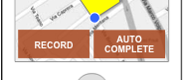
New Boundary Contd…
Plotting can be paused at any time by toggling on the Pause button. If the button is tapped, the label changes to ‘RECORD’
The system should also automatically stop plotting if the user is idle for a predefined amount of time.
To finish the boundary, the user can tap on Save Boundary to save the boundary.
To complete the plotting exercise, users can tap on Complete.
GROWER NAME
Automatic Plotting
GROWSER NAME
Automatic Plotting
Complete
Automatic map plotting
The phone will capture the
border while user tours the
field perimeter.
Step 1: Go to the perimeter and tap ‘Begin’. Points will be plotted as you go.
Step 2: Tap ‘Save’ to save a boundary. You can add more than one boundary.
Step 3: Tap ‘Complete’ to finish the plotting process.
BEGIN
PAUSE
AUTO COMPLETE

Slide 19
New Boundary – Save and further actions
On tapping the ‘Auto Complete’ button, a dialog is presented to the user with the status.
Users can now choose to Save and Exit, add an additional boundary, add an exclusion boundary or cancel.
The screen also indicates total acreage that has been calculated.
GROWSER NAME
Automatic Plotting
GROWSER NAME
Automatic Plotting
Complete
Auto Completed Successfully.
Total Acres
50
What would you like to do?
Save and Exit
Add an exclusion boundary
Add an additional boundary
Cancel
PAUSE
AUTO COMPLETE
PAUSE
AUTO COMPLETE

Slide 20
Soil Sampling List
Soil sampling can be accessed via the tasks screen.
Similar to mapping, the user is presented with a list of soil sampling activity that has been done and has been assigned.
The list also contains soil sampling activities that are ‘in progress’. Each of these are highlighted by color.
The meta information contains the Sampling type which may be Zone or Composite along with the number of points.
Users can also initiate a new soil sampling event from their device.
LEGEND
Red indicates a new soil sampling event that needs to be collected.
Orange indicates an in-progress event.
Green indicates a completed event.
GROWER NAME
Sub-Block Name
GROWER NAME
Soil Sampling
Edit
John Smith
Related Crop: Corn
TODAY
YESTERDAY
LAST WEEK
Scouting Events
New
Scouting
Photos
Notes
Soil Sampling Title
Type: Zone. Points: 25
Date-time stamp.
Traps
Soil Sampling Title
Type: Zone. Points: 25
Date-time stamp.
Soil Sampling Title
Type: Composite. Points: 25
Date-time stamp.
Field Events
Soil Sampling
Boundary Mapping
Rec
Writing
Soil Sampling Title
Type: Composite. Points: 25
Date-time stamp.

Slide 21
Soil Sampling Activity
Tapping on an assigned soil sampling activity will initiate the process of soil sampling.
A help dialog is presented with instructions.
The user needs to tap on Begin to start the process.
GROWER NAME
Soil Sampling
GROWSER NAME
Soil Sampling Title
Edit
TODAY
LAST WEEK
LAST 30 DAYS
MAP
NOTES
Soil Sampling
Points where soil is to be collected will be displayed on a map. Once you reach the desired location, collect the sample and enter a label for the bag. To save the information, tap on ‘Save Point’. You can complete the soil sampling activity by tapping ‘Save’.
New
Soil Sampling Title
Type: Zone. Points: 25
Date-time stamp.
Soil Sampling Title
Type: Zone. Points: 25
Date-time stamp.
Soil Sampling Title
Type: Composite. Points: 25
Date-time stamp.
BEGIN
Soil Sampling Title
Type: Composite. Points: 25
Date-time stamp.

Slide 22
Soil Sampling Activity Contd…
Points are color coded and numbered. Color is used to indicate if they are completed or not.
User location is also shown along with the points where soil needs to be collected.
Users can save any additional point if they choose to.
To complete the process, the user can click on the ‘Complete’ button.
GROWSER NAME
Soil Sampling Title
GROWSER NAME
Soil Sampling Title
Complete
Soil Sampling
Points where soil is to be collected will be displayed on a map. Once you reach the desired location, collect the sample and enter a label for the bag. To save the information, tap on ‘Save Point’. You can complete the soil sampling activity by tapping ‘Save’.
MAP
NOTES
1
2
3
4
6
5
9
7
8
10
BEGIN
11
SAVE POINT

Slide 23
Soil Sampling Activity Contd…
Tapping ‘Save Point’ brings up the dialog to save the label name.
The label name is pre-populated with a number. Users can override this if they choose to.
Tapping Save on the dialog saves the label name and dismisses the dialog.
GROWSER NAME
Soil Sampling Title
GROWSER NAME
Soil Sampling Title
Complete
MAP
NOTES
MAP
NOTES
Label 5
SAVE
Cancel
1
2
3
4
6
5
9
7
8
10
11
SAVE POINT

Slide 24
Soil Sampling Activity – New Point Definition
Tapping on New displays the new soil sampling activity screen.
Users need to enter the activity name, Grid Type (Regular or Irregular), and Point Placement (Random or Centered).
Values are defaulted to most frequently used based on research. Users can change these if required.
To begin the process, users tap on ‘Begin’.
GROWER NAME
Soil Sampling
GROWSER NAME
New Soil Sampling Activity
Edit
TODAY
LAST WEEK
LAST 30 DAYS
Enter Activity Name
New
Grid Type
Regular
Soil Sampling Title
Type: Zone. Points: 25
Date-time stamp.
Point Placement
Random
Soil Sampling Title
Type: Zone. Points: 25
Date-time stamp.
BEGIN
Soil Sampling Title
Type: Composite. Points: 25
Date-time stamp.
Soil Sampling Title
Type: Composite. Points: 25
Date-time stamp.

Slide 25
Soil Sampling Activity – New Point Definition
Tapping on Begin shows the user the map with the associated field.
The grid is generated based on the earlier selection.
Users can adjust the grid size and grid angle using the Grid Controls pane. Tapping the pane expands it to show the controls within it.
Users can tap on ‘Generate Points’ to review and save the points generated.
GROWSER NAME
New Soil Sampling Activity
GROWSER NAME
Soli Sampling Activity 1
Soil Sampling Activity 1
Grid Controls
Grid Type
Regular
Point Placement
Random
BEGIN
GENERATE POINTS

Slide 26
Soil Sampling Activity – New Point Definition
Adjusting the sliders changes the value of the respective fields.
Users can tap on Apply or Cancel to commit the new values.
Users also get an approximate point count based on the values that were set.
GROWSER NAME
Soli Sampling Activity 1
GROWSER NAME
Soli Sampling Activity 1
Grid Controls
Grid Controls
Grid Unit Size (acres)
2
Grid Angle (degrees)
0
Approximate Point Count: 10
Apply
Reset
GENERATE POINTS
GENERATE POINTS

Slide 27
Soil Sampling Activity – New Point Definition
Once the grid values have been set, users can tap on ‘Apply’.
This creates the grid on the map. Pinching and Zooming on the map will apply to the grid as well.
Once satisfied, users can tap on ‘Generate Points’.
This creates the numbers points based on the point placement chosen.
The Generate Points button is now replaced with two buttons to Save and Discard.
Tapping on Save will save the information and bring the user back to the list with a new entry with a red status (new).
Discard will return the user to the earlier screen without the points.
GROWSER NAME
Soli Sampling Activity 1
GROWSER NAME
Soli Sampling Activity 1
GROWSER NAME
Soli Sampling Activity 1
Grid Controls
Grid Controls
Grid Unit Size (acres)
2
Grid Angle (degrees)
0
1
2
Approximate Point Count: 10
3
4
5
Apply
Reset
6
7
8
9
10
GENERATE POINTS
GENERATE POINTS
SAVE & EXIT
DISCARD

Slide 28
Recommendation Writing
Tapping on the rec writing icon will take the user to the list view of all the recommendations for this account.
The user can tap New to create a new recommendation.
Tapping on an existing recommendation will show the detailed view.
GROWER NAME
Sub-Block Name
GROWER NAME
Recommendation Writing
Edit
John Smith
Related Crop: Corn
New
Scouting Events
Recommendation Name
Basic details of a recommendation
Date-time stamp.
Scouting
Photos
Notes
Recommendation Name
Basic details of a recommendation
Date-time stamp.
Traps
Recommendation Name
Basic details of a recommendation
Date-time stamp.
Field Events
Soil Sampling
Boundary Mapping
Rec
Writing

Slide 29
Recommendation Writing – Existing Recommendation (Basic Info)
The basic view of a recommendation contains the crop details, application deadline, spray volume and total acreage.
To be clarified: Can a user edit an existing recommendation?
The user can swipe or tap to see the recommended products or any associated notes with this recommendation.
GROWER NAME
Recommendation Writing
GROWER NAME
Recommendation Name
Edit
New
BASIC
PRODUCTS
NOTES
Total Negotiated Price
$4500
Recommendation Name
Basic details of a recommendation
Date-time stamp.
Corn
Sweet Corn
Crop & Variety
Recommendation Name
Basic details of a recommendation
Date-time stamp.
Application Deadline
START
08 April ‘13
END
12 April ‘13
Recommendation Name
Basic details of a recommendation
Date-time stamp.
Spray Volume
100
gallons / acre
Total Acres
59.7
Longest PHI
14
days
Longest REI
24
hours

Slide 30
Ignore
Recommendation Writing – Existing Recommendation (Product Info)
Option 1
The products view contains a list of all the recommended products and tank mixes if any.
Tapping on a product will expand the row inline and show additional details like Reason, Pest, etc.
Tapping on a tank mix will take the user to the tank mix page with all the products of that mix.
I think the reason can also come in place of Product code in the UI as it is more valuable at that level. The sample REC I have indicates that reasons are usually 1-2 words.
Tapping on the row again will close the expanded section.
If a section is open, and another row is tapped on, the earlier open section will still remain open. This is to avoid the focal point to switch due to any automatic movement.
GROWER NAME
Recommendation Writing
GROWER NAME
Recommendation Name
Edit
New
BASIC
PRODUCTS
NOTES
Product Name
Product Code
3
oz/acre
11.19
Total lbs
Recommendation Name
Basic details of a recommendation
Date-time stamp.
Reason
Fungicide
Target Pest
Disease Control
Price
$50 / lb
Recommendation Name
Basic details of a recommendation
Date-time stamp.
EPA#
264-777
PHI
14 Days
REI
12 Hours
Tank Mix 1
4 Products
2
oz / acre
597
Total lbs
Recommendation Name
Basic details of a recommendation
Date-time stamp.
Product Name
Product Code
10
oz / acre
298.5
Total lbs
Product Name
Product Code
12
oz / acre
11.19
Total lbs

Slide 31
Recommendation Writing – Existing Recommendation (Product Info)
Option 2
The products view contains a list of all the recommended products and tank mixes if any. Tank Mixes are explained later in this deck.
Tapping an existing product will show the product details.
GROWER NAME
Recommendation Writing
GROWER NAME
Recommendation Name
GROWER NAME
Product Name
Edit
New
BASIC
PRODUCTS
NOTES
BASIC
PRODUCTS
NOTES
Product Name
Product Code
3
oz/acre
11.19
Total lbs
Product Name
Recommendation Name
Basic details of a recommendation
Date-time stamp.
Tank Mix 1
4 Products
2
oz / acre
597
Total lbs
Value
Per unit
Price
Recommendation Name
Basic details of a recommendation
Date-time stamp.
Product Name
Product Code
10
oz / acre
298.5
Total lbs
Reason
Value
Recommendation Name
Basic details of a recommendation
Date-time stamp.
Product Name
Product Code
12
oz / acre
11.19
Total lbs
Target Pest
Value
EPA
Value
PHI
Value
REI
Value

Slide 32
Recommendation Writing – New Recommendation (Basic)
Tapping on the new recommendation button launches the new recommendations view.
Users can tap on the fields to enter information as required.
Appropriate keyboards (Alpha-numeric or numeric) will come up based on the nature of input.
The blue areas on the screen to the left indicate tappable inputs.
GROWER NAME
Recommendation Writing
GROWER NAME
New Recommendation
Edit
Save
New
BASIC
PRODUCTS
NOTES
Total Negotiated Price
Add
Recommendation Name
Basic details of a recommendation
Date-time stamp.
Corn
Sweet Corn
Crop & Variety
Recommendation Name
Basic details of a recommendation
Date-time stamp.
Application Deadline
START
Add
END
Add
Recommendation Name
Basic details of a recommendation
Date-time stamp.
Spray Volume
Add
gallons / acre
Total Acres
59.7

Slide 33
Recommendation Writing – New Recommendation (Products)
Tapping on Add Product brings the Add Product Screen.
Users can search for a product that shows a list of matching products in real time like type ahead search.
User can add details to all the fields associated to a product.
Each item brings up the associated keyboard.
GROWER NAME
New Recommendation
GROWER NAME
New Recommendation
GROWER NAME
Add Product
Save
Save
Done
BASIC
PRODUCTS
NOTES
BASIC
PRODUCTS
NOTES
Search Product
Total Negotiated Price
Add
Add Product
Create
Tank Mix
Unit
Value
Crop & Variety
Corn
Sweet Corn
Quantity Per Acre
Value
Product Name
Product Code
12
oz / acre
11.19
Total lbs
Application Deadline
Price (Optional)
Value
START
Add
END
Add
Add
gallons / acre
Reason
Value
Spray Volume
Target Pest
Value
Total Acres
59.7
EPA
Value
PHI
Value
REI
Value

Slide 34

Recommendation Writing – New Recommendation (Products)
Searching for a product brings up search results as users type in the product.
Once the user selects the product, additional details can be added.
Once all the details have been added, the user can tap to ‘Done’ to complete the process.
GROWER NAME
Add Product
GROWER NAME
Add Product
GROWER NAME
Add Product
Done
Done
Done
Search Product
x
BASIC
PRODUCTS
NOTES
Urea
Unit
Value
URA1
Urea
Quantity Per Acre
Value
URB1
Unit
Value
Price (Optional)
Value
UREA
Quantity Per Acre
Value
Reason
Value
UREA2
Price (Optional)
Value
Target Pest
Value
Reason
Value
EPA
Value
Target Pest
Value
PHI
Value
EPA
Value
REI
Value
PHI
Value
REI
Value

Slide 35

Recommendation Writing – Creating a Tank Mix
Tapping on the ‘Create Tank Mix’ changes the product list into select mode with checkboxes.
Additional buttons are surfaced and enabled when more than one product is selected.
Users need to select at least two products to be able to create a tank mix.
Once the selection is made, users can tap on ‘Save Tank Mix’.
Users can cancel out of the process by tapping the cancel button.
GROWER NAME
New Recommendation
GROWER NAME
New Recommendation
GROWER NAME
New Recommendation
Save
Save
BASIC
PRODUCTS
NOTES
BASIC
PRODUCTS
NOTES
Product Name
Product Code
12
oz / acre
11.19
Total lbs
Total Negotiated Price
Add
Add Product
Create
Tank Mix
Product Name
Product Code
10
oz / acre
14.30
Total lbs
Crop & Variety
Corn
Sweet Corn
Product Name
Product Code
17
oz / acre
11.23
Total lbs
Product Name
Product Code
12
oz / acre
11.19
Total lbs
Application Deadline
Product Name
Product Code
START
Add
END
Add
Product Name
Product Code
10
oz / acre
14.30
Total lbs
2
oz / acre
10
Total lbs
Spray Volume
Add
gallons / acre
Product Name
Product Code
17
oz / acre
11.23
Total lbs
Total Acres
59.7
Product Name
Product Code
2
oz / acre
10
Total lbs
Save Tank Mix
Cancel

Slide 36
Recommendation Writing – Creating a Tank Mix Continued
Tapping the Save Tank Mix button brings up the form to save the tank mix.
Users can enter a name for the tank mix and any additional notes for that tank mix.
Tapping Save converts the product list into a new tank mix.
GROWER NAME
New Recommendation
GROWER NAME
New Recommendation
GROWER NAME
New Recommendation
Save
Product Name
Product Code
12
oz / acre
11.19
Total lbs
Product Name
Product Code
12
oz / acre
11.19
Total lbs
BASIC
PRODUCTS
NOTES
Tank Mix Name
Product Name
Product Code
10
oz / acre
14.30
Total lbs
Product Name
Product Code
10
oz / acre
14.30
Total lbs
Add Product
Create
Tank Mix
Sample Note
Product Name
Product Code
17
oz / acre
11.23
Total lbs
Product Name
Product Code
17
oz / acre
11.23
Total lbs
Tank Mix Name
4 Products
12
oz / acre
11.19
Total lbs
Product Name
Product Code
2
oz / acre
10
Total lbs
Product Name
Product Code
2
oz / acre
10
Total lbs
Save
Cancel
Save Tank Mix
Cancel
Save Tank Mix
Cancel

Slide 37

Work Orders
Tapping on the icon to ‘Create Work Order’ displays the Work Order Entry screen.
Grower/Product information is shown to the user.
Users can enter tank related information.
*This tank related information here is different from ‘Tank Mixes’ in recommendation.
Users can email or print the work order.
This is not finalized yet. Need to discuss with Rahul on how this might pan out.
GROWER NAME
Recommendation Name
GROWER NAME
Create Work Order
Save
BASIC
PRODUCTS
NOTES
Grower related information like Name, Field, Crop and Acreage will appear here.
Total Negotiated Price
$4500
Crop & Variety
Corn
Sweet Corn
Products
Application Deadline
Product Name
Product Code
START
08 April ‘13
END
12 April ‘13
Product Name
Product Code
Spray Volume
100
gallons / acre
Product Name
Product Code
Total Acres
59.7
Product Name
Product Code
Longest PHI
14
days
Tanks
Longest REI
24
hours
Total Quantity
Auto
Tank Size
Spray Volume
50
gal/ / acre

Slide 38
Onboarding
Onboarding can be done from any grower selection screen by tapping on the icon at top-left.
The onboarding screen contains a list of common fields that need to be entered.
Users can save the grower by tapping on the Save button.
+
GROWER NAME
Onboard a new grower
GROWERS
Save
NEAR ME
RECENT
ALL
Personal Information
Name (First Last)
John Smith
Grower Name
Associated farm, field & Grower Information.
Activity performed with date-time stamp.
Email
0.1
miles
Phone (Mobile)
Grower Name
Associated farm, field & Grower Information.
Activity performed with date-time stamp.
1.2
miles
Phone (Work)
Grower Name
Associated farm, field & Grower Information.
Activity performed with date-time stamp.
2.1
miles
Phone (Home)
Grower Name
Associated farm, field & Grower Information.
Activity performed with date-time stamp.
Fax
3.7
miles
Billing Address
Grower Name
Associated farm, field & Grower Information.
Activity performed with date-time stamp.
3.8
miles
House/Apt. Number
Street
State
Zip code
Country
Shipping Address
Same as Billing

Slide 39
Onboarding
If there are no validations errors, a success screen is displayed to the user.
An option is provided to the user to enter credit related information if required. (This is an iPad scenario).
Users can tap ‘Done’ to return to the screen where they initiated the onboarding from.
GROWER NAME
Onboard a new grower
GROWER NAME
Onboard a new grower
Save
Personal Information
Grower John Smith
on-boarded successfully.
Name (First Last)
John Smith
Email
Click here to fill in the credit check application.
Phone (Mobile)
Done
Phone (Work)
Phone (Home)
Fax
Billing Address
House/Apt. Number
Street
State
Zip code
Country
Shipping Address
Same as Billing

Slide 40
Common Controls

Slide 41
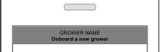
The header area is tappable on all screens and opens up a pane that shows all contextual information about the Grower like Grower Name, Field, Block and Sub Block.
Tapping the header again dismisses this pane. Tapping elsewhere on the screen also dismisses this pane.
An action bar will appear on detail screens for context specific actions like email, print, create work order, etc.
Grower
John Smith
Field
Field Name
Block
Block Name
Sub Block
Sub-Block Name

Slide 42
To be included as part of scouting and other areas. Placing here temporarily

Slide 43



Inventory
The Grower Inventory screen shows a list of Fertilizers, Pesticides, Equipment, Seeds and any ad-hoc items.
Users can filter through the list using the standard filter on top.
Users can search the list as well.
All items can be edited or deleted. Multiple selection is enabled using the ‘Edit’ button.
Individual items can be deleted using the standard swipe to delete gesture.
Tapping on any field name like ‘Fertilizer name’ or ‘Pesticide Name’ initiates the editing that item. This is picked from a predefined searchable list.
Tapping on the value will initiate editing the value and unit.
Tapping on ‘New’ will create a new entry.
GROWER NAME
Sub-Block Name
GROWER NAME
Grower Inventory
Edit
John Smith
Related Crop: Corn
All
Fertilizers
Pesticides
Equipment
Seeds
Misc.
Scouting Events
Scouting
Photos
Notes
New
Fertilizers
Traps
Disease Monitoring
Growth Mapping
Fertilizer Name
Last Updated Date/Time
2000
lbs.
Fertilizer Name
Last Updated Date/Time
430
gal.
Field Events
Pesticides
Soil Sampling
Boundary Mapping
Rec
Writing
Pesticide Name
Last Updated Date/Time
120
lbs.
Pesticide Name
Last Updated Date/Time
80
oz.
Work Orders
Grower Inventory
Equipment
Tractor Model 1
Last Updated Date/Time
4
Applicator Model 1
Last Updated Date/Time
3
Seeds
Seed Name
Last Updated Date/Time
5441
lbs.
Seed Name
Last Updated Date/Time
733
lbs.
Seed Name
Last Updated Date/Time
210
lbs.

Slide 44
Ignore
Inventory – Editing an existing value (Option 1)
Editing a value brings up the standard iOS drum interface.
Users can pick a value and a unit to make the change.
Tapping on Done saves the edited value.
GROWER NAME
Grower Inventory
GROWER NAME
Grower Inventory
Edit
Edit
All
Fertilizers
Pesticides
…
All
Fertilizers
Pesticides
…
New
New
Fertilizers
Fertilizers
Fertilizer Name
Last Updated Date/Time
2000
lbs.
Fertilizer Name
Last Updated Date/Time
2000
lbs.
Fertilizer Name
Last Updated Date/Time
430
gal.
Cancel
Done
Fertilizer Name
Last Updated Date/Time
430
gal.
1850
1900
1950
2000
2150
2200
Pesticides
Pesticides
Pesticide Name
Last Updated Date/Time
120
lbs.
Pesticide Name
Last Updated Date/Time
120
lbs.
Pesticide Name
Last Updated Date/Time
80
oz.
lbs.
oz.
gal.
Pesticide Name
Last Updated Date/Time
80
oz.
Equipment
Equipment
Tractor Model 1
Last Updated Date/Time
4
Tractor Model 1
Last Updated Date/Time
4
Applicator Model 1
Last Updated Date/Time
3
Applicator Model 1
Last Updated Date/Time
3
Seeds
Seeds
Seed Name
Last Updated Date/Time
5441
lbs.
Seed Name
Last Updated Date/Time
5441
lbs.
Seed Name
Last Updated Date/Time
733
lbs.
Seed Name
Last Updated Date/Time
733
lbs.
Seed Name
Last Updated Date/Time
210
lbs.
Seed Name
Last Updated Date/Time
210
lbs.

Slide 45
Inventory – Editing an existing value
Tapping anywhere on a row item brings up the edit screen.
Users can change any item by tapping on it.
Fertilizers can be picked from a searchable pick list.
Quantity brings up the numeric keypad.
Unit brings up the drum roll.
Users can save the changes by tapping done which brings them back to the inventory list.
GROWER NAME
Grower Inventory
GROWER NAME
Fertilizer Details
Edit
Done
All
Fertilizers
Pesticides
…
Fertilizer Name
Urea
Quantity
2000
New
Unit
lbs.
Fertilizers
Fertilizer Name
Last Updated Date/Time
2000
lbs.
Fertilizer Name
Last Updated Date/Time
430
gal.
Pesticides
Pesticide Name
Last Updated Date/Time
120
lbs.
Pesticide Name
Last Updated Date/Time
80
oz.
Equipment
Tractor Model 1
Last Updated Date/Time
4
Applicator Model 1
Last Updated Date/Time
3
Seeds
Seed Name
Last Updated Date/Time
5441
lbs.
Seed Name
Last Updated Date/Time
733
lbs.
Seed Name
Last Updated Date/Time
210
lbs.

Slide 46
Disease Monitoring
Users can add a new disease by tapping on the Disease monitoring icon.
This brings them to a list view of all the entries that they may have captured earlier.
Users can filter this information using the standard date based filters.
To drill down, the user can tap on an individual row to see more details like associated photos or notes.
GROWER NAME
Sub-Block Name
GROWER NAME
Disease Monitoring
John Smith
Related Crop: Corn
TODAY
YESTERDAY
LAST WEEK
Scouting Events
New
Scouting
Photos
Notes
Disease Name
Date-time stamp.
Disease Name
Date-time stamp.
Traps
Disease Monitoring
Growth Mapping
Disease Name
Date-time stamp.
Disease Name
Date-time stamp.
Field Events
Disease Name
Date-time stamp.
Soil Sampling
Boundary Mapping
Rec
Writing
Disease Name
Date-time stamp.
Work Orders
Grower Inventory
Disease Name
Date-time stamp.

Slide 47
Disease Monitoring – Existing Record
The detailed view will show the disease details, associated photos and notes for that particular disease.
*We may not need the details section here.
GROWER NAME
Disease Monitoring
GROWER NAME
Disease Instance
Edit
TODAY
YESTERDAY
LAST WEEK
DETAILS
PHOTOS (5)
NOTES
New
Disease Name
Date-time stamp.
Disease Name
Date-time stamp.
Disease Name
Date-time stamp.
Disease Name
Date-time stamp.
Disease Name
Date-time stamp.
Disease Name
Date-time stamp.
Disease Name
Date-time stamp.

Slide 48
Disease Monitoring – New Event
Users can add details like the disease name and add notes.
Additionally, they can add one or more photos to the event.
Long pressing on any of the photos will allow them to remove any photo if they want to delete it.
Users can also open an in-app browser to do any research if required. They do not need to leave the application for this.
Tapping on the ‘Save’ button will complete the activity.
GROWER NAME
Disease Monitoring
GROWER NAME
Disease Instance
Save
TODAY
YESTERDAY
LAST WEEK
Sample Disease Instance
New
Spotted an instance of ‘disease name’ today. Attached two photos for reference.
Disease Name
Date-time stamp.
Disease Name
Date-time stamp.
Disease Name
Date-time stamp.
Disease Name
Date-time stamp.
Photos
Disease Name
Date-time stamp.
Disease Name
Date-time stamp.
Disease Name
Date-time stamp.

Slide 49
Growth Stage Monitoring - Stages
Tapping on growth stage mapping shows the user any existing growth stage mappings that might have been done.
This includes the Growth stage name and the date and time stamp.
Tapping on New will initiate a new Growth Stage Mapping activity.
Tapping on an existing item will show the details screen.
GROWER NAME
Sub-Block Name
GROWER NAME
Growth Mapping
John Smith
Related Crop: Corn
New
Scouting Events
Growth Stage Name
Date-time stamp.
Scouting
Photos
Notes
Growth Stage Name
Date-time stamp.
Traps
Disease Monitoring
Growth Mapping
Growth Stage Name
Date-time stamp.
Field Events
Soil Sampling
Boundary Mapping
Rec
Writing
Work Orders
Grower Inventory

Slide 50
Growth Stage Monitoring - Existing
Tapping on growth stage mapping shows the user any existing growth stage images that might have been done.
This will include the Growth Stage Name and the data/time stamp.
*Note that different crops might have different growth stages. I’m assuming that there are n number of growth stages and not a fixed number.
GROWER NAME
Growth Mapping
GROWER NAME
Growth Stage Name
New
Details
NOTES
Growth Stage Name
Date/Time Stamp
Growth Stage Name
Date-time stamp.
Growth Stage Name
Date-time stamp.
Growth Stage Name
Date-time stamp.
Actual
Reference

Slide 51
Growth Stage Monitoring - New
A new growth stage activity will involve a split view.
The top section contains the live preview from the camera viewfinder.
The bottom section contains a swipable collection of reference images that the user can choose to compare the live image with.
Users can tap anywhere on the live area to capture the image.
GROWER NAME
Growth Mapping
GROWER NAME
New Growth Stage Mapping
New
Growth Stage Name
Date-time stamp.
Live Image from phone viewfinder will appear here.
Growth Stage Name
Date-time stamp.
Growth Stage Name
Date-time stamp.
Reference Image Name

Slide 52
Growth Stage Monitoring – New Contd…
After the user decides the image to use, they can tap ‘Use’
Once the ‘Use’ button is tapped, the user is presented with a dialog where they enter the Growth Stage Name and any notes that they might have.
Once satisfied, they can save the event by tapping the Save button.
GROWER NAME
New Growth Stage Mapping
GROWER NAME
New Growth Stage Mapping
Growth Stage Name
Sample Note
Use
Re-take
Save
Cancel
Reference Image Name
Reference Image Name

Slide 53
Process

Slide 54
Key Considerations
Fast. Fluid
Color. Contrast
Flat
Familiar

Slide 55
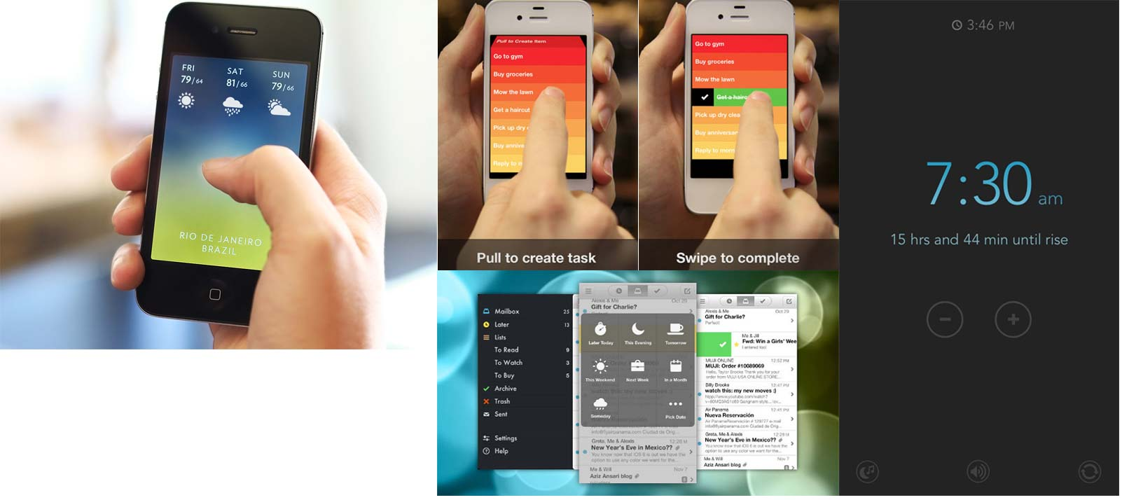
Fast & Fluid
User research revealed that the number one asks from a PCA is that they don’t want to navigate through a complex system.
Users are expecting the system to have context of where they are, who they are dealing with and show just the information that they need to complete their task.
On the right shows applications that are exploring newer paradigms using gestures, flat design and audio that make applications unique.

Slide 56
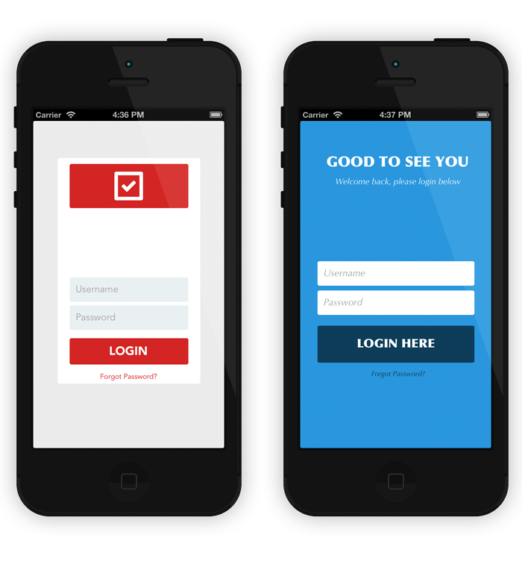
Color & Contrast
The application can be used in varying conditions in different regions.
Quick scanability of the information is key to enable PCAs to infer and make decisions quickly.

Slide 57
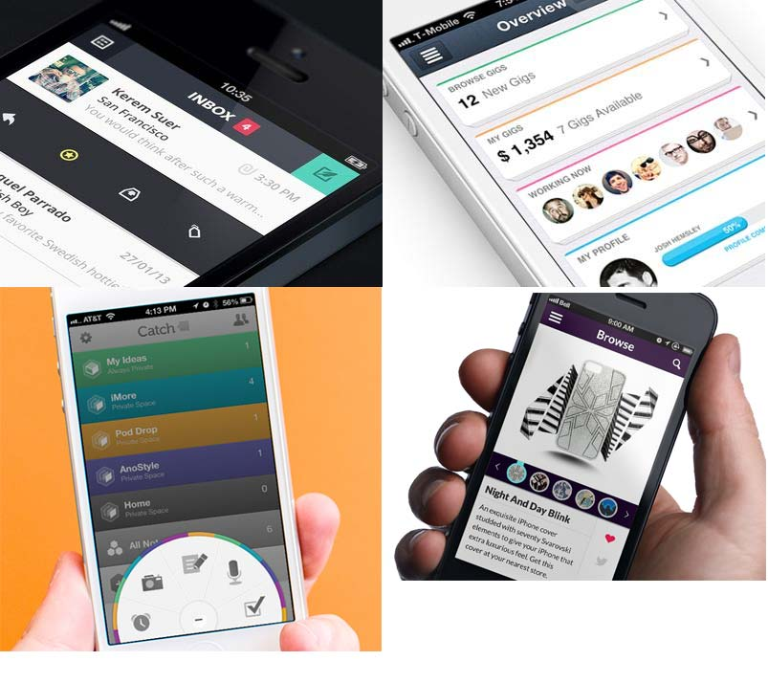
FLAT
Flat design as a paradigm is fast gaining popularity and adoption as it works on a key principle of not letting the design come in the way of content.
By using clear backgrounds and strong typography,

Slide 58
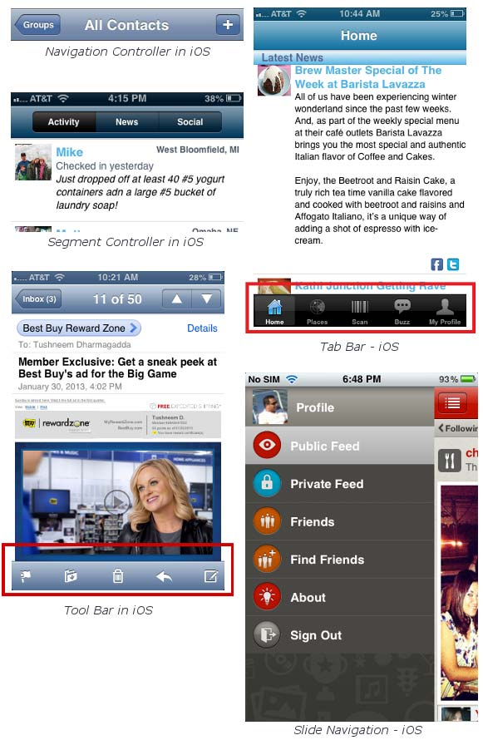
FAMILIAR
While it is good to explore new ways of interaction, there is a fine balance that needs to be achieved in order to make the system usable.
Key functions need to be created along the lines of existing interaction paradigms in the iOS eco system.
Using familiar patterns will reduce the learning curve and increase adoption faster.

