Slide 1

Seattle Housing Project
customer purchase behavior modeling
Mindy Jen, July 27th, 2020

Slide 2
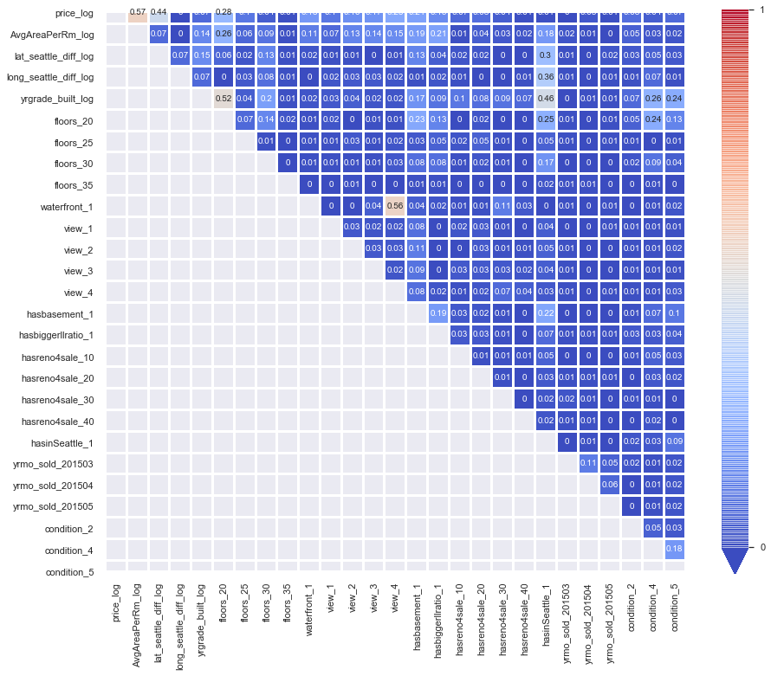
Features: What're major factors that may make impact on house buyers' behaviors?
Predictors:
Location
Condition
Amenities
Design
Size
Age
House tour
Season
Target: price

Slide 3
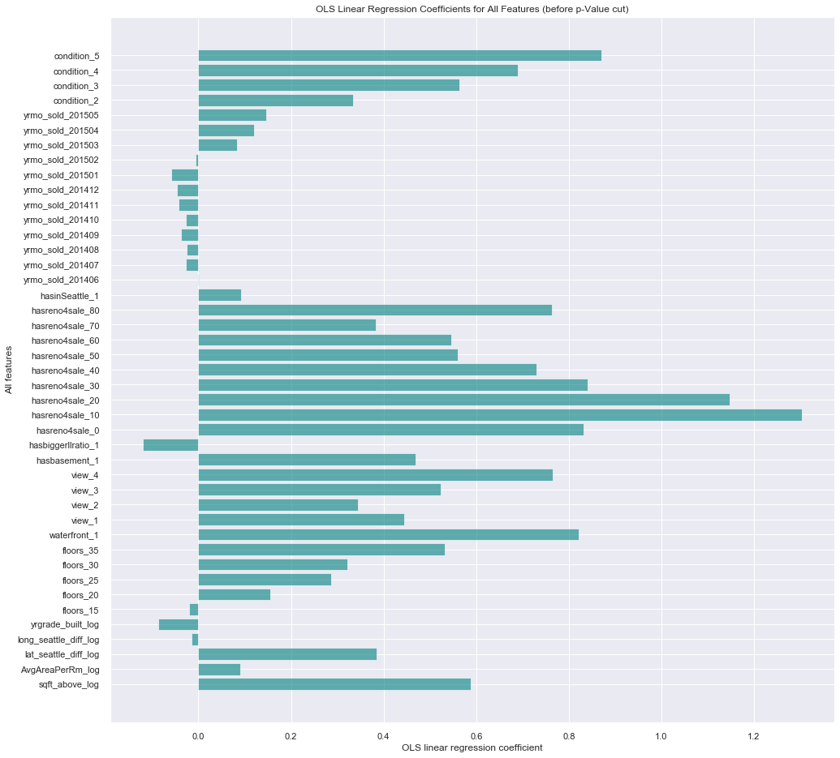
Features: What're all factors considered?
House selling season
House maintenance/condition
House tour
House amenity
House design
House age/grade
House location
House size

Slide 4
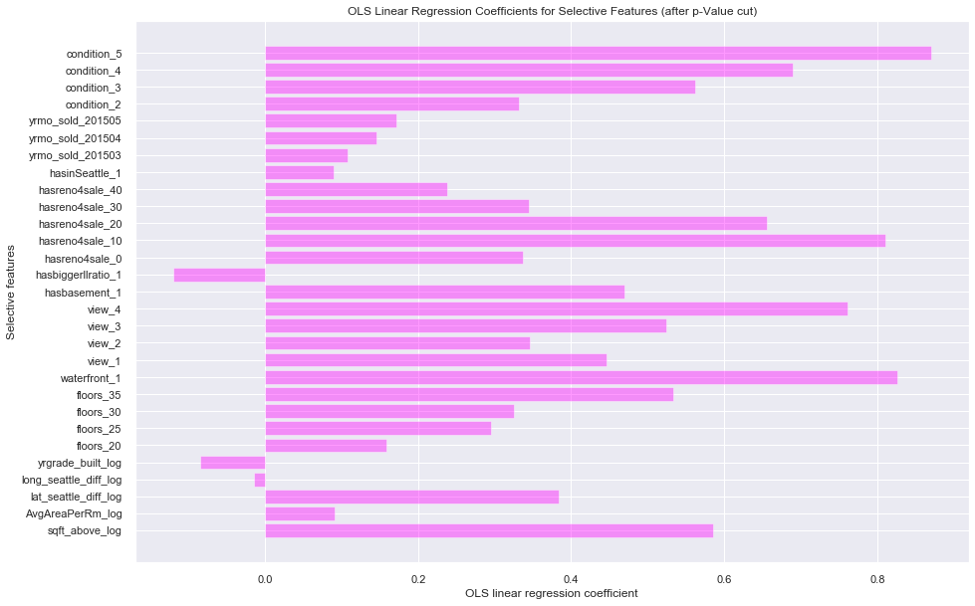
Features: What're major factors that affect house selling price dramatically?

Slide 5
Question 1: What are influential factors on frequencies of house tour?
Season matters!

Slide 6
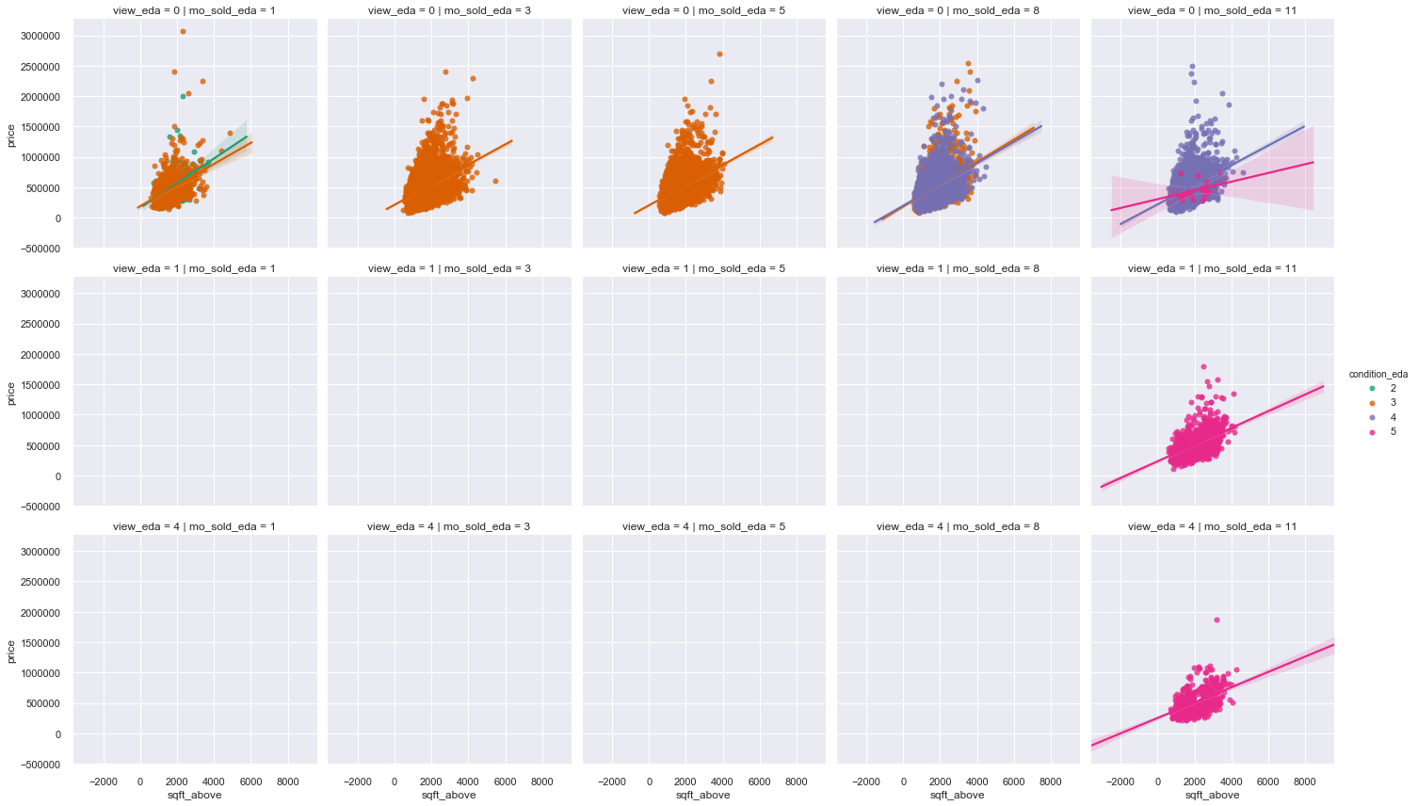
House condition (maintenance/renovation)
Jan-Feb Mar-Apr May-Jul Aug-Oct Nov-Dec
No house tour
house tour (1 – 3 times)
house tour (> 3 times)

Slide 7
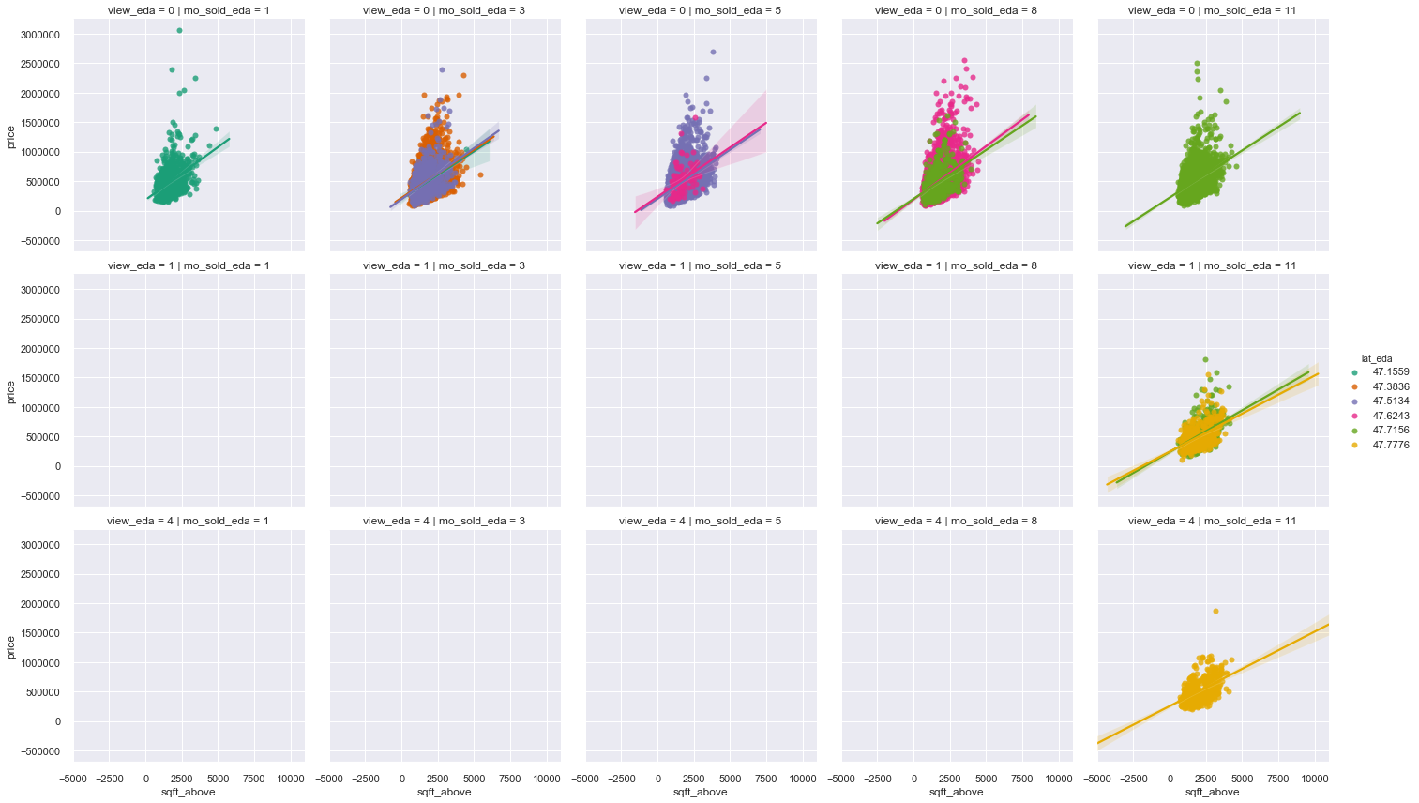
House location
Jan-Feb Mar-Apr May-Jul Aug-Oct Nov-Dec
No house tour
house tour (1 – 3 times)
house tour (> 3 times)

Slide 8
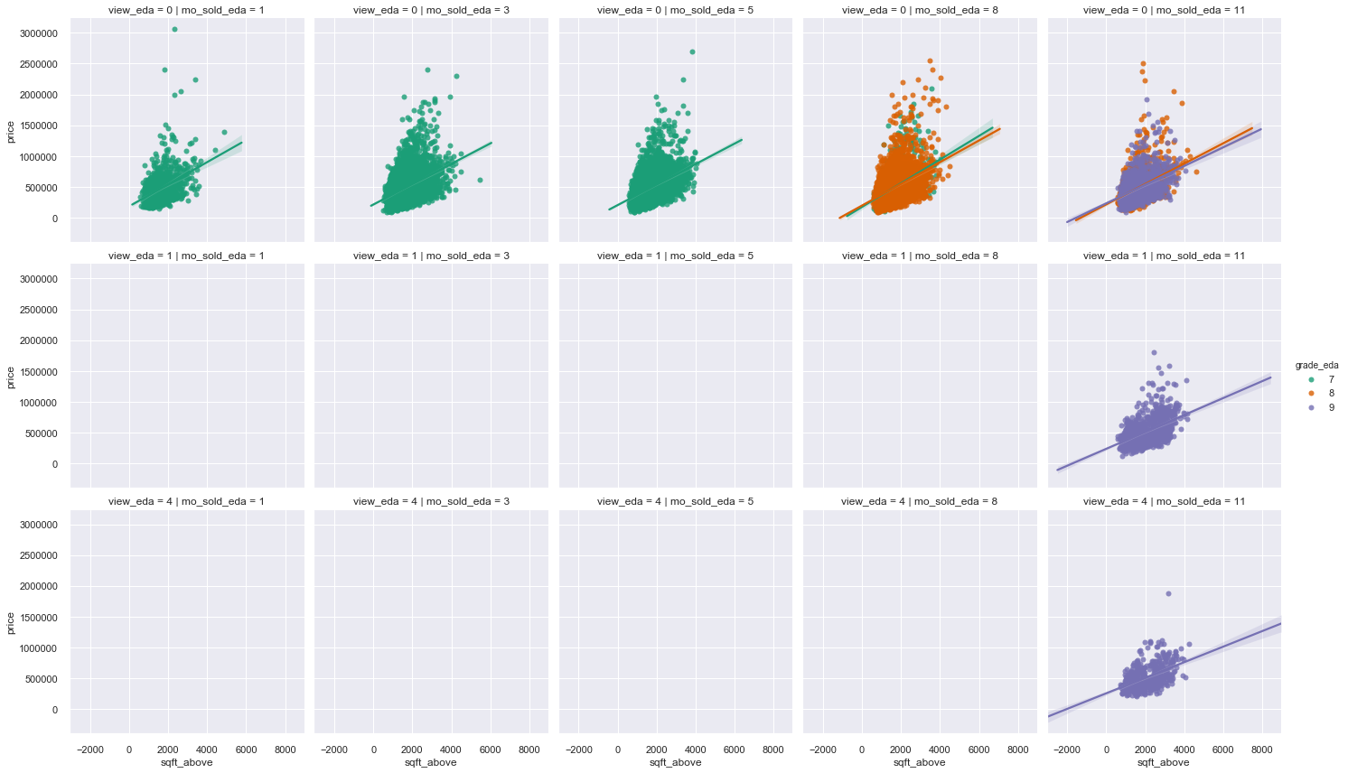
House grade scale (~ House age)
Jan-Feb Mar-Apr May-Jul Aug-Oct Nov-Dec
No house tour
house tour (1 – 3 times)
house tour (> 3 times)

Slide 9
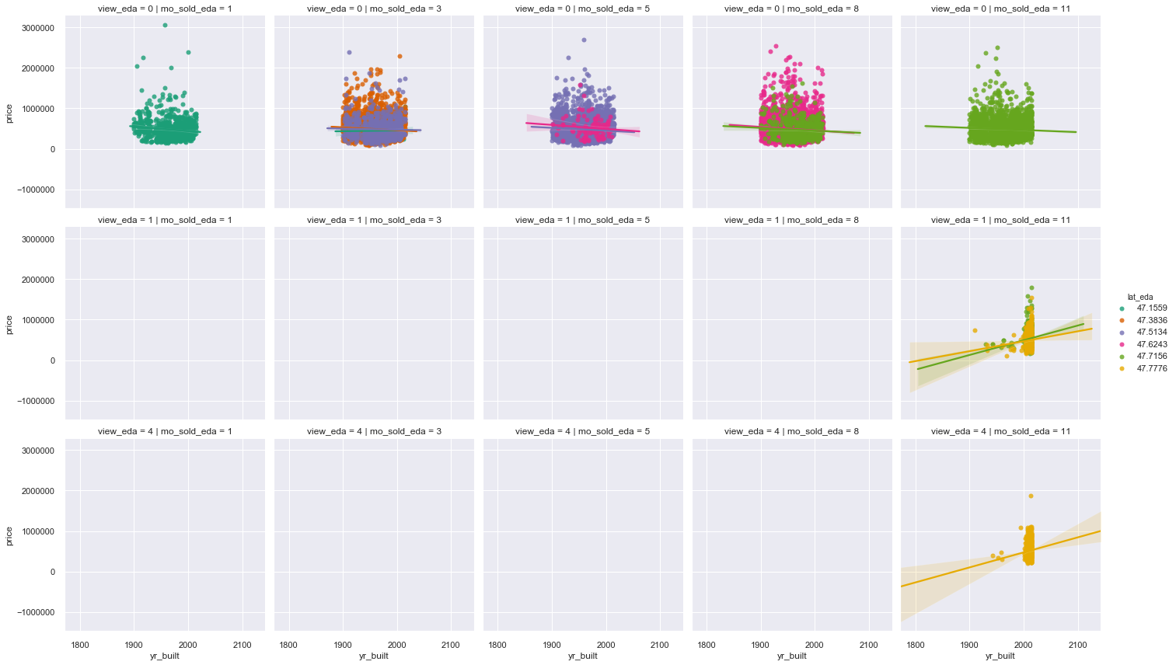
House age (~ Grade scale)
Jan-Feb Mar-Apr May-Jul Aug-Oct Nov-Dec
No house tour
house tour (1 – 3 times)
house tour (> 3 times)

Slide 10
Question 2: What are influential factors on house buyers' decision-making behaviors??
House itself!

Slide 11
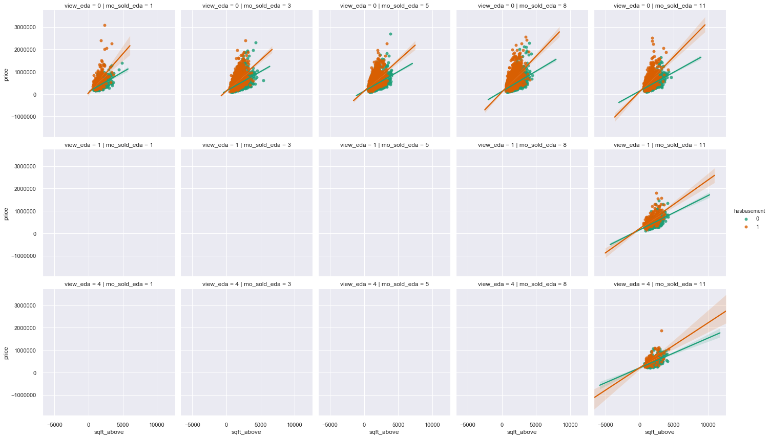
House design: basement
Jan-Feb Mar-Apr May-Jul Aug-Oct Nov-Dec
No house tour
house tour (1 – 3 times)
house tour (> 3 times)

Slide 12
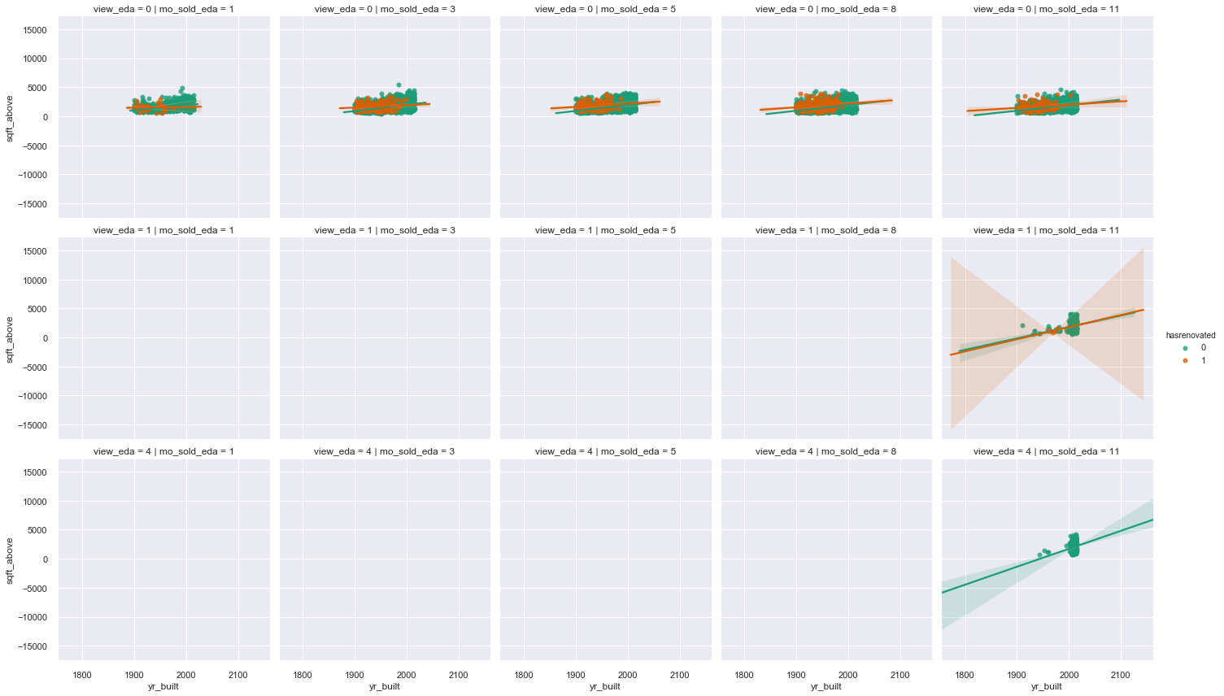
House condition (maintenance/renovation)
Jan-Feb Mar-Apr May-Jul Aug-Oct Nov-Dec
No house tour
house tour (1 – 3 times)
house tour (> 3 times)

Slide 13
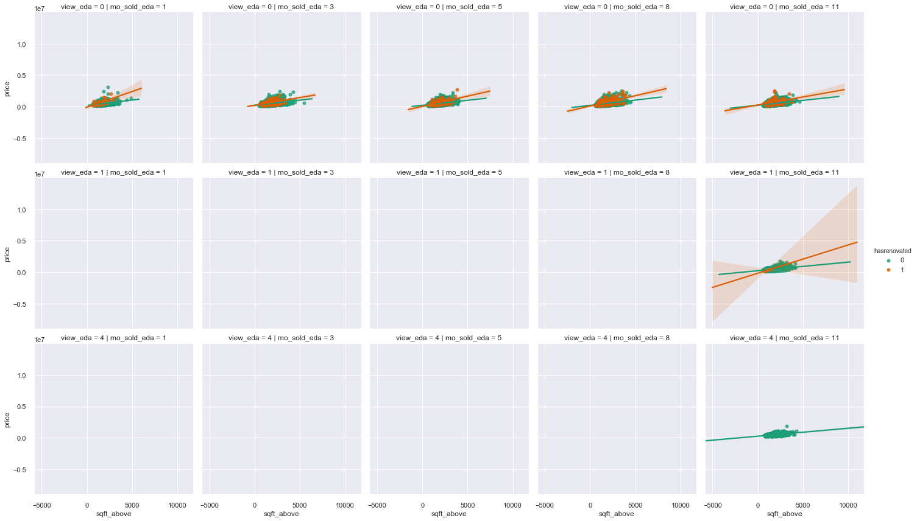
House condition (maintenance/renovation)
Jan-Feb Mar-Apr May-Jul Aug-Oct Nov-Dec
No house tour
house tour (1 – 3 times)
house tour (> 3 times)

Slide 14
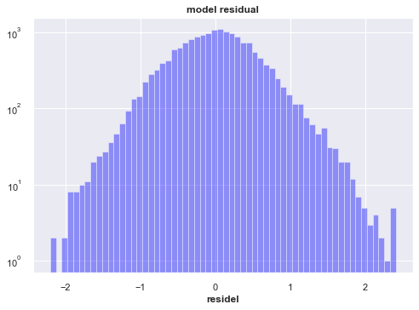
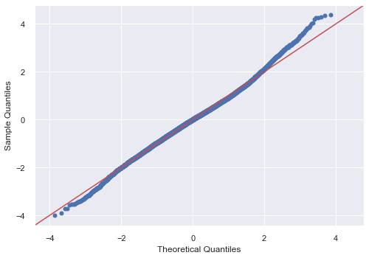
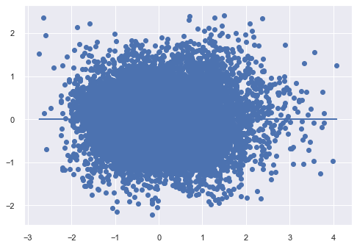
What's model performance and OLS nomality check? R2 = 0.697, skew = 0.098, kurtosis = 3.633 MSE = 0.305, RMSE = 0.552 Goldfeld-Quandt test: [('F statistic', 0.985), ('p-value', 0.766)]

Slide 15
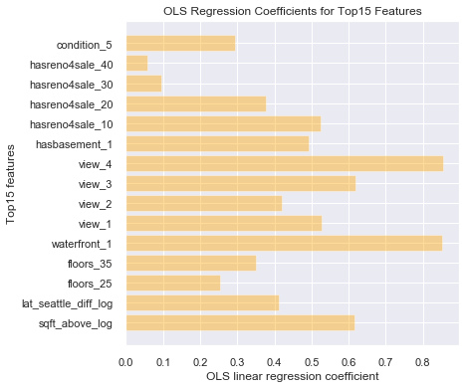
Features: What're Top15 factors that affect house selling price most significantly?
House maintenance/condition
House design
House tour
House amenity
House design
House location
House size

Slide 16
Recommendation list
housing price is highly sensitive to the variation of house interior area
house grading system in King county accounts for each house's age
time length after house renovation to sold year determines house condition
house tour correlates to house amenities, design and maintenance, e.g. pool, basement, floors and renovation (condition)
house selling price affected by its latitude (north to Vancouver and south to Portland, OR) ; instead, its longitude has no effect
winter holiday season attracts more tours and greater discount on houses located further away from Seattle city
lot size weights more on selling price than house interior area
house price goes down from middle of summer through fall (end of fiscal year) till January of following year
House Size
House Age & Grade Scale
House Renovation Life Time
House Tour
House Location
Holiday Winter Season
Lot / Living ratio
Spring Season

Slide 17
Future Work
Future Work
Relate
relate zipcode to city name
Relate
relate house age with grading scale
Relate
relate house renovation with condition score
Relate
relate house price with city

Slide 18

Thank You!
renjmindy@gmail.com

