Slide 1
Python编程基础
分享人：任俊新
南京信息职业技术学院 讲师

Slide 2
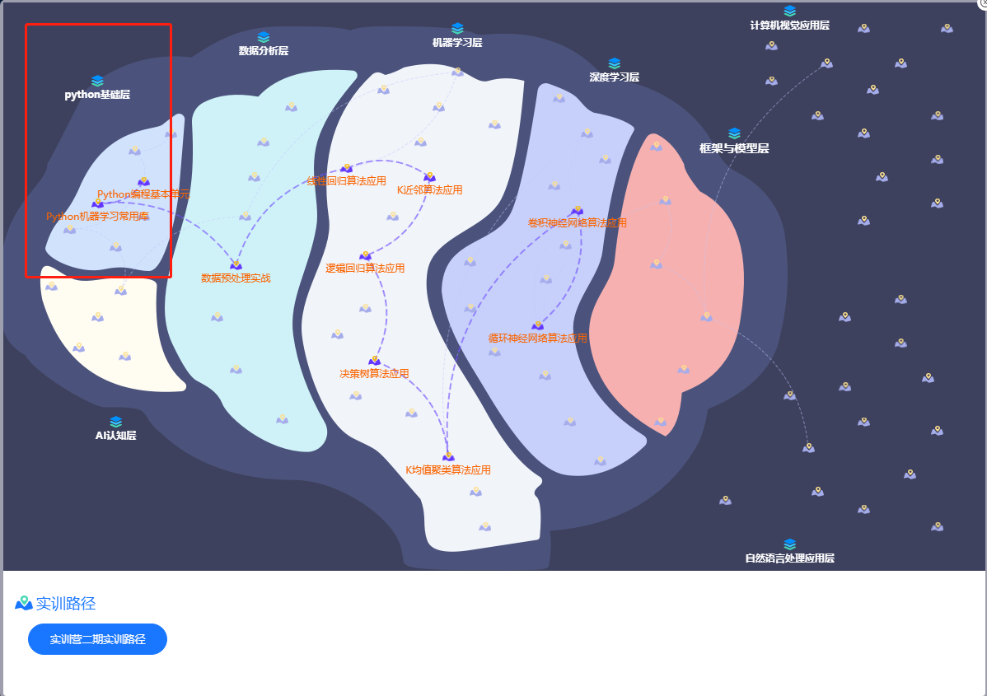
整体目标

Slide 3
Python优势
弱类型，解释型，交互式运行
大数据，人工智能
大量的第三方库

Slide 4
Python开发环境
IDLE，VSCODE，记事本等
Pycharm
Jupyter
www.314ai.cn

Slide 5
Python版本
Python2
Python3
….

Slide 6
Python式代码-数据交换
temp = a
a = b
b = temp
a, b = b, a

Slide 7
Python式代码-遍历列表
a = [1,2,3,4,5,6]
for i in range(len(a)):
x = a[i]
print(x)
a = [1,2,3,4,5,6]
for e in a:
print(e)

Slide 8
拼接字符串
arr = [‘h’,’e’,’l’,’l’,’o’]
s=‘’
for c in arr:
s += c
arr = [‘h’,’e’,’l’,’l’,’o’]
s = ‘’.join(arr)

Slide 9
Python式代码-拼接字符串
arr = [‘h’,’e’,’l’,’l’,’o’]
s=‘h’
for c in arr[1:]:
s += ‘,’+c
arr = [‘h’,’e’,’l’,’l’,’o’]
s = ‘,’.join(arr)

Slide 10
Python式代码-连续比较
return 0 < x and x < 10
return 0 < x < 10

Slide 11
Python式代码-In
if x==1 or x==2 or x==3:
return True
if ‘haha’.find(‘ha’) != -1:
print(‘找到了’)
if x in [1,2,3]:
Return True
if ‘ha’ in ‘haha’:
print(‘找到了’)

Slide 12
Python式编程-Boolean
if x == True:
print(‘OK’)
if len(items) >0:
print(‘OK’)
if x != None:
print(‘OK’)
If x:
Print(‘OK’)
If items:
Print(‘OK’)
If x is not None:
Print(‘OK’)

Slide 13
我的Python课 http://github.com/renjx/pythonstudy

