Slide 1






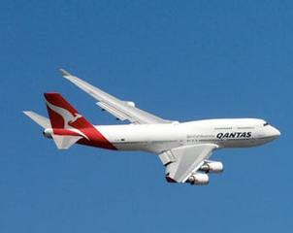







Pretrained Backbone
Base Class Weights
dog
Backbone
CNN
cat
plane
train
…
$$W_{a}$$
Attention
Attractor
Network
$$φ(θ)$$
Query
Support
Few-Shot Episode
Attention
$$R(W_{b};θ)$$
Attractor Regularizer
dog
cat
When are parameters being learned?
$$R$$
Minimization
plane
$$+$$
train
Pretraining Stage
$$L^{S}$$
…
Support Loss
Meta-Learning Stage
fish
Few-Shot
Episodic Network
ship
Every Few-Shot Episode
Joint
Classification
Fast weights
$$W_{b}$$

Slide 2







Pretrained Backbone
Base Class Weights
dog
Backbone
CNN
cat
plane
train
…
$$W_{a}$$
Attention
Attractor
Network
$$φ(θ)$$
Query
Support
Few-Shot Episode
Attention
$$R(W_{b};θ)$$
Attractor Regularizer
dog
cat
When are parameters being learned?
$$R$$
Minimization
plane
$$+$$
train
Pretraining Stage
$$L^{S}$$
…
Support Loss
Meta-Learning Stage
fish
Few-Shot
Episodic Network
ship
Every Few-Shot Episode
Joint
Classification
Fast weights
$$W_{b}$$

