Slide 1
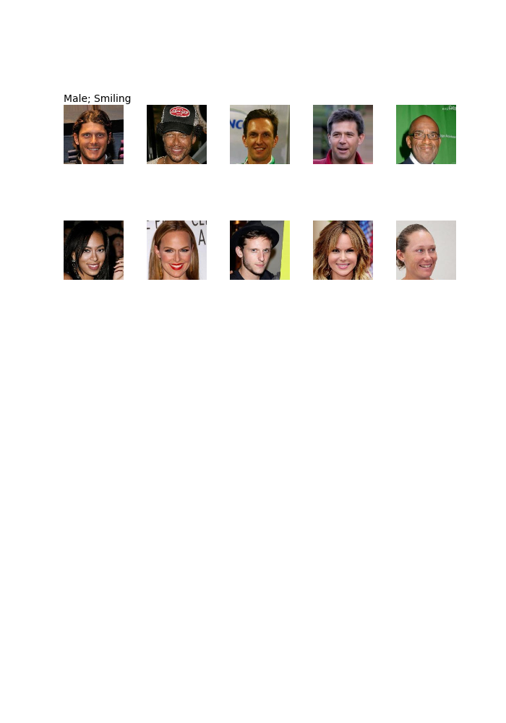
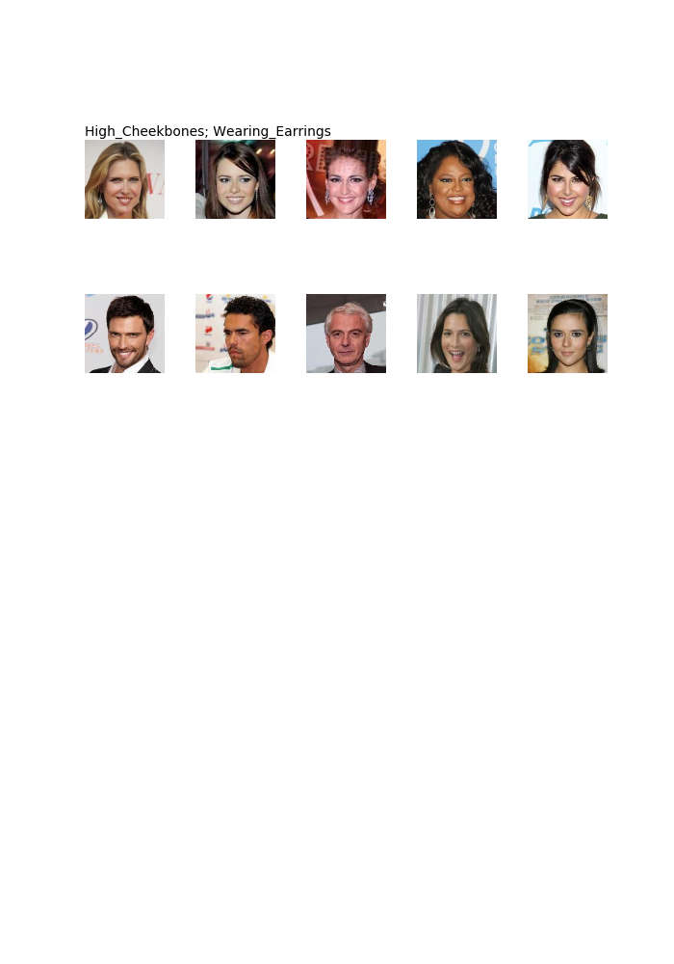
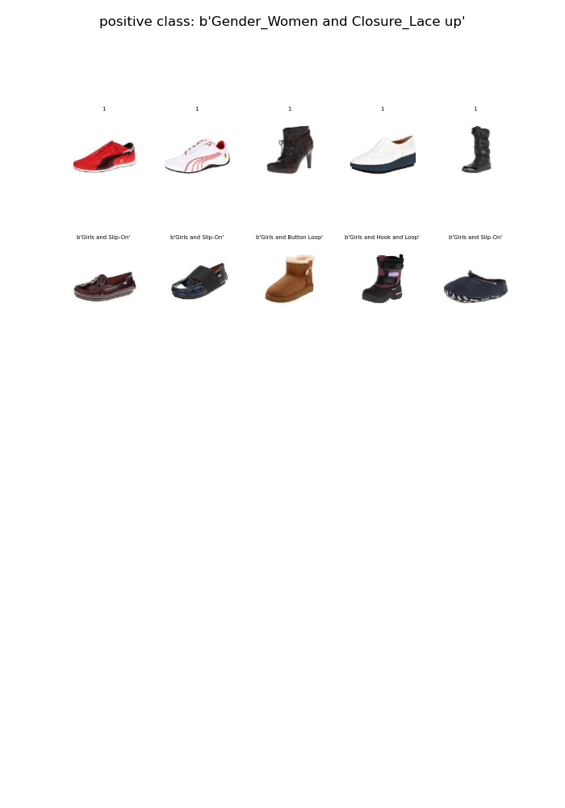
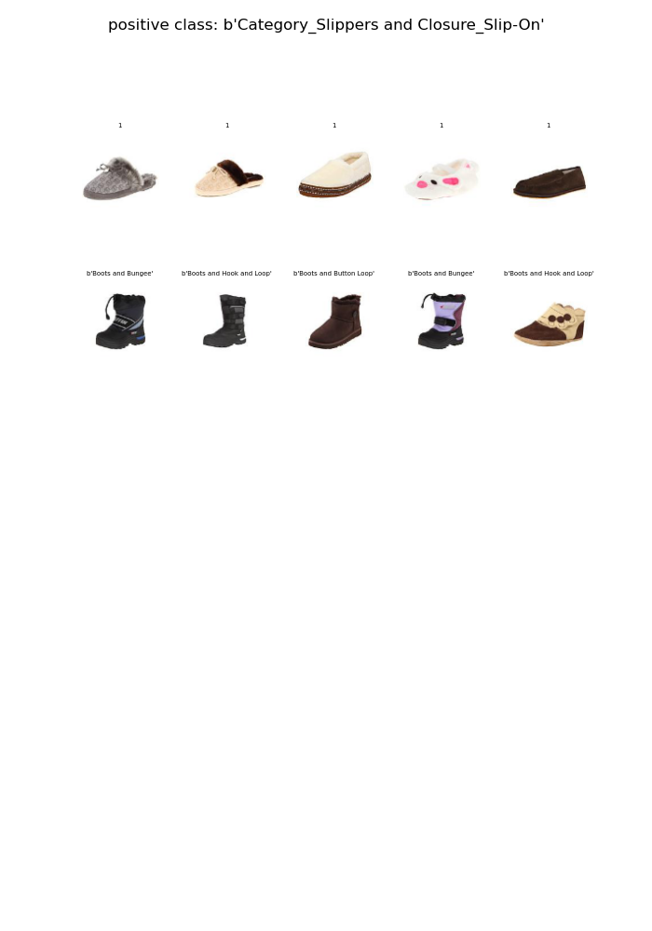
Celeb-A
Zappos-50K
Attribute: Male & Smiling
Attribute: Cheekbones & Earrings
Attribute: Women & Lace Up
Attribute: Slippers & Slip-On
Positive examples
Positive examples
Positive examples
Positive examples
Negative examples
Negative examples
Negative examples
Negative examples

Slide 2
Celeb-A
Zappos-50K
Male & Smiling
Cheekbones & Earrings
Women & Lace Up
Slippers & Slip-On
Positive
Positive
Positive
Positive
Negative
Negative
Negative
Negative

