Slide 1
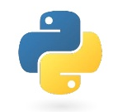
Basic Python
Tips, tool, and techniques for those starting in Python
Notes:
Today, rather than focusing on a particular problem, we’re going to talk about
The goal here is finding ways to get more done when you’re programming

Slide 2
Topics
Prelude
Data structures
Iterators
Functions
Exercises
Plotting
Exercises

Slide 3
Go to syzygy:
https://uvic.syzygy.ca/

Slide 4
Open a new terminal and clone this repository:
https://bit.ly/2pp5kDx

Slide 5

Topic 0 Prelude

Slide 6

Prelude What is Python?
Invented in the early ‘90s by Guido Van Rossum
CPython Interpreter
Reads your code 📖
Parses it 👀
Checks for syntax errors ✔️
Generates instructions 👉
Steps through instructions ⏭️
Notes:
Each instruction corresponds to a C function!
∴ it is a scripting language!

Slide 7


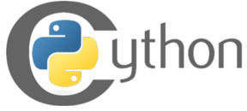
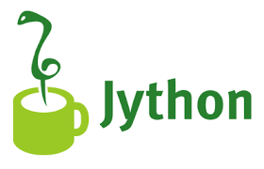



Prelude Beyond CPython
There are other ways of running your Python code:
The best way to get CPython + Scientific libraries

Slide 8
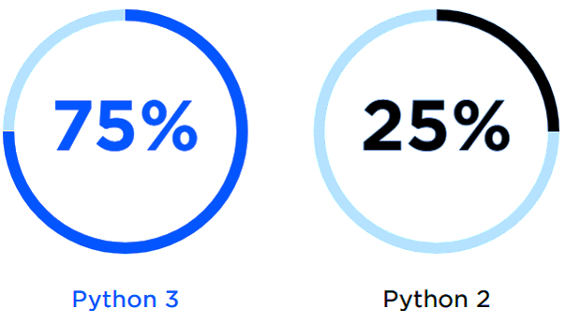
Prelude 2 vs. 3
Python 3 > Python 2
Stick to 3.5+
source: opensource.com
Notes:
Python 3 came out a decade ago
Bit of a mess for a while
Now its 2018, its all better
Use 3!

Slide 9
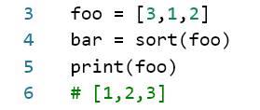
Prelude Variables
What happened to foo?

Slide 10
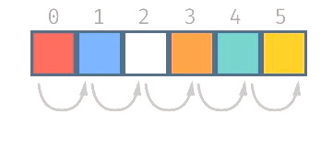
Topic 1 Data Structures
Notes:
Can anyone name a data structure? What do I mean by that?

Slide 11

Topic 1 Data Structures
Lists
Most of us are familiar
Store data in order
Can loop through
Can look up by index
Slow searching
Notes:
Can anyone name a data structure? What do I mean by that?

Slide 12
Data Structures Dictionaries
Store data as key: value pairs
Keys can be:
Numbers
Strings
Tuples of numbers, strings
Values can be: anything!
“Instant” lookup by key!
O(1) even if 1e6 entries!
Slower than lists for looping

Slide 13
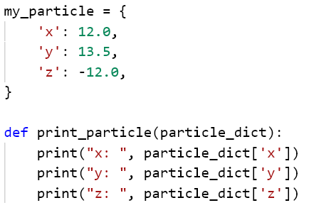
Data Structures Dictionaries
Use cases:
Store properties of something in one place
Example:

Slide 14
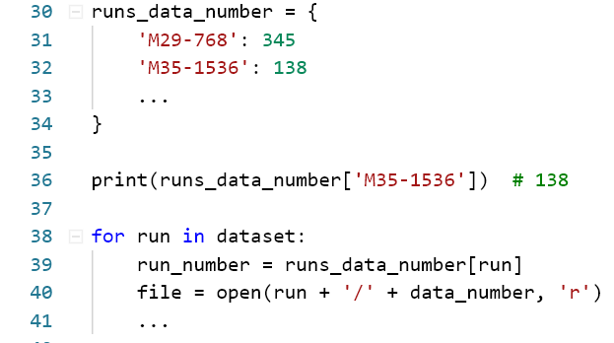
Data Structures Dictionaries
Use cases:
Data you have to access by a name or ID
Catalogs
Filenames for datasets
Example:

Slide 15
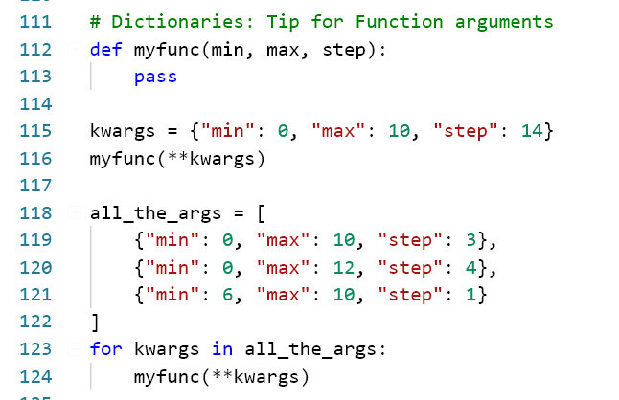
Data Structures Dictionaries – Trick!
You can use dictionaries to hold arguments for functions, apply them later

Slide 16
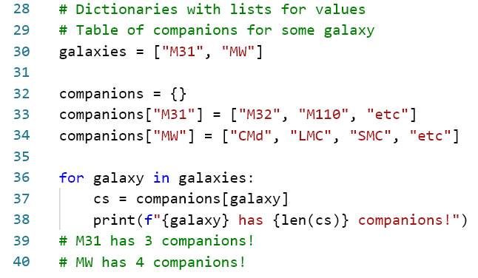
Data Structures Dictionaries – Tip!
You can use lists, and other dictionaries *inside* dictionary values!

Slide 17
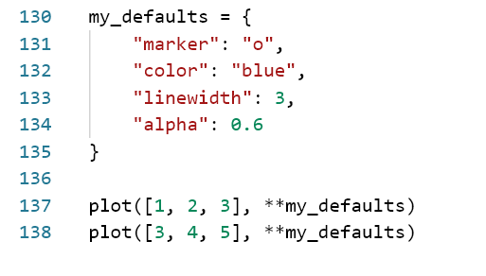
Data Structures Dictionaries – Technique!
If you’re calling some function, e.g. from matplotlib lots of times with slight differences, use a dictionary to hold defaults
Better yet! Make a function!

Slide 18
Data Structures Sets
Sets are like a “bag” of values
Values can be strings, numbers, tuples, etc.
Values are unique.
Adding the same thing twice has no effect
Not ordered
“instant” adding and removing values
“instant” membership testing
Operations for
Testing
Grouping
Differencing
etc.
Notes:
Motivating example from student numbers

Slide 19
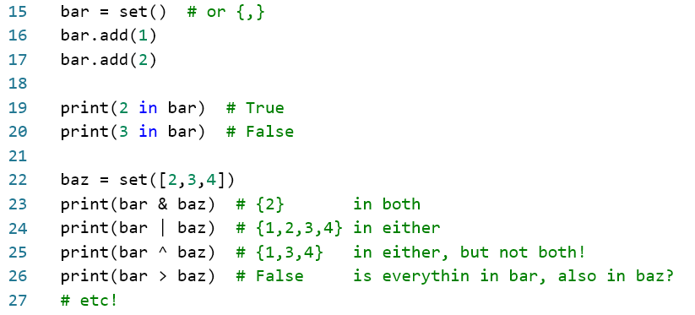
Data Structures Sets
Notes:
Motivating example from student numbers

Slide 20

Topic 2 Iterators

Slide 21
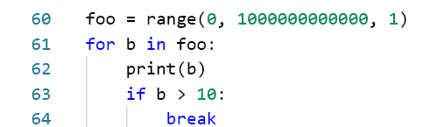
Topic 2 Iterators
Generators create “lazy sequences”, called iterators
This works!
Why doesn’t my computer crash?
Notes:
Talk about green threads/coroutines? Async/await.
Gevent patches all stdlib functions to have yields, multiplexes between them to let you program concurrently in python!
Async/await is the more official way to do this now.

Slide 22
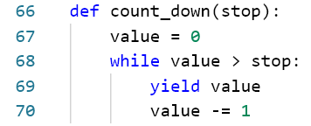
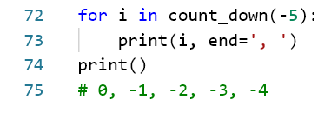
Iterators Behind the scenes
Behind the scenes, they are a function that returns more than one value.
Every time you run the function, you get the next value!
Definition:
Usage:
Notes:
Talk about green threads/coroutines? Async/await.
Gevent patches all stdlib functions to have yields, multiplexes between them to let you program concurrently in python!
Async/await is the more official way to do this now.

Slide 23
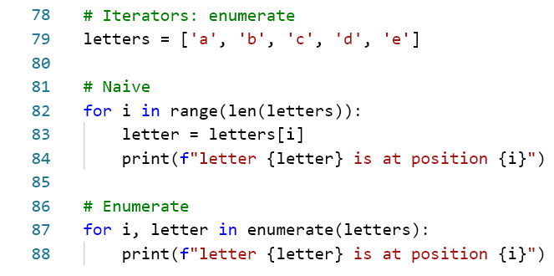
Iterators Useful Iterator Functions
enumerate
Loop through things with indexes
Notes:
Let’s “unpack” this a little! Aside on tuple unpacking

Slide 24
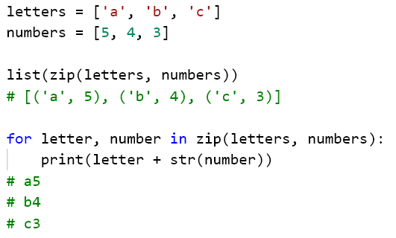
Iterators Useful Iterator Functions
zip
Group items from multiple lists into tuples

Slide 25
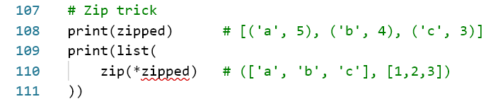
Iterators Useful Iterator Functions
zip
Trick! You can unzip as well, using *

Slide 26
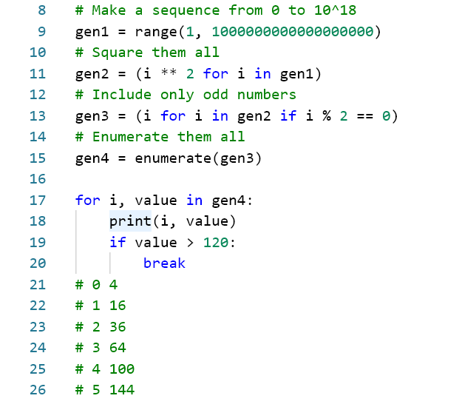
Iterators Generator Expressions
Generator comprehensions by example
Prints:
Notes:
Generator expressions can be handy in a pinch.
This is a contrived example

Slide 27

Topic 3 Functions, Files & Modules

Slide 28
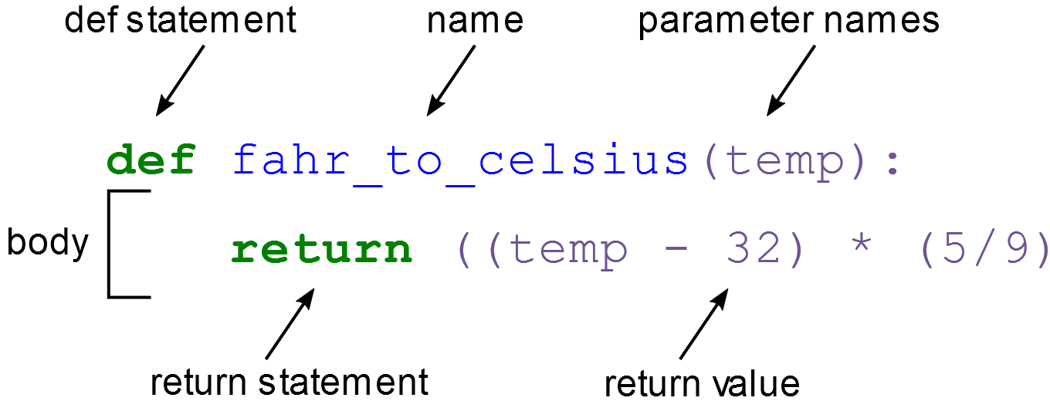
Topic 3 Functions
DRY: Do not Repeat Yourself
Use functions to pull out repeated code, patterns
Safety
Variables inside functions can’t leak out
Easier variable naming
Abstraction
Once you’ve written one type of data analysis, don’t need to worry about the details again
Notes:
Talk about green threads/coroutines?

Slide 29

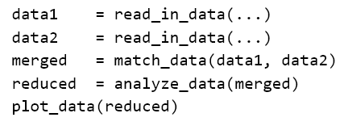
Functions Rules of Thumb
Create a function if:
You write the same thing 2 or more times
You know it will change in the future
It was tricky to get right
It’s a step in a data analysis pipeline

Slide 30
Functions Rules of Thumb (to avoid)
“Magic Functions”
It does different things, based on parameters
Symptoms:
19+ parameters
Some parameters can’t be used with others
matplotlib...
IMO scientists are particularly prone to this
Split it up!

Slide 31
Functions Decorators
@np.vectorize
Put this above your function, and it will work on arrays
Lots of other use cases for decorators, but this is the one I use on a daily basis

Slide 32
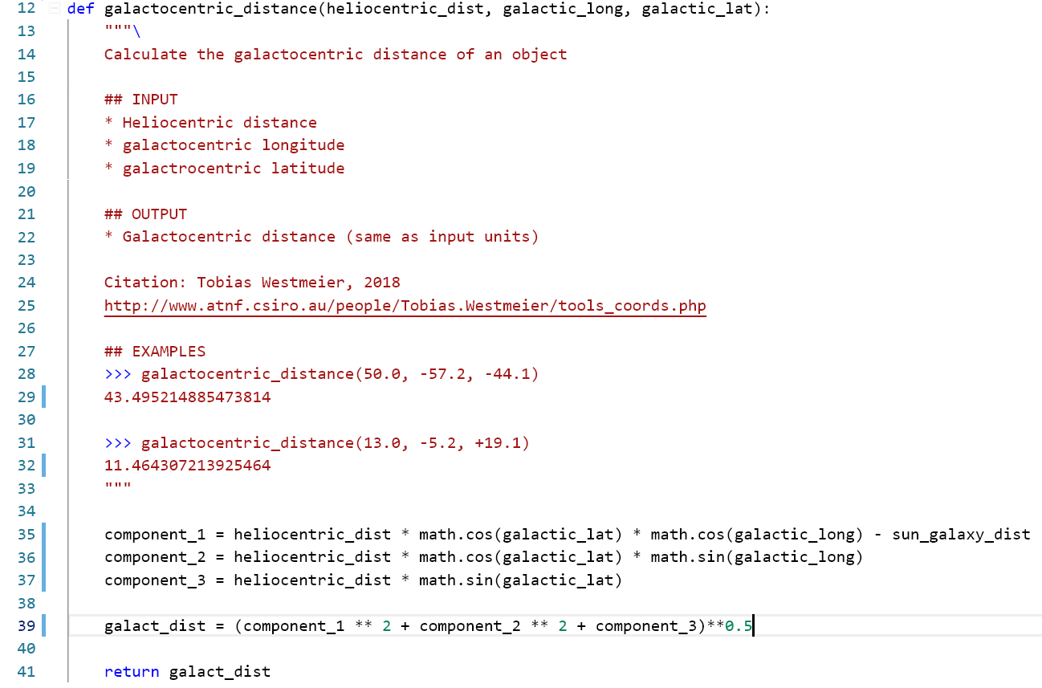
Functions: Docstrings

Slide 33
Topic 3 Files & Modules
Make a text file, give it a .py extension
Congrats, you made a module!
Any python file is a module that can be imported
Python looks for modules in your current directory, and PYTHONPATH (that’s where e.g. numpy is)
If you want to find where a module is:
Import it, and print(somemodule).__file__

Slide 34
Topic 3 Files & Modules
Importing things should have no side-effects
At the top level, modules should only include:
Constants
Functions
Classes
Bad design: importing the module makes a plot show up

Slide 35
Topic 3 Packages
Put a group of modules in a folder
Add a file named “__init__.py”
Congrats, you have a package!
Now you can group your modules together, e.g. scipy
You could even publish your package to pypi

Slide 36
Exercises
Make a function that:
Takes three arguments (x,y,z)
Returns the distance of the vector
Make a function that:
Takes two points as dictionaries
Returns the distance between them
Put your functions in a module
Document them!
Import your module, and use it!
Notes:
Uvic.syzygy.ca
bit.ly/2ScFewN

Slide 37
Topic 4 Plotting

Slide 38
Available Packages
matplotlib
Standard
Seaborn
Great for statistics
ProPlot
Possibly good?
Check out the matplotlib_basics.ipynb and plot_template.ipynb files!
Notes:
Uvic.syzygy.ca
bit.ly/2ScFewN

Slide 39
Exercise
Open star_formation_rate_exercise.ipynb
Follow the instructions and use notebooks below to guide your plotting. matplotlib_basics.ipynb plot_template.ipynb
We will go through step-by-step after some time.
Notes:
Uvic.syzygy.ca
bit.ly/2ScFewN

