Slide 1
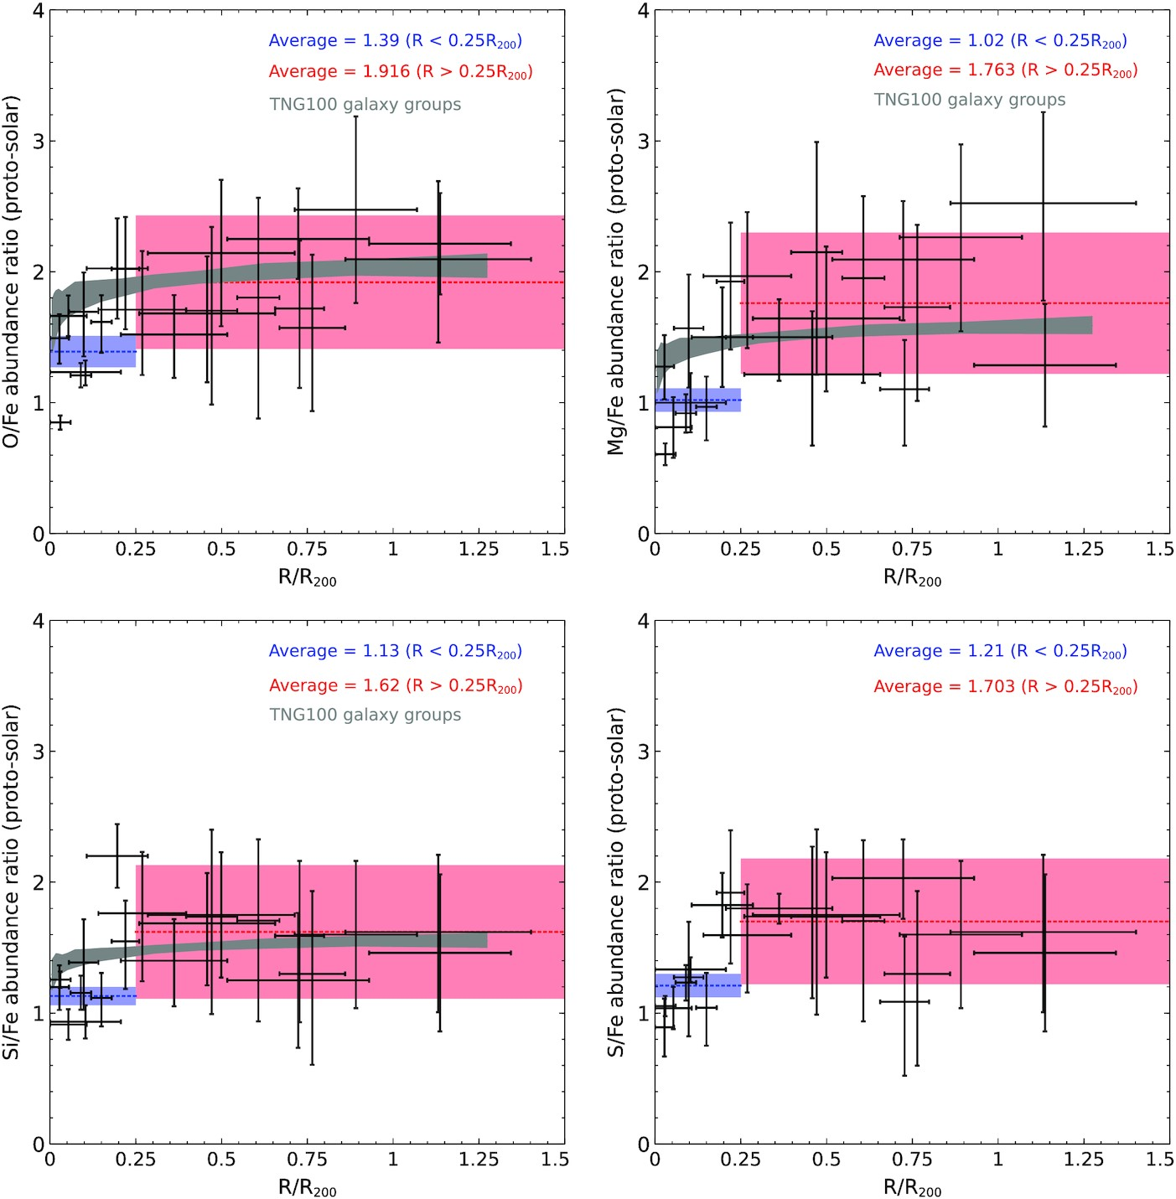

Figure 2. X/Fe ratios as a function of radius for individual metals. The red shaded region represents the average X/Fe ...
Notes:
Figure 2. X/Fe ratios as a function of radius for individual metals. The red shaded region represents the average X/Fe excluding central R < 0.25R200 region. The blue shaded region represents the average X/Fe for the central R < 0.25R200 region. The black shaded region shows the average X/Fe profile of 41 galaxy groups in TNG100.
Unless provided in the caption above, the following copyright applies to the content of this slide: © 2022 The Author(s) Published by Oxford University Press on behalf of Royal Astronomical SocietyThis article is published and distributed under the terms of the Oxford University Press, Standard Journals Publication Model (https://academic.oup.com/journals/pages/open_access/funder_policies/chorus/standard_publication_model)

