Slide 1
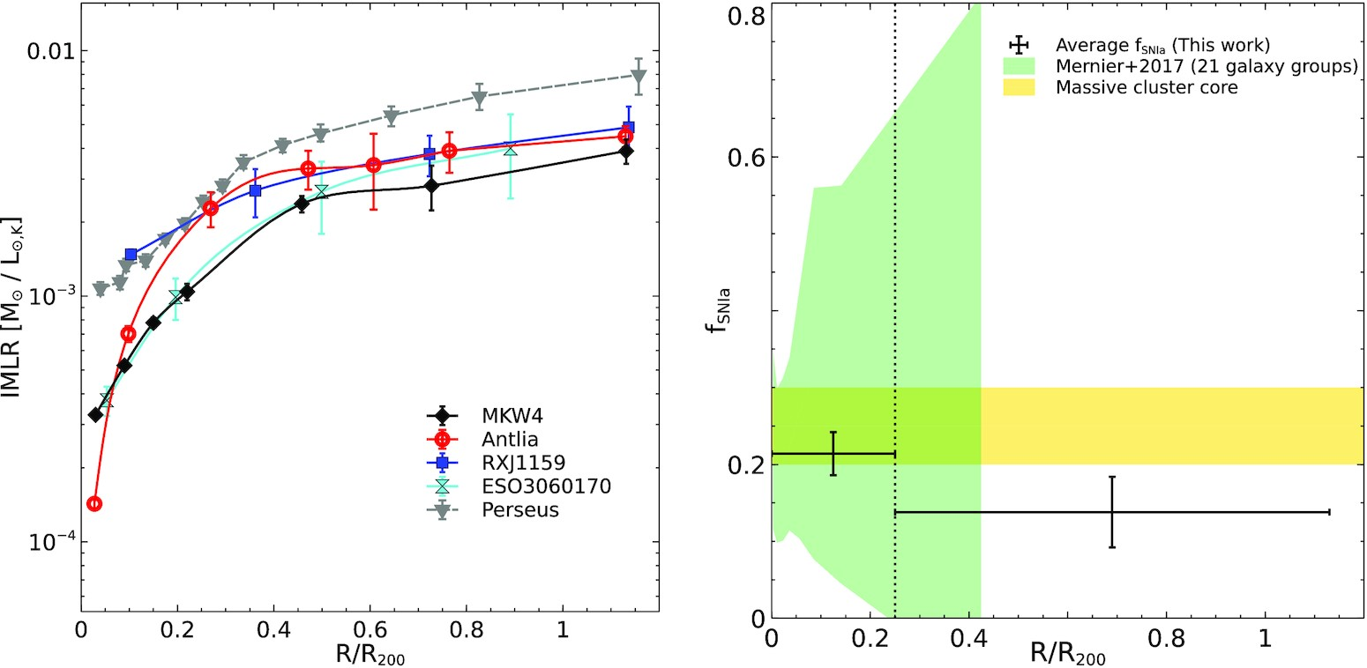

Figure 3. Left-hand panel: Radial profiles of IMLR with K_{s}-band luminosity for groups in our sample and the ...
Notes:
Figure 3. Left-hand panel: Radial profiles of IMLR with Ks-band luminosity for groups in our sample and the Perseus cluster. We obtain IMLR of Perseus from Matsushita et al. (2013). Right-hand panel: The averaged fSNIa for the four groups at R < 0.25R200 and 0.25R$_{200}\, \lt $R < R200. The green shaded region represents the measurement scatter obtained from a large number of groups (Mernier et al. 2017). The yellow shaded region indicates the limit of fSNIa at the massive cluster core (de Plaa et al. 2007). The vertical dotted line indicates 0.25R200.
Unless provided in the caption above, the following copyright applies to the content of this slide: © 2022 The Author(s) Published by Oxford University Press on behalf of Royal Astronomical SocietyThis article is published and distributed under the terms of the Oxford University Press, Standard Journals Publication Model (https://academic.oup.com/journals/pages/open_access/funder_policies/chorus/standard_publication_model)

