Slide 1
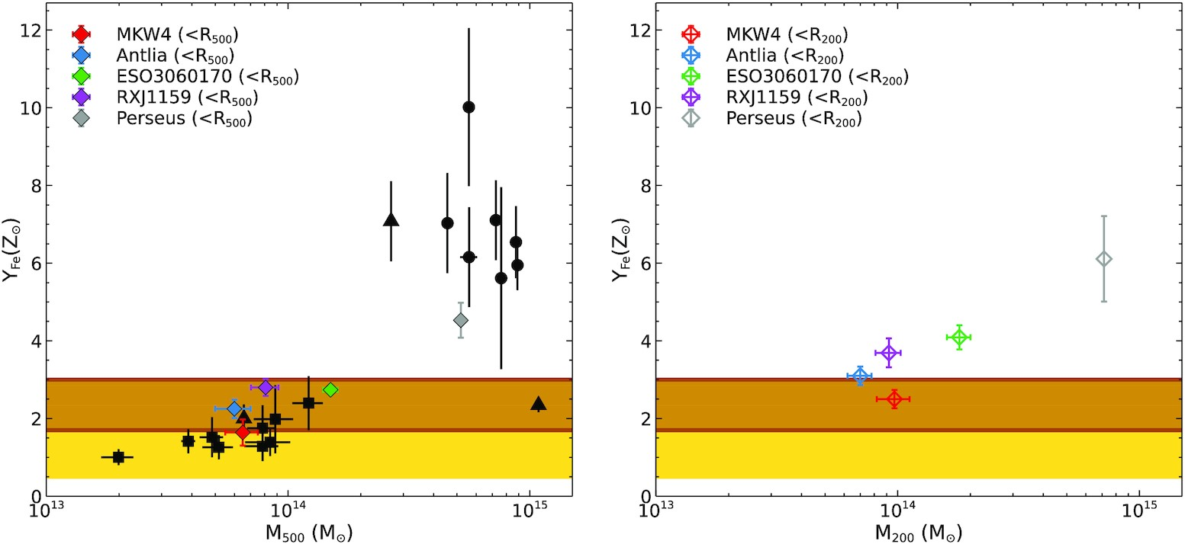

Figure 4. Left-hand panel: Effective Fe yield as a function of cluster/group mass within R₅₀₀. The circles ...
Notes:
Figure 4. Left-hand panel: Effective Fe yield as a function of cluster/group mass within R500. The circles represent Fe yield for the cluster in the sample of Ghizzardi et al. (2021), squares represent the groups in the sample of Renzini & Andreon (2014), triangles represent NGC 1550, Hydra A, and Coma in the sample of Sasaki, Matsushita & Sato (2014). The yellow shaded region shows the expected value estimated from the SN yields derived from Maoz & Graur (2017) and Renzini & Andreon (2014). The brown shaded region shows the expected value calculated assuming higher SNIa rate from Freundlich & Maoz (2021). Right-hand panel: Effective Fe yield as a function of cluster/group mass within R200.
Unless provided in the caption above, the following copyright applies to the content of this slide: © 2022 The Author(s) Published by Oxford University Press on behalf of Royal Astronomical SocietyThis article is published and distributed under the terms of the Oxford University Press, Standard Journals Publication Model (https://academic.oup.com/journals/pages/open_access/funder_policies/chorus/standard_publication_model)

