Slide 1
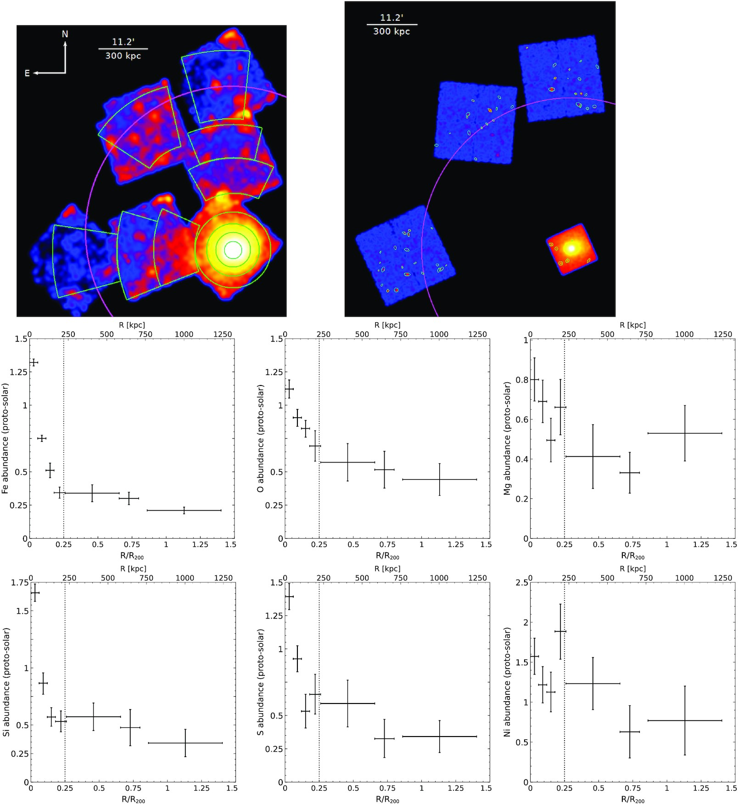

Figure A1. Top left-hand panel: NXB-subtracted and exposure-corrected mosaic Suzaku image of MWK4 in the 0.5–2 keV ...
Notes:
Figure A1. Top left-hand panel: NXB-subtracted and exposure-corrected mosaic Suzaku image of MWK4 in the 0.5–2 keV energy band. The magenta circle indicates R200. The green annuli represent the regions used for spectra extraction. Top right-hand panel: mosaic Chandra image of MKW4 in the 0.5–7.0 keV energy band. The resolved point sources are marked in green elliptical regions. Middle and Bottom panels: radial profiles of different elements from the group centre to the outskirts. The vertical dotted line indicate 0.25R200.
Unless provided in the caption above, the following copyright applies to the content of this slide: © 2022 The Author(s) Published by Oxford University Press on behalf of Royal Astronomical SocietyThis article is published and distributed under the terms of the Oxford University Press, Standard Journals Publication Model (https://academic.oup.com/journals/pages/open_access/funder_policies/chorus/standard_publication_model)

