Slide 1
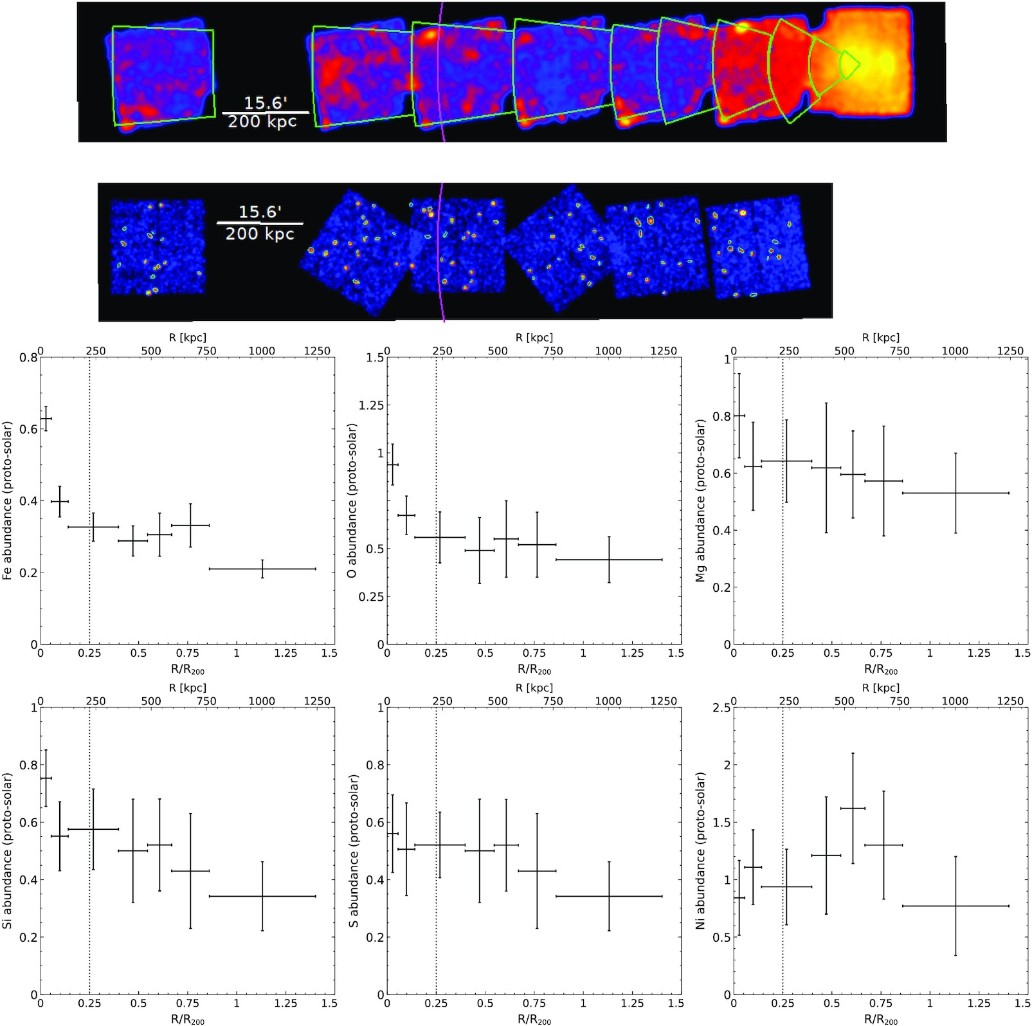

Figure A2. Antlia; same as Fig. A1.
Notes:
Figure A2. Antlia; same as Fig. A1.
Unless provided in the caption above, the following copyright applies to the content of this slide: © 2022 The Author(s) Published by Oxford University Press on behalf of Royal Astronomical SocietyThis article is published and distributed under the terms of the Oxford University Press, Standard Journals Publication Model (https://academic.oup.com/journals/pages/open_access/funder_policies/chorus/standard_publication_model)

