Slide 1




Denver Dev Day
October 28, 2016

Slide 2
An Introduction to ASP.NET Core
Denver Dev Day – October 28, 2016
Presented By Nathan Renner - Architect, RevGen Partners
Contact Information
Email: rennerizer@gmail.com / nrenner@revgen.com
Twitter: @rennerizer
GitHub: https://github.com/rennerizer

Slide 3
ASP.NET Core
An exploration of the latest Microsoft web framework

Slide 4
Session Agenda
ASP.NET Core Overview
Quick Start Walkthrough
Feature Exploration
Middleware
Client-Side Development

Slide 5


Microsoft Marketing
Totally Modular
Faster Development Cycle
OSS
Open Source with Contributions
Seamless transition from on-premises to cloud
Cross-Platform
Choose your Editors
and Tools
Fast
A new open-source and cross-platform framework for building modern cloud-based Web applications using .NET

Slide 6



Big Picture
Web
Forms
MVC
Web API
ASP.NET Core MVC
ASP.NET 4.6
ASP.NET Core 1.0
.NET Framework
.NET Core
Full .NET Framework for any scenario and
library support on Windows
Modular libraries & runtime optimized for server and cloud workloads

Slide 7
Key Questions
Does the current version of ASP.NET have problems?
ASP.NET Evolution
ASP.NET
Web Forms
Problems!
ASP.NET
MVC
Problems?
ASP.NET
Core
What are the main drivers behind the new framework?
Platform Accessibility
ASP.NET Pipeline Redesign
Development Ecosystem

Slide 8
ASP.NET Core Quick Start Walkthrough

Slide 9
Quick Start Intro
Walkthrough
Setting up an ASP.NET Core project in Visual Studio 2015
Prerequisites
Visual Studio 2015 w/ Update 3
.NET Core 1.0.1 - VS 2015 Tooling Preview 2

Slide 10
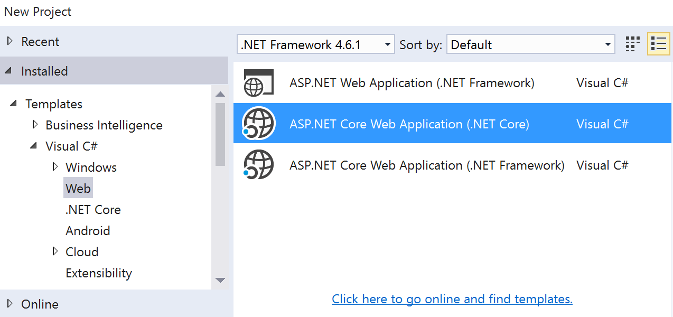
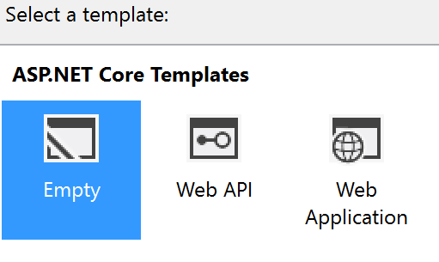
Project Creation
Select project type
(.NET Core)
Select project template
(Empty)
1
2

Slide 11
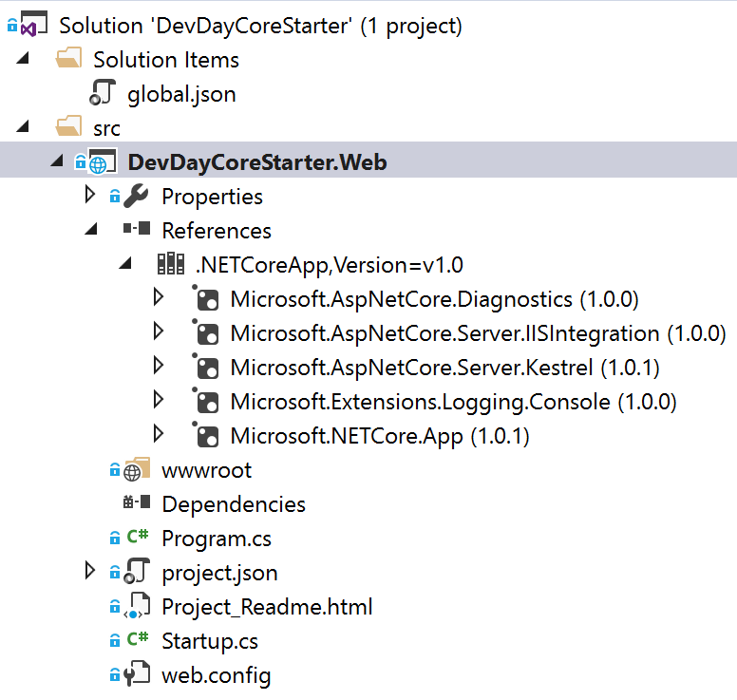
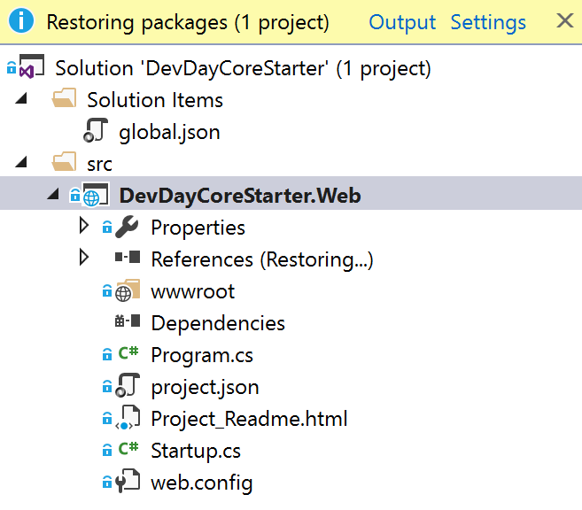
ASP.NET Core Packages
Get .NET Core Packages (Automatic)
3

Slide 12
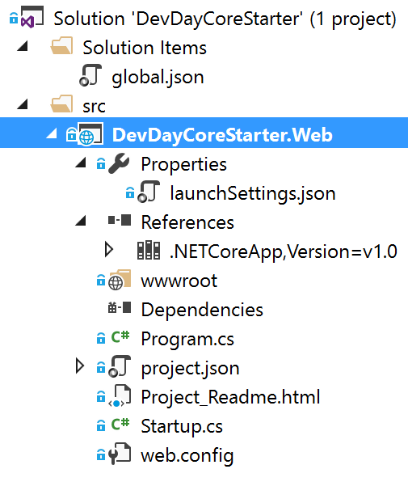
Files and Folders
Identifies projects and .NET execution environment
Defines application-specific settings
Holds static content (images, styles, scripts, etc.)
Configures the hosting platform for the application
Specifies configuration options, such as packages
Configures the application
Enables IIS deployment

Slide 13
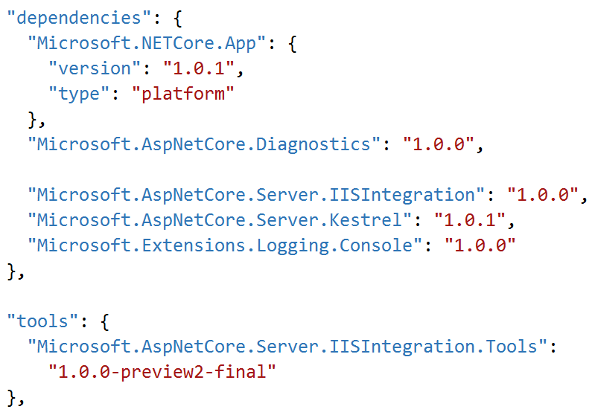
project.json
Configuration Options
Dependencies and Tools
Dependencies
Tools
Frameworks
Build Options
Runtime Options
Publish Options
Scripts

Slide 14
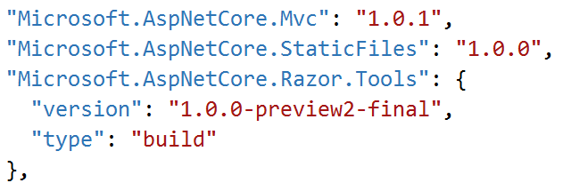
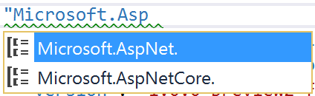
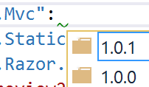
Add MVC References
Adding Packages (3 Methods)
4
Add 3 Dependencies (References)
NuGet Package Manager GUI
NuGet Package Manager Console
Directly to package.json
package.json features Intellisense!
5
Add 1 Tool

Slide 15
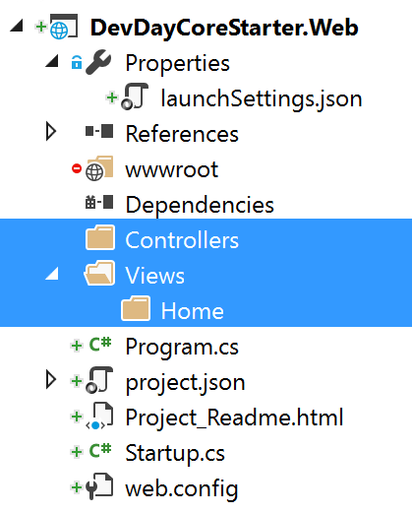
Build Out MVC Structure
6
Add (M)VC Folders
Controllers
Views
Views/Home

Slide 16
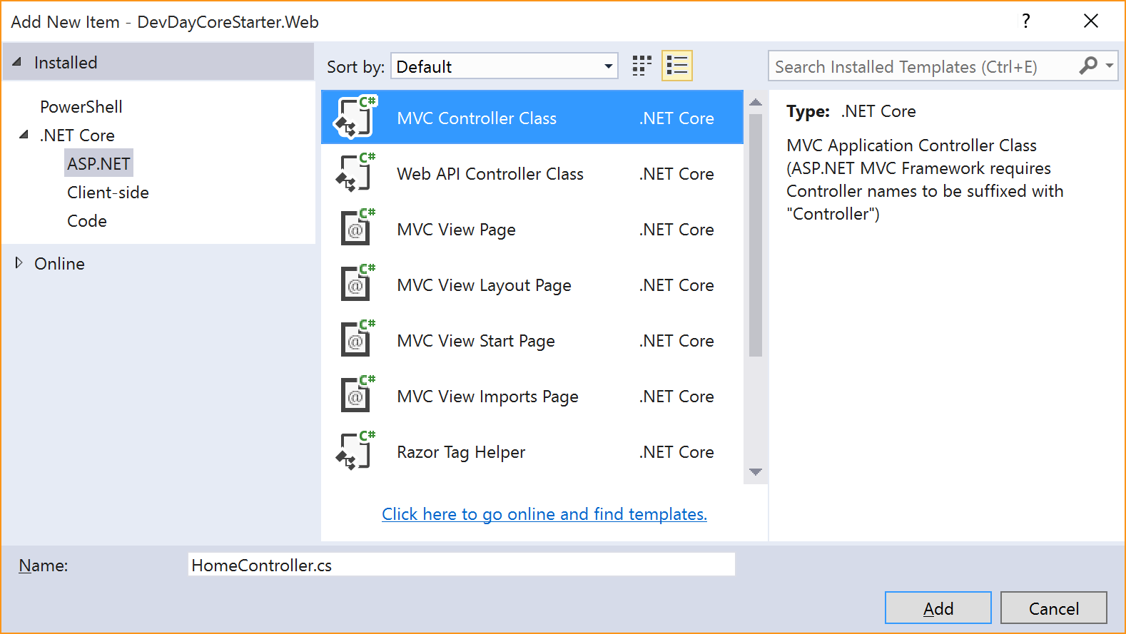

Add A Controller
Add HomeController
7

Slide 17
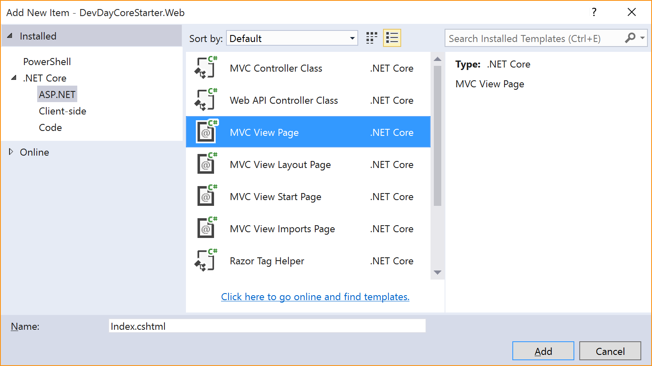
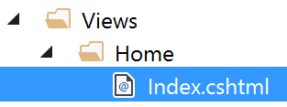
Add A View
Add Index.cshtml
7

Slide 18
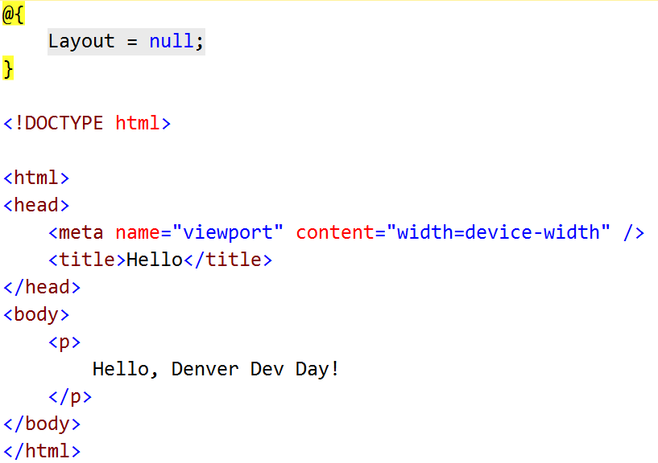
Add Content to View
Replace Existing View Content
8

Slide 19

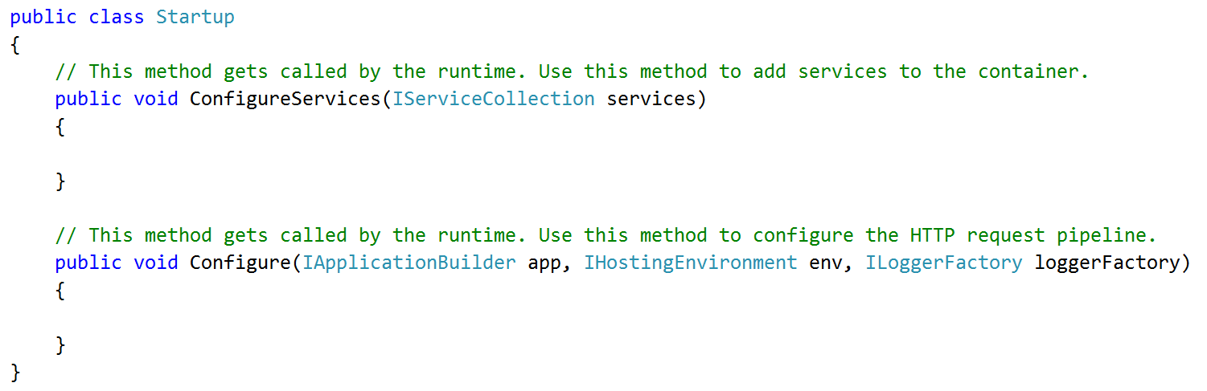
Startup
Program file uses the Startup file for the configuration of the application
(taken from program.cs)

Slide 20
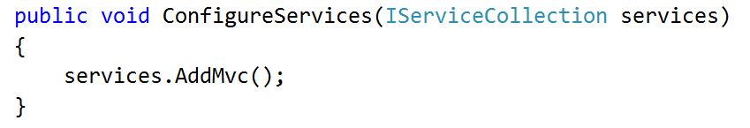
Add MVC Services
Add MVC Services to IServiceCollection
9

Slide 21
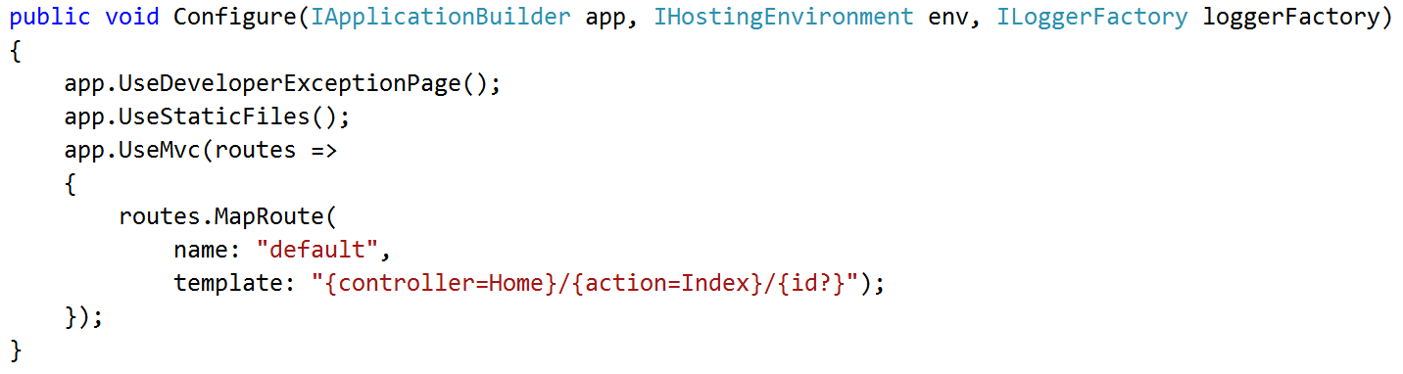
Configure HTTP Request Pipeline
10
Add Middleware Components

Slide 22
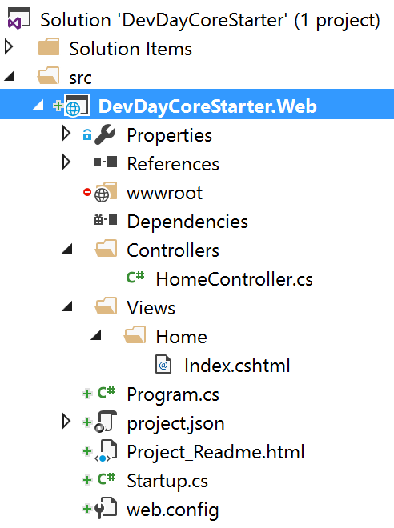
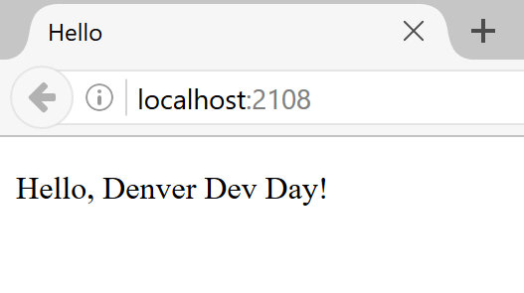
Run It!
Final Solution Explorer
F5

Slide 23
ASP.NET Core Feature Exploration

Slide 24
Middleware

Slide 25
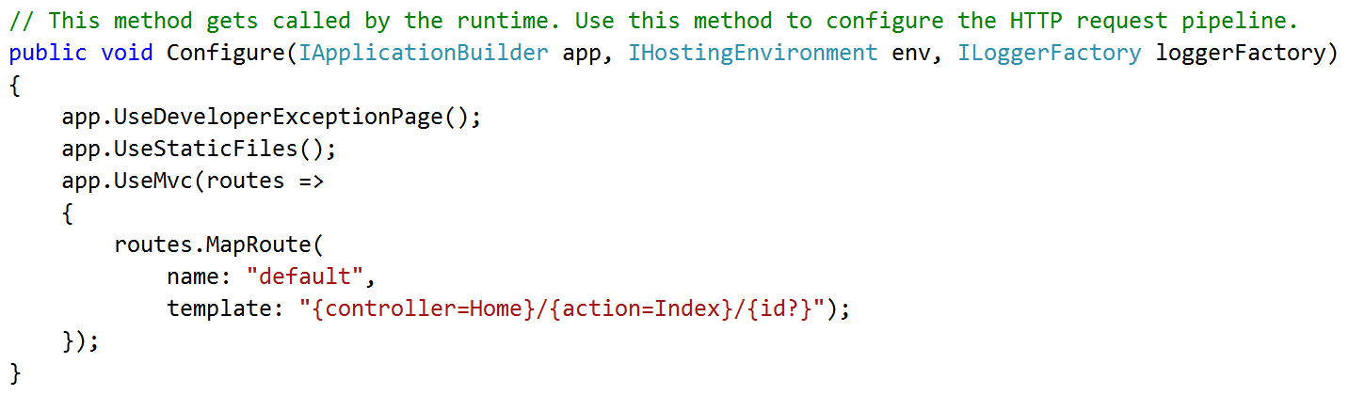
Middleware
Software components used to create the application’s request pipeline
Example Middleware

Slide 26
Legacy ASP.NET Pipeline
aspnet_wp.exe
IIS
HttpRuntime
HttpApplication
HttpModule1
HttpHandler
(PageHandler)
HttpModule2
HttpModule3
HttpModule4
HttpModule5
HttpContext

Slide 27
ASP.NET Core Pipeline
IIS
Kestrel
Application
Starts
Startup
Class
Initialized
Configure Services
Configure Pipeline
Request Handling Starts
Services
Created
Request
Pipeline
Created
HttpContext

Slide 28
Middleware Deep Dive
Middleware Characteristics
Middleware Flow
Form a Request Handling Chain
Handle both Requests & Responses
Components Called Consecutively
RequestDelegate Used To Invoke Next
MW1
MW2
MW3
Request
// Logic
next();
// Logic
next();
// Logic
// Logic
// Logic
Response

Slide 29
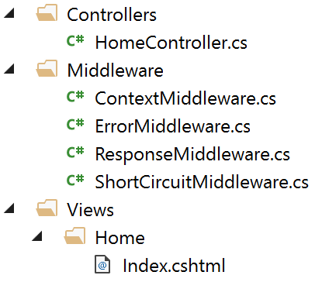
Middleware Scenarios
Modifying HttpContext
Adding Response Content
Handling
Errors
Short-Circuiting
Requests

Slide 30
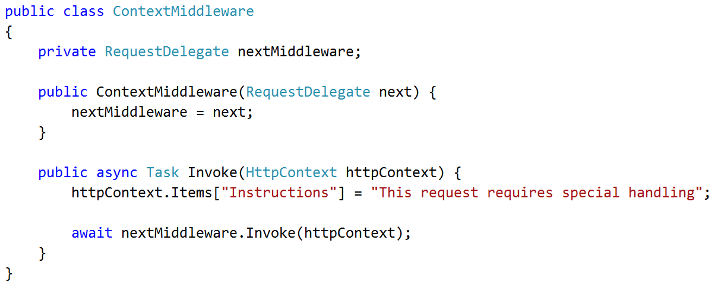
HttpContext Modification Middleware

Slide 31
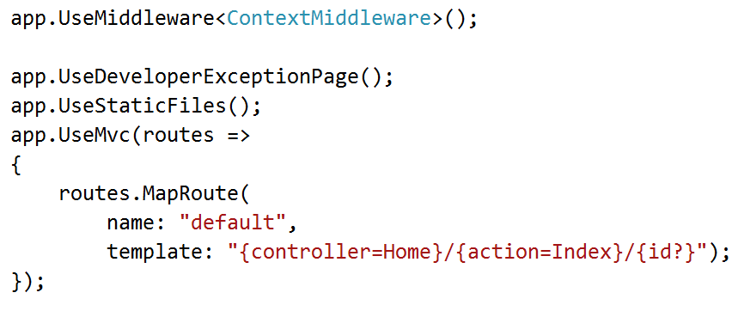
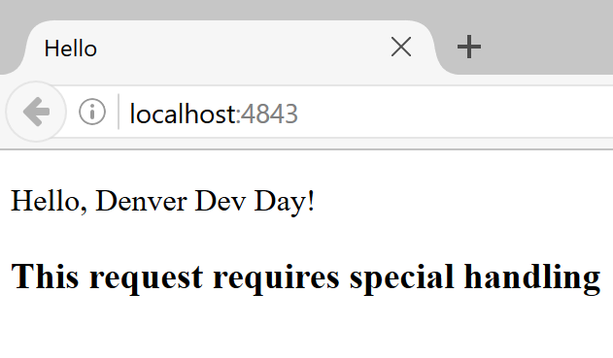
ContextMiddleware Configuration
F5

Slide 32
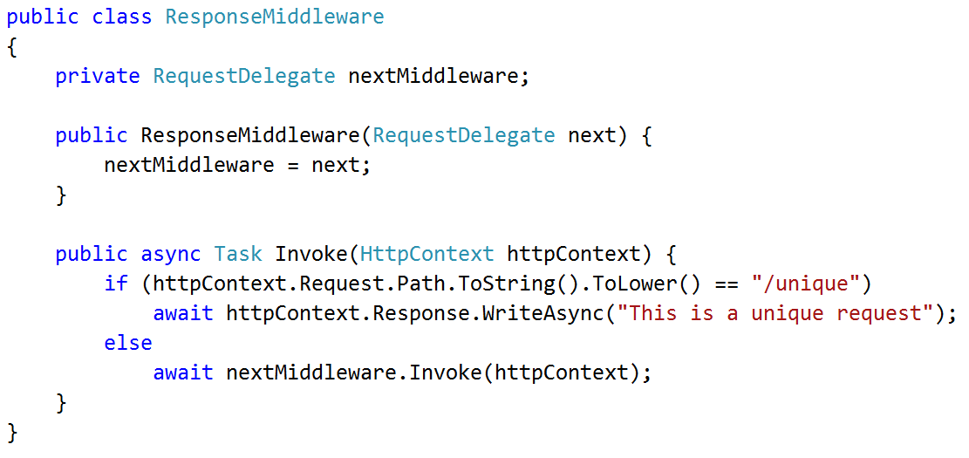
Response Modification Middleware

Slide 33
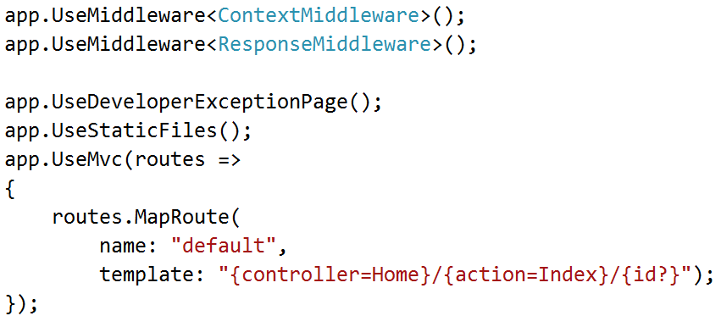
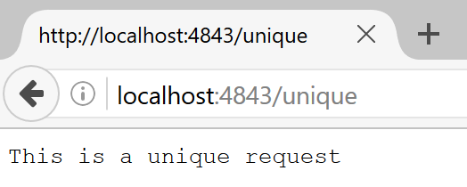
ResponseMiddleware Configuration
F5

Slide 34
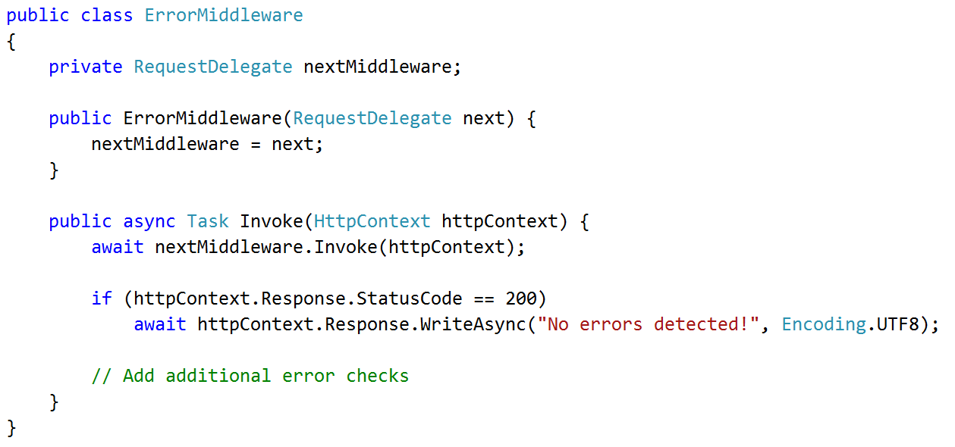
Error Handling Middleware

Slide 35
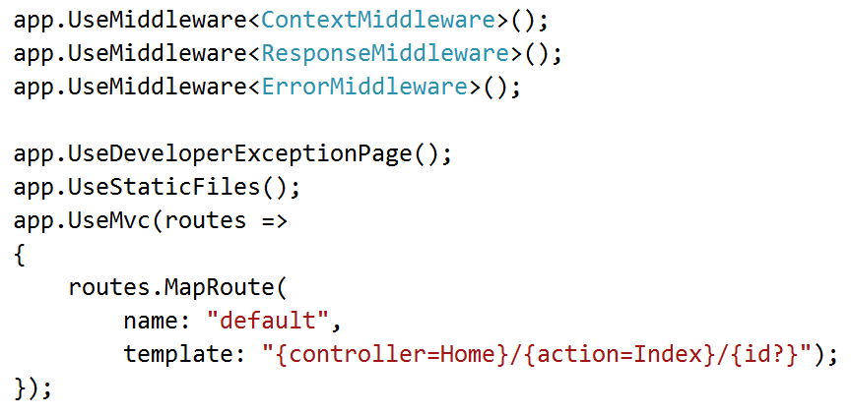
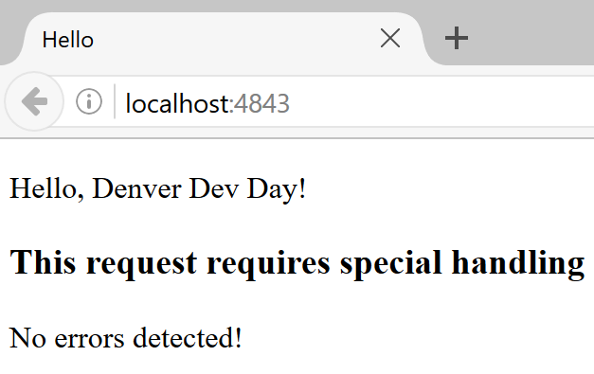
ErrorMiddleware Configuration
F5

Slide 36
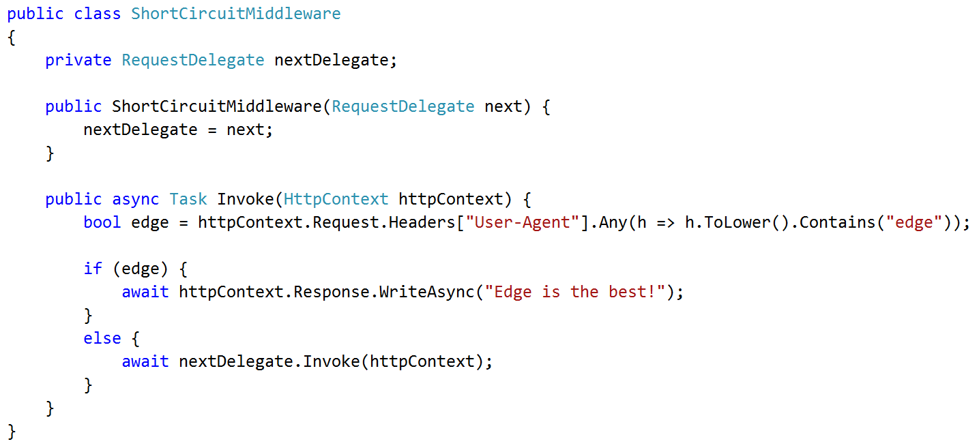
Short-Circuiting Middleware

Slide 37
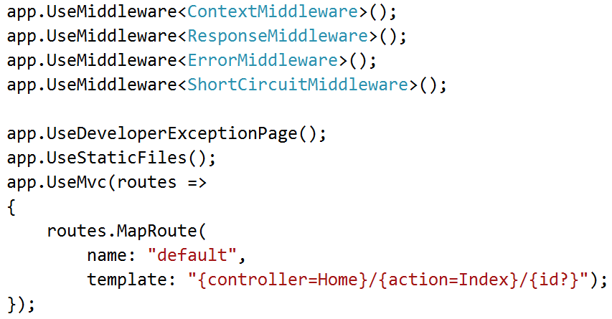
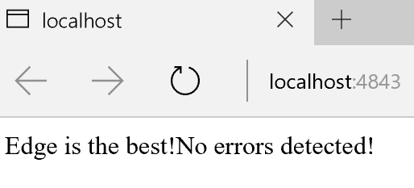
ShortCircuitMiddleware Configuration
Firefox
F5
Edge

Slide 38
Client-Side Development

Slide 39
Web Anarchy (libraries, packages, tools)
React
MUI
Wow
Node
Shine
Essence
NPM
Milligram
Select
Capture
Skeleton
Path
Blast
Ember
Bootstrap
Lazy
FN
Metro
Material
Grunt
KickStart
Hammer
Font Awesome
Aurelia
Lodash
Sticker
Consise
Zebra
Assemble
Knockout
Bulma
Angular
GifShot
Express
UIKit
Epoch
Boba
Dropzone
Notes:
Web technologies can come from companies, groups, or individuals. Startups can push tech out to the world rapidly.

Slide 40

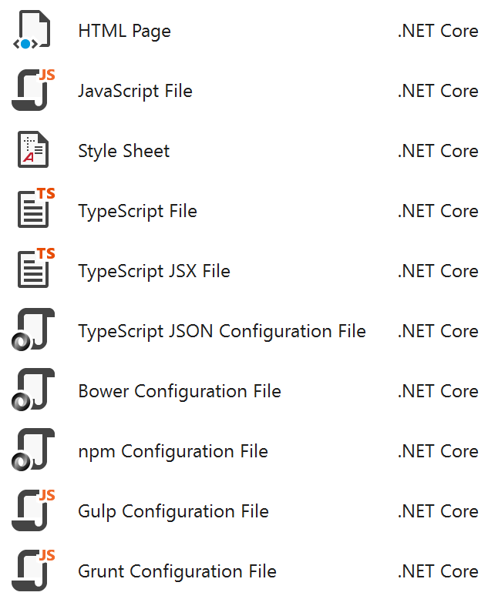
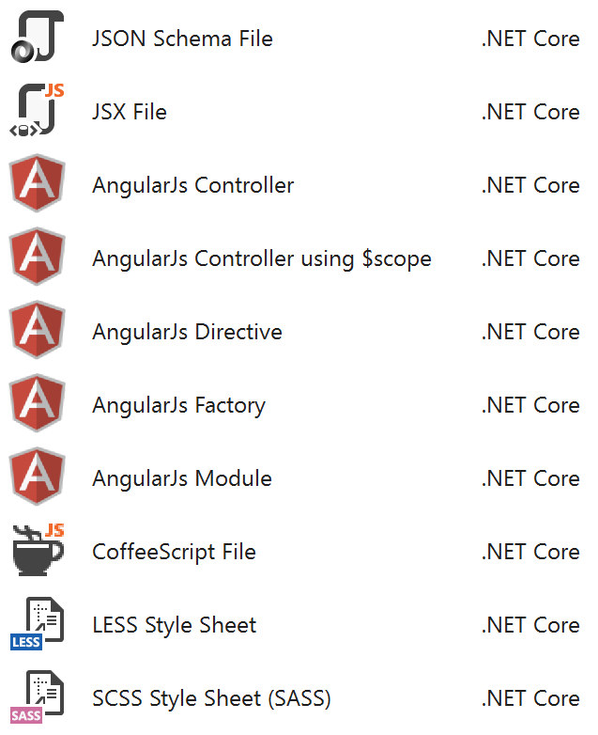
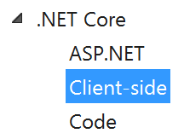
ASP.NET Core Client-Side Files

Slide 41
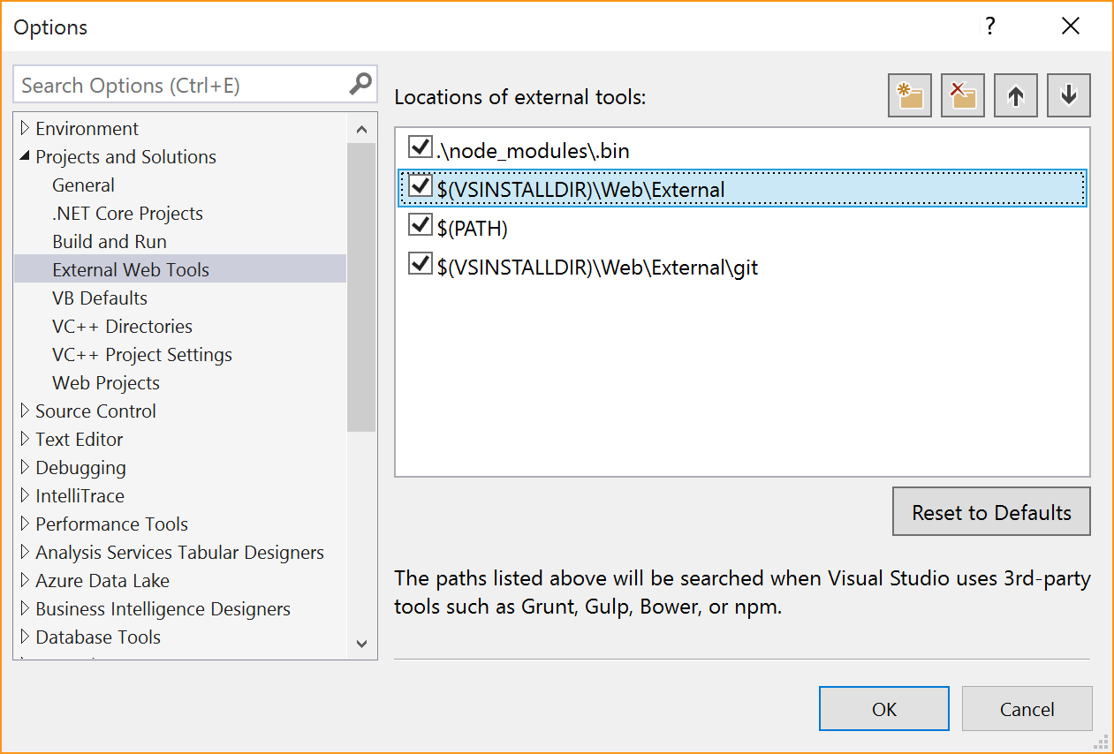
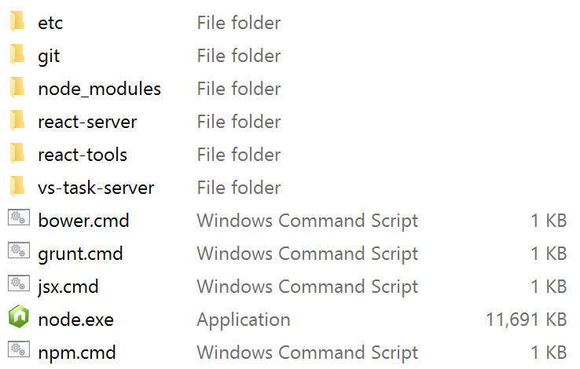
ASP.NET Core Client-Side Tooling
Tool Integration
External Tool Folder

Slide 42
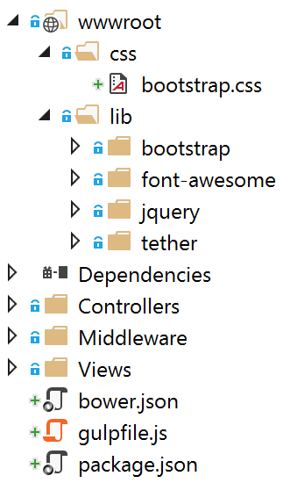
Client-Side Scenarios
Adding Bootstrap with Bower
Compile Bootstrap using SASS and Gulp

Slide 43

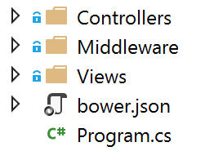
Add Bower
Bower
Add Bower Configuration File
Web Focused Package Manager
Analogous to NuGet

Slide 44
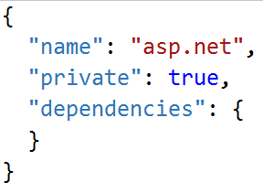
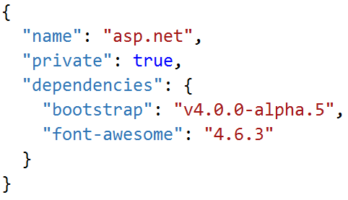

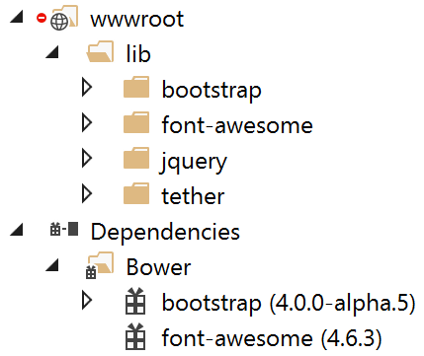
Add Bootstrap Dependency
bower.json

Slide 45
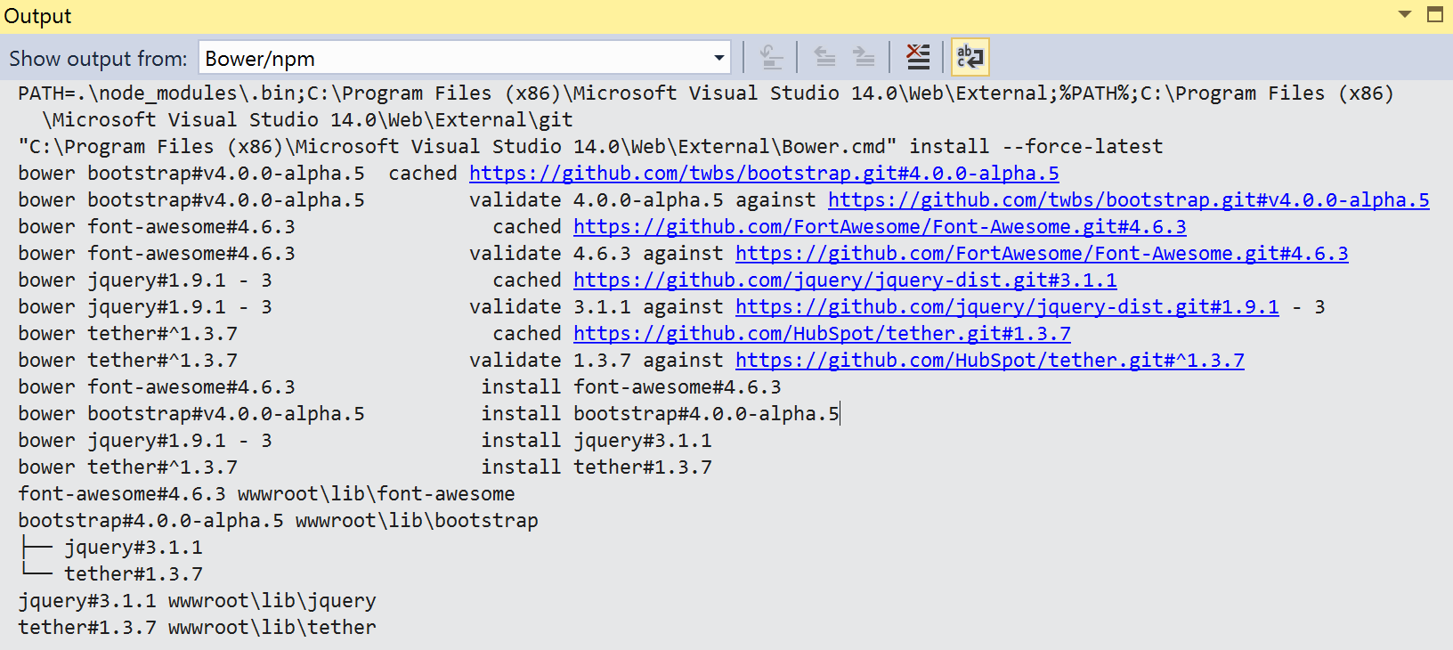
Bower (Behind The Scenes)

Slide 46

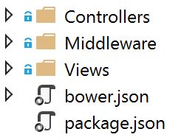
Add NPM (Node Package Manager)
NPM
Add NPM Configuration File
JavaScript Focused Package Manager
Manages Functionally Rich Libraries

Slide 47
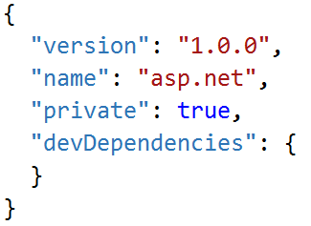
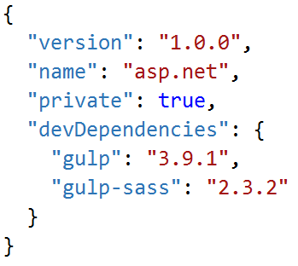
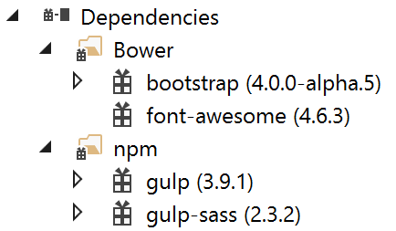
Add Gulp Dependency
package.json

Slide 48
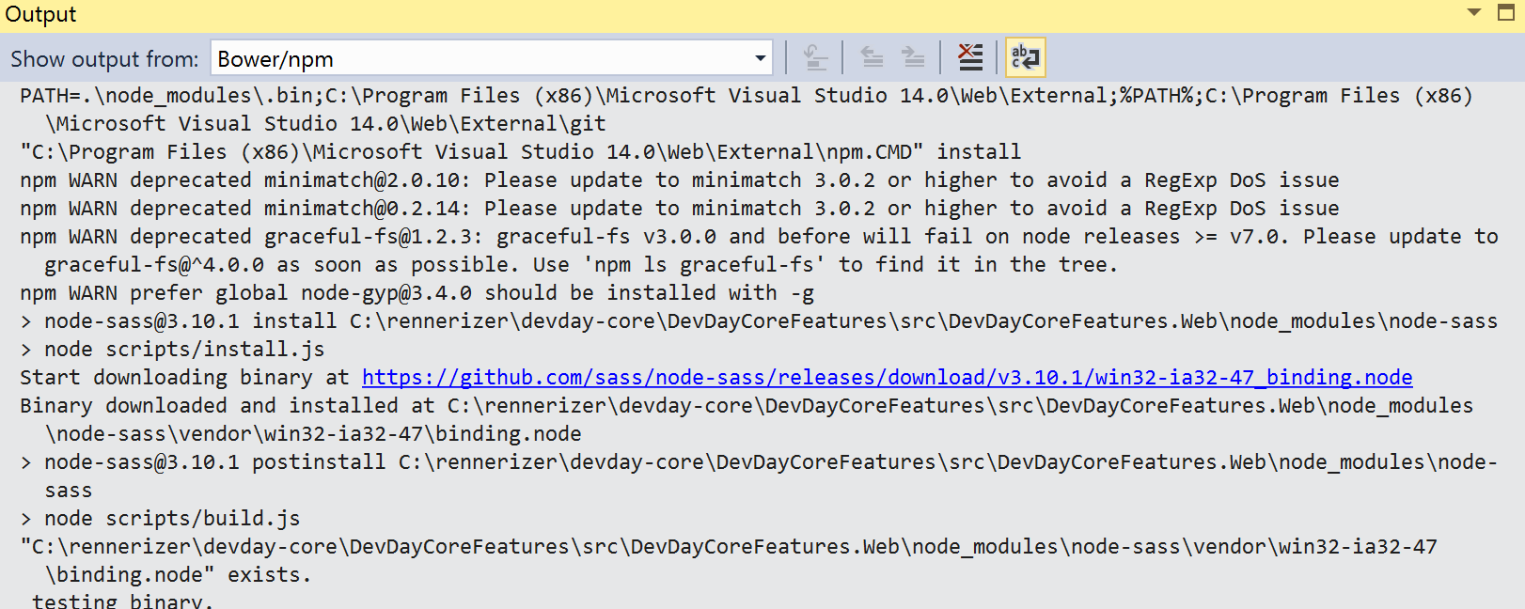
NPM (Behind The Scenes)

Slide 49

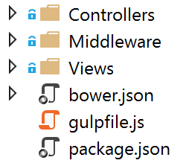
Add Gulp
Gulp
Add Gulp Configuration File
Automated Task Running Tool
Performs Various Tasks
Bundle JavaScript & CSS Files
Minify JavaScript & CSS Files
Compile SASS Files to CSS
Compile TypeScript to JavaScript
Manage Files and Folders

Slide 50

Modify gulpfile.js

Slide 51


Task Runner Explorer

Slide 52


Execute Gulp Task

Slide 53
Slides & Source Code
https://github.com/rennerizer/devday-core
Code - DevDayCoreStarter
Code – DevDayCoreFeatures
Deck - DDD-ASPNET-Core-102016-vFinal.pptx

