Slide 1






w e l c o m e
Denver Dev Day - June 23, 2017
"Donations by YOU, Denver Dev Day attendees,
are provided to support KidsTek, http://kidstek.org - Thank you!"

Slide 2
Modern JavaScript Development
Denver Dev Day – June 23, 2017
Presented By Nathan Renner - Senior Architect, RevGen Partners
Contact Information
Email: rennerizer@gmail.com / nrenner@revgen.com
Twitter: @rennerizer
GitHub: https://github.com/rennerizer

Slide 3
Modern JavaScript Development
Always code as if the guy who ends up maintaining your code will be a violent psychopath who knows where you live
Lose the quote or find a better one… this isn’t about coding standards
- John Woods
Notes:
Began doing Angular development… Soon asked quite a few questions… What are all of these dependencies? Am I even writing JavaScript? What is happening?... So I went out and found the answers.

Slide 4
NG-Code Example

Slide 5
Outline
Web Development Areas
Ecosystem Overload
JavaScript Evolution
Transpiler Overview
Framework Insights
Self-Education (Maybe)

Slide 6
Web Development Areas
Web
Design
Web
Functionality
Transpilers
Runtime
Support
Development
Support
HTML
JavaScript
Module
Loaders
Task
Runners
CSS
Libraries
Bundling & Packaging
Test
Tools
Frameworks
Debugging
Tools
CLI & Scaffolding

Slide 7
Ecosystem Overload
Too many choices can overwhelm us and cause us to not choose at all.
- Sheena Iyengar
JavaScript Standards
Libraries
Transpilers
ES 5 (2009)
ES 6 (2015)
ES 7 (2016)
JQuery
D3
RxJS
TypeScript
Dart
Babel
3
100+
40+
Frameworks
Operational Support
Angular
Ext JS
Knockout
Module Loaders
Task Runners
Testing
20+
100+

Slide 8
JavaScript
Level 1
Variables
Function Declarations
Object Notation
DOM
Events
Function Scopes
Level 3
Prototypes
Inheritance
Closures
Memoization
Revealing Module Pattern
Lexical Environments
Level 2
Dynamic Properties
Constructors
Function Contexts
Execution Contexts
Function Expressions
Private Variables

Slide 9
ES 2015
Variables & Functions
let / const
Rest & Default Parameters
Arrow Functions
Spread Operator
Promises
Generators
for…of
Proxies
Tools
Objects
Classes
Modules
Maps & Sets
Array Methods

Slide 10
Modern JavaScript
Level 1
Variables
Function Declarations
Object Notation
DOM
Events
Function Scopes
Level 3
Prototypes
Inheritance
Closures
Memoization
Revealing Module Pattern
Lexical Environments
Classes
Promises
Level 2
Dynamic Properties
Constructors
Function Contexts
Execution Contexts
Function Expressions
Private Variables
let / const
Rest & Default Parameters
Generators
Proxies
Array Methods
for…of
Arrow Functions
Spread Operator
Maps & Sets
Modules

Slide 11
Using Modern JavaScript Today
Only Target Modern Browsers
Use shim libraries
Utilize Transpilers

Slide 12

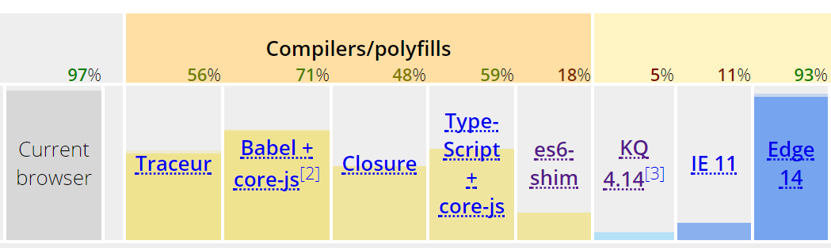
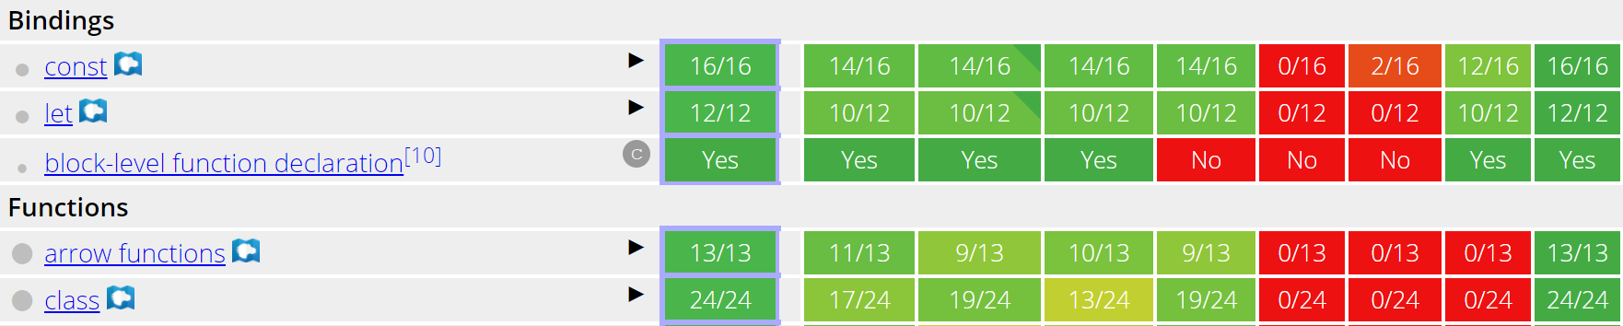
ECMAScript Compatibility
https://kangax.github.io/compat-table/es6/
1
2
3

Slide 13
Transpilers
A type of compiler that translates one language into another language at the same level of abstraction
Reasons For Usage
Potential Concerns
Reduce Language Limitations
Add Language Enhancements
Provide Future Language Features Now
Additional Complexity
Transpilation Process
Support Files
Resource Training

Slide 14
TypeScript
Features
Configuration Options
Superset of JavaScript
Supports ES 2015 features
Transpiler is a node.js package
Uses tsconfig.json for configuration
TypeScript is TypeScript
JavaScript standard specification
Source & Target file locations
Mapping files
Module specification

Slide 15
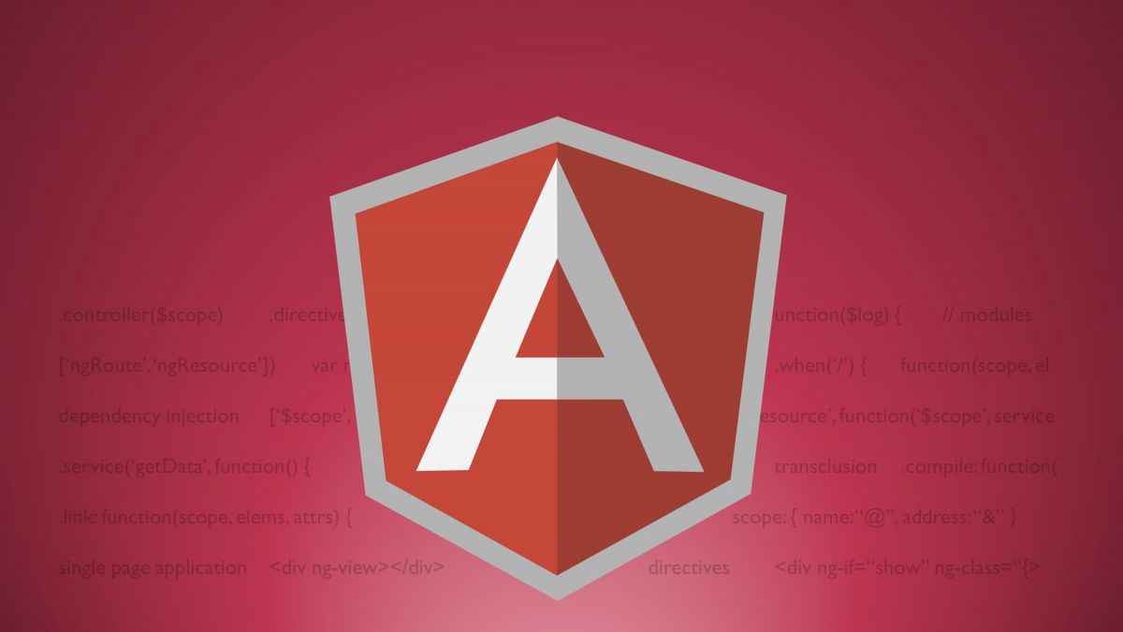











Frameworks
Our JavaScript framework will solve all of your development problems. It has so many features that it is completely future proof.
- No one ever

Slide 16
Future JavaScript Architecture
Server-side Technology
Client (Browser)
Support Libraries
ASP.NET
Core
MVC
Web API
Domain Model
Business Logic
Application
Services
Framework
Infrastructure

Slide 17
Legacy & Extras
Key Questions
Implementation Checklist
What problem does this framework solve?
What are the drawbacks?
What additional dependencies are needed?
What is the learning curve?
Can a new developer provide maintenance?
Build a demo
Show it to your team
Discuss the pros & cons
Provide team with training directions

Slide 18
Framework Features
List all of the features that frameworks provide
Add backbone, polymer, knockout, and mercury

Slide 19
Guidelines
Tackle one piece of the puzzle at a time
Don’t make a decision based on hype (quantify your reasoning)
Identify maintenance and resource concerns
Share it with your team, but beware anarchists!

Slide 20
Technical Skill Acquisition
Internet Search
Videos
Blogs
Online
Docs
Books
Stack Overflow
Sessions
Immediate Answers
Educational Investment
Shallow Understanding
Deeper Understanding

Slide 21
Thank You
Development Resources
Pluralsight Videos
JavaScript Fundamentals for ES6, Scott Allen & Joe Eames
Getting Started with Reactive Programming Using RxJS, Scott Allen
JavaScript Module Fundamentals, Brice Wilson
Practical Design Patterns in JavaScript, Jonathan Mills
Books
Secrets of the JavaScript Ninja, John Resig
Effective JavaScript, David Herman

