Slide 1






w e l c o m e
Denver Dev Day - June 23, 2017
"Donations by YOU, Denver Dev Day attendees,
are provided to support KidsTek, http://kidstek.org - Thank you!"

Slide 2
Modern JavaScript Development
Denver Dev Day – June 23, 2017
Nathan Renner - Senior Architect, RevGen Partners
Contact Information
Email: rennerizer@gmail.com / nrenner@revgen.com
Twitter: @rennerizer
GitHub: https://github.com/rennerizer

Slide 3
Modern JavaScript Development
If there is no struggle, there is no progress.
- Frederick Douglass
Notes:
Began doing Angular development… Soon asked quite a few questions… What are all of these dependencies? Am I even writing JavaScript? What is happening?... So I went out and found the answers.

Slide 4
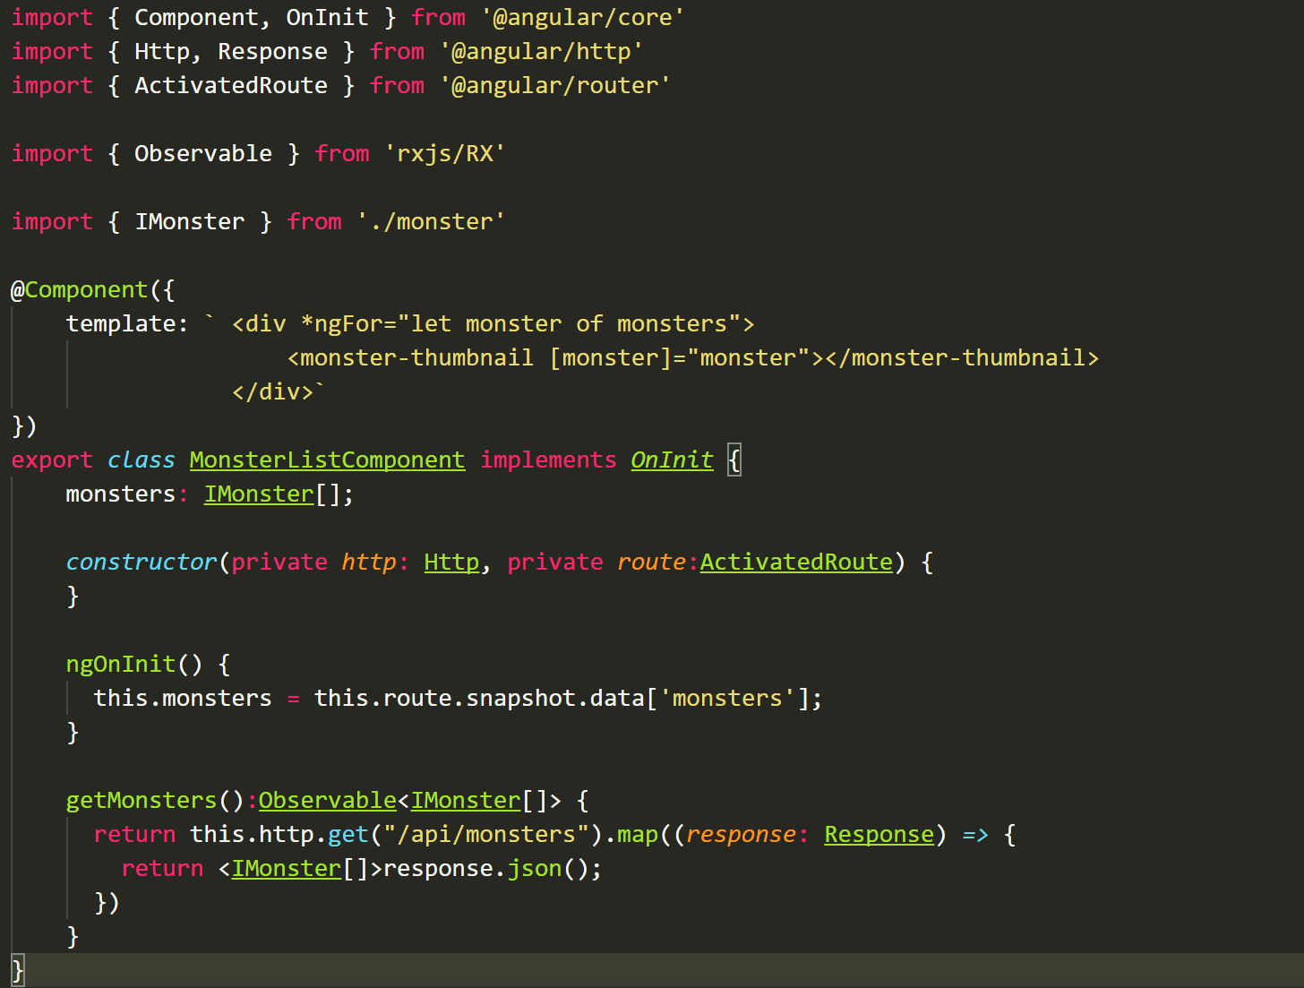

Slide 5
Outline
Web Development Areas
Ecosystem Overload
JavaScript Evolution
Transpiler Overview
Framework Insights

Slide 6
Web Development Areas
Web
Design
Web
Functionality
Transpilers
Runtime
Support
Development
Support
HTML
JavaScript
Module
Loaders
Task
Runners
CSS
Libraries
Bundling & Packaging
Test
Tools
Frameworks
Debugging
Tools
CLI & Scaffolding

Slide 7
Ecosystem Overload
In a world where we have too many choices and too little time, the obvious thing to do is just ignore stuff.
- Seth Godin
JavaScript Standards
Libraries
Transpilers
ES 5 (2009)
ES 6 (2015)
ES 7 (2016)
JQuery
D3
RxJS
TypeScript
Dart
Babel
3
100+
40+
Frameworks
Operational Support
Angular
Ext JS
Knockout
Module Loaders
Task Runners
Testing
20+
100+

Slide 8
JavaScript
Level 1
Variables
Function Declarations
Object Notation
DOM
Events
Function Scopes
Level 3
Prototypes
Inheritance
Closures
Memoization
Revealing Module Pattern
Lexical Environments
Level 2
Dynamic Properties
Constructors
Function Contexts
Execution Contexts
Function Expressions
Private Variables

Slide 9
ES 2015
Variables & Functions
let / const
Rest & Default Parameters
Arrow Functions
Spread Operator
Promises
Generators
for…of
Proxies
Tools
Objects
Classes
Modules
Maps & Sets
Array Methods

Slide 10
Modern JavaScript
Level 1
Variables
Function Declarations
Object Notation
DOM
Events
Function Scopes
Level 3
Prototypes
Inheritance
Closures
Memoization
Revealing Module Pattern
Lexical Environments
Classes
Promises
Level 2
Dynamic Properties
Constructors
Function Contexts
Execution Contexts
Function Expressions
Private Variables
let / const
Rest & Default Parameters
Generators
Proxies
Array Methods
for…of
Arrow Functions
Spread Operator
Maps & Sets
Modules

Slide 11
Using Modern JavaScript Today
Only Target Modern Browsers
Use shim libraries
Utilize Transpilers

Slide 12

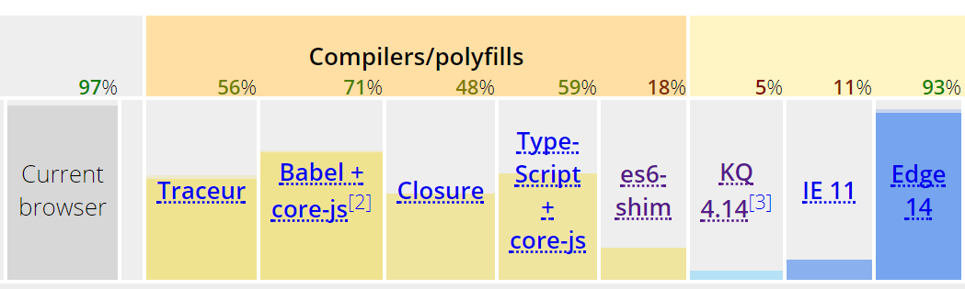
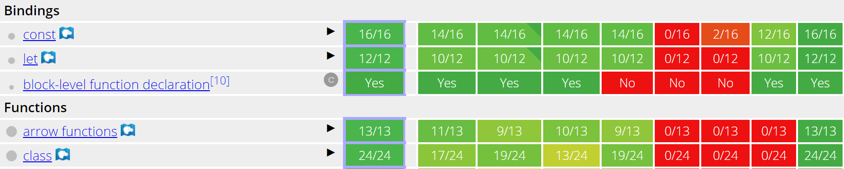
ECMAScript Compatibility
https://kangax.github.io/compat-table/es6/
1
2
3

Slide 13
Transpilers
A type of compiler that translates one language into another language at the same level of abstraction
Reasons For Usage
Potential Concerns
Reduce Language Limitations
Add Language Enhancements
Provide Future Language Features Now
Additional Complexity
Transpilation Process
Support Files
Resource Training

Slide 14
TypeScript
Features
Configuration Options
Superset of JavaScript
Supports ES 2015 features
Transpiler is a node.js package
Uses tsconfig.json for configuration
Utilizes type definition files
TypeScript is TypeScript
JavaScript standard specification
Source & Target file locations
Mapping files
Module specification

Slide 15
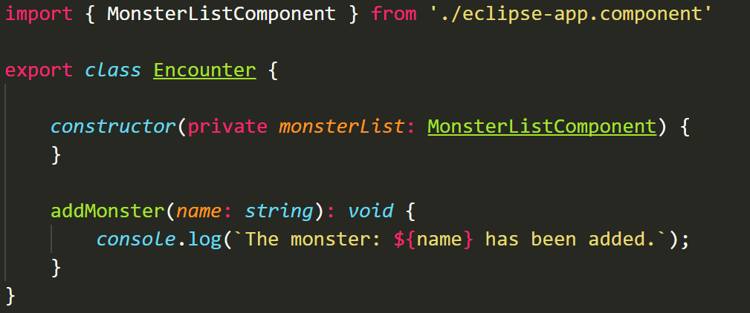
TypeScript Code Example

Slide 16
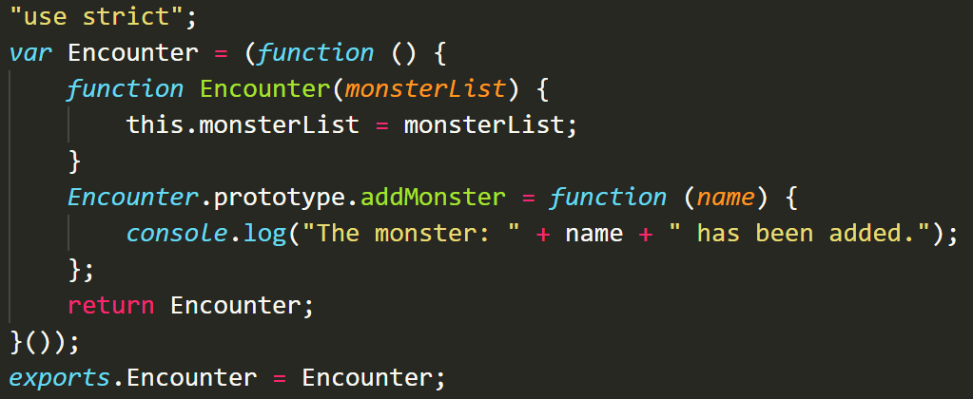
Resulting JavaScript

Slide 17
Other Transpilers
Babel
Traceur
Performs syntax transformations
Utilizes Plugins
Can be used as a polyfill
Focuses on ES6 to ES5 conversions
Legacy browser support
Closure
Dart
Performs basic code checks
Reduces file size
Java application
Created to replace JavaScript
Uses AngularDart language

Slide 18
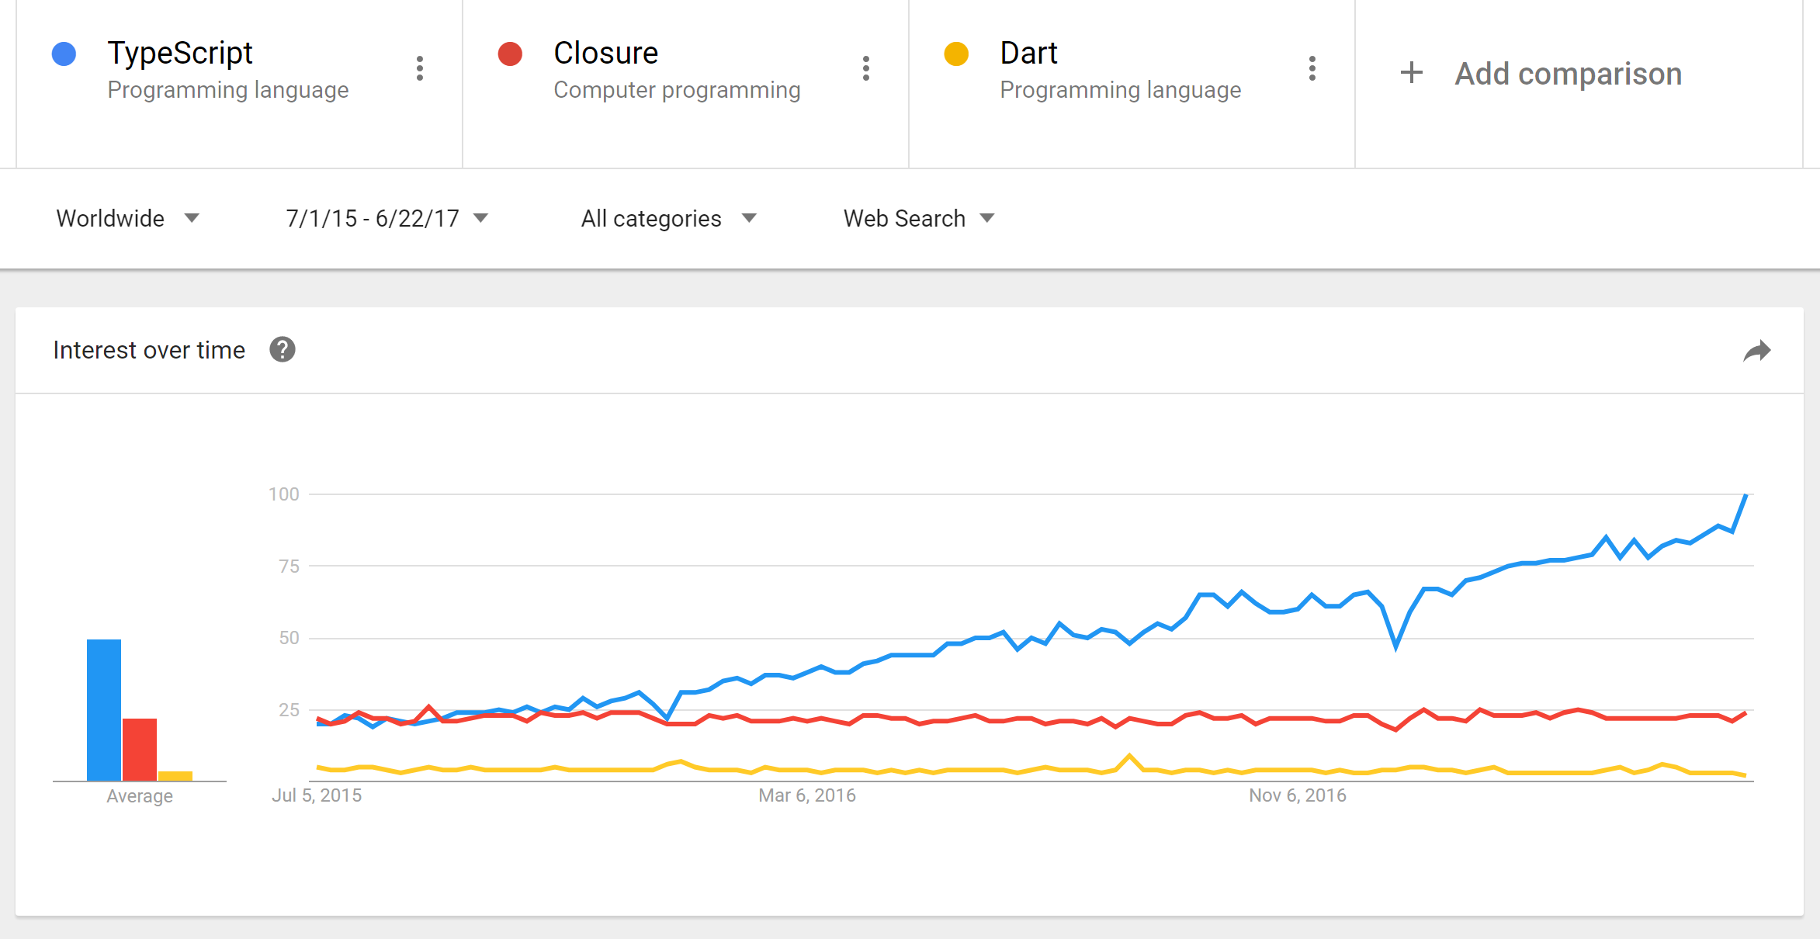

Slide 19
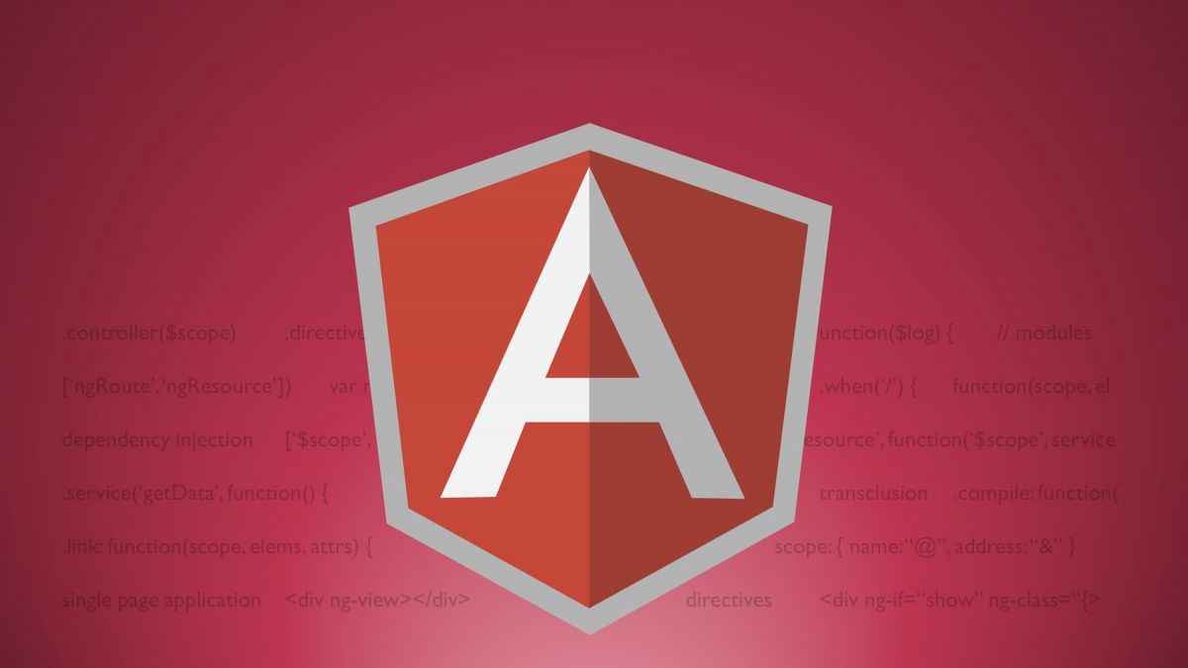











Frameworks
Our JavaScript framework will solve all of your development problems. It has so many features that it is completely future proof.
- No one ever

Slide 20
Key Framework Questions
What problem does the framework solve?
Is the framework focused on HTML, JavaScript, or a balance?
How flexible, or opinionated, is the framework?
How is the code organized (business logic, views, etc.)?
What is the learning curve?

Slide 21
Implementing A Framework
Build a demo
Show it to your team
Discuss the benefits and drawbacks
Provide team members with training direction

Slide 22
Future JavaScript Architecture
Server-side Technology
Client (Browser)
Support Libraries
ASP.NET
Core
MVC
Web API
Domain Model
Business Logic
Application
Services
Framework
Infrastructure

Slide 23
Development Resources
Pluralsight Videos
rapid-es6-training
reactive-programming-rxjs-getting-started
javascript-module-fundamentals
javascript-practical-design-patterns
typescript-getting-started
angular-fundamentals
react-js-getting-started
Aurelia-fundamentals
Books
Secrets of the JavaScript Ninja
Effective JavaScript
Pro Angular

Slide 24
Thank You
Presentation Deck
https://github.com/rennerizer/devday-javascript/blob/master/Modern-JavaScript-Development-062017_vFinal-DDD.pptx
Contact Information
Email: rennerizer@gmail.com / nrenner@revgen.com
Twitter: @rennerizer
GitHub: https://github.com/rennerizer

