Slide 1
Agentic Architecture Framework
Draft – For Discussion Purposes Only

Slide 2
Helix Vision & Philosophy
Helix is Capital Group’s AWS‑based integrated cloud platform that delivers a first‑class developer experience through built‑in security, everything‑as‑code, flexible design, and a cohesive suite of platform services.
Vision - Helix is described as “the cloud reimagined”: a single, streamlined platform where the complexity of modern cloud application development is abstracted away. The vision emphasizes:
Empowering rapid development without cognitive burden
Making security, observability, and resiliency foundational
Enabling developers to build applications that are both innovative and resilient
Design Philosophy – Helix is designed around four explicit core principles:
Developer Experience - Developers should focus on building applications, not on environment setup or figuring out security and resiliency concerns.
Security - Security is a top priority. Helix commits to best practices and provides tools and services to help developers build secure applications.
Everything‑as‑Code - Application logic, infrastructure, pipelines, and documentation are defined as version‑controlled artifacts, enabling automation, collaboration, and use of familiar developer workflows.
Flexibility - Common tasks are made easy while still allowing room for innovation and customization.
The information above is based on the Helix Vision & Philosophy

Slide 3
Agentic Archetypes
With Sub-Type
Group | # | Archetype | Core Job | Sub-types
A · Content & Knowledge Synthesis | 1 | Content Generation | Create or rewrite content — text, code, images, audio, video | Text generation · Image/video/audio generation · Template & draft creation
 | 2 | Summarization & Extraction | Condense information or extract structured data from unstructured inputs | Text transformation · Document analysis
 | 3 | Grounded Q&A | Answer questions from a curated knowledge base with citations | Knowledge-base Q&A · Explanation & education
 | 4 | Research & Synthesis | Produce analytical artifacts by synthesizing information from many sources | Multi-source retrieval & synthesis · Research assistance
B · Insight & Decision Intelligence | 5 | Data Interpretation & Analytics | Explain trends and anomalies from structured data; trigger automated responses | Data interpretation · Dashboard narration · Automated response
 | 6 | Recommendation & Personalization | Tailor content, workflows, or experiences to a user or context | Content personalization · Recommendation generation · Learning & skill development
 | 7 | Simulation & Synthetic Data | Generate datasets, scenarios, or environments for training and testing | Synthetic dataset creation · Adversarial testing · Scenario analysis
C · Process & Task Automation | 8 | Software Dev Acceleration | Assist with coding, testing, review, and debugging across the SDLC | Code generation · Code review · Refactoring · Doc generation · Debugging
 | 9 | Structured Workflow Automation | Automate deterministic business processes using GenAI for NLU/NLG steps | Workflow automation · Writing assistance
 | 10 | Agentic Task Automation | Plan and execute multi-step, dynamic tasks by orchestrating tools | Interactive task execution · Autonomous agents · Personal productivity agents
 | 11 | Ops & Monitoring Copilot | Monitor signals, diagnose issues, and suggest or take controlled remediation | Proactive system monitoring
 | 12 | AI Governance & Assurance | Support GRC: policy checks, control testing, audit evidence gathering | Risk assessment · Legal & compliance
 | 13 | Conversational Agent | Conduct sustained, goal-directed conversations for support, sales, coaching, or advisory | Customer support · Sales & advisory · Coaching & mentoring · Onboarding · Escalation management

Slide 4
Archetype Composition
Real-world solutions frequently span (or be composed of) more than one archetype
Pattern | Mechanism | Example
Sequential | Output of A feeds input of B | Research & Synthesis → Content Generation
Parallel | Two archetypes run on the same context | Ops Copilot ∥ Data Interpretation & Analytics
Nested | Outer archetype delegates to inner as sub-tasks | Agentic Task Automation → Grounded Q&A + Summarization & Extraction + Structured Workflow

Slide 5
Additional Archetype Dimensions
Use these four dimensions to characterize how it will be implemented. The same archetype can be realized in very different ways depending on the choices made here.
Dimension | Description | Levels
1. Interaction Model | How users and systems interact. Defines the UX and API surface. | One-shot: Stateless request-response. Conversational: Multi-turn dialogue with clarification and refinement. Batch: High-volume, scheduled or triggered processing of many items — no expectation of immediate per-item response. Async delivery is inherent. Proactive: System-initiated based on triggers or observations. API-driven: Programmatic interface consumed by other systems.
2. Autonomy Level | The degree of independent action permitted. A critical control plane. | Assistive (HITL for Execution): AI suggests, human executes. Semi-Autonomous (HITL for Approval): AI acts within bounds, human approves. Fully Autonomous (HITL for Audit): AI executes end-to-end, human audits.
3. Grounding Strategy | How the system ensures factual accuracy and relevance. | Ungrounded: Model's pre-trained knowledge only. Curated Grounding (RAG): Augmented with a specific knowledge base. Live Grounding (Tool Use): Real-time data via tools, APIs, databases.
4. Governance Posture | Required level of risk management, compliance, and oversight. | A set of constraints driven by the domain Data handling (PII, PHI, sensitive data) Auditability (logging depth, traceability) Safety & compliance (filters, regulations, standards)

Slide 6
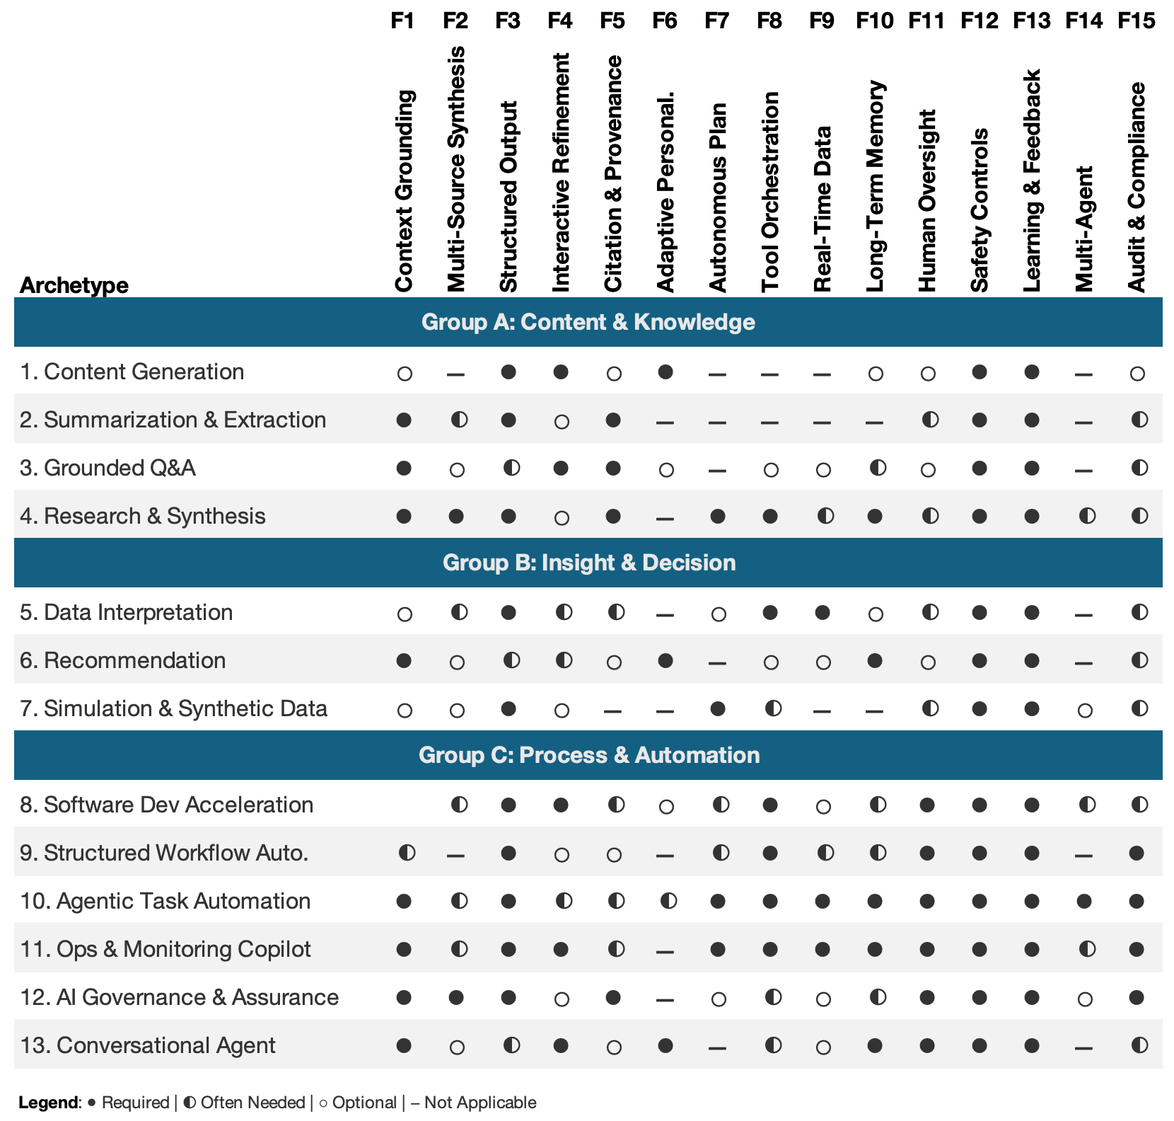
Archetypes & Features

Slide 7
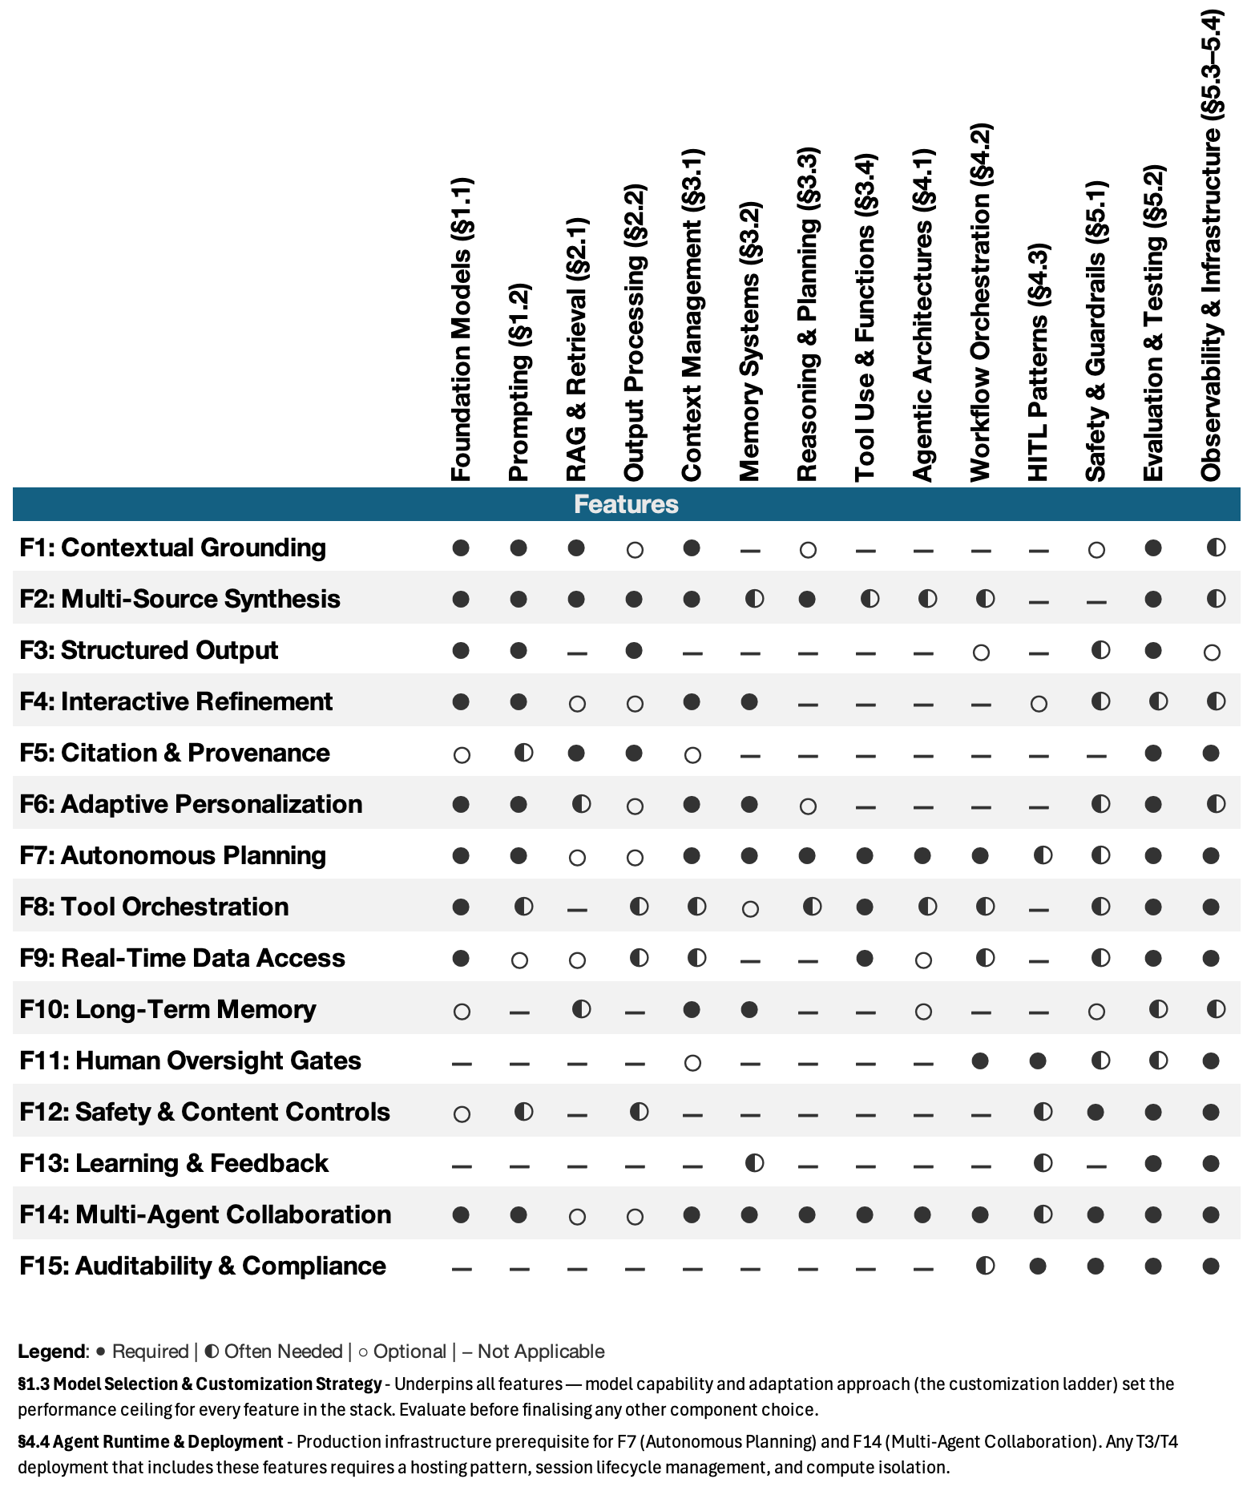
Features & Technical Components

Slide 8
What is the intent of this slide – how do I marry this to architecture dimensions Are these tiers just another dimension – e.g Agentic
Maturity Layer | Focus | Implementation Tiers | Key Characteristics
Layer 1: Foundation | Reliable Text & Data Access | T1 (Basic) T2 (Enhanced) | Single LLM calls, Zero/Few-shot prompts, Standard RAG, Basic memory.
Layer 2: Capability | State, Memory & Action | T3 (Orchestrated) | Multi-step workflows, Function calling, Tool use, Structured reasoning chains.
Layer 3: Autonomy | Collaboration & Self-Improvement | T4 (Agentic) | Autonomous planning, Multi-agent collaboration, Self-correction, Episodic memory.
Tier | Name | Characteristics | Typical Components | Example
T1 | Basic | Single LLM call, no external data, minimal orchestration | LLM + Prompting | Simple Q&A chatbot
T2 | Enhanced | RAG integration, basic memory, structured output | LLM + RAG + Output Parsing | Knowledge base assistant
T3 | Orchestrated | Multi-step workflows, tool use, conditional logic | LLM + RAG + Tools + Orchestration | Research assistant with web search
T4 | Agentic | Autonomous planning, multi-agent, complex reasoning | Full stack including agents, memory, multi-tool | Autonomous coding assistant

Slide 9

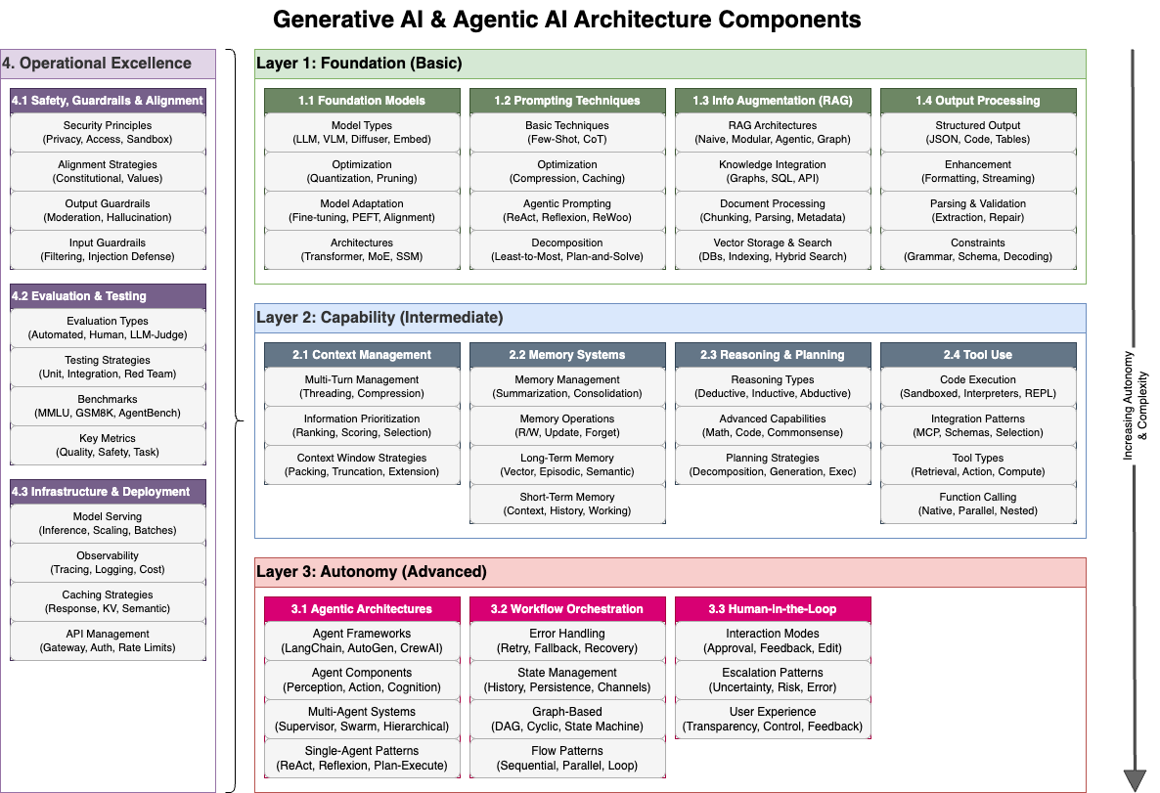
GenAI Technical Components
How do layers relate to tiers slide 4 I need a concise easy to understand model for the relationship of Archetype to Technical Components via complexity / capability This mapping should be related to effort and platforms

Slide 10
Archetype Mapping
Archetype Group | Archetype | Fdn Models | Prompting | Retrieval (RAG) | Output Proc | Context Mgmt | Memory | Reasoning | Tools | Agents | Workflow | HITL | Safety | Eval | Infra | Obs.
A: Content & Knowledge Synthesis | 1. Content Generation | ⬤ | ⬤ | ⭘ | ◐ | ⭘ | ⭘ | ⭘ | − | − | ⭘ | ⭘ | ⬤ | ⬤ | ⬤ | ⬤
 | 2. Summarization & Extraction | ⬤ | ⬤ | ◐ | ⬤ | ⭘ | ⭘ | ⭘ | − | − | ◐ | ◐ | ⬤ | ⬤ | ⬤ | ⬤
 | 3. Grounded Q&A | ⬤ | ⬤ | ⬤ | ◐ | ⬤ | ◐ | ⭘ | ⭘ | − | ⭘ | ⭘ | ⬤ | ⬤ | ⬤ | ⬤
 | 4. Research & Synthesis | ⬤ | ⬤ | ⬤ | ⬤ | ⬤ | ⬤ | ⬤ | ⬤ | ◐ | ⬤ | ⬤ | ⬤ | ⬤ | ⬤ | ⬤
B: Insight & Decision Support | 5. Data Interpretation & Analytics | ⬤ | ⬤ | ⭘ | ⬤ | ◐ | ◐ | ◐ | ⬤ | − | ◐ | ◐ | ⬤ | ⬤ | ⬤ | ⬤
 | 6. Recommendation & Personalization | ⬤ | ⬤ | ⬤ | ⬤ | ⬤ | ⬤ | ◐ | ⭘ | − | ◐ | ⭘ | ⬤ | ⬤ | ⬤ | ⬤
 | 7. Simulation & Synthetic Data | ⬤ | ⬤ | ⭘ | ⬤ | ⭘ | ⭘ | ◐ | ◐ | ◐ | ⭘ | ◐ | ⬤ | ⬤ | ⬤ | ⬤
C: Process & Task Automation | 8. Software Development Acceleration | ⬤ | ⬤ | ⬤ | ⬤ | ⬤ | ◐ | ⬤ | ⬤ | ◐ | ⬤ | ⬤ | ⬤ | ⬤ | ⬤ | ⬤
 | 9. Structured Workflow Automation | ⬤ | ⬤ | ◐ | ⬤ | ◐ | ◐ | ◐ | ⬤ | − | ⬤ | ⬤ | ⬤ | ⬤ | ⬤ | ⬤
 | 10. Agentic Task Automation | ⬤ | ⬤ | ⬤ | ⬤ | ⬤ | ⬤ | ⬤ | ⬤ | ⬤ | ⬤ | ⬤ | ⬤ | ⬤ | ⬤ | ⬤
 | 11. Operations & Monitoring Copilot | ⬤ | ⬤ | ⬤ | ⬤ | ⬤ | ⬤ | ⬤ | ⬤ | ⬤ | ⬤ | ⬤ | ⬤ | ⬤ | ⬤ | ⬤
 | 12. AI Governance & Assurance | ⬤ | ⬤ | ⬤ | ⬤ | ◐ | ◐ | ⬤ | ◐ | ◐ | ⬤ | ⬤ | ⬤ | ⬤ | ⬤ | ⬤
Validate the accuracy of this
⬤ ⭘ ◐

Slide 11
Complexity Dimensions
Dimension | Low ──────────────────────────────────────► High
FUNCTIONAL DIMENSIONS
Autonomy Data Integration Reasoning Tool Use Memory Output | Human-driven │ Assisted │ Semi-autonomous │ Autonomous None │ Static Context │ RAG │ Multi-source + Live Single-shot │ Chain-of-Thought │ Multi-step │ Planning + Reflection None │ Single tool │ Multi-tool │ Dynamic tool selection Stateless │ Session │ Persistent │ Episodic + Semantic Free-form │ Templated │ Structured │ Multi-artifact
NON-FUNCTIONAL DIMENSIONS
Security Performance Resilience Observability Responsible AI Compliance | Basic API Key │ OAuth + Encryption │ RBAC + Audit │ Zero-trust + DLP Best-effort │ SLA-bound │ Low-latency │ Real-time + Auto-scale None │ Retry Logic │ Circuit Breakers │ Full HA + DR Basic Logs │ Metrics + Traces │ Full APM │ AI-specific Monitoring Content Filter │ Bias Checks │ Explainability │ Full Governance Minimal │ Industry Standards │ Regulated │ Mission-critical

Slide 12
NFR Domain | T1 Basic | T2 Enhanced | T3 Orchestrated | T4 Agentic
Security | ▓░░░░░░░░░ | ▓▓▓░░░░░░░ | ▓▓▓▓▓▓░░░░ | ▓▓▓▓▓▓▓▓▓▓
Performance | ▓░░░░░░░░░ | ▓▓▓░░░░░░░ | ▓▓▓▓▓░░░░░ | ▓▓▓▓▓▓▓▓░░
Resilience | ▓░░░░░░░░░ | ▓▓░░░░░░░░ | ▓▓▓▓▓▓░░░░ | ▓▓▓▓▓▓▓▓▓▓
Observability | ▓░░░░░░░░░ | ▓▓▓░░░░░░░ | ▓▓▓▓▓▓▓░░░ | ▓▓▓▓▓▓▓▓▓▓
Responsible AI | ▓▓░░░░░░░░ | ▓▓▓░░░░░░░ | ▓▓▓▓▓▓░░░░ | ▓▓▓▓▓▓▓▓▓▓
Compliance | ▓░░░░░░░░░ | ▓▓░░░░░░░░ | ▓▓▓▓▓▓░░░░ | ▓▓▓▓▓▓▓▓▓▓
DevOps | ▓░░░░░░░░░ | ▓▓▓░░░░░░░ | ▓▓▓▓▓▓░░░░ | ▓▓▓▓▓▓▓▓░░
Cost Management | ▓░░░░░░░░░ | ▓▓░░░░░░░░ | ▓▓▓▓▓░░░░░ | ▓▓▓▓▓▓▓▓▓▓
Legend: ▓ = Required focus area, ░ = Lower priority
Functional Dimension | T1 Basic | T2 Enhanced | T3 Orchestrated | T4 Agentic
Autonomy | ▓░░░░░░░░░ | ▓▓▓░░░░░░░ | ▓▓▓▓▓▓░░░░ | ▓▓▓▓▓▓▓▓▓▓
Data Integration | ▓░░░░░░░░░ | ▓▓▓░░░░░░░ | ▓▓▓▓▓▓░░░░ | ▓▓▓▓▓▓▓▓▓▓
Reasoning | ▓░░░░░░░░░ | ▓▓▓░░░░░░░ | ▓▓▓▓▓▓░░░░ | ▓▓▓▓▓▓▓▓▓▓
Tool Use | ▓░░░░░░░░░ | ▓▓░░░░░░░░ | ▓▓▓▓▓▓░░░░ | ▓▓▓▓▓▓▓▓▓▓
Memory | ▓░░░░░░░░░ | ▓▓▓░░░░░░░ | ▓▓▓▓▓▓░░░░ | ▓▓▓▓▓▓▓▓▓▓
Output | ▓▓░░░░░░░░ | ▓▓▓░░░░░░░ | ▓▓▓▓▓▓░░░░ | ▓▓▓▓▓▓▓▓▓▓
Functional Complexity Matrix
This matrix visualizes the progression of functional capabilities across tiers:
Legend: ▓ = Capability level, ░ = Growth potential

Slide 13
Selection Framework
1. What is the primary output? (content, structure, answer, decision, action)
2. Does it need grounding? If yes: what sources, freshness, and provenance?
3. Does it take actions in external systems? If yes: what is the blast radius?
4. What is the error tolerance? (low-stakes draft vs. regulated decision)
5. What is the required oversight model? (review, approve, audit-only)
6. How will you measure quality? (offline evals, online monitoring, HITL feedback)

Slide 14
Tier Heuristic
This aligns with common implementation tiers (e.g., T1–T4 as used in many enterprise architectures):
T1: Single-call generation/transformation; minimal integration
T2: Grounding (RAG), structured outputs, basic memory
T3: Multi-step orchestration, tool use, conditional flows, stronger observability
T4: Agentic execution with planning, long-lived state, advanced safety/governance

Slide 15
Appendix

Slide 16
Agentic Archetypes
With Features
Group | # | Archetype | Core Job | Key Features
A · Content & Knowledge Synthesis | 1 | Content Generation | Create or rewrite content — text, code, images, audio, video | F3 · F4 · F6 · F12 · F13
 | 2 | Summarization & Extraction | Condense information or extract structured data from unstructured inputs | F1 · F3 · F5 · F12 · F13
 | 3 | Grounded Q&A | Answer questions from a curated knowledge base with citations | F1 · F4 · F5 · F12 · F13
 | 4 | Research & Synthesis | Produce analytical artifacts by synthesizing information from many sources | F1 · F2 · F3 · F5 · F7 · F8 · F13
B · Insight & Decision Intelligence | 5 | Data Interpretation & Analytics | Explain trends and anomalies from structured data; trigger automated responses | F3 · F8 · F9 · F12 · F13
 | 6 | Recommendation & Personalization | Tailor content, workflows, or experiences to a user or context | F1 · F6 · F10 · F12 · F13
 | 7 | Simulation & Synthetic Data | Generate datasets, scenarios, or environments for training and testing | F3 · F7 · F12 · F13
C · Process & Task Automation | 8 | Software Dev Acceleration | Assist with coding, testing, review, and debugging across the SDLC | F1 · F3 · F4 · F8 · F11 · F12 · F13
 | 9 | Structured Workflow Automation | Automate deterministic business processes using GenAI for NLU/NLG steps | F3 · F8 · F11 · F12 · F13 · F15
 | 10 | Agentic Task Automation | Plan and execute multi-step, dynamic tasks by orchestrating tools | F7 · F8 · F9 · F10 · F11 · F12 · F13 · F14 · F15
 | 11 | Ops & Monitoring Copilot | Monitor signals, diagnose issues, and suggest or take controlled remediation | F1 · F7 · F8 · F9 · F10 · F11 · F12 · F13 · F15
 | 12 | AI Governance & Assurance | Support GRC: policy checks, control testing, audit evidence gathering | F1 · F2 · F3 · F5 · F11 · F12 · F13 · F15
 | 13 | Conversational Agent | Conduct sustained, goal-directed conversations for support, sales, coaching, or advisory | F1 · F4 · F6 · F10 · F11 · F12 · F13
ID | Feature
F1 | Contextual Grounding
F2 | Multi-Source Synthesis
F3 | Structured Output
F4 | Interactive Refinement
F5 | Citation & Provenance
F6 | Adaptive Personalization
F7 | Autonomous Planning
F8 | Tool Orchestration
F9 | Real-Time Data
F10 | Long-Term Memory
F11 | Human Oversight
F12 | Safety Controls
F13 | Learning & Feedback
F14 | Multi-Agent Collaboration
F15 | Auditability & Compliance

Slide 17
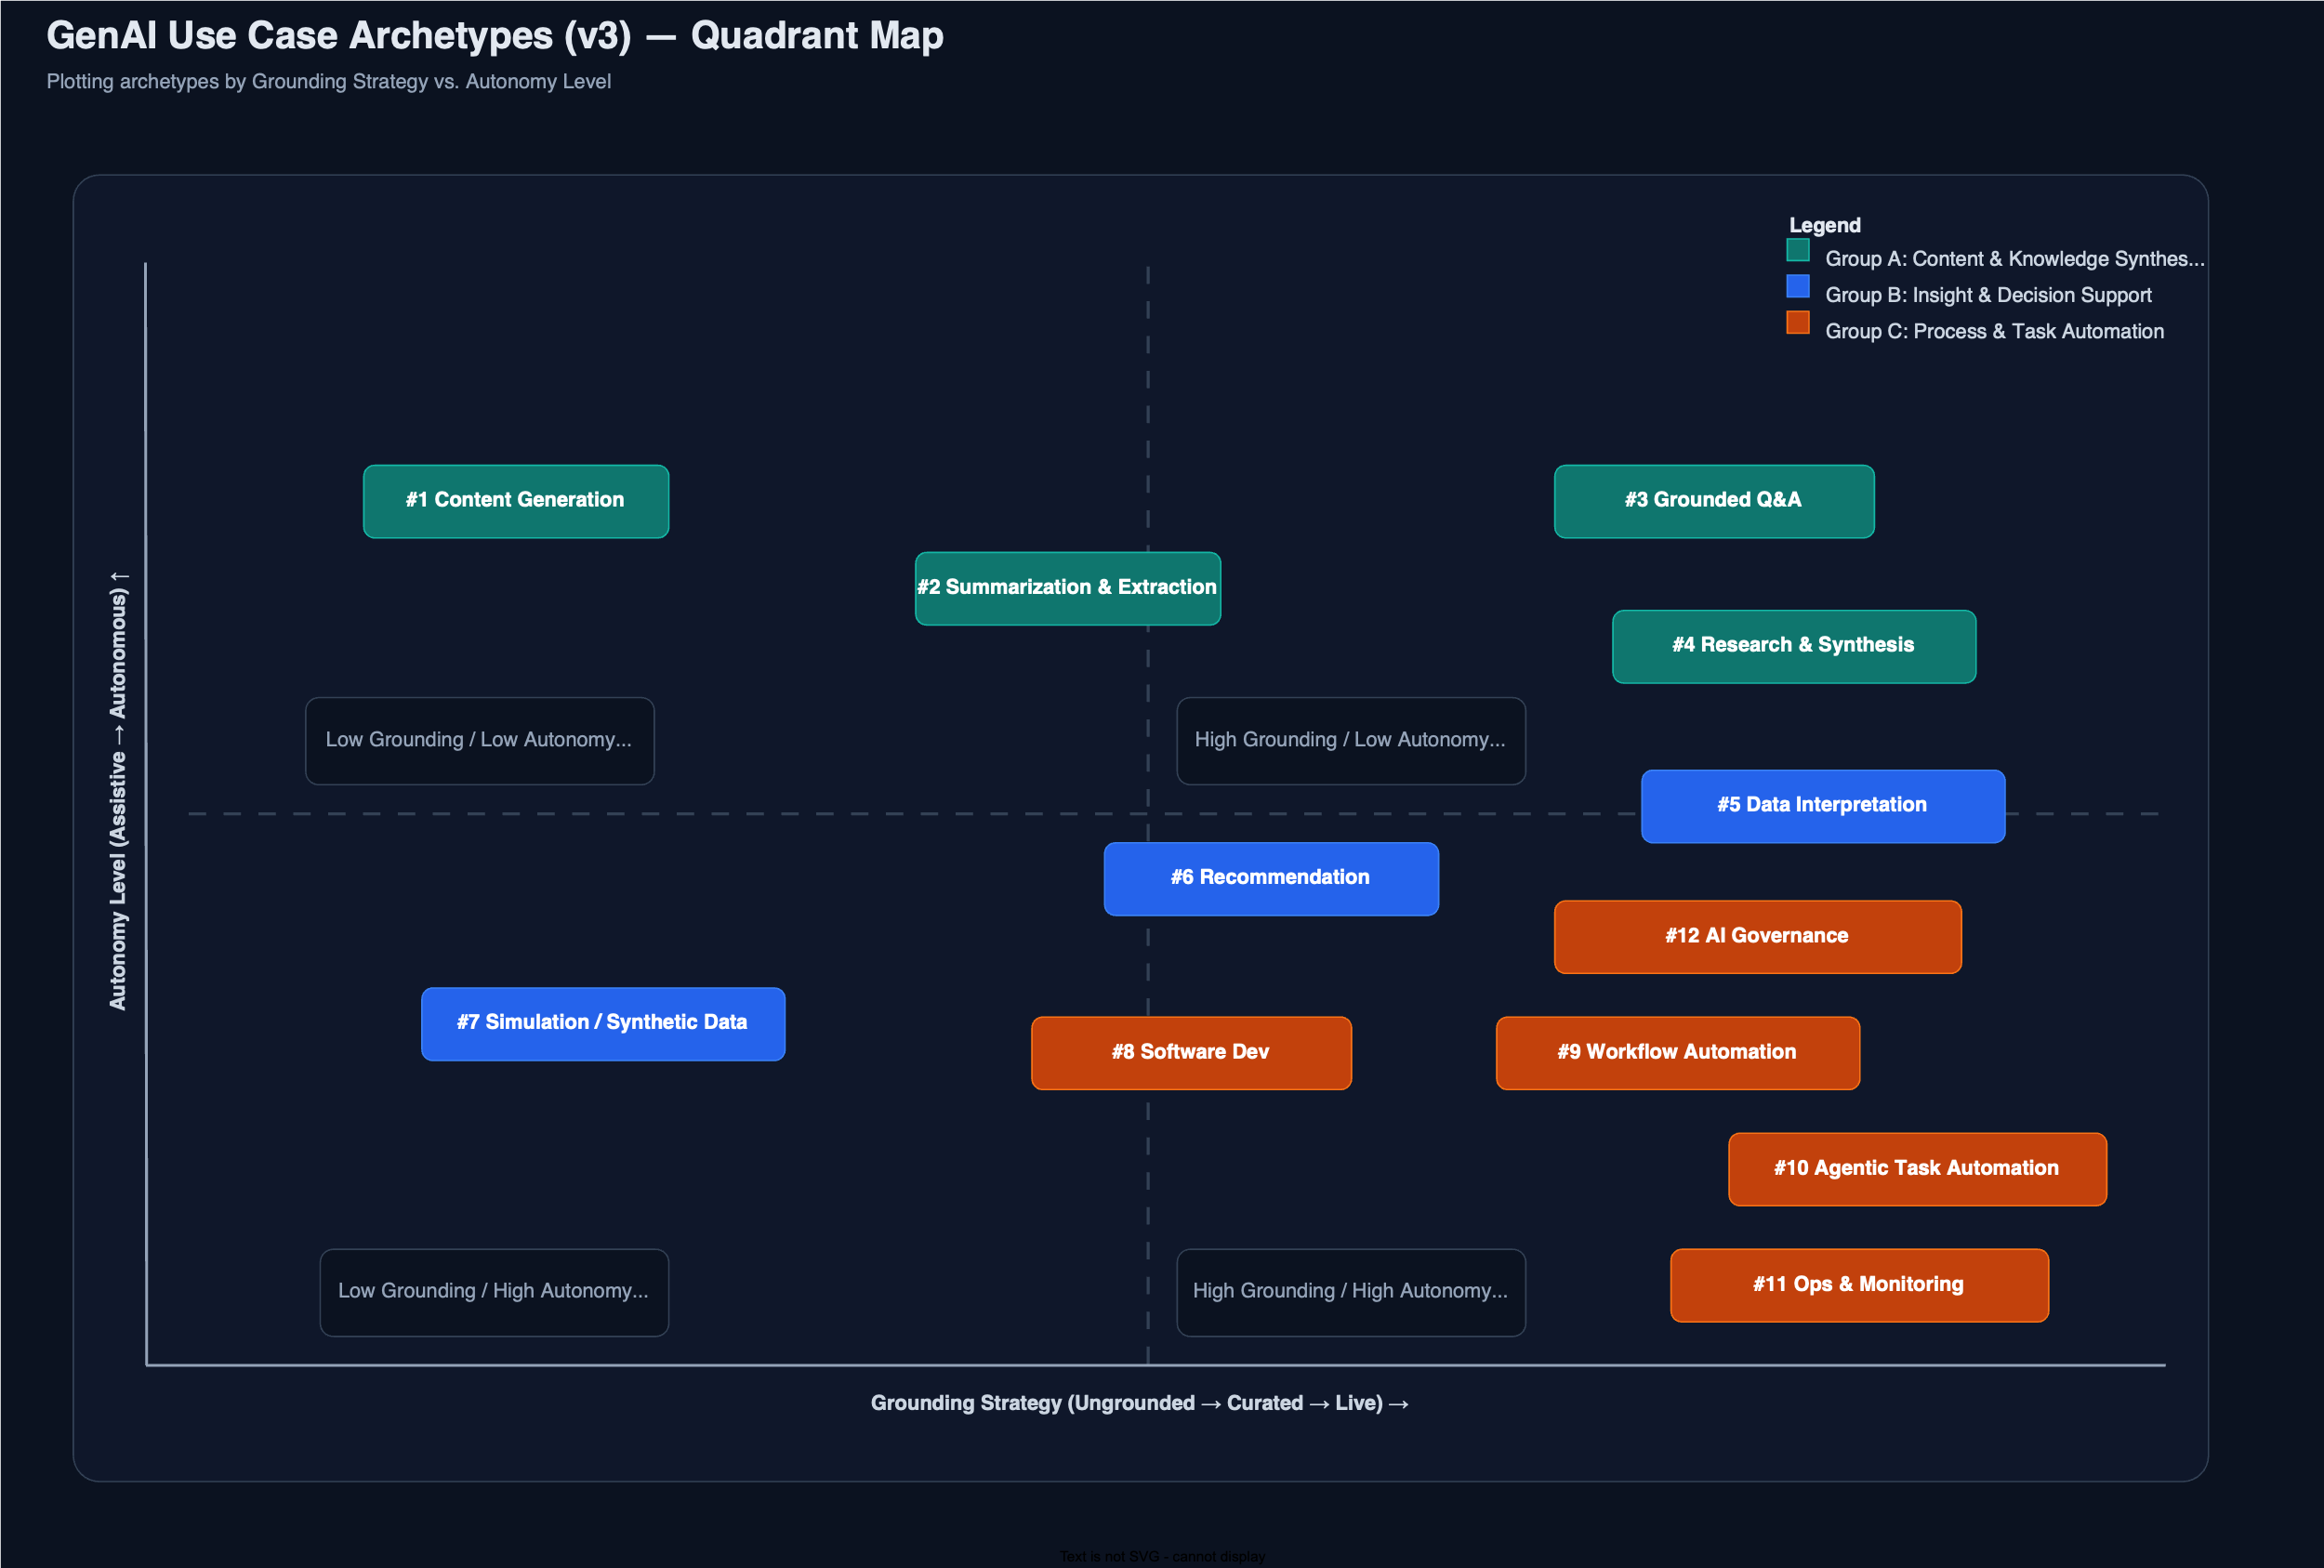
Archetypes – Grounding vs Autonomy

Slide 18
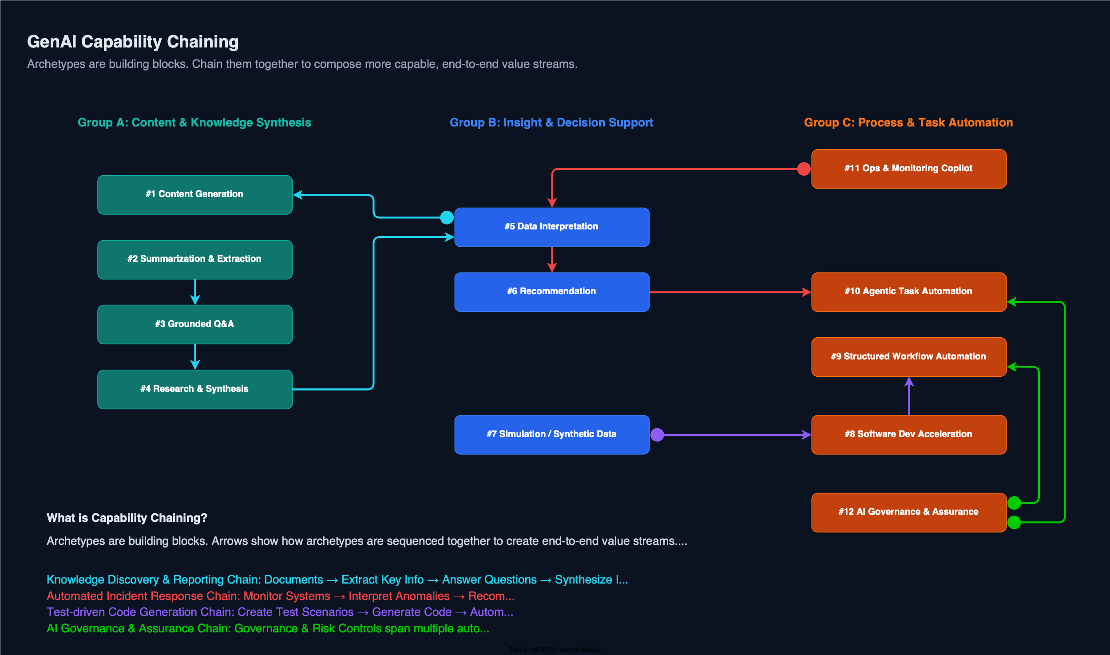
Archetype Chaining

Slide 19
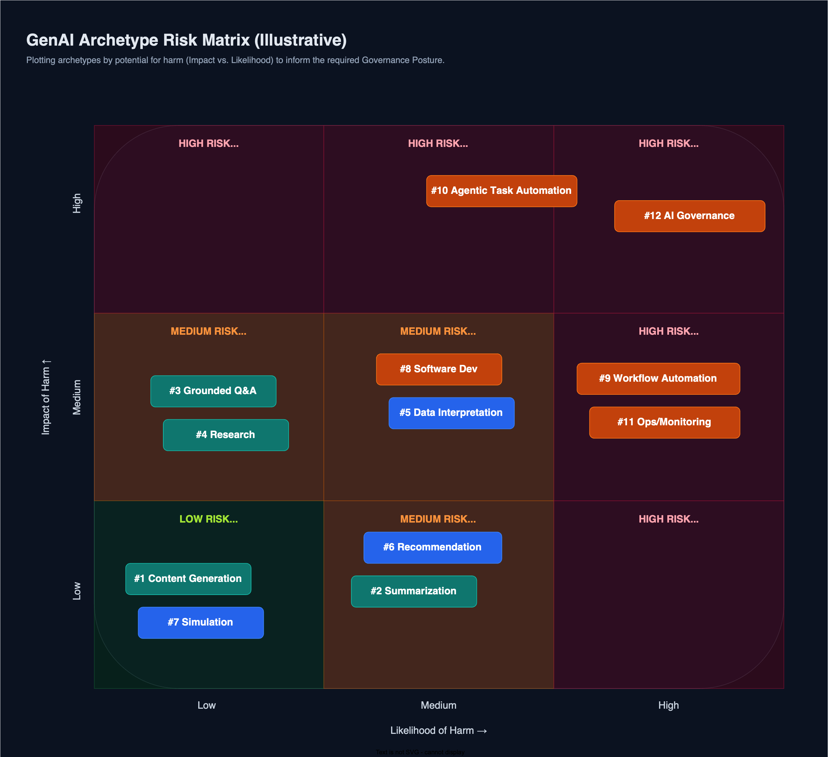
Archetypes – Risk (Harm vs Impact))

