Slide 1

Car Crash Data Analysis
Chirag Bilimoria (A20099258)
Priyank Rao (A20108221)
Reno Rajan Christy (A20082578)
TEAM 7

Slide 2
Business objectives / understanding
To identify major factors that contribute to a severe/Fatal injury in an accident
To build a predictive model which identify severity of accident
To provide recommendations that could help to avoid/reduce accident severity
To identify most risk prone factors in accidents

Slide 3
Data Understanding
The data used for building these models are related to different areas associated with car accidents. These involve accident information, people involved in the accidents and the vehicles involved in the accident.
Subjective analysis of each variable in each table
Coverage Ensured : Demographic, Environment condition, Driving conditions, Vehicular info etc. covering every category /theme/ characteristic variety
For each area, we only wanted to consider certain independent variables that we assume will have an impact on the severity of a car crash.
Avoid using any unnecessary variables that would have a negative impact on the accuracy of the predictions

Slide 4
Data preparation
Data Consolidation
Accident Left Outer Join Vehicle
Accident&Vehicle Inner Join Person

Slide 5
Data preparation
Data Cleaning
Usage of Imputed variables
Normalizing numerical variables
Number to String node for conversion of categorical variables
Rule based row filter & Math formula for filtering & derived variable
Categorizing using Numerical Binner & “Rule Engines”

Slide 6
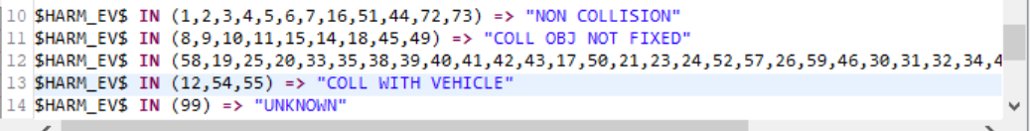
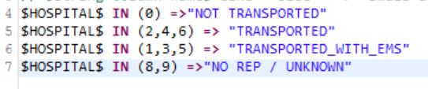


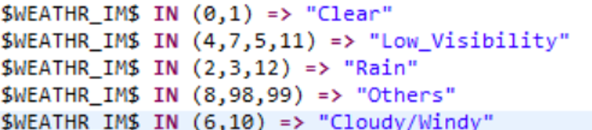

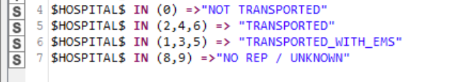
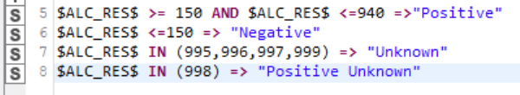

Data preparation
Data CLEANING
Data Categorization with Rule Engines

Slide 7
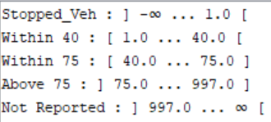
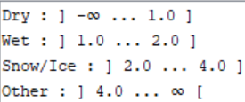
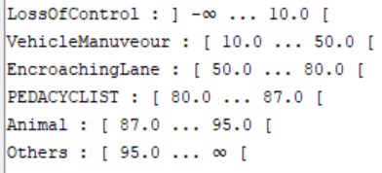
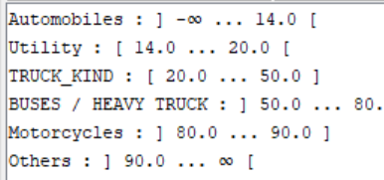



Data preparation
Data CLEANING
Data Categorization with Numeric Binner

Slide 8
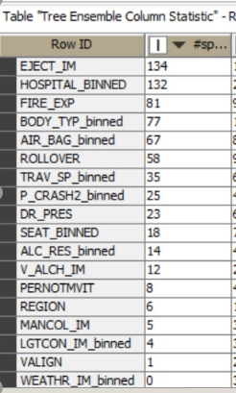
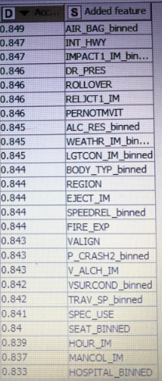
Variable selection
Random Forest Forward Selection

Slide 9
Variable selection
Accident :Pernotmvit, Region, Mancol_im, Lgtcon_im, Weathr_im
Vehicle : Fire_Exp, Body_Typ, Rollover, Trav_Sp, P_Crash2, Dr_Pres, V_alc_im, SpeedRel, Vsurcond, Valign , Ve_Total
Person : Air_Bag, Seat, Rest_use, Age
Target Variable: Injury Severity – Interest area : Severe / Fatal Injury
Note: Focus was on factors/variables prior to accident event; Variables include binned variables

Slide 10
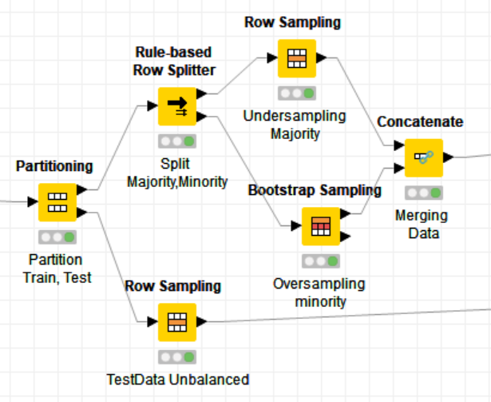
GENERATING BALANCED DATA
Under sampling Majority classes with row sampling,
Oversampling Minority classes with bootstrapping

Slide 11
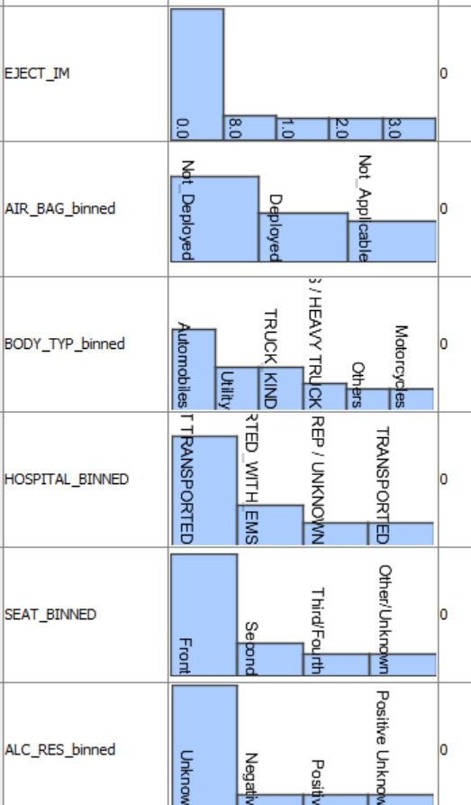
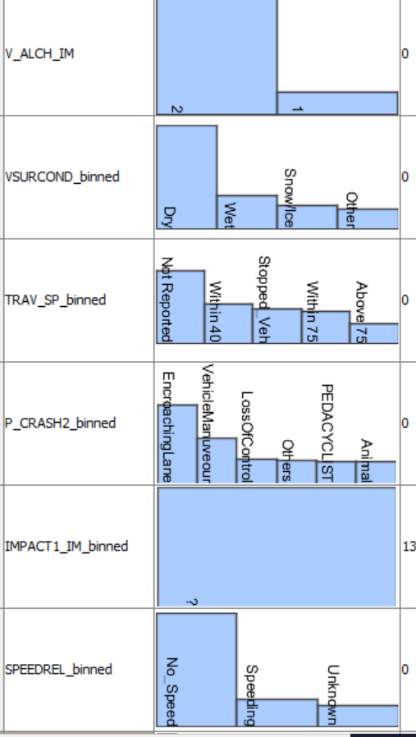
Descriptive analysis
Histogram for categorical data

Slide 12
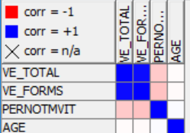
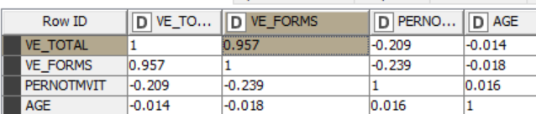
Descriptive analysis
Checking multicollinearity / correlation between numerical variables

Slide 13
Model selection / approach
Looking with the complexity of data we choose Decision Tree, Logistic Regression and ANN for Modelling.
Predictor variable being categorical in nature we selected Logistic Regression and Decision Tree.
After balancing data ANN worked with less data.

Slide 14
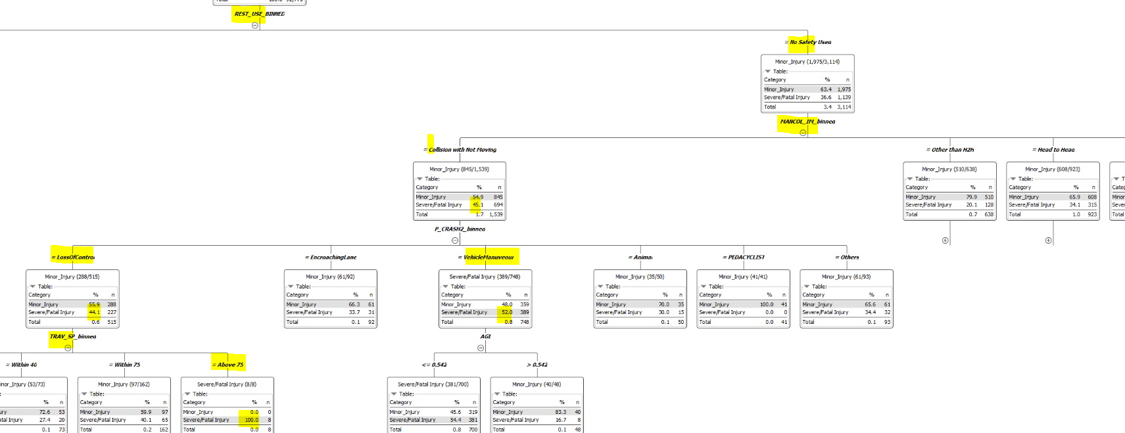
Decision tree
Unbalanced Data:
Tree: Lack of Seatbelt usage followed by manner of collision, Increased speed and resulted in Sever Injuries in majority of the cases.

Slide 15
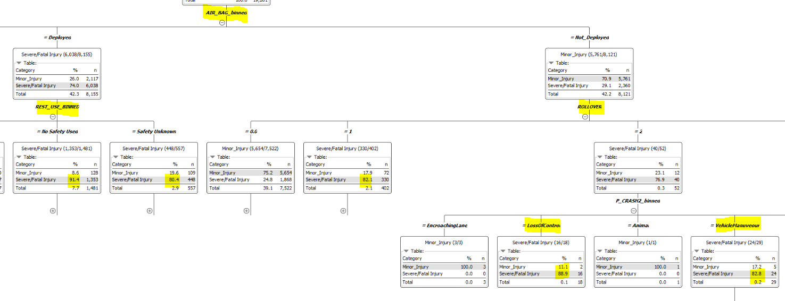
Decision tree
Balanced Data:
Tree: Lack of Air bag, followed by Seat belt, rollover and loss of vehicle control/miss maneuver leads to Fatal/Severe injuries

Slide 16
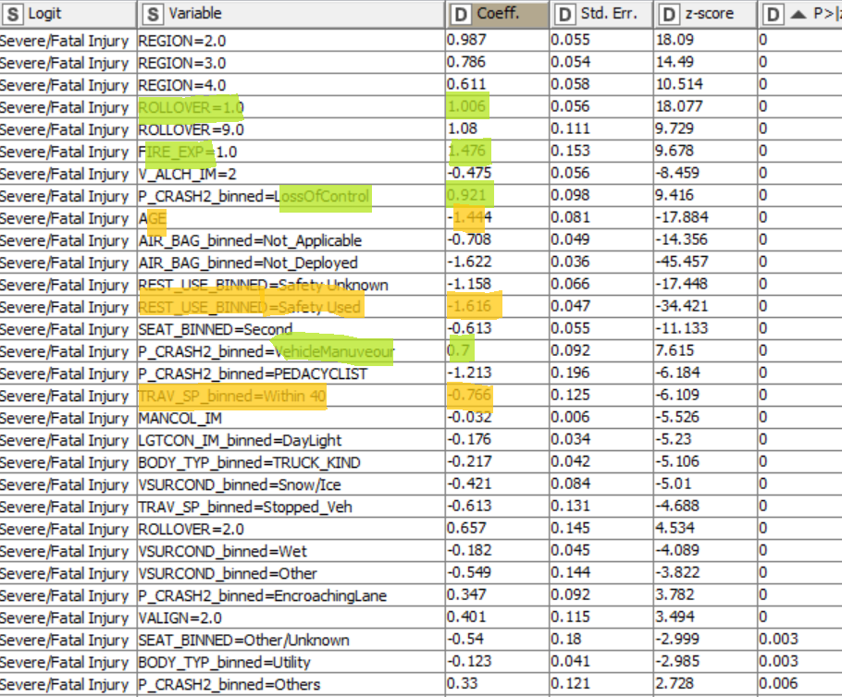
Logistic regression
Unbalanced
Positively impact Severity:
Rollover, Fire_Explosion Loss of control and Vehiclemanuveour error seems to be associated positively with severe injury.
Negatively impact severity:
Safety_Used, Age, Body_Type Light Truck/utility, Air bag unknown (did not deploy), speed <40 seems to be associated negatively with Severe Injury.

Slide 17
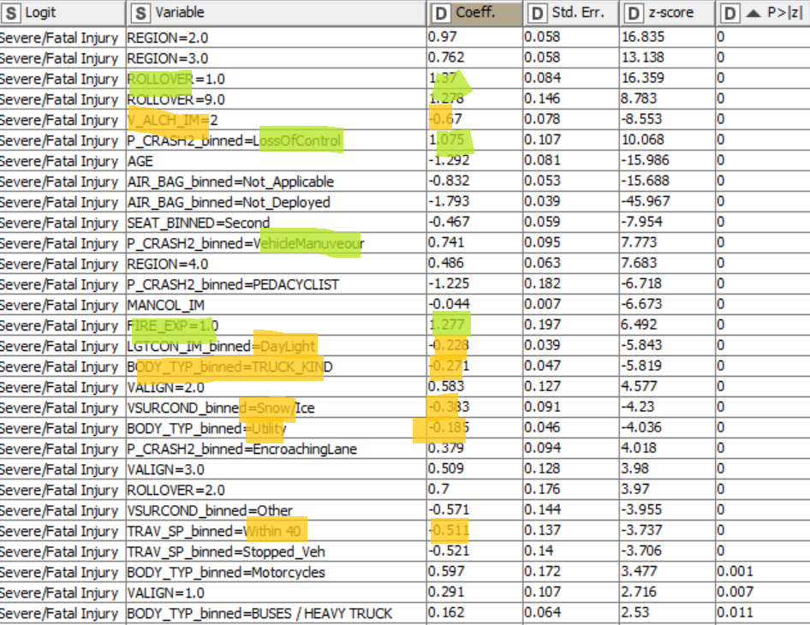
Logistic regression balanced
Positively impact Severity:
Rollover, Vehicle Manuveour, Lossof Control, Heavy/Truck seems to be most associated positively with severe injury.
Negatively impact severity:
Daylight, Non Alcoholic, Light Truck/Utility, Speed <40 seems to be most associated negatively with Severe Injury.

Slide 18
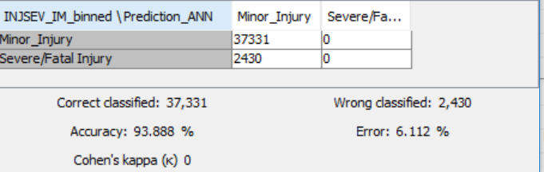
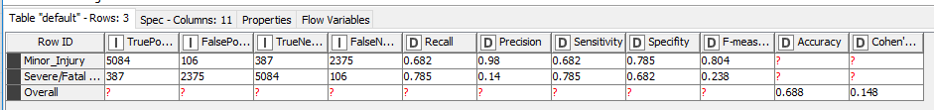
Mlp ann
Unbalanced Output ? Vs Balanced Output

Slide 19
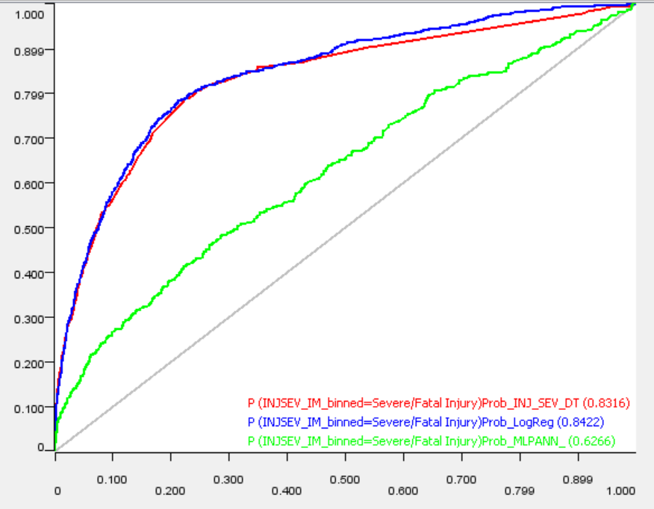
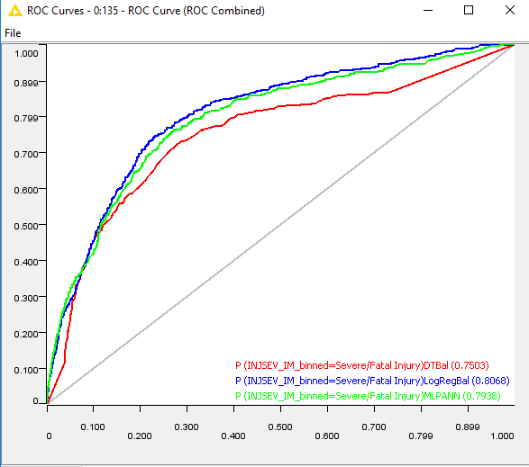
ROC Curves
Unbalanced Data | Balanced Data

Slide 20
EVALUATION: unbalanced vs Balanced DATA
Model | Decision Tree |  | Logistic Regression |  | MLP ANN
 | Unbalanced | Balanced | Unbalanced | Balanced | Unbalanced | Balanced
Accuracy | 94 | 76.87 | 94 | 76.9 | 93.9 | 68.8
Specificity | 99 | 77 | 99 | 76.8 | 100 | 68.2
Sensitivity | 11 | 70.1 | 11 | 78 | 0 | 78.5
AUC | 0.832 | 0.75 | 0.83 | 0.80 | 0.62 | 0.79
Looking on the above results we decided to select Logistic Regression with balanced data as our final model
Note:
Inclusion of Hospital variable would have provided up to 87% of accuracy on balanced data but our focus was on factors prior to accident event
Sensitivity is being defined based on Severe Injury Category

Slide 21
FINDINGS
We found because of lack of safety usage leads to higher chance of person ejected out of the car which leads to high severity / fatality.
In cases where the safety usage / seat belt etc. were used the most important factor contributing to severe injury is Loss of control and Miss maneuver of vehicle.
Whenever the speed is more that 75 there is higher chances of loss of control of vehicle which leads to high injury severity.
We could observe that whenever there is a loss of control of vehicle only when the speed of vehicle is high it leads to high severity of accident.
Accidents associated with Motorcyclists and Heavy Trucks seemed to have high severity when in comparison to light utility, automobiles and light truck models

Slide 22
RECOMMENDATIONS to reduce injury severity
Promote usage of Safety systems and practices like Seat belt, Air Bag etc.
Preventing Passenger ejection in the event of the accident is critical to avoid fatality
Adhere to traffic rules like reduced speed limits on specified roadways is key to avoid accident severity
Usage of better vehicular body types seemed to have reduced severity in the event of a accident.

Slide 23
LEARNINGS
Balanced data provides a better sensitivity and thus provide with a better model in predicting the minority class.
Binning of data improves our predictability and meaningfulness of the model
Learned to do Data balancing apart from Smote etc.
Learned a structured approach towards the variable selection which our case includes Subjective selection, feature selection, Random Forest splitting.

Slide 24
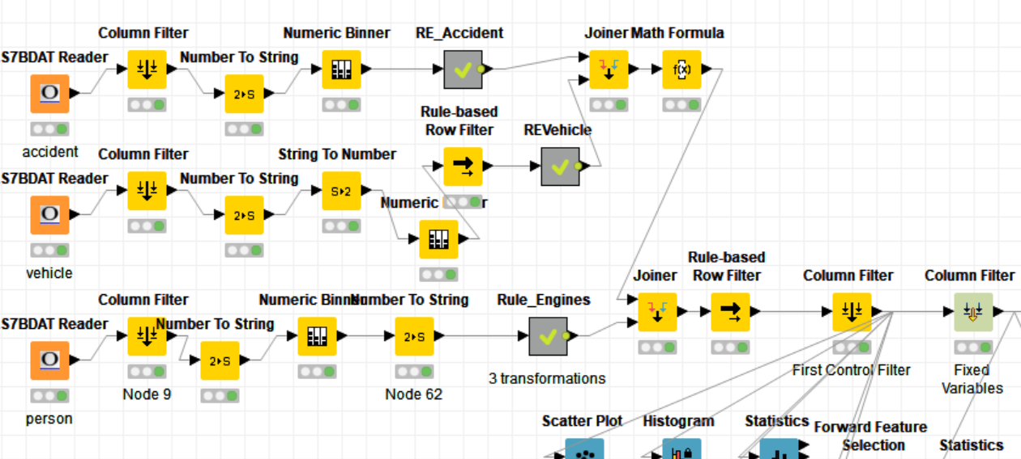
Workflow Screenshot : Data Preprocessing

Slide 25
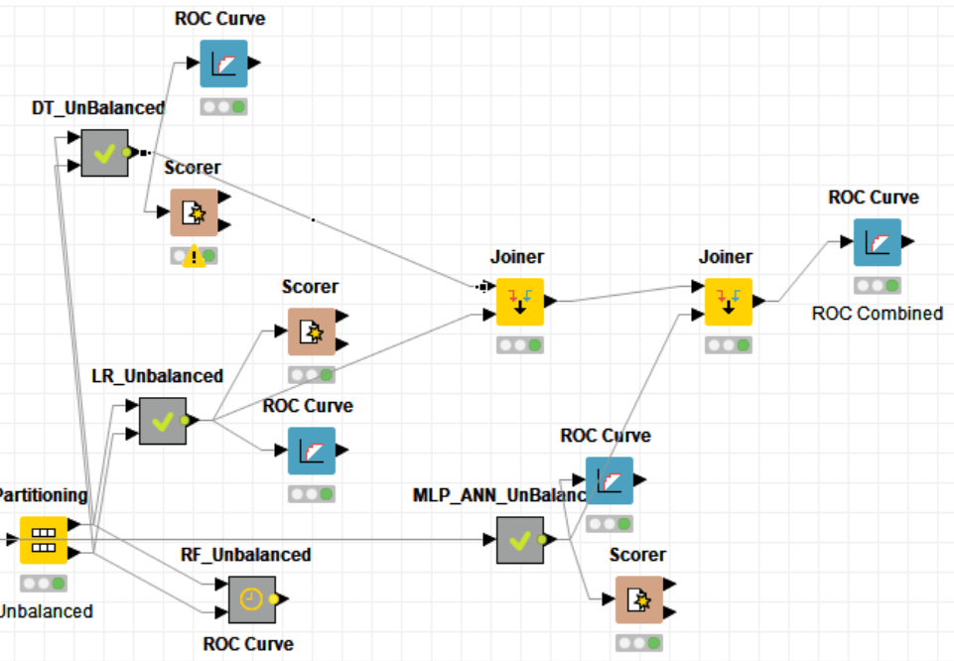
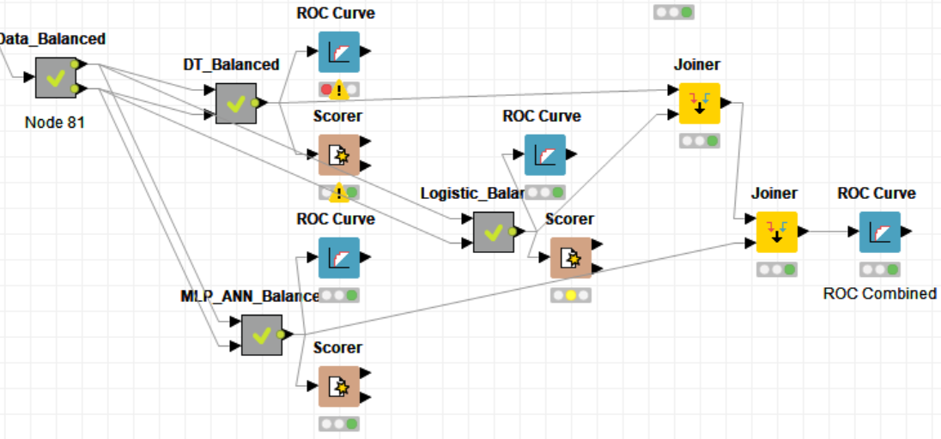
Workflow Screenshot : Models: Unbalanced, Balanced

Slide 26


Slide 27
Thank You

