Slide 1

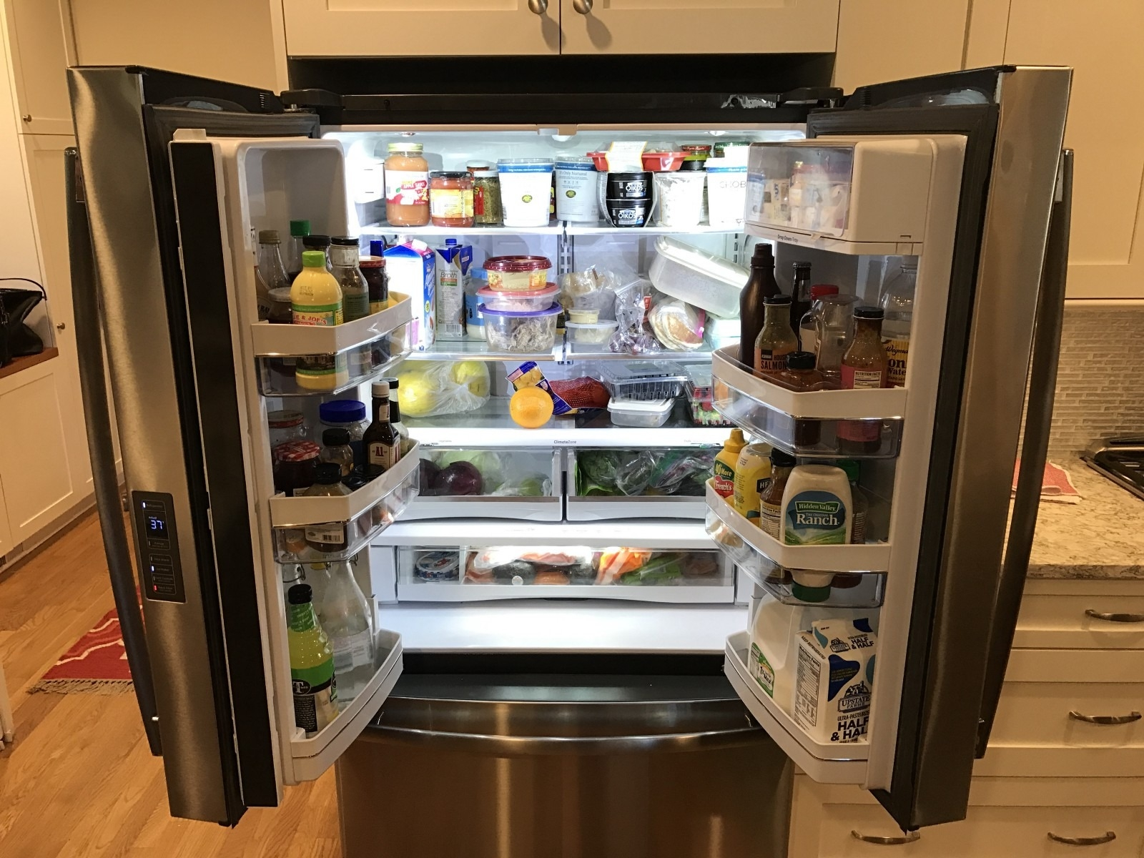









Updated: January 24th, 2019
Release: 1.0.0
Project 2
WHAT’S IN YOUR FRIDGE
A RECIPE AND WINE PAIRING APPLICATION
Presented by:
Neha Sahey Front End & Principle API Developer
Swaroop (“Roop”) Kondreddy Authentication Developer & Principle DB Administrator
Peter Santiago Backend API & DB Developer
3HD, LLC ©2019

Slide 2
Updated: January 24th, 2019
Release: 1.0.0
Project 2
WHAT’S IN YOUR FRIDGE?
A RECIPE AND WINE PAIRING APPLICATION
Why raid my fridge?
Once upon a time there were three hungry developers that didn’t know what to eat just prior to a huge development project. None of them wanted to leave their offices to scavenger for eats..
.. all they wanted to do was satiate their appetites. “What’s in the fridge!?” exclaimed a developer. An idea, and a company was born.
“Food, Wine, Opportunity. This makes us all happy”
– Peter Santiago, founder and CEO
Three Hungry Developers (3HD)
LLC, 2019
3HD, LLC ©2019

Slide 3




Updated: January 24th, 2019
Release: 1.0.0
Project 2
WHAT’S IN YOUR FRIDGE?
A RECIPE AND WINE PAIRING APPLICATION
The Concept
Recipe API Engine
Ever had the munchies but didn’t know what to make? Not in the mood to go out grocery shopping or order Chinese take out again?
What’s in your fridge is a simple application that exposes the joys of cooking at home using just the ingredients in your fridge. Just provide the ingredients and the application will present instant recipes that you can craft at home based on your selection. Moreover the application will optionally find that perfect wine in your cellar to pair with your delicious home cooked cuisine.
3HD-WIYF WINE PARING SERVICES
Expert Wine Sommelier API Engine
3HD, LLC ©2019

Slide 4


Updated: January 24th, 2019
Release: 1.0.0
Project 2
New Technologies
PugJS FE Frame Work (Site Containers)
https://pugjs.org/api/getting-started.html
D3 Data Driven Docs (Reporting)
https://d3js.org/
Materialize FE Frame Work (Login)
https://materializecss.com/
Encrypted User Authentication
http://www.passportjs.org/
3HD, LLC ©2019

Slide 5

Updated: January 24th, 2019
Release: 1.0.0
Project 2
C’mon! No More Slides. I want to EAT!!!!
DEMO
https://github.com/nehasahay/Project2
https://whatsinyourfridge.Heroku.com
Let’s Eat!
3HD, LLC ©2019

Slide 6

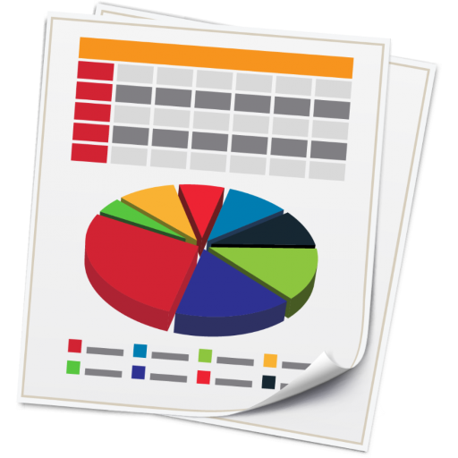





Updated: January 24th, 2019
Release: 1.0.0
Project 2
WHAT’S IN YOUR FRIDGE?
A RECIPE AND WINE PAIRING APPLICATION
Road Map (2019)
Nutritional Data (3DS Reporting)
ReactJs Technology Application
Migrate to MongoDB
Enhanced Registration and Authentication
Extended Context Driven Sommelier Pairing DB
Price, Allergy and Caloric Filtering
Social Media Referencing (Sharing Recipes)
Scheduling and Reminder Recipe Services
3HD, LLC ©2019

Slide 7
Updated: January 24th, 2019
Release: 1.0.0
Project 2
Thank You
Q&A
3HD Team Panel
3HD, LLC ©2019

