Slide 1
Health, Safety & Wellbeing Messages
2026

Slide 2
2026 Calendar
January – Winter Working & Travel Safety
February – Display Screen Equipment (DSE) & Home Working Safety
March – Stress Awareness & Workload Management
April – Manual Handling & Office Safety
May – Driving for Work & Fatigue Management
June – Health & Safety in the Garden and Home
July – UV Safety, Heat Health & Hydration
August – Slips, Trips & Housekeeping
September – Ergonomics & Musculoskeletal Health
October – Fire Safety & Emergency Awareness
November – Mental Health, Resilience & Shorter Days
December – Staying Safe Over the Festive Period

Slide 3
July 2026
Health, Safety & Wellbeing Focus: UV Safety, Heat Health & Hydration
Why This Matters?
Working, travelling and spending time outdoors during the summer months can increase the risk of heat-related illness and sun exposure.
Common health risks include:
Dehydration
Sunburn and UV exposure
Heat exhaustion
Reduced concentration leading to mistakes and accidents
Hot weather can affect anyone, whether you're working from home, travelling to meetings or visiting client sites.
Heat-related illness in pets during walks and car journeys
Did You Know?
UV rays can damage skin even on cloudy days.
Dehydration can reduce concentration, reaction time and decision-making, increasing the likelihood of accidents.
Taking regular breaks and staying hydrated are simple but effective ways to reduce heat-related risks.
Common Risks
Travelling
Long journeys in hot vehicles
Fatigue caused by heat
Dehydration affecting concentration
Increased holiday traffic and delays
Working Outdoors
Prolonged exposure to the sun
Inadequate hydration
Lack of shade during breaks
Hot surfaces and equipment
What We Can All Do
Drink water regularly throughout the day.
Take regular breaks, particularly when travelling or working outdoors.
Wear suitable clothing and protect exposed skin from the sun.
Plan journeys to avoid unnecessary pressure and fatigue.
Look out for colleagues who may be affected by the heat.
Protect pets by avoiding walks during the hottest part of the day and never leaving them in parked vehicles.
Home & Office
Poor ventilation
Overheated workspaces
Forgetting to drink enough water
Reduced concentration during prolonged hot weather
Safety doesn't stop when the temperature rises!

Slide 4
June 2026
Health, Safety & Wellbeing Focus: Health & Safety in the Garden and Home
Why This Matters?
Many accidents happen at home and in the garden during routine activities such as DIY, gardening and maintenance
Common injuries include:
Slips, trips and falls
Cuts and lacerations
Manual handling strains
Injuries from tools and equipment
Before any task STOP – THINK – CHECK
Taking shortcuts often creates unnecessary risk.
Do I have the right equipment?
Is the area safe and clear?
Do I need help?
Am I rushing the job?
If not — stop and reassess.
Small jobs can quickly become high-risk when rushed or undertaken without planning.
Common Risks
Gardening
Lawnmowers, hedge trimmers and power tools
Uneven ground, trip hazards and ladders
Sun exposure, dehydration and fatigue
Home
DIY tasks and use of hand tools
Working at height (steps / ladders)
Lifting, carrying and moving heavy items
What we expect all of us to do
Use the correct tools and PPE where needed
Keep work areas tidy and free from trip hazards
Avoid working alone on higher-risk tasks
Take breaks and stay hydrated during outdoor work
Stop if the task becomes unsafe
Safety doesn’t stop when the working day ends!
Notes:
Seasonal gardening activities (cutting, mowing, planting, fence maintenance)
Safe ladder use and avoiding improvised platforms
Heat, hydration and sun protection as summer approaches
Encouraging us all apply workplace safety thinking at home as well

Slide 5
May 2026
Health, Safety & Wellbeing Focus: Driving for Work & Fatigue Management
Why This Matters?
Driving for work is one of the highest-risk activities undertaken by many employees.
Fatigue, distraction and poor journey planning can significantly increase the likelihood of incidents.
Safe driving protects:
You and your passengers
Other road users
The company and our reputation
Signs of Driver Fatigue
Difficulty concentrating or missing road signs
Frequent yawning or heavy eyes
Drifting within lanes
Feeling restless or impatient
If you notice these signs, you should stop and rest safely as soon as possible.
What We Expect Everyone To Do
Plan journeys and allow realistic travel time
Take regular breaks on longer journeys
Never use a handheld mobile phone while driving
Avoid driving when excessively tired or unwell
Speak up if travel schedules become unrealistic
Key Driving Risks
Fatigue from long journeys or early starts
Mobile phone distraction, even hands-free
Poor weather or heavy traffic conditions
Pressure to arrive on time or attend multiple meetings
Before every journey, ask yourself:
“Am I fit, focused and properly rested to drive safely today?”
If the answer is no — stop, delay or seek support.
No meeting or deadline is more important than getting home safely.
Notes:
Nuccol supports employees stopping or rearranging journeys where fatigue or conditions make travel unsafe
Encourage teams to challenge unrealistic travel expectations
Remind staff that driving safely is part of our professional responsibility when travelling for work

Slide 6
Health, Safety & Wellbeing Focus: Manual Handling & Office Safety
April 2026
Why This Matters? Poor manual handling and unsafe office practices can lead to:
Musculoskeletal injuries (e.g. back, neck, shoulder strain)
Slips, trips, and falls
Reduced productivity and increased absence
Long-term health issues if not addressed early
Safe handling and good workstation setup help protect both health and performance.
Signs That Issues May Be Developing
Back, neck, or shoulder discomfort
Tingling, stiffness, or reduced movement
Fatigue from prolonged sitting or poor posture
Near misses involving trips or dropped items
Recognising these early helps prevent more serious injury.
What You Can Do?
Assess the load before lifting – use mechanical aids where possible
Follow correct lifting techniques (keep load close, avoid twisting)
Set up your workstation correctly (screen at eye level, good posture)
Keep work areas tidy to prevent trips and hazards
Take regular breaks and change posture throughout the day
Report hazards, discomfort, or concerns early
Common Risks in the Workplace
Lifting, carrying, or moving items incorrectly
Repetitive movements or awkward postures
Poor workstation setup (chair, screen, keyboard)
Trailing cables or cluttered walkways
Sitting for prolonged periods without breaks
Did You Know? Musculoskeletal disorders are one of the most common causes of workplace absence in the UK. Many of these injuries are preventable through simple changes to how we lift, move, and work at our desks.
Safe handling and good workstation setup help protect both health and performance.

Slide 7
Health, Safety & Wellbeing Focus: Manual Handling & Office Safety
April 2026
Why This Matters? Poor manual handling and unsafe office practices can lead to:
Musculoskeletal injuries (e.g. back, neck, shoulder strain)
Slips, trips, and falls
Reduced productivity and increased absence
Long-term health issues if not addressed early
Safe handling and good workstation setup help protect both health and performance.
Signs That Issues May Be Developing
Back, neck, or shoulder discomfort
Tingling, stiffness, or reduced movement
Fatigue from prolonged sitting or poor posture
Near misses involving trips or dropped items
Recognising these early helps prevent more serious injury.
What You Can Do?
Assess the load before lifting – use mechanical aids where possible
Follow correct lifting techniques (keep load close, avoid twisting)
Set up your workstation correctly (screen at eye level, good posture)
Keep work areas tidy to prevent trips and hazards
Take regular breaks and change posture throughout the day
Report hazards, discomfort, or concerns early
Common Risks in the Workplace
Lifting, carrying, or moving items incorrectly
Repetitive movements or awkward postures
Poor workstation setup (chair, screen, keyboard)
Trailing cables or cluttered walkways
Sitting for prolonged periods without breaks
Did You Know? Musculoskeletal disorders are one of the most common causes of workplace absence in the UK. Many of these injuries are preventable through simple changes to how we lift, move, and work at our desks.
Safe handling and good workstation setup help protect both health and performance.

Slide 8
Health, Safety & Wellbeing Focus: Stress Awareness & Workload Management
March 2026
Why This Matters?
Work-related stress can affect:
Concentration and decision-making.
Productivity and quality of work.
Physical and mental health.
Managing workload and recognising stress early helps maintain performance, wellbeing and team support.
Common Causes of Work Stress
High or unclear workload priorities.
Tight deadlines or competing demands.
Long periods working alone (home working).
Lack of breaks or switching off from work.
Signs That Stress May Be Building
Feeling overwhelmed or unable to focus.
Irritability or reduced motivation.
Working longer hours without real progress.
Physical signs such as headaches or fatigue.
Recognising these signs early helps prevent issues becoming more serious.
What We Expect Everyone To Do
Prioritise tasks and focus on what is most important.
Take regular breaks during the working day.
Speak up early if workload becomes difficult to manage.
Support colleagues and check in with each other.
Did You Know?
Work-related stress, depression or anxiety accounts for a large proportion of working days lost in the UK each year.
Early support and open conversations are one of the most effective ways to prevent longer-term absence.
Looking after your wellbeing supports both you and the team.

Slide 9
Health, Safety & Wellbeing Focus: Display Screen Equipment (DSE) & Home Working Safety
February 2026
Increased home and hybrid working can increase the risk of:
Musculoskeletal discomfort (neck, shoulders, back, wrists).
Eye strain, headaches and fatigue.
Reduced concentration and productivity.
Poor work–life boundaries leading to stress.
Key DSE & Home Working Risks
Workstation setup: Poor chair support, incorrect screen height, unsuitable desk or table
Display screen use: Extended screen time without breaks, glare, poor lighting.
Working habits: Static postures, long periods sitting, missed breaks.
Home environment: Limited space, trip hazards from trailing cables, distractions.
What would you do if you are working from home for several consecutive days, using a laptop at the kitchen table, experiencing neck stiffness and eye strain?
What is the safest option?
Continue working as normal?
Adjust your workstation and take regular breaks?
Discomfort is an early warning sign…..it should not be ignored.
So, please…
Complete and regularly review your DSE self-assessment ().
Adjust your chair, screen and keyboard to maintain a neutral posture.
Position screens to avoid glare and ensure good lighting.
Take short, frequent breaks away from the screen.
Change posture regularly: sitting, standing, moving.
Keep work areas tidy to avoid slips, trips and electrical hazards.
Raise concerns early if your home setup is not suitable.
Before starting work, ask:
“Is my workstation set up to support me safely and comfortably today?”

Slide 10
Health, Safety & Wellbeing January Focus: Winter Working & Travel Safety
January 2026
What would you do if you are travelling to the office or a client meeting on a cold January morning when roads are icy, visibility is poor, and you are running late?
What is the safest option?
Proceed as planned?
Slow down or change route?
Delay or rearrange the meeting?
No meeting is worth taking unnecessary risk.
So, please…
Allow extra time for journeys
Adapt driving style: slow down, increase distance
Wear suitable footwear when travelling or attending the office
Report hazards (ice, lighting, access issues) promptly
Winter increases the risk of:
Slips, trips and falls
Driving incidents due to ice, fog and poor visibility
Fatigue related errors after the holiday period
Key Winter Risks
Travel: Icy roads, longer stopping distances, reduced visibility
Office / Client Sites: Wet floors, icy car parks, poor lighting
Home Working: Cold conditions, poor lighting, reduced alertness
Before any journey, ask:
“Is this journey necessary today, and is it safe to make?”

Slide 11
Health, Safety & Wellbeing Messages
2025

Slide 12
Health, Safety & Wellbeing December Focus: Supporting Mental Health Over the Christmas Period
December 2025
Why This Matters
The Christmas period can be a time of joy, rest and connection.
But for many, it also brings increased pressure, isolation, financial strain, and emotional challenges.
How We Can Support Ourselves and Each Other
Be Realistic and Prioritise: Set achievable goals for work and home. It’s okay to say no to additional pressures.
Stay Connected: Reach out to friends, colleagues or support networks. Even a quick conversation can make a difference.
Look After Your Physical Health: Good sleep, hydration, regular breaks and movement all support mental wellbeing.
Take Breaks from Social Media: Constant comparison of festive expectations can heighten stress and anxiety.
Talk to Someone Early: If you’re feeling overwhelmed speak to someone.
Common Challenges at Christmas
Increased Stress & Burnout: End-of-year deadlines, workloads, and preparation for the holidays can reduce personal time and increase stress.
Financial Pressure: Gift buying, travel, and seasonal events may add additional financial worries.
Loneliness & Isolation: Not everyone has family or social gatherings to join, and many find the contrast with festive messaging difficult.
Grief & Emotional Triggers: Festive periods can intensify feelings of loss or sadness, especially for those missing loved ones.
Disrupted Routines: Changes to working patterns, school holidays, and social demands can affect sleep, diet, exercise and general wellbeing.
If you or someone you know is in immediate need of support:
Samaritans – 116 123 (24/7)
NHS 111 – for urgent mental-health concerns
Shout – text SHOUT to 85258 for free, confidential crisis support
Christmas looks different for everyone so please be mindful, compassionate and supportive, both to yourself and those around you.

Slide 13
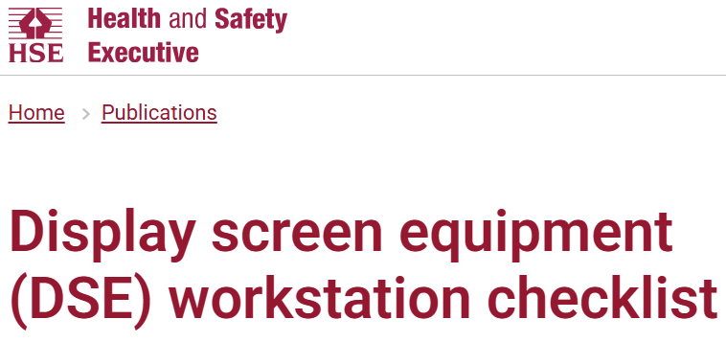
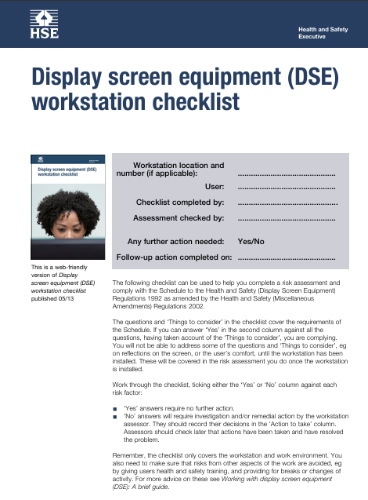
Health, Safety & Wellbeing Message: Ergonomics & Posture
November 2025
This Month’s Call to Action
Take 5 minutes today to check your workstation.
Complete a DSE self-assessment
Small adjustments now prevent long-term discomfort and injury.
Why it matters?
Poor posture and workstation setup are leading causes of musculoskeletal disorders (MSDs).
These develop gradually from repetitive strain, awkward positions, or poor screen alignment.
Good ergonomics improves comfort, concentration, and productivity.
Good Posture Essentials
Sit tall: Back supported, shoulders relaxed, feet flat on floor/footrest.
Screen at eye level: Top of monitor roughly at eye height.
Elbows close: 90° angle, wrists straight, mouse/keyboard close.
Move often: Stand, stretch or walk every 30–45 mins.
Check your setup: Apply good ergonomics at both home and office.
Display screen equipment (DSE) workstation checklist - HSE
Your workstation setup is your first line of defense against discomfort!

Slide 14
Health & Safety Message: Seasonal change brings new risks
September – October 2025
Remote & Office Working
Lighting & posture: Ensure workspaces are well-lit; adjust screen brightness to avoid eye strain.
Heating safely: Check portable heaters and electricals for damage; never cover vents.
Stay active: Short daylight walks boost energy, mood, and vitamin D.
Slips, trips & falls: Wet leaves and rainwater increase risk. Wear sensible footwear, use mats, and report hazards.
Ventilation: Keep good air flow even in cooler weather to reduce illness spread.
Travelling
Driving in for work: Allow extra time for fog, rain, and low-sun glare.
Vehicle checks: Tyres, wipers, lights, and fluids before each journey.
Visibility: Keep hi-vis gear and torches handy for darker evenings.
Fatigue: Shorter days = lower alertness; plan rest stops and avoid rushing.
Stay safe, visible, and healthy as darker, wetter, and colder conditions set in

Slide 15
H&S Message: “Have a safe TRIP this summer”
July - August 2025
We are driving more than ever, and it is essential that we understand the risks and do so safely in summer
59% more fatigue-related serious injuries & fatalities in the summer months versus rest of year [1].
+25% more motorway speeding in the summer [2]
Child casualties are on average 57% higher in July to August than November to December [3]
Common causes of accidents in summer…..
Fatigue due to long journeys without rest.
Tyre failure from under-inflated, worn, heat-damaged tyres.
Glare from low sun & hay fever-related distractions.
Higher traffic volumes & roadworks plus more cyclists and pedestrians.
Increase in speeding on rural and A-roads.
Recommendations
On the Road break every 2 hrs (15 mins min).
Check tyres (pressure, tread ≥ 1.6mm, no cracks/bulges).
Top up oil, coolant, fuel, screen wash.
Ensure AC & cooling system work.
Avoid speeding and adjust for conditions.
Use two-second gap rule (more in poor conditions).
Wear sunglasses to reduce glare.
Remember TRIP
T
op-up fluids/fuel
R
est regularly
I
nspect tyres/lights
P
repare for weather/route changes
[1] National Highways urges drivers to plan memory-making breaks as fatigue-related collisions surge over summer - National Highways / [2] Beware these 8 summer driving risks – Ageas / [3] Road safety questions and answers

Slide 16
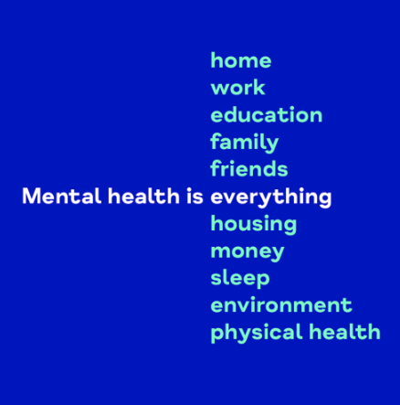


H&S Message: “Mental health is everything”
May – June 2025
Mental health is everything, everywhere, everyone.
It’s connected to every little thing we do, every place we go and every person around us.
Mental Health Awareness Week 2025 is running from the 12th to 18th May.
This year's theme is “Community”
Our social connections both within and outside of NucCol along with our supportive environments for mental well-being are so very important.
For more information and support locally:
mind.org.uk/get-involved/mental-health-awareness-week/#assets
www.derbyshiremind.org.uk/
www.sheffieldmind.co.uk/

