Slide 1
Fabricio
Recipes and best practices
Rinat Khabibiev, github.com/renskiy
http://bit.ly/2myVk7y

Slide 2
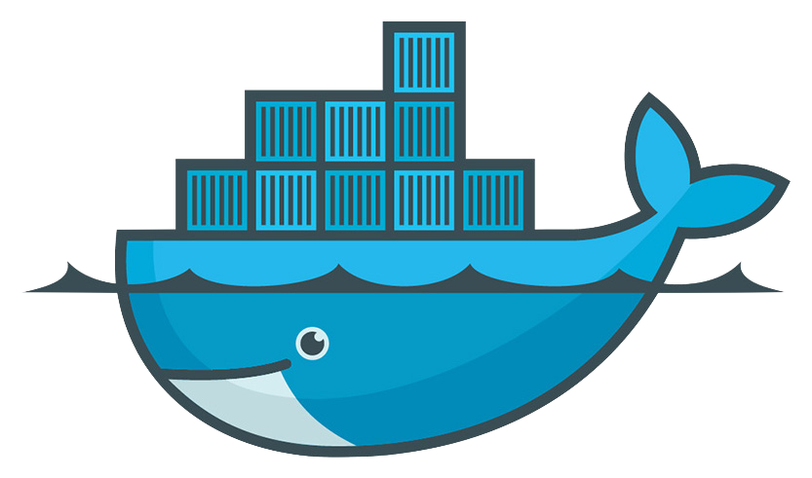
Plan
Containers deploy
Images build
Services
Infrastructure selection
PostgreSQL cluster
Bonus

Slide 3
Requirements
Python 2.6 or 2.7
pip
virtualenv
VirtualBox
Vagrant
Docker 1.12+
hub.docker.com account

Slide 4
Legend
local command
command inside VM
cmd_list.sh

Slide 5





Fabricio
Docker deploy automation tool
$ fab
https://github.com/renskiy/fabricio

Slide 6
Installation and setup
git clone https://github.com/renskiy/fabricio-devopsdays-2017.git
cd fabricio-devopsdays-2017
virtualenv fabricio && source fabricio/bin/activate
pip install -r requirements.txt
vagrant up
vagrant ssh docker-1
docker info && docker ps
https://github.com/renskiy/fabricio-devopsdays-2017

Slide 7
Fabricio: Hello World
fab --list
fab nginx
docker ps

Slide 8
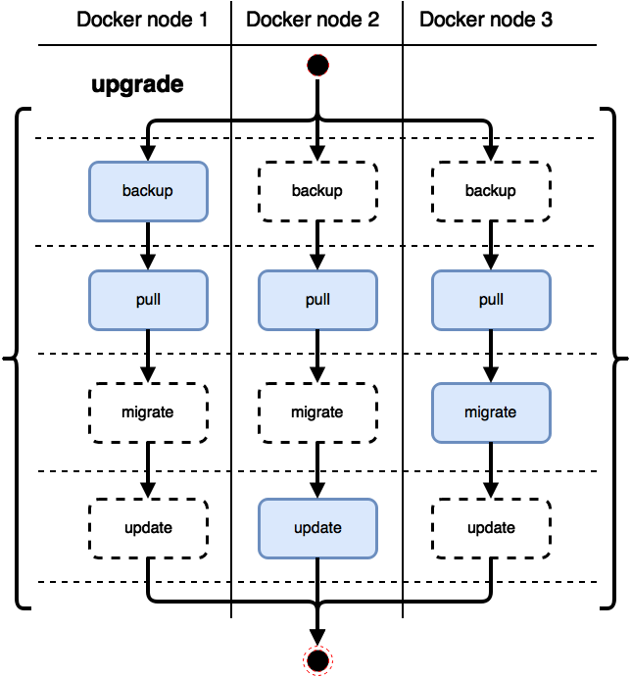
Fabricio deploy
deploy = prepare + push +

Slide 9
Fabricio deploy params
most Fabricio commands are idempotent
fab nginx
forced update
fab nginx:force=yes
custom image tag
fab nginx:1.11-alpine
make backup before update
fab nginx:backup=yes
skip migration
fab nginx:migrate=no

Slide 10
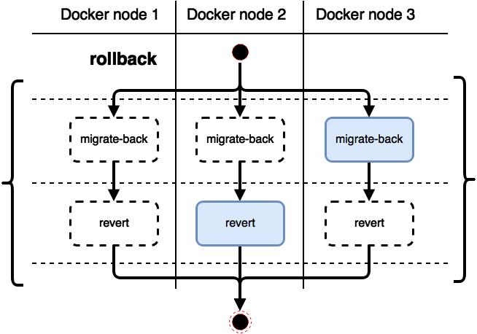
Fabricio rollback
fab nginx.rollback

Slide 11
Fabricio: building images
fab --fabfile fabfile_build --list
fab --fabfile fabfile_build custom.prepare
fab --fabfile fabfile_build custom.push
fab --fabfile fabfile_build custom.upgrade
fab --fabfile fabfile_build custom
docker ps

Slide 12
Fabricio: Docker services
fab --fabfile fabfile_swarm --list
fab --fabfile fabfile_swarm swarm-init
fab --fabfile fabfile_swarm nginx
docker service ps nginx
increase ‘replicas’ option value
fab --fabfile fabfile_swarm nginx
docker service ps nginx
parallel mode
fab --fabfile fabfile_swarm nginx --parallel

Slide 13
Fabricio: deploy failover
# fabfile_swarm.py nginx = tasks.DockerTasks( service=docker.Service( name='nginx', image='nginx:stable-alpine', options={ # ‘publish’: ’80:80’, 'replicas': 2, }, ), hosts=all_hosts[:1] + [‘failed_host’], )
fab --fabfile fabfile_swarm nginx
fab --fabfile fabfile_swarm nginx --parallel
try this
hosts=[‘failed_host’]

Slide 14

Fabricio: infrastructures
fab --fabfile fabfile_infrastructure --list
fab --fabfile fabfile_infrastructure web
fab --fabfile fabfile_infrastructure docker2 web
fab --fabfile fabfile_infrastructure docker2.confirm web
fab --fabfile fabfile_infrastructure docker2 web --parallel
fab --fabfile fabfile_infrastructure docker2.confirm web --parallel
fab --fabfile fabfile_infrastructure docker3:renskiy web
fab --fabfile fabfile_infrastructure no_hosts web

Slide 15
Fabricio: PostgreSQL cluster
fab --fabfile fabfile_postgres --list
fab --fabfile fabfile_postgres postgres
fab --fabfile fabfile_postgres postgres --parallel
docker exec -ti postgres ps aux

Slide 16
Fabricio: master promotion
docker exec -ti postgres ps aux
PID USER TIME COMMAND
1 postgres 0:00 postgres
18 postgres 0:00 postgres: checkpointer process
19 postgres 0:02 postgres: writer process
20 postgres 0:04 postgres: wal writer process
21 postgres 0:01 postgres: autovacuum launcher process
22 postgres 0:01 postgres: stats collector process
27 postgres 0:01 postgres: wal sender process postgres 172.28.128.3(43241)
28 postgres 0:01 postgres: wal sender process postgres 172.28.128.5(54436)
1621 root 0:00 ps aux
docker rm --force postgres
sudo rm -rf /data/fabricio_postgres
fab --fabfile fabfile_postgres postgres --parallel

Slide 17
Fabricio: new slave
docker exec -ti postgres ps aux
PID USER TIME COMMAND
1 postgres 0:00 postgres
17 postgres 0:02 postgres: startup process recovering 000000010000000000
18 postgres 0:00 postgres: checkpointer process
19 postgres 0:02 postgres: writer process
20 postgres 0:00 postgres: stats collector process
21 postgres 1:53 postgres: wal receiver process streaming 0/40115D8
22 root 0:00 ps aux
docker rm --force postgres
sudo rm -rf /data/fabricio_postgres
fab --fabfile fabfile_postgres postgres --parallel

Slide 18
Links
Materials: https://github.com/renskiy/fabricio-devopsdays-2017
Fabricio: https://github.com/renskiy/fabricio
Thank you!

Slide 19
Fabricio customisation
uncomment ‘account’ param in fabfile.py
fab nginx
start local Docker registry
docker run -d -p 5000:5000 --name registry registry:2
uncomment ‘registry’ and ‘ssh_tunnel_port’ params in fabfile.py
fab nginx
uncomment ‘publish’ option
fab nginx:force=yes
uncomment all other params
fab --list

