Slide 1
Adding the Q2 lidar to the lab's shaker setup
How the Ommatidia Q2 fits our own random vibration controller (vcactl) instead of the VR9700, and which shaker to use
CITG macrolab · October 2026 · draft for discussion
Notes:
Based on Ommatidia's document 'Q2_lidar+VR9700_integration.pdf' (4 slides: options 1-3 and two accelerometer-sharing circuits), the vcactl README and the shaker/DAQ profiles in the repository. Q2 specifications beyond what the Ommatidia slides show (±2 V analog in/out) are not known yet; open questions are listed on slide 11.

Slide 2
Recommendation: share the accelerometer
Ommatidia's option 3, wired to our controller. It works today, with every shaker and DAQ we have
0
4 / 4
1
changes to the
controller software
shakers supported
(TIRA ×2, BK 4809, BK 4801/4812)
BNC tee per setup
(+ DC blocker if the DAQ powers the IEPE sensor)
How it works: vcactl keeps closing the loop on the accelerometer; the same signal goes to the Q2 Analog In as its reference. The Q2 then computes lidar/acceleration FRFs (transmissibility) on its own clock.
Why this one: no clock sync between the Q2 and the NI DAQ is needed, because the Q2 samples reference and lidar together. The controller's safety aborts stay in place.
What to check: keep the shared signal inside the Q2's ±2 V (slide 7), and confirm with Ommatidia that the Q2 handles non-periodic random excitation and resolves nm-level motion at kHz (slides 9, 11).
Q2 lidar + vcactl integration
2 / 12
Notes:
Option 3 needs only passive BNC parts. The Q2 does its own FRF from the two signals it records, so the DAQ's clock and the converter filter delay of the USB-4431/PXIe-4468 do not matter for the Q2 results.

Slide 3
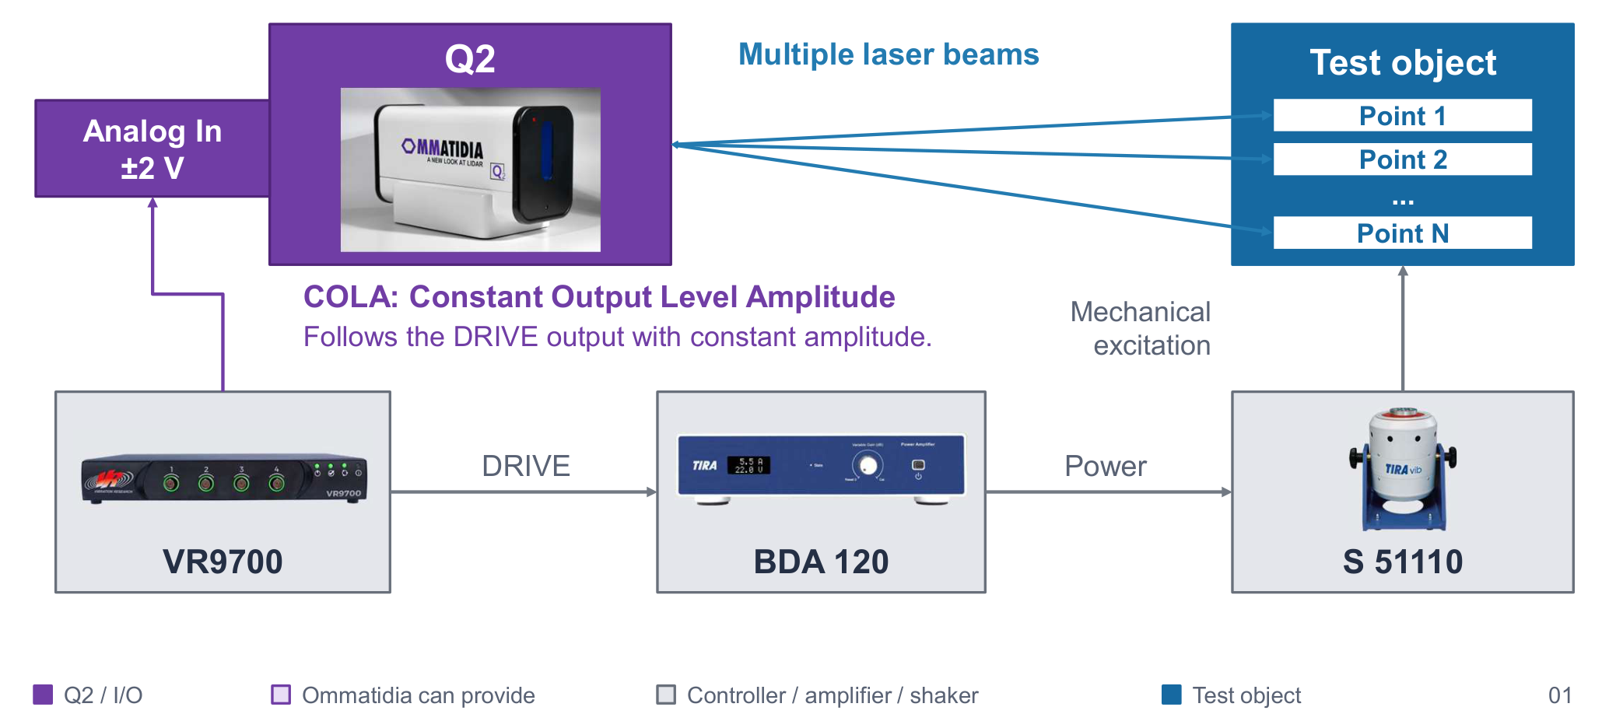
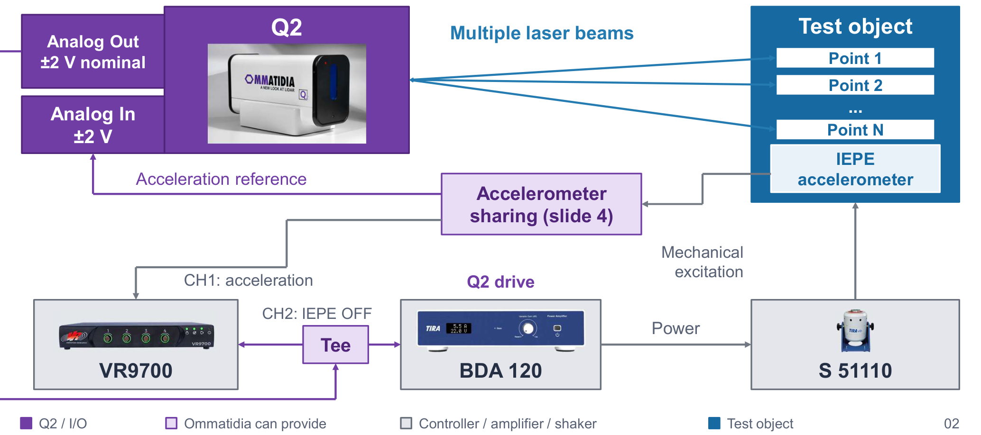
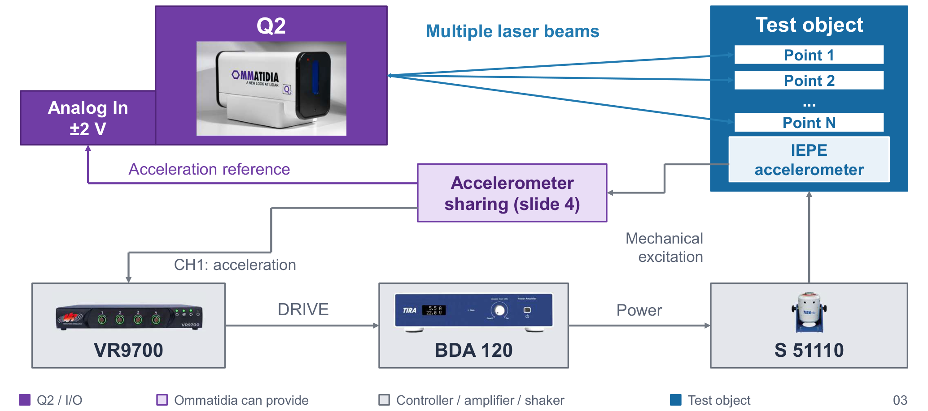
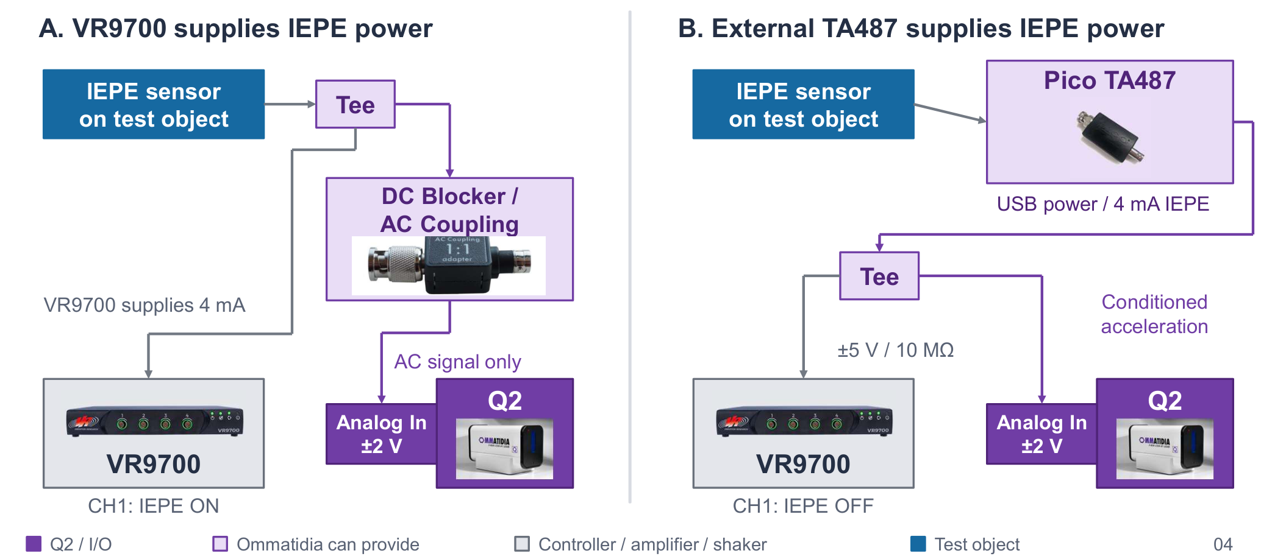
What Ommatidia proposed for the VR9700
Three options for a VR9700 + BDA 120 + S 51110 setup, plus two sharing circuits
Option 1: COLA reference
Option 2: Q2 drives the shaker
Option 3: accelerometer reference
Sharing circuits (options 2, 3)
VR9700 COLA output → Q2 Analog In. COLA is a constant-amplitude sine that follows the sine drive frequency
Q2 Analog Out → amplifier; VR9700 only records the drive and acceleration
VR9700 controls as usual; the control accelerometer is shared with the Q2 Analog In
A: VR9700 powers the IEPE sensor, DC blocker to the Q2. B: external Pico TA487 powers it, tee to both
All three assume the VR9700's I/O (4 inputs, drive + COLA outputs, sine and random). vcactl has one AO and one AI and runs random only, so the next slide maps each option onto it.
Q2 lidar + vcactl integration
3 / 12
Notes:
Source: docs/Q2_lidar+VR9700_integration.pdf (Ommatidia). Their drawings all use the TIRA S 51110 with the BDA 120, which is our TV 51110. The VR9700 datasheet lists two analog outputs: drive, and an optional differential or COLA output.

Slide 4
How each option translates to vcactl
vcactl drives one AO and reads one AI, runs random only, and has its safety aborts in the loop
Ommatidia option | vcactl equivalent | Hardware | Software | Verdict
1 COLA reference | No COLA: vcactl runs random, not sine. Closest is a scaled copy of the random drive as Q2 reference | Tee + 2:1 divider on the drive, or a 2nd AO (USB-6211, PXIe-4468; not USB-4431) | None (tee) / low (2nd AO) | Later, if needed
2 Q2 drives the shaker | Q2 Analog Out on the amplifier; vcactl unplugged. Open loop: no level control, no aborts | Q2 → amplifier input; DAQ AO disconnected (never two outputs on one input) | High, if vcactl should monitor and abort | Avoid
3 Accelerometer reference | vcactl controls as usual; its accelerometer signal also feeds the Q2 Analog In | BNC tee + DC blocker (DAQ powers the IEPE sensor), or tee on the IEPE conditioner output (USB-6211); slide 6 | None | Use this
A drive copy (option 1) gives Q2 FRFs relative to the drive, which include the amplifier and shaker dynamics. The acceleration reference (option 3) gives the motion of each point relative to the base, which is what a specimen test needs.
Q2 lidar + vcactl integration
4 / 12
Notes:
Option 2 would bypass the controller completely: no equalisation of the random profile, no rms/clip/open-loop/overload aborts. If the Q2's own stimulus is ever needed (for a modal-type check), use it only at low level with the amplifier gain turned down. Software effort is given only as low/medium/high.

Slide 5
Recommended setup: the Q2 listens in
Ommatidia Q2
Analog In ±2 V:
acceleration reference
multiple laser beams
Test object
Point 1
Point 2
…
Point N
acceleration reference
Accelerometer sharing
tee + DC blocker, or conditioner
Reference point on fixture
Control accelerometer
IEPE, on the fixture
control signal
excitation
vcactl + NI DAQ
USB-6211 / USB-4431 / PXIe-4468
AO0 drive · AI0 control
Power amplifier
BDA 120 / 2718 / 2707
Shaker
TV 51110 / TV 52110
BK 4809 / BK 4801 + 4812
drive
power
Q2 lidar + vcactl integration
5 / 12
Notes:
Put one Q2 beam on the fixture next to the control accelerometer: the Q2 then measures the base motion itself, and relative displacement of each point is a subtraction in the Q2 data. The Q2 measures along its beam: for vertical excitation it looks down from above, or the beam angle gives a cosine error.

Slide 6
One sharing circuit per DAQ setup
The control sensor is always an IEPE accelerometer; all circuits are passive and keep sensitivity_mv_per_g
1
USB-4431 / PXIe-4468 powers IEPE
2
USB-6211 + IEPE conditioner
3
USB-4431 / PXIe-4468 + conditioner
DAQ powers the sensor (Ommatidia's circuit A)
Conditioner powers the sensor (Ommatidia's circuit B)
Conditioner powers the sensor (Ommatidia's circuit B)
DAQ IEPE on (USB-4431: 2.1 mA, PXIe-4468: 4/10/20 mA), AC coupling
Tee on the sensor line; DC blocker in the Q2 branch, because the line carries ~8–12 V bias
Check the sensor works at 2.1 mA on the USB-4431 (VR9700 gives 4 mA)
The USB-6211 has no IEPE excitation: a conditioner (e.g. Pico TA487) powers the sensor
Tee on the conditioner output: one branch to AI 1/AI 9, one to the Q2
Floating (battery) conditioner: keep the 10–100 kΩ AI 9 → AI GND resistor
DAQ IEPE off; the conditioner powers the sensor, tee to both inputs
No DC blocker needed, because the conditioner output carries no bias
Use it if the sensor needs more than the USB-4431's 2.1 mA
Q2 lidar + vcactl integration
6 / 12
Notes:
vcactl always closes the loop on an IEPE accelerometer (README, Hardware setup). USB-6211 wiring per the README: AI 1 (pin 17) / AI 9 (pin 18) differential, conditioner output AC-coupled. The USB-4431/PXIe-4468 AI are pseudo-differential, which limits ground-loop current through the tee. Pico TA487 is the part Ommatidia drew (USB powered, 4 mA); any IEPE conditioner with a ±5 V output works. DC blocker cut-off depends on the Q2 input impedance, which we still need from Ommatidia.

Slide 7
Keep the shared signal inside the Q2's ±2 V
Random peaks reach about 4.5 × rms; the sensitivity then sets the highest test level
Control level (rms) | 5 g | 10 g | 20 g | 30 g | 53 g (BK 4809 max) | 70 g (BK 4801 max)
Max. sensitivity for ±2 V | 89 mV/g | 44 mV/g | 22 mV/g | 15 mV/g | 8 mV/g | 6 mV/g
10 mV/g
IEPE sensor: fine up to 44 g rms, which covers the TIRA ratings
100 mV/g
IEPE sensor: clips the Q2 input above about 4 g rms
The control sensor is always IEPE: pick its sensitivity for the highest test level (10 mV/g for most tests).
Or put a 1:N attenuator in the Q2 branch only, and give the Q2 the reduced sensitivity.
Q2 lidar + vcactl integration
7 / 12
Notes:
Max. sensitivity = 2000 mV / (4.5 × a_rms). 53 g and 70 g rms are the derived random ratings in bk4809.toml and bk4801_4812.toml; TV 51110 is 30 g rms, TV 52110 25 g rms. If the Q2 input range turns out to be wider than ±2 V, these limits relax.

Slide 8
Which shaker: the specimen decides
The Q2 adds no mass, so the payload is fixture + specimen + control accelerometer
Shaker + amplifier | Random force | Stroke p-p | Static payload | Range | Use with the Q2 for
TIRA TV 51110 + BDA 120 | 70 N rms | 13 mm | 5.3 kg | 2 Hz – 7 kHz | Default. Matches Ommatidia's drawings; good stroke for low-frequency displacement
TIRA TV 52110 + BDA 120 | 50 N rms | 15 mm | 10 kg | 2 Hz – 7 kHz | Larger stroke; lower random force than the 51110
BK 4809 + 2718 | 31.5 N rms* | 8 mm | 4.9 kg | 10 Hz – 20 kHz | Small, light specimens; small table, so fewer Q2 points fit
BK 4801/4812 + 2707 | 315 N rms* | 12.7 mm | 13.5 kg | 5 Hz – 10 kHz | Heavier specimens or larger fixtures for many Q2 points
* derived from the sine rating (sine peak / √2); the BK datasheets give no random rating. Control band of vcactl: up to 7 kHz for all.
The Q2 needs a clear line of sight to every point: plan the fixture, cables and accelerometer position around the beams.
Q2 lidar + vcactl integration
8 / 12
Notes:
Values from config/shakers/*.toml (datasheets in docs/). Dynamic payload limits per profile are in each shaker file and in docs/shaker_comparison.pdf. Static payload is the derived vertical-mounting limit (sag uses the half-stroke); the usable value is lower.

Slide 9
µm at low frequency, nm at high frequency
What the Q2 has to resolve: base displacement density of flat random profiles, in nm/√Hz
Profile | 20 Hz | 100 Hz | 500 Hz | 1 kHz | 2 kHz | 5 kHz | 7 kHz
0.001 g²/Hz | 20 k | 790 | 31 | 7.9 | 2.0 | 0.31 | 0.16
0.01 g²/Hz | 62 k | 2 480 | 99 | 25 | 6.2 | 0.99 | 0.51
0.05 g²/Hz | 139 k | 5 550 | 222 | 56 | 14 | 2.2 | 1.1
≈ 1 nm/√Hz
base motion at 5 kHz for 0.01 g²/Hz. Specimen resonances amplify this, but between them the Q2 noise floor must sit lower.
rms displacement of a flat 20–2000 Hz profile is 50–360 µm, almost all of it below 100 Hz.
Ask Ommatidia for the Q2 displacement noise floor and dynamic range per beam up to 7 kHz.
The Q2 stand must not pick up the shaker's reaction forces: put it on a separate floor support or isolate the shaker; the fixture reference beam shows what is left.
Q2 lidar + vcactl integration
9 / 12
Notes:
Displacement ASD = sqrt(S_a) * 9.81 / (2*pi*f)^2. The 0.001/0.01/0.05 g2/Hz levels are the same as in the shaker-file payload tables (rms 1.4 / 4.4 / 9.9 g for 20-2000 Hz).

Slide 10
Optional controller extensions
None is needed for option 3; add them only if the tests need them (effort: low / medium / high)
Low
Drive copy on a 2nd AO
Low
Start trigger / time stamps
Scaled random drive on AO 1 (USB-6211, PXIe-4468) as the option 1 reference; same task, same clock as the drive
Export the AI start trigger on a PFI line and log wall-clock times, to align Q2 records with vcactl runs (if the Q2 has a trigger input)
Medium
Record extra AI channels
High
Monitor-only mode for a Q2 drive
Log a second accelerometer or a Q2 analog output next to the control signal, for cross-checks in the vcactl run directory
Option 2 with vcactl reading the response and only aborting; needs a separate state machine and a hardware drive cut-off
Q2 lidar + vcactl integration
10 / 12
Notes:
vcactl today uses one AO channel (AnalogSingleChannelWriter) and one AI channel (AnalogSingleChannelReader) in src/vcactl/daq/nidaq.py. A second AO channel in the same task keeps the drive copy sample-aligned. The USB-4431 has only one AO. Without a second AO, a passive tee + 2:1 divider on the drive line gives the same reference for the TIRA and BK 4801 drives (up to 3.5 V peak) and the BK 4809 (2.5 V peak).

Slide 11
Open questions for Ommatidia
Their slides give only ±2 V for the analog in/out; these decide the details
?
Analog In
Input impedance, AC/DC coupling, sample rate and anti-aliasing; behaviour on overload above ±2 V
?
FRF with random
Does the Q2 compute H1 FRFs with windowing and averaging for a continuous, non-periodic random reference?
?
Resolution
Displacement noise floor and dynamic range per beam from 10 Hz to 7 kHz; number of beams and spot size
?
Sync
Trigger input/output or external clock, to align Q2 records with vcactl runs
?
Mounting
Working distance and field of view for our shaker tables; stand recommendations; laser class
Q2 lidar + vcactl integration
11 / 12
Notes:
The Q2 Analog In impedance also sets the DC blocker cut-off in circuit A. The laser class sets the lab procedure (enclosure, eyewear, signage).

Slide 12
Next steps
1
Send the questions on slide 11 to Ommatidia
2
Choose the shaker from the specimen mass and frequency range (default TV 51110)
3
Pick the sharing circuit for the DAQ in use and check the ±2 V budget for the test level
4
Dry run: vcactl pretest with the Q2 connected; compare the noise floor with and without the tee (ground loops)
5
First test at --level -12 with a Q2 beam on the fixture; compare it with the integrated accelerometer signal
Notes:
vcactl has run only in simulation and 'check' for the BK setups; pretest and run on hardware are still untested, so start low (--level -12) regardless of the Q2.

