Slide 1
🐾
PawsClassifier
Pet Breed Identification with Transfer Learning
🎓 Fanshawe College | Capstone Project
👤 Luis Renteria
📦 Oxford-IIIT Pets | ResNet18 | PyTorch

Slide 2
The Approach
Architecture Decisions
Training Pipeline
ResNet18 backbone
01
Data Augmentation
Pretrained on 1.2M ImageNet images. Early layers encode edges and textures, deep layers encode semantic concepts like fur, ears, and faces.
RandomResizedCrop + Flip + ColorJitter
02
ImageNet Normalization
Frozen weights
mean=[0.485,0.456,0.406] std=[0.229,0.224,0.225]
Only the final classification layer was retrained. This prevents overfitting on ~3K images and keeps training under 30 minutes.
03
ResNet18 + frozen backbone
Purpose
Replace fc: Linear(512, 37)
It is a standard fine-grained recognition benchmark - challenging, many visually similar breeds.
04
Adam optimizer
lr=0.001, only fc parameters
trainval / test split
Used the official Oxford-IIIT split. Trainval (3,680 images) was further divided 80/20 for train/val.
05
Early stopping
🐾
patience=5 on val loss, best checkpoint saved

Slide 3
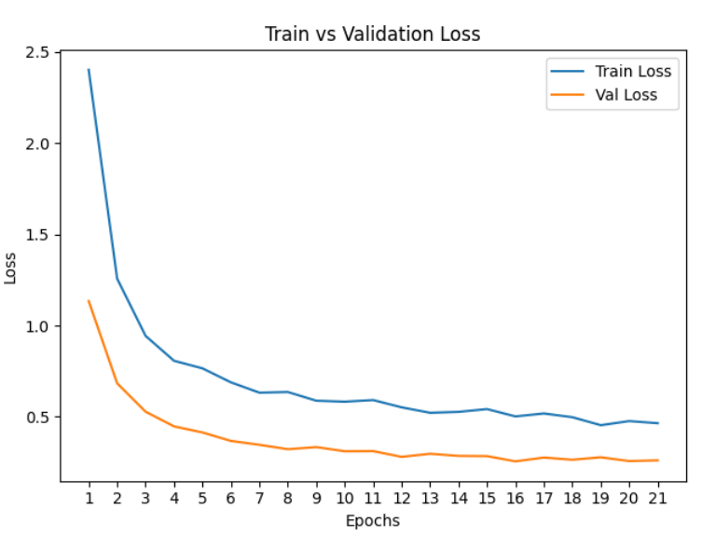
Results
88.2% Test Accuracy 3,669 held-out images
0.88 Macro F1 avg across 37 classes
21 Best Epoch early stopped at 24
Best Performing Breeds
Hardest Breeds (visually similar pairs)
Japanese Chin 🐶
0.99
American Pit Bull Terrier 🐶
0.52
Keeshond 🐶
0.98
Staffordshire Bull Terrier 🐶
0.62
Scottish Terrier 🐶
0.98
Ragdoll 🐱
0.62
Pug 🐶
0.97
Birman 🐱
0.81
Samoyed 🐶
0.97
American Bulldog 🐱
🐾
0.83

Slide 4
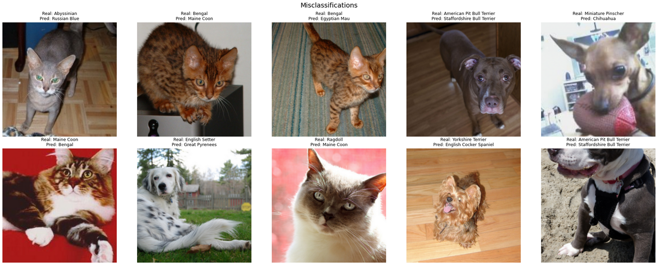
Results - Misclassifications
🐾

Slide 5
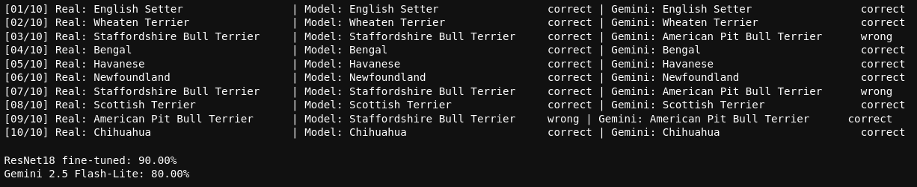
Results - Resnet vs Gemini
90%
Benchmark (10 img)
vs Gemini 2.5
🐾

Slide 6
What's Next
What Could Improve This
🔓 Gradual Unfreezing (Stage 2 Fine-Tuning)
After the classification head converges, unfreeze layer3 and layer4 of ResNet18 and continue training with lr=1e-4. The backbone would adapt higher-level features to pet-specific patterns. Estimated gain: +3-5% accuracy.
🧠 Stronger Backbone
EfficientNet-B4 or ViT-B/16 would offer higher feature capacity. ViT in particular handles fine-grained classification well due to global attention. Tradeoff: longer training time.
✂️ Class-Aware Augmentation
Apply Mixup or CutMix specifically on the hardest class pairs (Staffordshire vs Pit Bull, Bengal vs Abyssinian) to improve decision boundary sharpness where the model currently fails.
🐾
🐾 github.com/renteria-luis/oxford-pets-classifier

