Slide 1
Pairwise Comparisons between Testing and Other QA Alternatives
任天天 13126122

Slide 2
Testing vs. Defect Prevention
Testing is the Important link in dev. Process, its activities spilt over to other phases; Defect Prevention can be used before all activities.
Defect Prevention costs lower, but it has up-front cost
Defect Prevention need to know “causes”

Slide 3
Testing vs. Inspection
Inspection is good throughout dev. Process; Testing is more important at end of dev. Process.
Inspection need experience.

Slide 4
Testing vs. Formal Verification
Formal Verification cost high

Slide 5
Testing vs. Fault Tolerance
Fault Tolerance has high cost and low defect
Fault Tolerance need high technique

Slide 6
Testing vs. Failure Containment
Failure Containment has Extremely high cost, apply only when safety matters

Slide 7
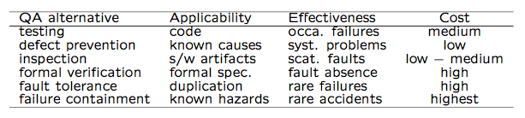
Comparison

