Slide 1


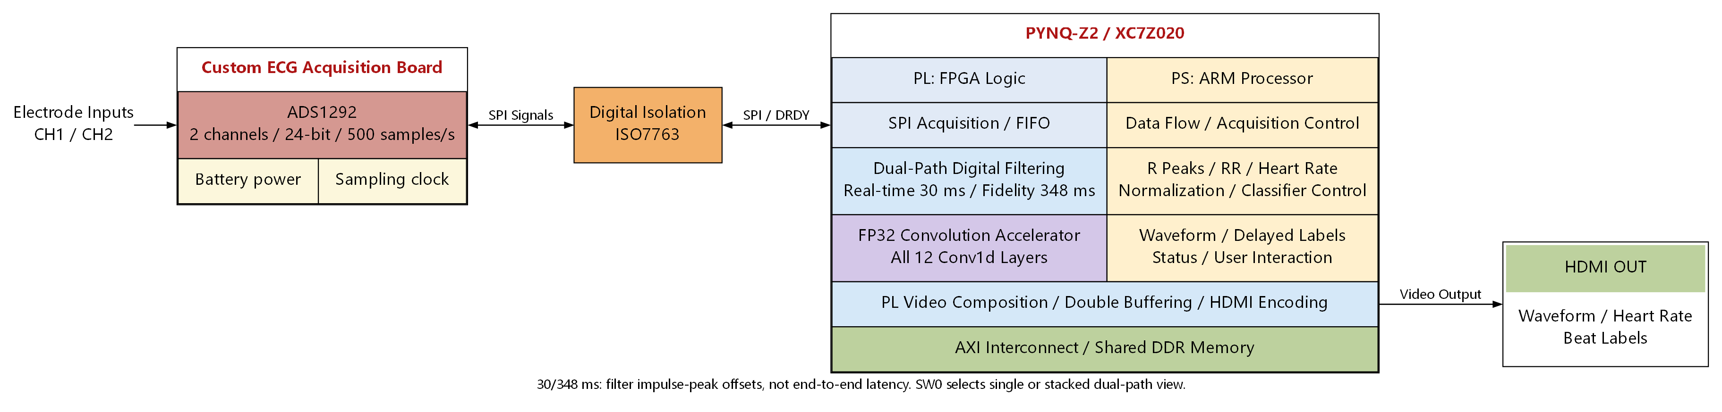
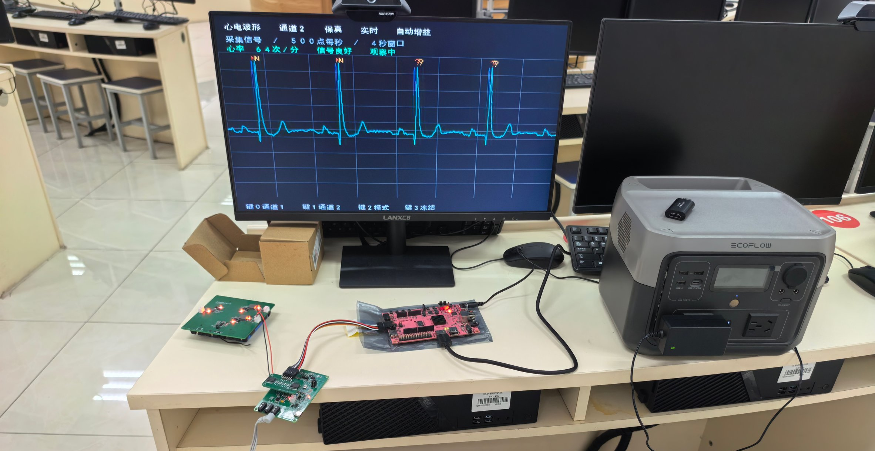


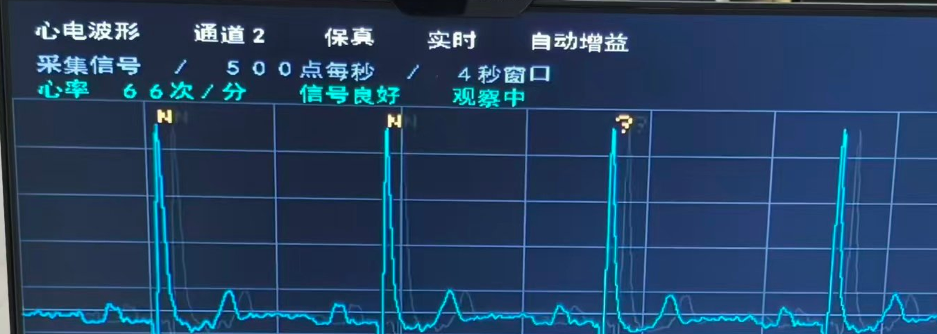
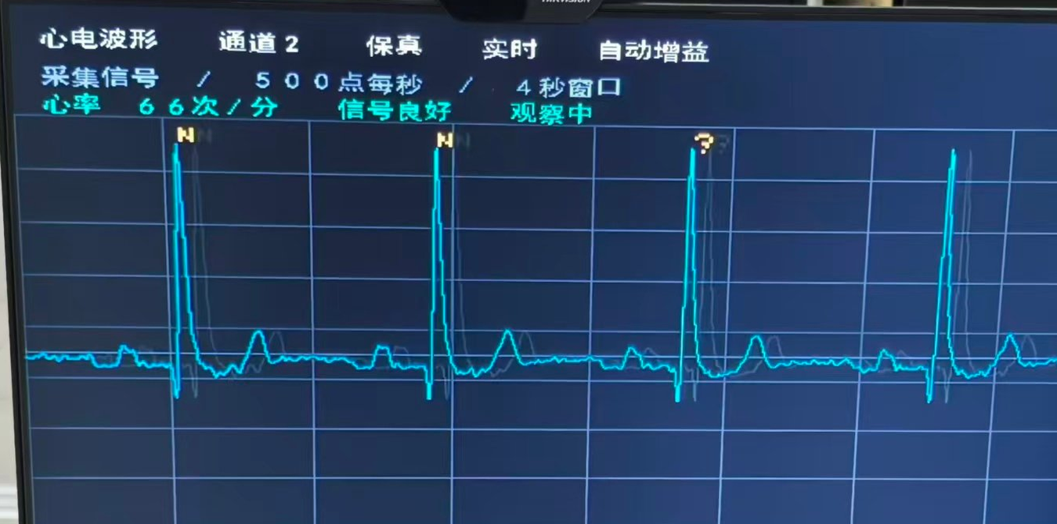
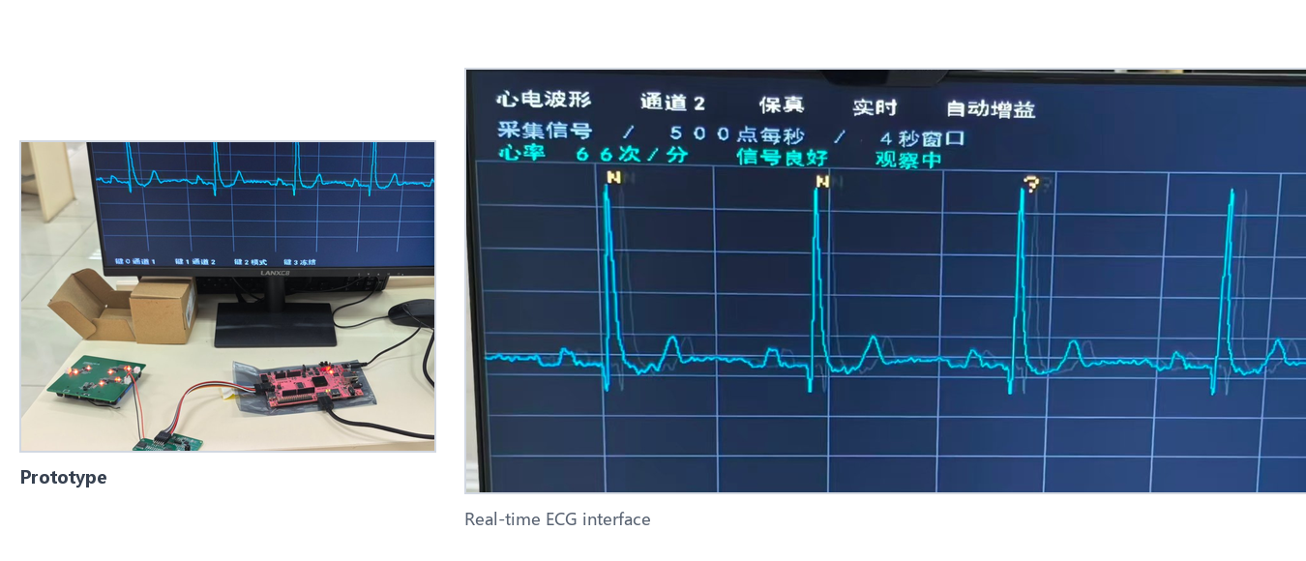
AMD ADAPTIVE COMPUTING COMPETITION · ENTRY
Dual-Path ECG Monitoring with FPGA-Assisted Beat Recognition
PYNQ-Z2 · Dual-Path Filtering · Per-Beat Assisted Recognition
ADAPTIVE COMPUTING
Team: Ren Jialin · Cheng Shuo · Li Yibo School: Beijing Wuzi University
01 Overview
04 System Design
06 Innovations
Built on PYNQ-Z2 (AMD XC7Z020) and a custom ADS1292 board, this prototype acquires two 24-bit ECG channels at 500 Hz over isolated SPI.
A PS–PL co-design performs dual-path filtering, heart-rate estimation, FPGA convolution-assisted beat classification, and HDMI display. Each input produces a low-latency real-time path and a delayed high-fidelity path; SW0 switches between single- and stacked-path views to expose waveform and timing differences.
1
Same-source dual delay: shared baseline estimate and different taps form real-time and fidelity paths; SW0 switches single/stacked views.
2
Resource reuse: single-DSP time multiplexing at 100 MHz; all 12 Conv1d layers share one FP32 accelerator.
3
Display/recognition decoupling: an independent inference queue maps labels back to beats using source samples and path delay.
Fig. 1 System architecture and data flow
Keywords: ECG · PYNQ · PS–PL co-design · deterministic latency
DATA FLOW
2 × 24-bit @ 500 Hz · isolated SPI / FIFO
PL: dual-path filtering + FP32 Conv1D
PS: R-peak / HR, quality gating, delayed labels
Filter offsets: 30 / 348 ms (peak, not end-to-end)
Resources: LUT 15,735 · FF 20,490 · DSP 57
07 Test Results
02 Motivation
0
dropped / bad frames
•
Different biosignals impose different latency and waveform requirements: EMG/EEG prioritize low latency, while ECG prioritizes waveform fidelity and baseline stability.
30 s continuous acquisition
•
A fixed single path cannot satisfy both: low-latency filtering sacrifices morphology, while high-fidelity filtering adds delay.
•
A same-source dual-path design outputs low-latency and high-fidelity signals from one acquisition path for multiple biosignals.
05 HW/SW Co-design
03 Features
01 Acquisition
02 Processing
03 Display
ADS1292 / isolated SPI / FIFO
Dual-path filtering / FP32 Conv1D
HDMI / double buffering / labels
•
Dual input channels: 24-bit, 500 Hz, isolated SPI configuration/readout and FIFO frame checking.
•
Dual-path filtering: real-time/fidelity peak offsets of about 30/348 ms; SW0 switches the view.
PL performs dual-path filtering, FP32 convolution, and HDMI composition; PS handles SPI/FIFO, R-peak/heart rate, quality gating, and classification. Shared AXI/DDR buffers let display proceed without waiting for inference.
•
Recognition and display: FP32 convolution + ARM classification, delayed per-beat labels, HDMI output.
Fig. 2 Prototype and on-board ECG display
Outlook
Deliverables: dual-path waveforms · per-beat labels · prototype
Platform: AMD Zynq-7000 XC7Z020 / PYNQ-Z2 Key devices: ADS1292 · ISO7763 · HDMI
With the board's expansion interfaces and a scriptable software stack, different biosignal front ends can be connected and configured quickly. Modular drivers, multi-modal acquisition, and per-signal delay settings will turn the prototype into a general-purpose biosignal acquisition tool.
Platform: AMD Zynq-7000 XC7Z020 / PYNQ-Z2 | Toolchain: Vivado/Vitis 2026.1 · PYNQ/Python | Docs/Code: [link] | Contact: [email]
AMD ADAPTIVE COMPUTING COMPETITION · ENTRY
01 / 01
Notes:
【模板使用说明】
1. 所有 [ ] 内容都可以直接替换为你的项目信息。
2. 图片占位框：右键占位框→设置形状格式→填充→图片，或删除占位框后直接插入图片；建议 300 dpi。
3. 推荐字体：中文微软雅黑，英文 Arial；标题 24 pt，正文不小于 7.5 pt。
4. 配色：主色 #151A21，强调色 #E4002B，浅灰 #F6F7F9。
测试结果卡中的 500 Hz 为示例，请替换为你的核心指标。
5. 封面尺寸为 16:9（13.333 × 7.5 in）；打印 A1/A0 时请保持比例，先导出 PDF 检查。
6. AMD 标志已按官方样式放入；如需更高清版本，请替换为官方矢量 logo，不要拉伸变形。
7. 右上角校徽已放大并放入透明底版本，可右键“更改图片”替换。

